Slide 1


GoCode
We learn by doing, by falling down, and by picking ourselves back up
HTTP://GOCODENOW.COM

Slide 2
Performance and Algorithms
Search/Sort Algorithms
Why do you need to know this for web?
Examples:
a) Bubble Sort
b) Binary Search
4) How do we assess performance/speed?

Slide 3
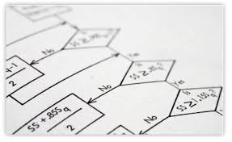
Algorithms
An algorithm is a set of steps to accomplish some goal.
There are usually different solutions! Some are faster than others.

Slide 4
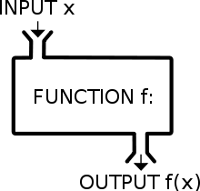

Slide 5
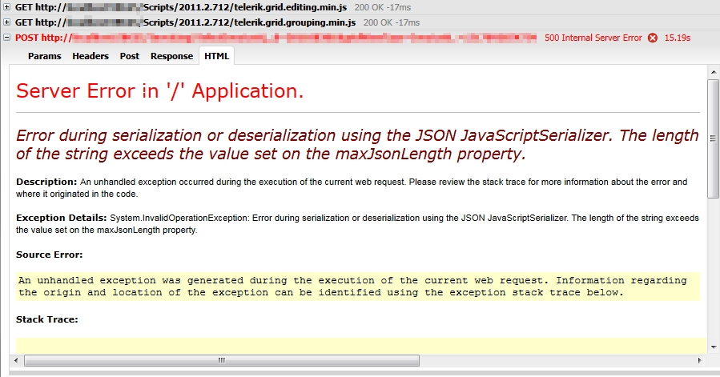
Web Development
Processing a large piece of data

Slide 6
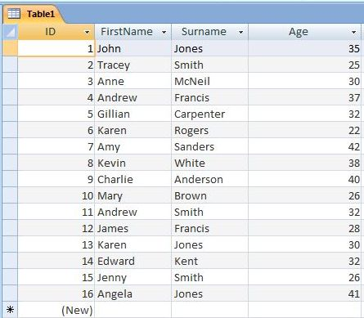
Web Development
2) Searching a large database/table

Slide 7
Examples
Searching an array:
a) Linear Search
b) Binary Search
c) Many others!
Sorting an array:
a) Bubble Sort
b) Merge Sort
c) Many others!

Slide 8
Linear Search
Lets say we have an array
>>> a = ['b','a','c','e','d']
>>> a.index('c')
2
>>> def linear_search(value,list):
... for i,v in enumerate(list):
... if value == v:
... return i
... return None
...
>>> linear_search('c',a)
2
GoCode
We learn by doing, by falling down, and by picking ourselves back up

Slide 9
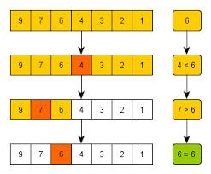
Binary Search Algorithm (Divide and Conquer)

Slide 10
Binary Search Algorithm (Divide and Conquer)
a = [1,2,3,4,5,6,7,8]
value = 3
Sort array
Look at the midpoint
Does it match the value
lower, dive into the lower half
higher, dive into the upper half, repeat

Slide 11
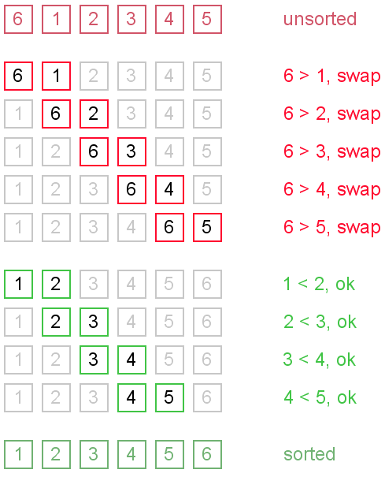
Bubble Sort

Slide 12
Bubble Sort
for passes in len(array)-1
for i in len(array) - 1
if array[i] > array[i+1]
swap(array[i],array[i+1]
Nested for loop – O(n^2) - worst and average

Slide 13
Key Points
Two main concerns in web: database, data processing
Search/Sort functions built into most languages
Big-O notation used to describe performance

