Slide 1
Probability Models for Enhancing Calibration of Computer Numerical
Control (CNC) Systems
By Jacob Seman, Viktor Woldruff, Tyler Nelson
Intro to Probability Theory
Dr. Santos, Fall 2023
University of Colorado Boulder

Slide 2
Problem Statement
Computer-numerical-control (CNC) milling can be used to manufacture printed-circuit-board (PCB) designs. PCB prototyping is being made accessible to students in the Electrical & Computer Engineering and Mechanical Engineering programs.
PCB milling requires a high degree of accuracy (within 0.005mm), particularly when setting the depth-of-cut (0.1mm typical). PCB surfaces are known to be irregular, and CNC machine defects may be present.
Accuracy is improved by calibrating the machine to the board surface. However, repeated calibration is often time-consuming, sometimes taking up to several hours. This is a barrier to accessibility, ease-of-use, and rapid prototyping of designs in an academic setting.
Notes:
Jake
Vic jumpin

Slide 3
Summary
PCBs that are milled on desktop CNC machines benefit from machine calibration relative to a PCB heightmap applied as a Z-offset per coordinate in G-code
These heightmaps can be modeled and applied to future boards when the heightmap calibration process is too lengthy or complex to perform in the context of rapid prototyping
Certain characteristics of the “system” (the CNC machine, fixture, and PCB) were observed to contribute to heightmap variance when analyzing a dataset of 10 heightmaps collected from unique PCBs
Data was collected and normalized to show local variance and extract details such as CNC machine lead screw defects and PCB flexure induced by fixture design
A reusable heightmap model was produced which accounts for observed system characteristics
Notes:
Viktor/Jake

Slide 4
Approach
Open-source software must be used to probe the PCB and generate heightmaps
Candle CNC control software is freely available and implements heightmap generation and application as a Z-offset in any G-code routine
Heightmaps can be created by monitoring the Z position when the tool makes electrical contact with the PCB surface, Candle detects this and creates a matrix of coordinates and Z-heights
Heightmap data must be analyzed and interpreted to produce usable conclusions and generate a model which can be applied consistently to improve accuracy
MATLAB scripts can be written to ingest Candle’s heightmap files and generate results such as statistical mean and standard deviation plots based on the dataset
Extensive plots were generated to make comparisons, observe probabilistic results, and draw conclusions about system behaviors
Results must be subject to scrutiny; additional considerations must be made based on limitations of dataset size
Random sampling with replacement and determination of percentage error can quantify confidence in the resulting model
Notes:
Jake explain candle, Tyler about heightmap

Slide 5
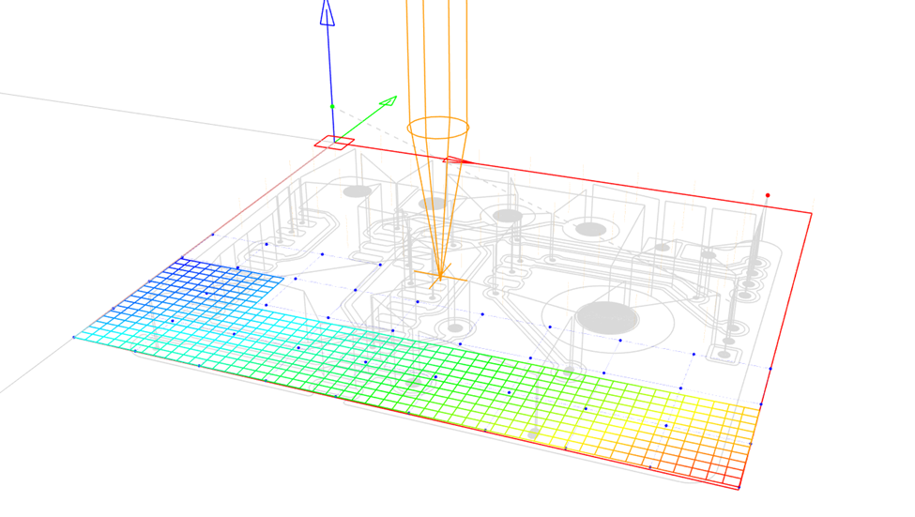
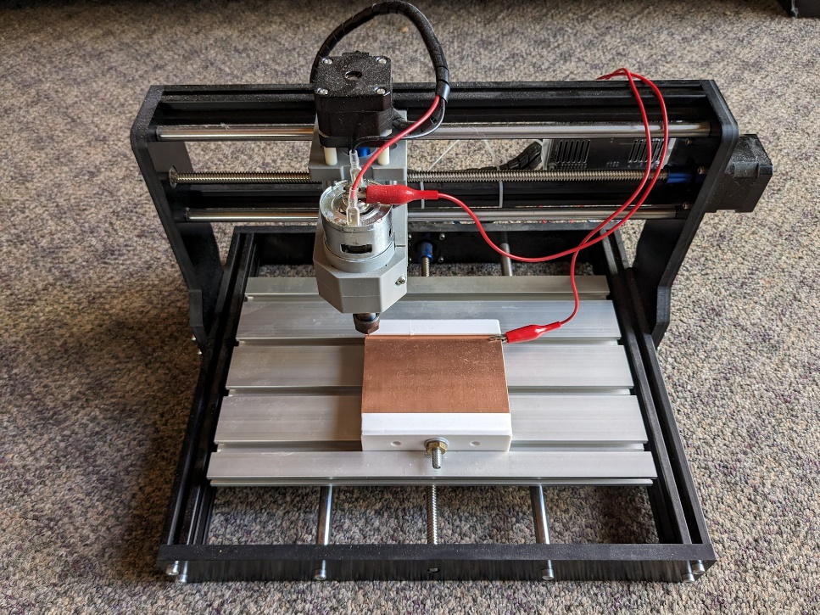
Method
10 single-sided, 100x70mm, copper-clad boards were clamped in CNC machine fixture at 3NM
Heightmap data was collected in a 95x65mm region, with 34x16 point grid resolution
Datasets containing each heightmap were created in MATLAB
A normalization routine was applied to local variance (“normalized”) dataset
Notes:
Viktor newton meters, torque tool

Slide 6
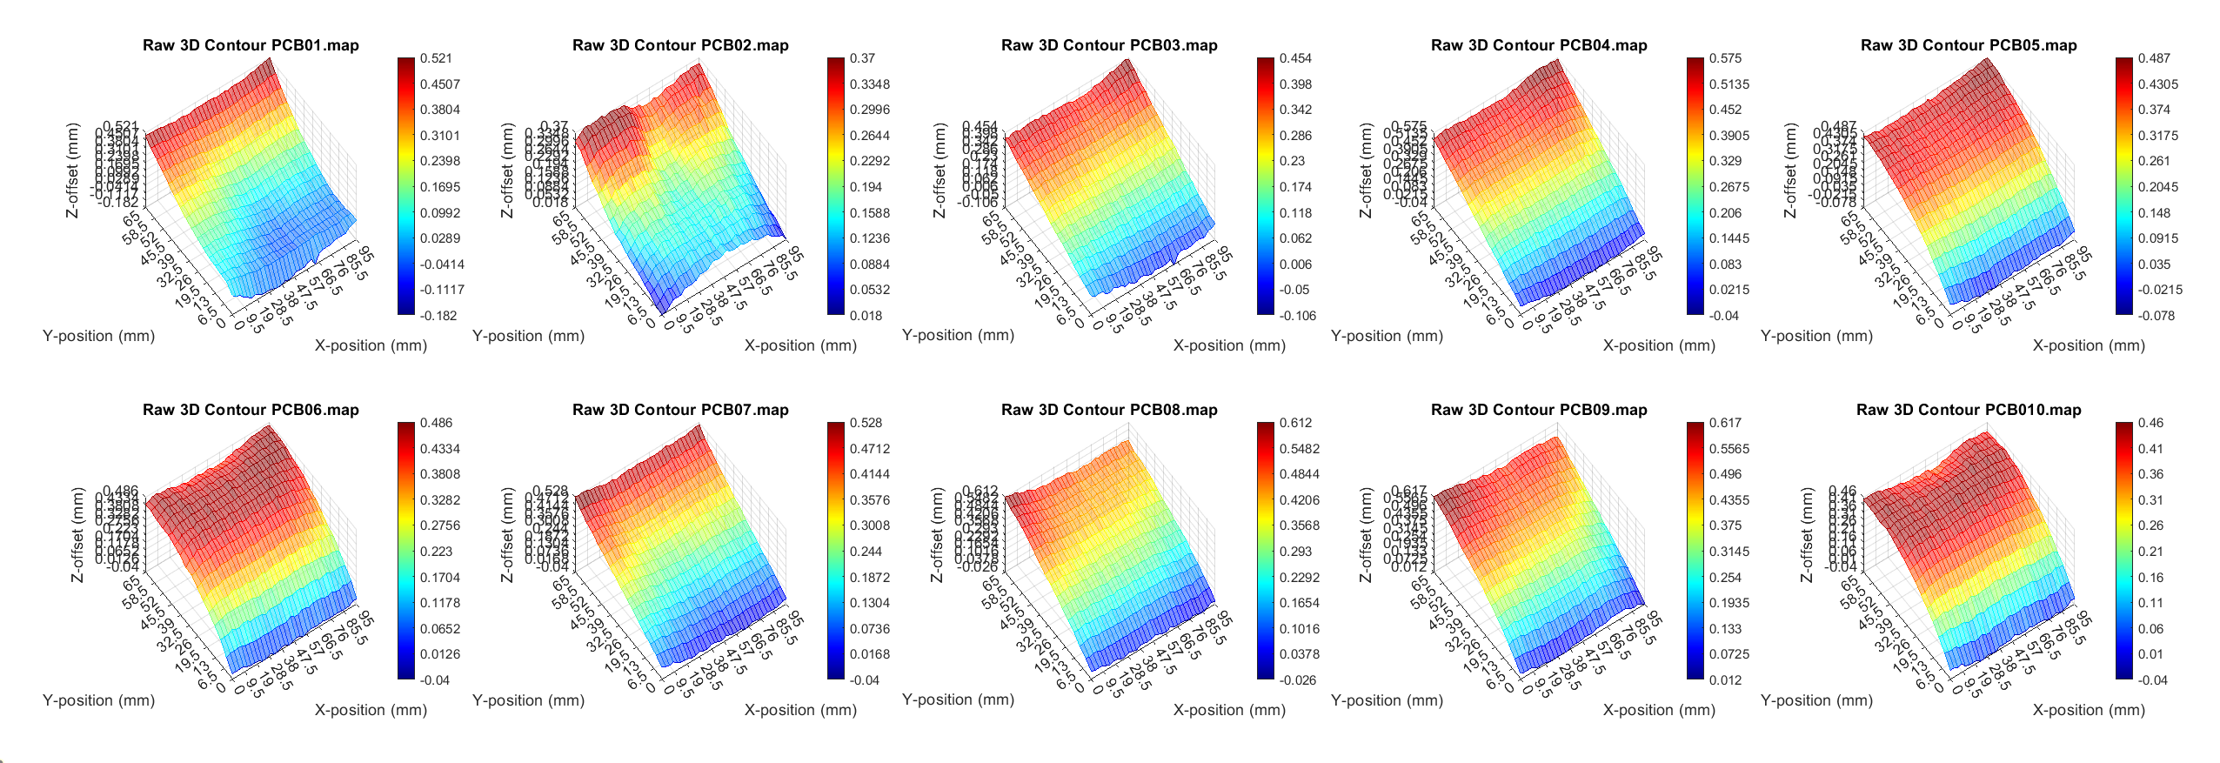
PCB Raw Heightmap Sample Set
Notes:
Tyler

Slide 7
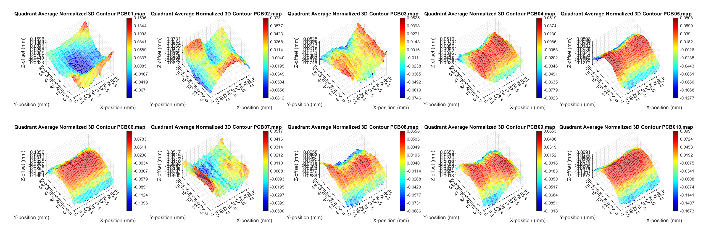
PCB Normalized Heightmap Sample Set
Notes:
Tyler

Slide 8
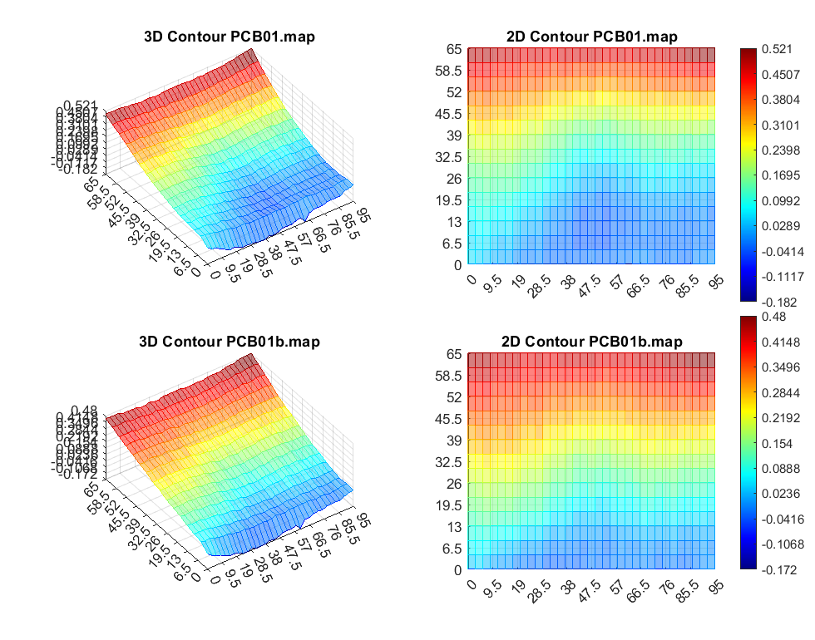
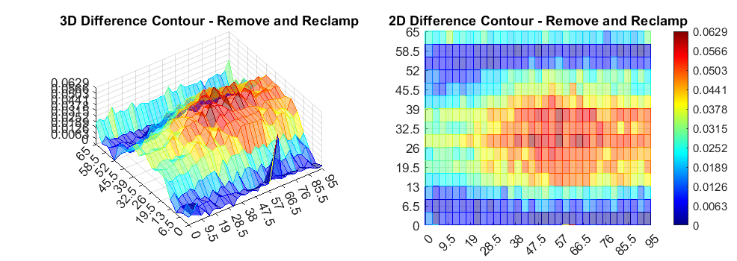
Repeatability
Boards were selectively removed and re-clamped in the fixture to address consistency
Resultant heightmaps were compared and standard deviations generated
Deviations of less than a tenth of a millimeter were observed after re-clamping
Maximum deviation was localized in center of board

Slide 9
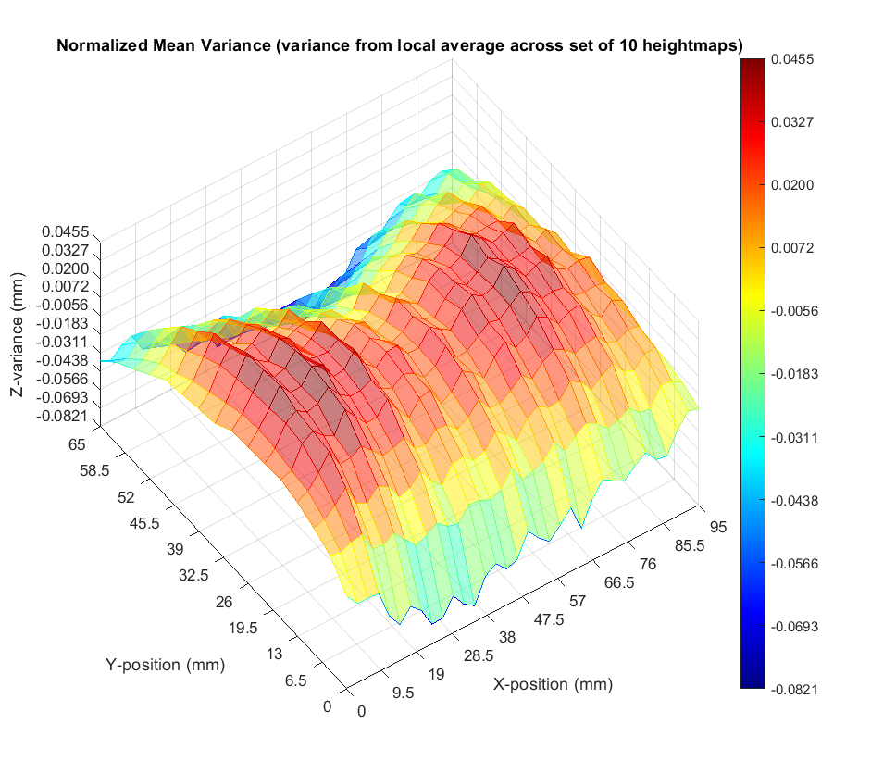
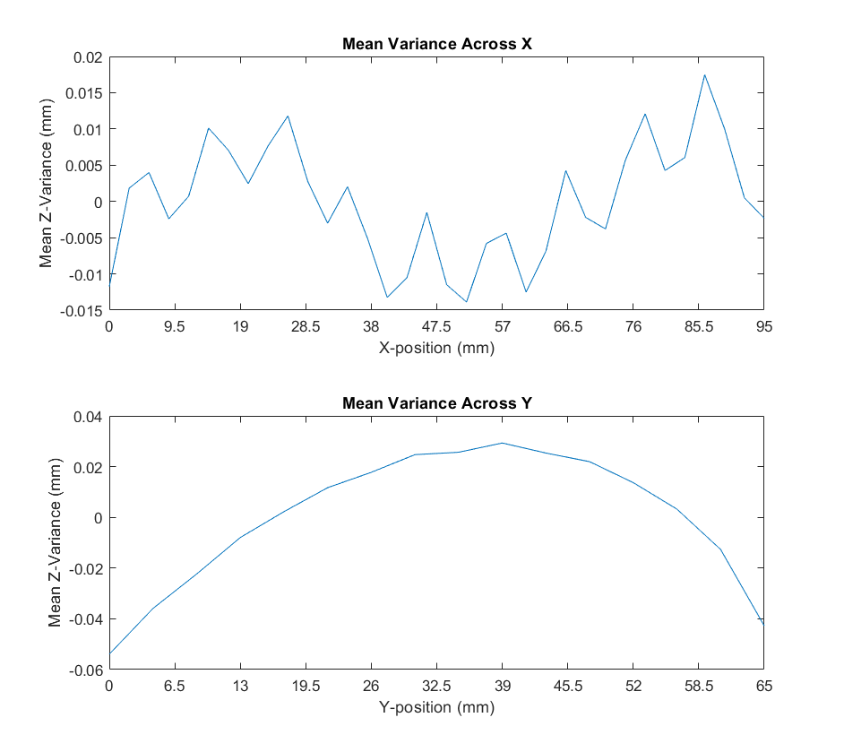
Normalized Mean-Variance
Normalized mean data shows local variance such as lead-screw defects and flexure due to fixture design (addressed in later slide)
Mean variance across Y-axis shows flexure due to fixture design and clamping force, as expected
Notes:
Tyler/Jake

Slide 10
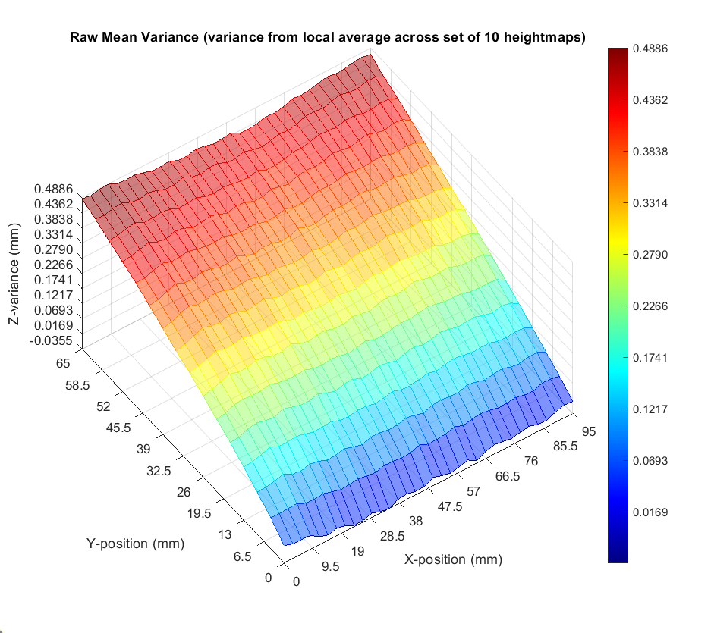
Raw Mean-Variance
Raw mean data shows real-world model which can be applied as a heightmap to any PCB
Local variation visible in normalized data is orders of magnitude less significant than slope feature in raw data (addressed in later slide)
Notes:
Tyler/Jake

Slide 11
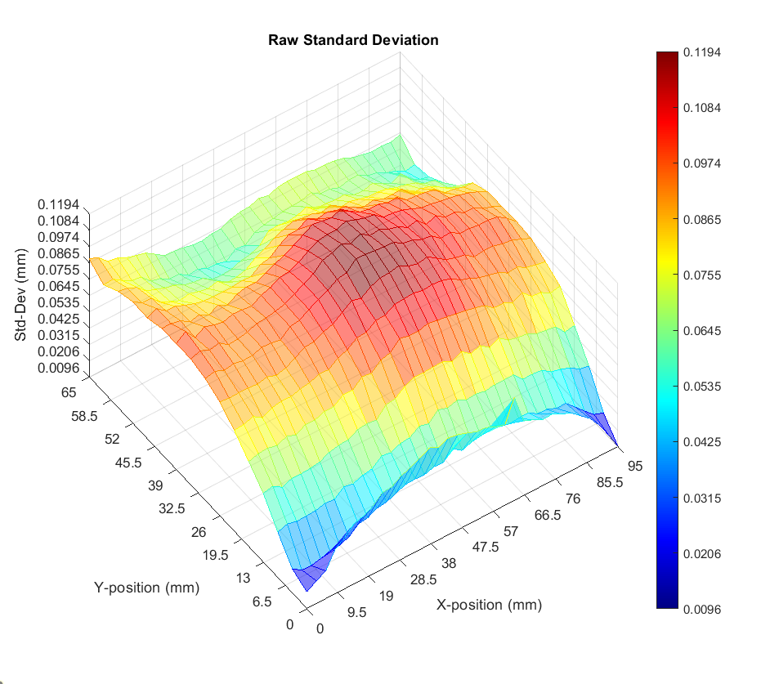
Raw Standard Deviation
Standard deviation plot shows areas where the model is statistically likely to be accurate (low deviation)
Normalized deviation is less impactful due to normalization, near-zero quadrant centers
Observed +/- 0.06mm deviation maximum, in center of PCB
Notes:
Tyler/Jake

Slide 12
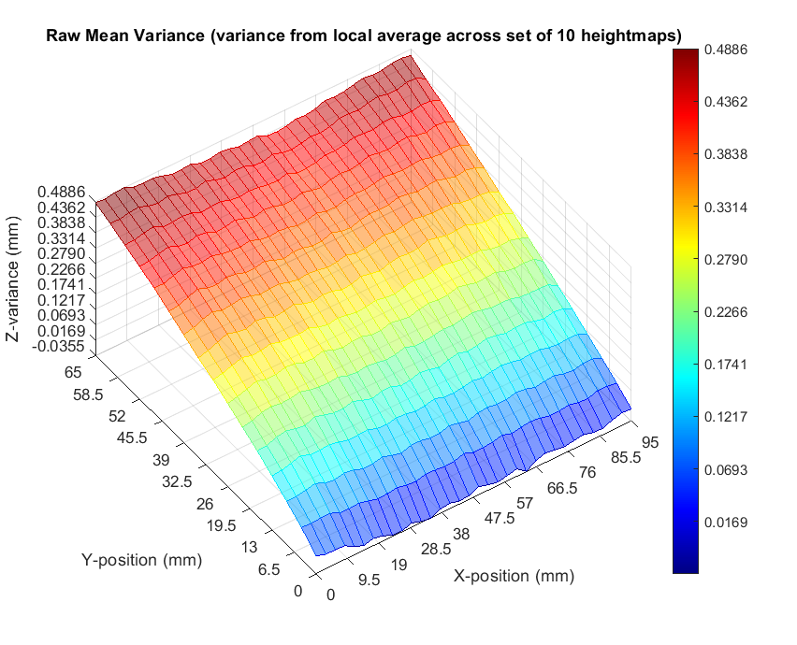
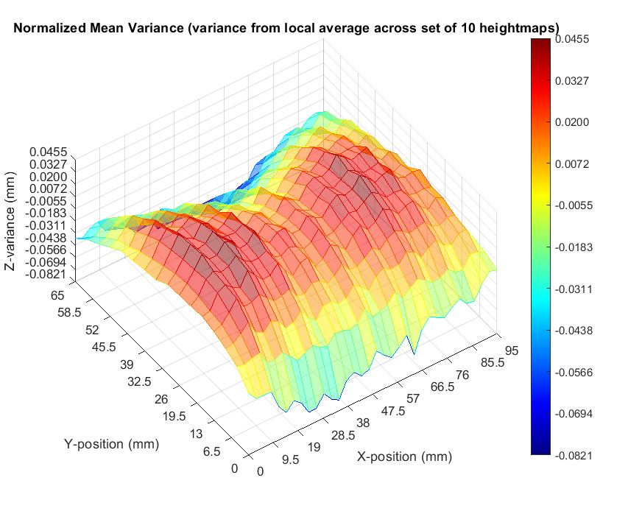
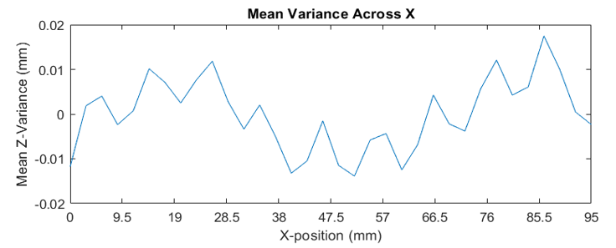
Observed Variance Features
Fixture-induced slope of PCB
Most significant observed feature
Observed in raw data and raw mean
Low standard deviation within raw dataset
+0.5mm offset from end-to-end
Fixture-induced flexure of PCB
Observed in normalized dataset
High standard deviation within normalized dataset
+0.08mm offset in center-region of PCB
CNC machine X-axis lead-screw defect
Observed in normalized dataset
Exclusively observed in X-axis
+/- 0.005mm offset per 10mm X-axis travel
Lead-screw rotational period measured to be ~4.3mm, X-resolution was coincidentally near a harmonic of this period
Notes:
Viktor want to make note of the last one you can really note high pre effects. Jake to hop in.

Slide 13
Next Steps
Bootstrapping: resampling with replacement to address small sample size
Percentage-error calculation per coordinate for each board
Quantifying data set confidence by interpretation of the resampling and percentage-error result
Depending on results, extension of data set sample size
If time permits, generation of a single high-resolution (millimeter parity) heightmap to critically observe X-axis lead-screw defect
Fixture design, 100x70mm modeled heightmap file, supporting documentation, and ongoing opportunity to contribute to future datasets to be made available to University of Colorado Boulder and Colorado Mesa University faculty and students at https://www.github.com/jbsco/probability_project in the near future
Notes:
Tyler, Jake jump in

Slide 14
Conclusion & Applications
The mean dataset models a PCB surface and heightmap when affixed in a CNC milling machine with reasonable confidence
Students will be able to apply this model as a heightmap and achieve satisfactory results without needing to perform complex height-mapping calibration routines for every design
Accessibility to Colorado Mesa University and University of Colorado Boulder Partnership Program prototyping resources can be improved and refined by applying these methods and results
Notes:
Jake

