Slide 1
Food Lockers
Josiah Buxton
Bryan Heiser
Richard Morley

Slide 2
Motivation
Long dining lines on campus
Dining services’ locations close too early
Automating daily tasks is the future

Slide 3
Our Solution
Design and fabricate a food locker that will vend food outside dining services’ locations
Features:
Modified commercial 4’x3’x3’ undercounter refrigerator
Interior compartmentalized into 6 individual lockers by perforated stainless steel
10.1” touch screen for consumers to interface with the locker and purchase meals
Mobile application to purchase meals within the locker on your phone
Automated checkout process that will vend the food to the customer

Slide 4



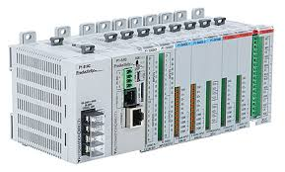
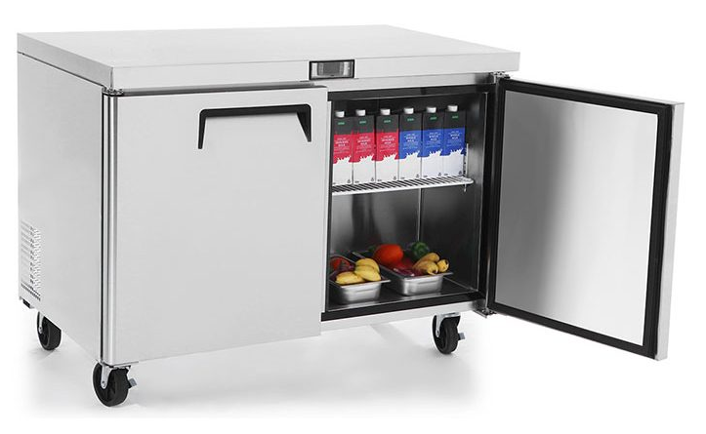
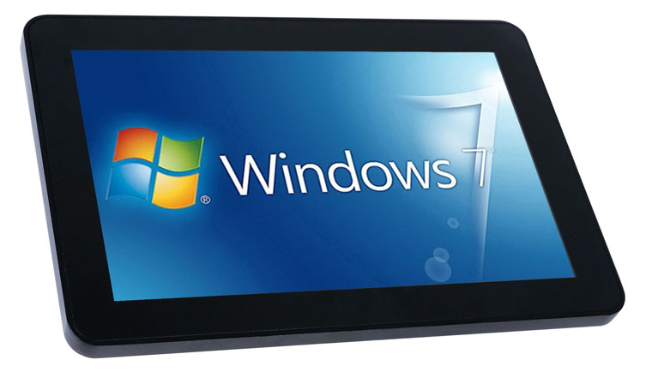
Preliminary Design/System Overview
Software
AWS DynamoDB
Dining Services Web App
Consumer Mobile App
Physical Hardware
Controls
PLC rack
EM locks
Proximity sensors
Photo eyes
Food Locker
Interface
10.1” touch screen
App to communicate to locker and DB

Slide 5
Potential Benefits
Increase availability to food among students who purchased the meal plan
Provide a futuristic, unique dining option for busy individuals on campus
Reduce food waste in the future
Gather valuable data on the students’ dining habits
Provide the University with a new revenue stream

