Slide 1
Commercial Performance Analysis – Power BI Dashboard
Jagadeesh Chandrasetty | Data Analyst |
Tools Used: Excel, Power BI Dax
Notes:
In this PPT Following Dashboard along with their insights Covered:
1. Monthly & YTD Performance
2. Top 50 Customer Contribution
3. Territory-wise Revenue Analysis

Slide 2
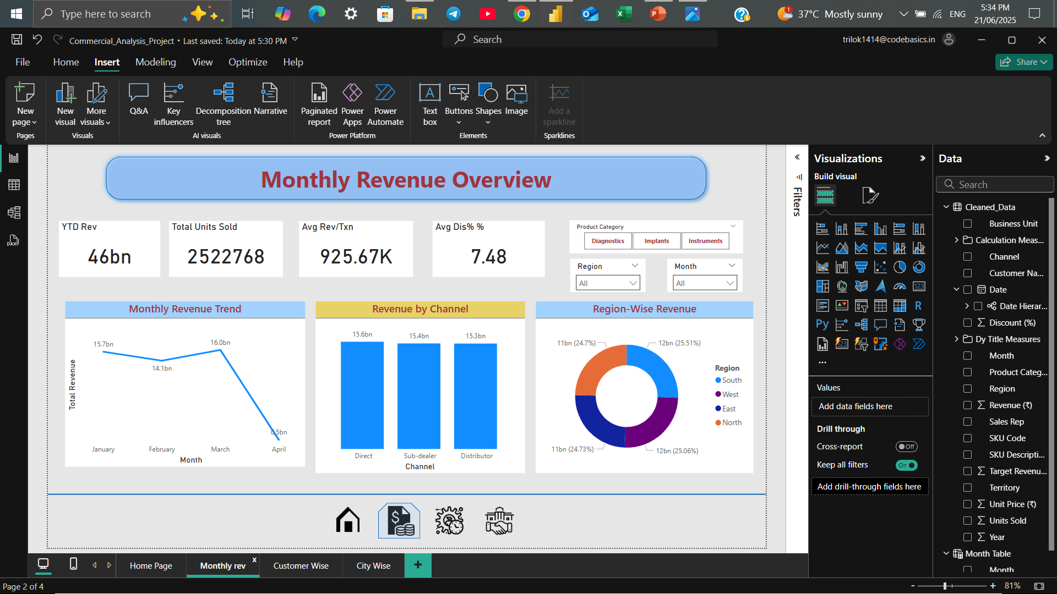
Notes:
The dashboard presents a clear snapshot of business performance from January to April. Total YTD revenue stands at ₹46Bn, driven by over 2.5 million units sold.
March marked the peak month with ₹16.08Bn in revenue, showing strong momentum across categories.
April dropped significantly, likely due to quarter-end slowdown or data cutoff.
Revenue per transaction averages ₹9.25L, reflecting the high-ticket nature of key SKUs like ECG Machines and Spinal Implants.
Discounts remained stable at ~7.5%, indicating pricing discipline across product lines.
Channel performance is well balanced — Direct, Sub-dealer, and Distributor each contribute ~₹15Bn.
Regional split is even, with South and West leading slightly, suggesting consistent market coverage.
This overview sets the foundation for deeper exploration into customer-level trends and territory performance.

Slide 3
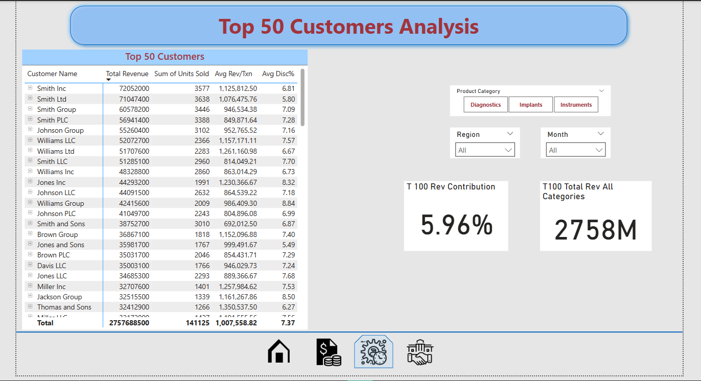
Notes:
This view highlights the most valuable customers driving business performance.
The Top 50 customers contributed ₹2,758M, accounting for 5.96% of total revenue.
Customers like Smith Inc., Smith Ltd., and Johnson Group lead the list with over ₹600M+ each.
Average revenue per transaction exceeds ₹1M for most top accounts, indicating high-value institutional sales.
Discount rates remain consistent, averaging ~7.3%, with top customers receiving balanced pricing.
Some customers appear across multiple channels (e.g., Smith entities), emphasizing the importance of consolidated account management.
This analysis helps identify key accounts for strategic focus, retention planning, and growth targeting.

Slide 4
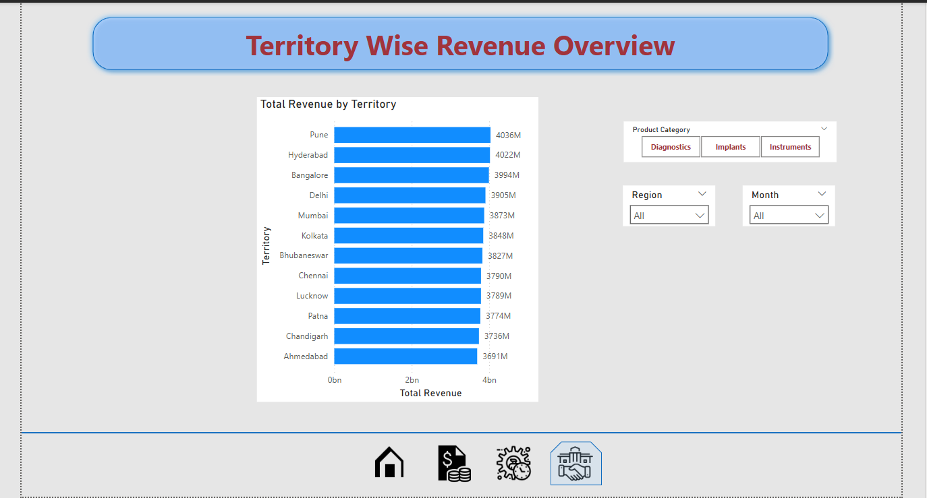
Notes:
This view highlights city-level performance across major territories.
Pune and Hyderabad lead all cities with over ₹4,000M in revenue.
Bangalore, Delhi, and Mumbai follow closely, indicating strong metro market penetration.
Even contribution from Kolkata, Chennai, and Lucknow signals a balanced national footprint.
Revenue trends are consistent across cities, with no major outliers, suggesting a uniform sales execution strategy.
Filters allow users to slice territory performance by Product Category, Region, and Month for deeper analysis.
This view supports territory planning, resource allocation, and regional performance benchmarking.

