Slide 1

Capstone Project
Julio Cesar Aldana Almanza

Slide 2
Agenda
Architecture Overview
Instrumentation & Monitoring
Challenges & Solutions
Learnings & Improvements
Live Demo

Slide 3
Three-Tier Architecture
Infrastructure as Code

Slide 4
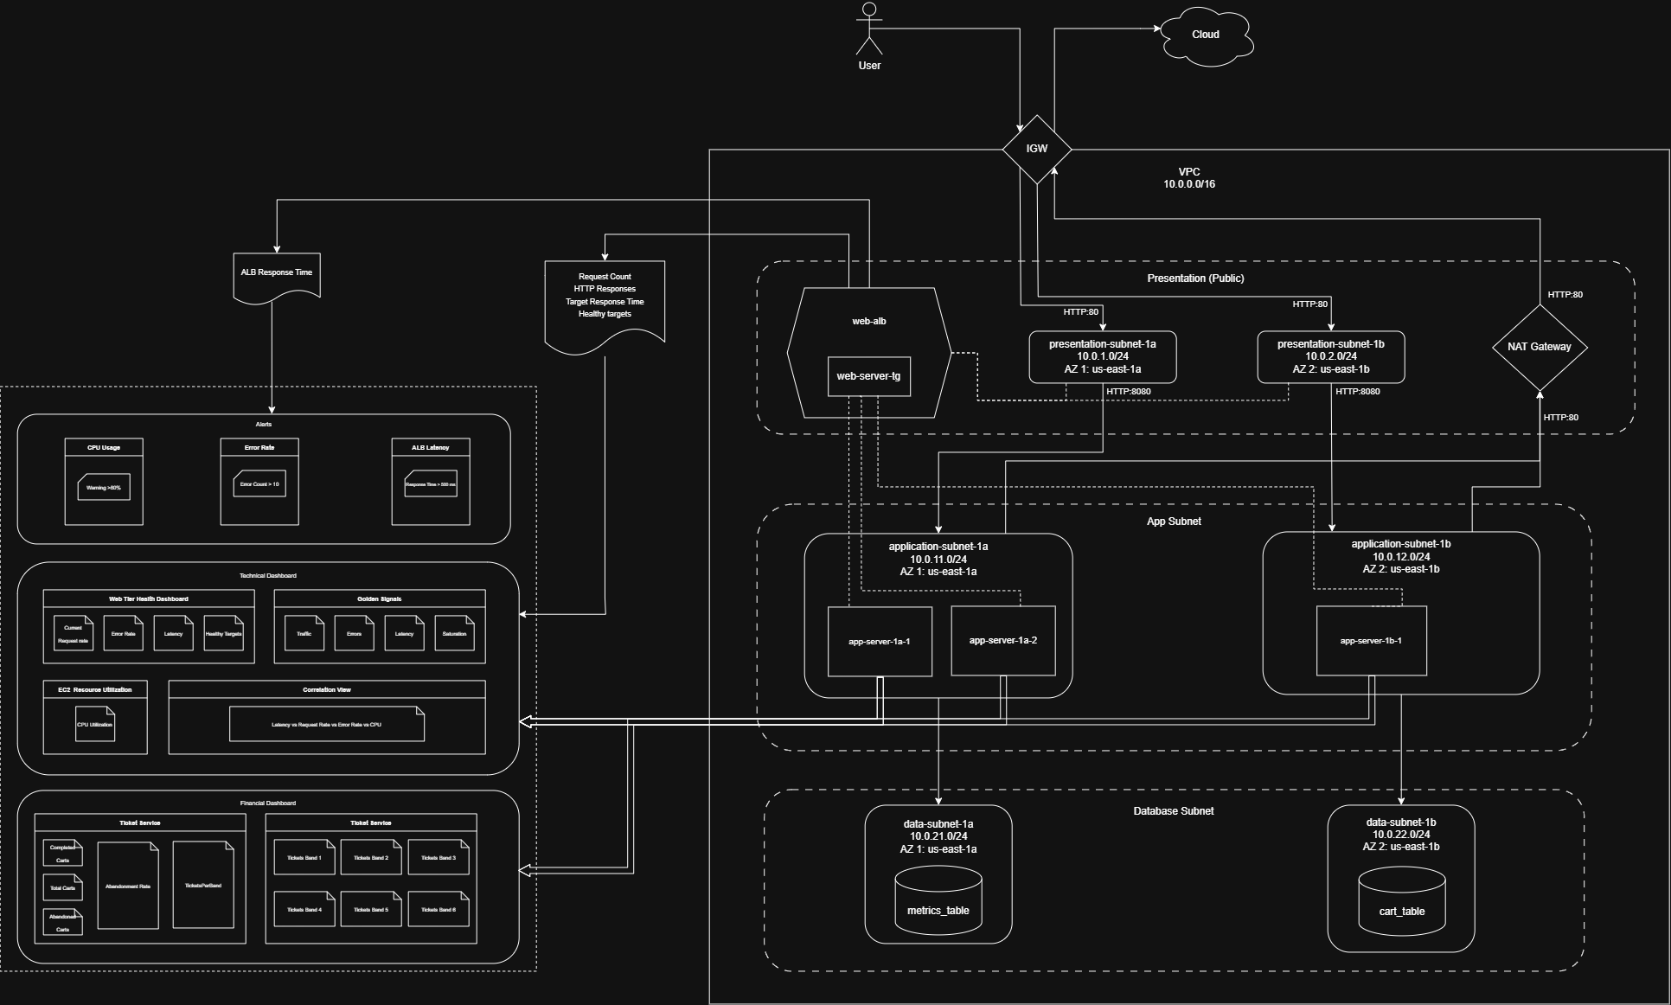
Three-Tier Architecture

Slide 5
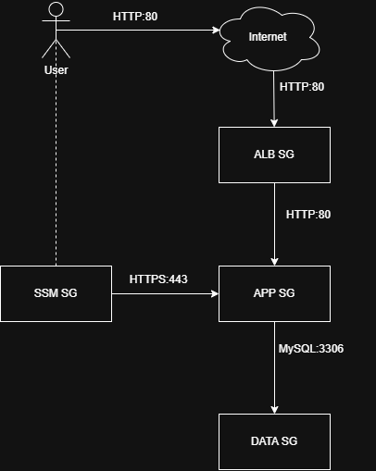
Network strategy
VPC: 10.0.0.0/16
Presentation Subnets (Public)
Application Subnets (Private)
Data Subnets (Private)
VPC Endpoints for:
AWS Session Manager
Database communication
ALB with Auto-Scaling Group

Slide 6
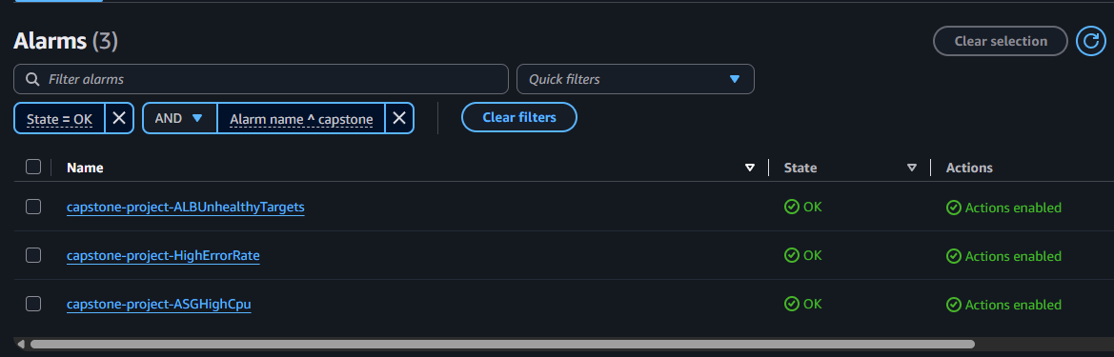
Instrumentation & Monitoring
CloudWatch Agent – Metrics send by application
Alerting System
CPU Usage (Threshold > 70%)
Application Error Rate
Unhealthy targets
Dashboards:
Technical Dashboard
Business Dashboard

Slide 7
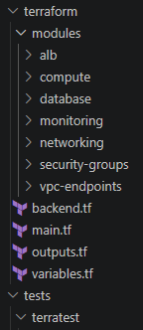
Automation with Terraform
IaC: Modular approach.
CI/CD Pipeline for planning and building architecture
Drift Detection Workflow
Security scanning with tfsec and Trivy.
Testing with Terratest.

Slide 8

Challenges & Solutions

Slide 9
Challenges & Solutions
Challenges | Solution
Extend application caused overhead | Limit application scope, use more powerful AI tools as helpers.
Custom metrics collection | Call CloudWatch agent inside the application to send the metrics directly
Switching between instances due to ALB | Connect Instances to a DynamoDB table and collect/store data (Single Source of Truth)
Troubleshooting application in complex networking infrastructure | Creation of a testing instance, app installation from s3 bucket.

Slide 10
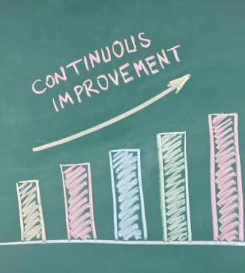
Learnings & Improvements

Slide 11
Learnings & Improvements
Learnings
Create complete Networking Infrastructure using modular approach with terraform
Create a portable application that handles requests using information from database
Select the best approach for metrics creation and collection.
Use Security tools to generate findings and establish compliance.
Improvements
Implement Workload Optimization.
Get ACM Certificate and enable secure HTTP protocol.
Further optimization of CI/CD Pipelines. Blue/Green development
Enable WAF Protection to prevent ALB to be attacked.
Revisit terraform code for unused resources.
11

Slide 12

Live Demo

Slide 13
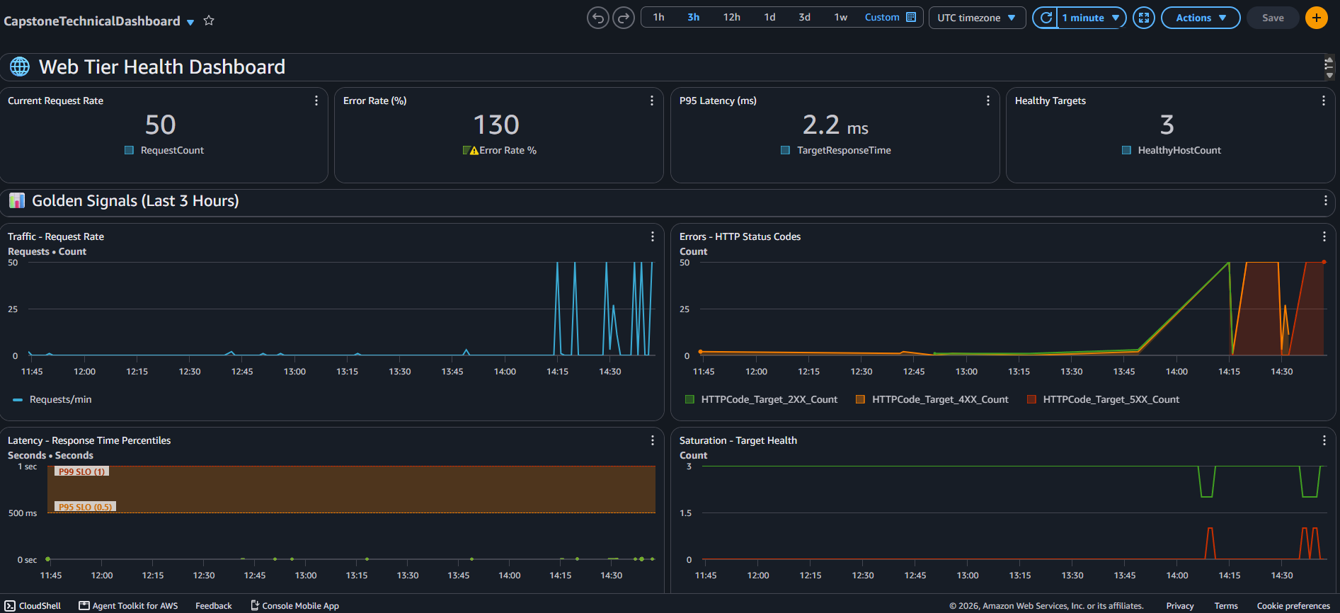

Slide 14
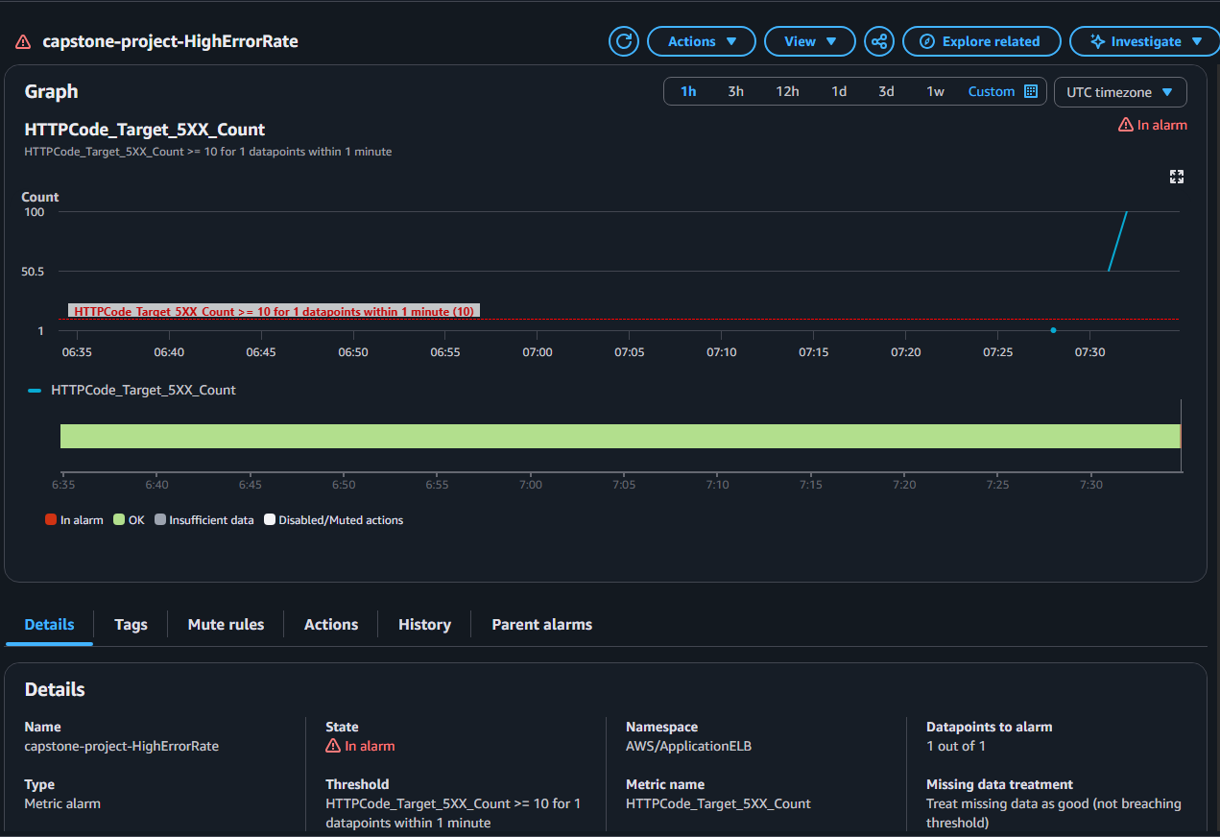

Slide 15
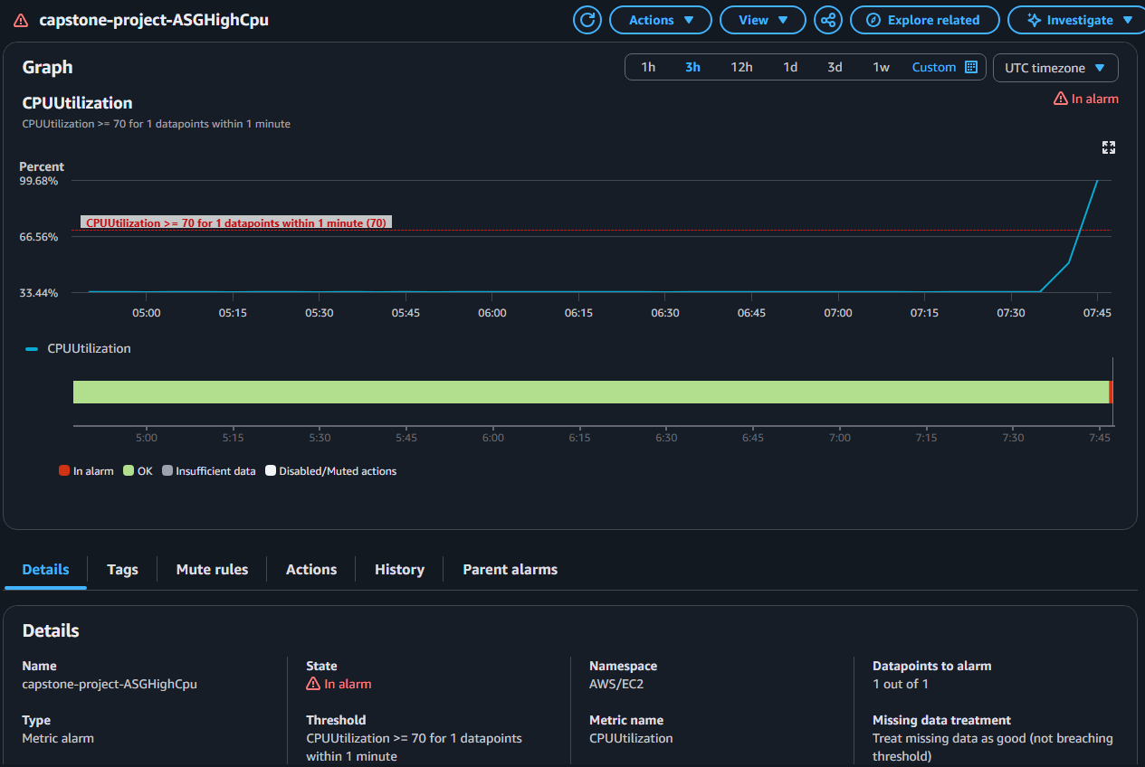

Slide 16
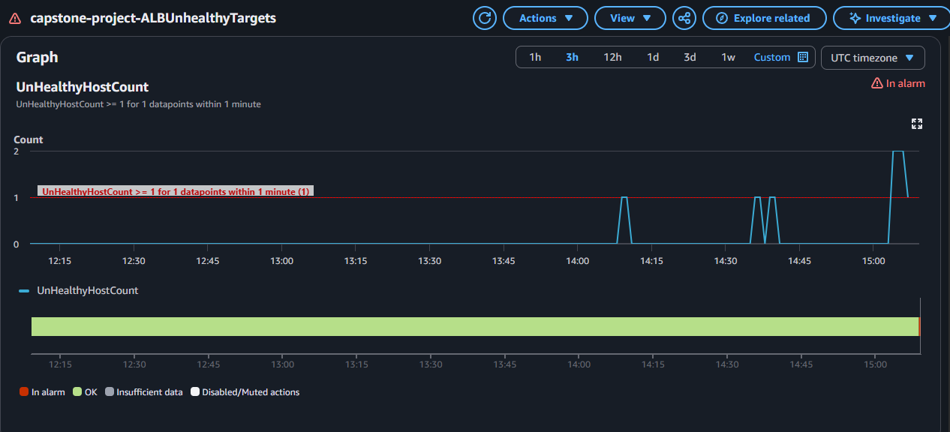

Slide 17
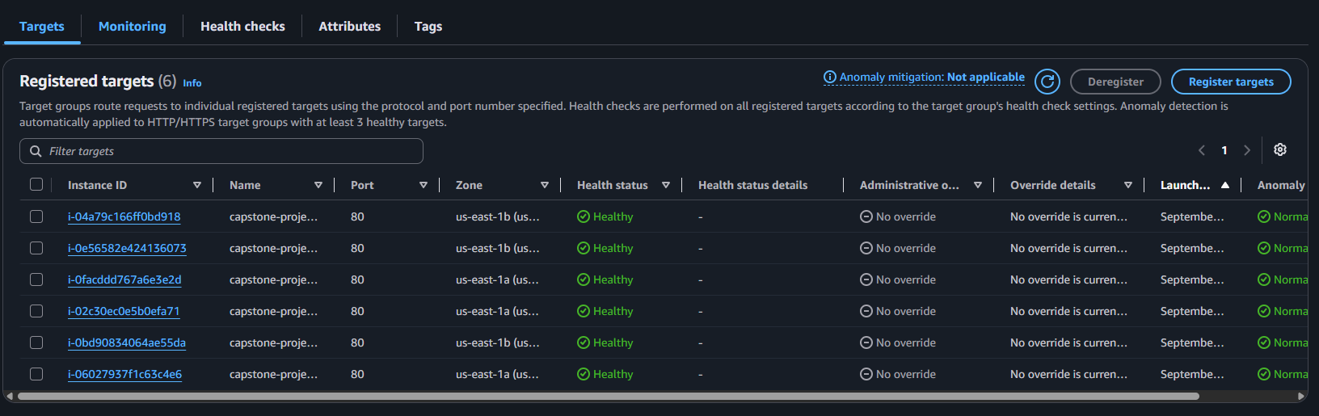

Slide 18
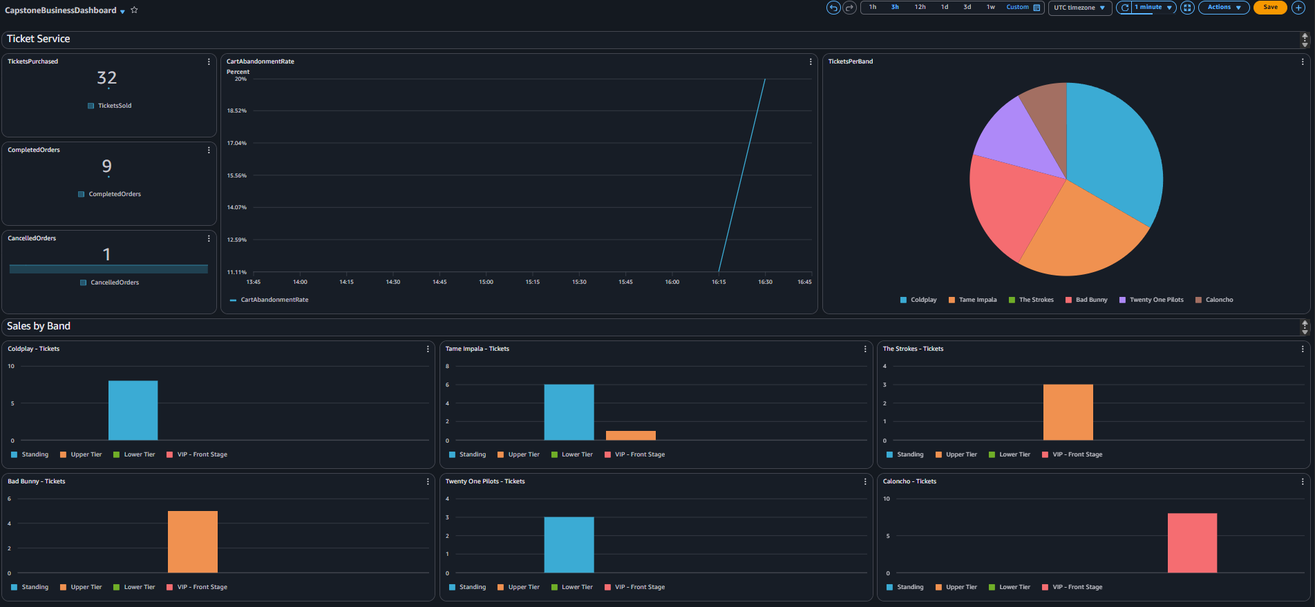

Slide 19
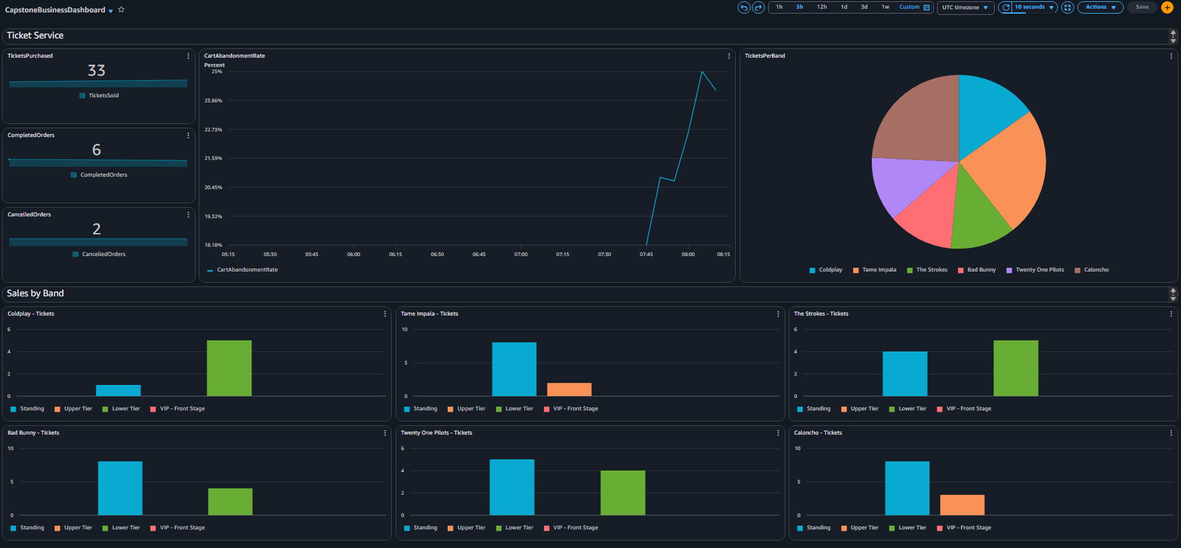

Slide 20
Q&A

Slide 21
Thank you
Julio Cesar Aldana Almanza

