Slide 1

Instrumented & Monitored Cloud Service
Julio Cesar Aldana Almanza

Slide 2
Agenda
Architecture & Instrumentation
Alerting system
Live Demo
Incidence Response
Learnings & Improvements

Slide 3
Architecture & Instrumentation
Instrumented & Monitored Cloud

Slide 4
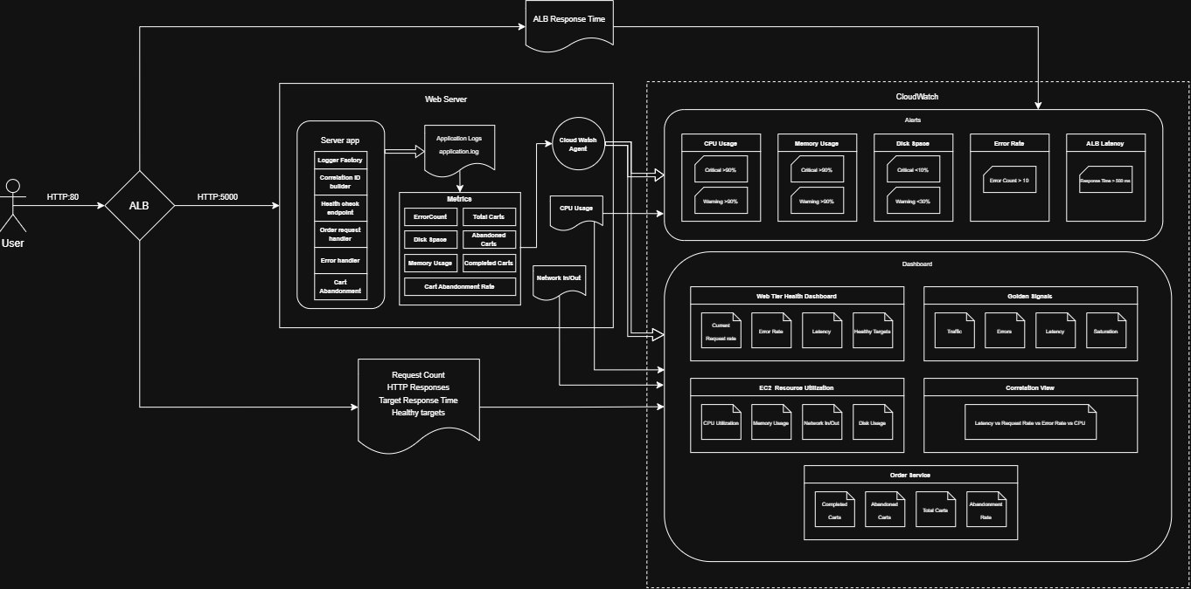
Architecture
Web Server
Logger Factory
application.log
Application Load Balancer
CloudWatch Agent
CloudWatch Alerts
CloudWatch Dashboard

Slide 5
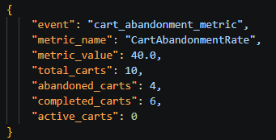
Instrumentation
Technical metrics | Business Metrics
Memory Usage | Total Carts
Disk Space | Completed Carts
Application Error Rate | Abandoned Carts
 | Abandonment Cart Rate
Correlation ID
Cloud Watch Agent
Filter Logs
EC2 Metrics | ALB Metrics
CPU Usage | Target Response Time
Network In/Out | Request Count
 | Healthy Targets
 | HTTP Code Responses

Slide 6
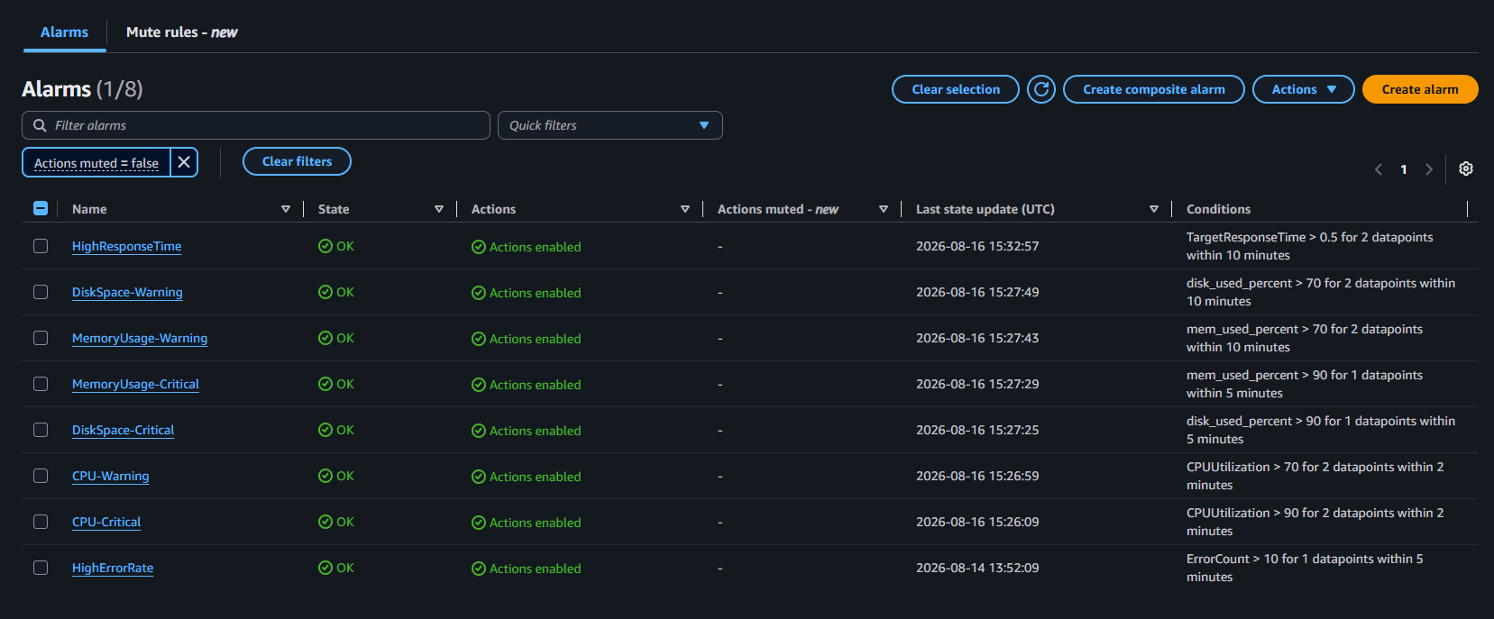
Alerting System
CPU Usage (Tiered Alerting)
Critical >90%
Warning >70%
Memory Utilization (Tiered Alerting)
Critical >90%
Warning >70%
Disk Space (Tiered Alerting)
Critical >90%
Warning >70%
Application Error Rate
Application Load Balancer Response Time

Slide 7

Live Demo

Slide 8
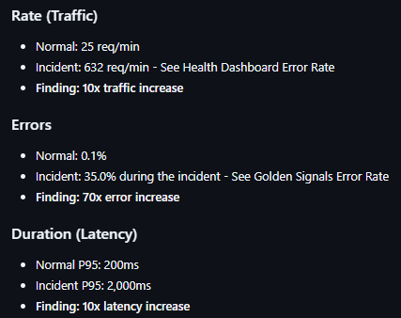
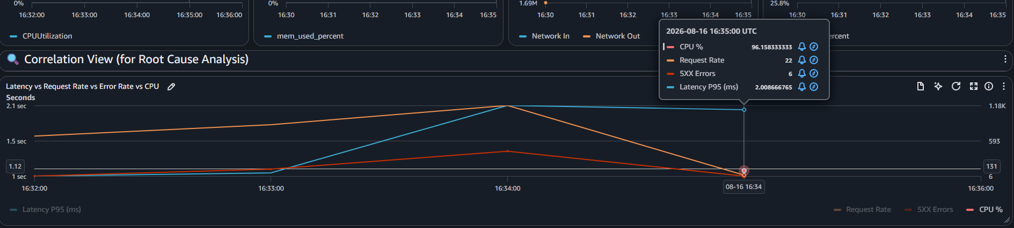
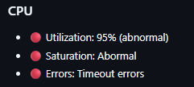
Incidence Summary & Solution
Incident: API latency increased from 200ms (P95) to 2,000ms (P95)
Impact: 250 users experienced slow page loads, 35% error rate
Duration: 60 minutes (17:00-18:00 UTC, Aug 14, 2024)
Root Cause: Unexpected traffic/application workload

Slide 9

Learnings & Improvements

Slide 10
Learnings
Create logs with sufficient data and identified to track relevant information for troubleshooting.
Filter log info to monitor the server and create alerts to perform actions immediately.
Functionality of a widget, how it is populated, sample frequency and display type.
Use of RED/USE Methodology to find the root cause.
Improvements
Redesign logging of cart requests to get proper values for active carts to be displayed in the dashboard.
Enable duration metric to be filtered in the log insights.
Increase the number of business metrics and eventually create a dashboard for business metrics
Add cart storage using DynamoDB or another datastore.
10

Slide 11
Q&A

Slide 12
Thank you
Julio Cesar Aldana Almanza

