Slide 1

Three-Tier Cloud Architecture Deployment
Julio Cesar Aldana Almanza

Slide 2
Agenda
Architecture Overview
Challenges & Solutions
Cost Analysis
Improvements & Next Steps
Live Demo

Slide 3
Three-Tier Architecture
Virtual Private Cloud

Slide 4
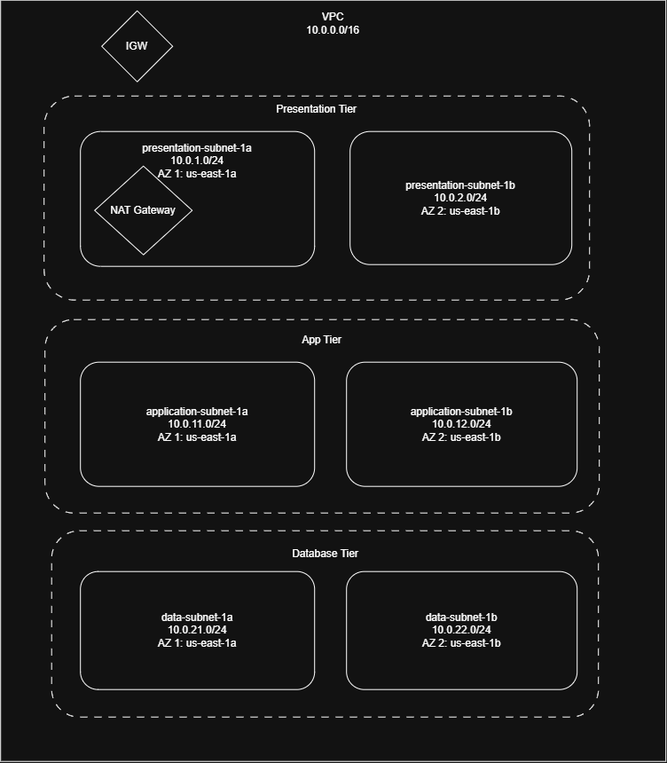
Network strategy
VPC: 10.0.0.0/16
Presentation Subnets (Public):
AZ 1: 10.0.1.0/24
AZ 2: 10.0.2.0/24
Application Subnets (Private):
AZ 1: 10.0.11.0/24
AZ 2: 10.0.12.0/24
Data Subnets (Private):
AZ 1: 10.0.21.0/24
AZ 2: 10.0.22.0/24

Slide 5
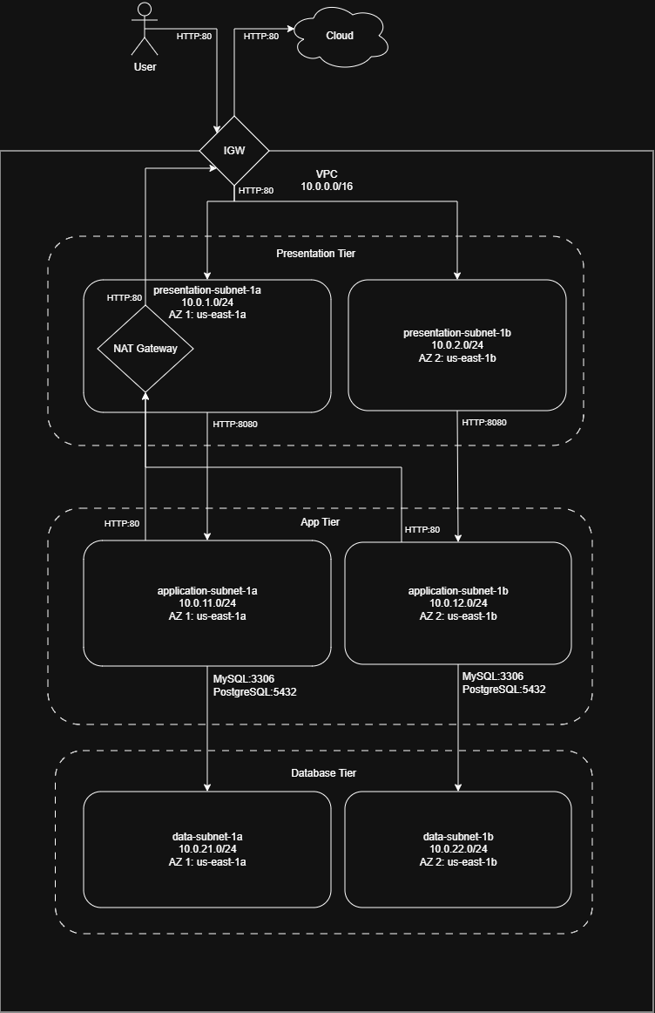
Traffic Flow
Internet Gateway: allow traffic from outside to VPC
Presentation Tier:
Allows HTTP requests from IGW (Port 80)
NAT Gateway attached to allow outbound requests from app-tier
Application Tier:
Receives HTTP request from presentation tier only (Port 8080)
Outbound traffic allowed through NAT Gateway for package downloads
Data Tier
Isolated from Outside: receives request from app tier only (MySQL:3306 and PostgreSQL:5432)

Slide 6
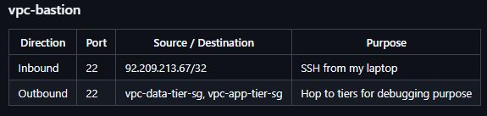
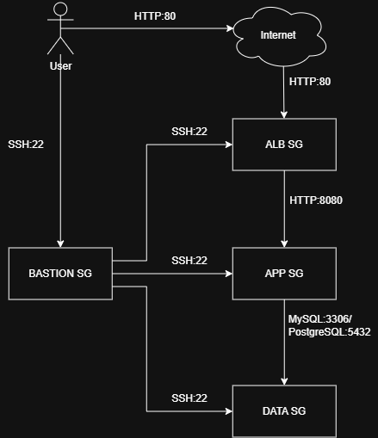
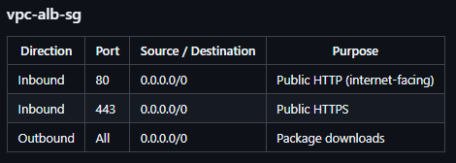
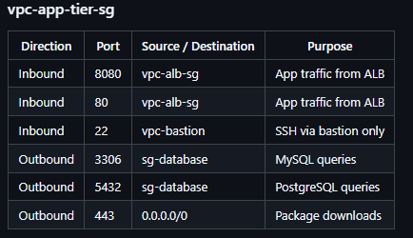
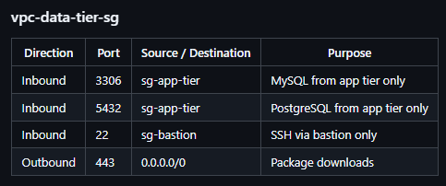
Security Groups
6

Slide 7
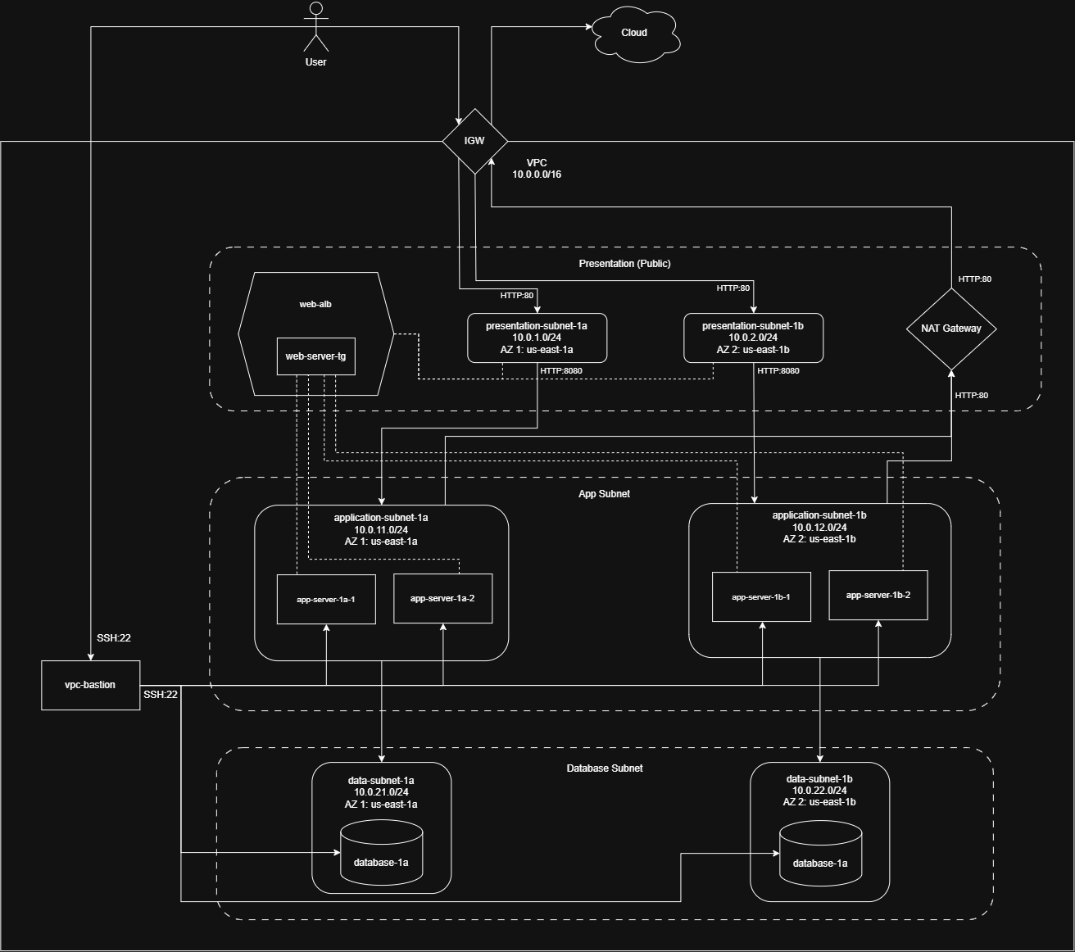
Three-Tier Architecture
Presentation Subnets
Application Subnets
Data Subnets
Bastion
Internet Gateway
NAT Gateway
Load Balancer
Target Group

Slide 8

Challenges & Solutions

Slide 9
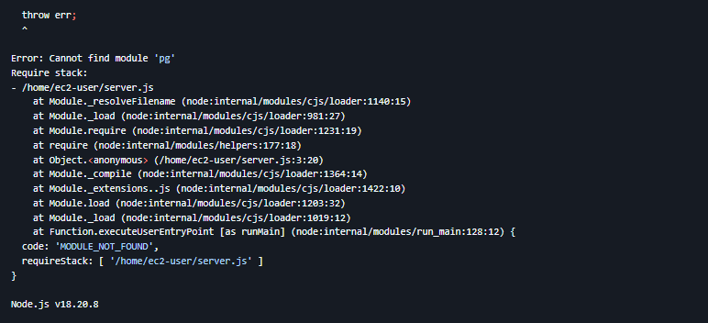
Application Instance stars unhealthy
Application server is marked as unhealthy at the first start.
Solution
Run bash npm install pg to install the dependency needed.
Run bash sudo chmod 777 app.log to allow edition of app.log file.
Run the application using the command sudo nohup node server.js > app.log 2>&1 &.
9

Slide 10
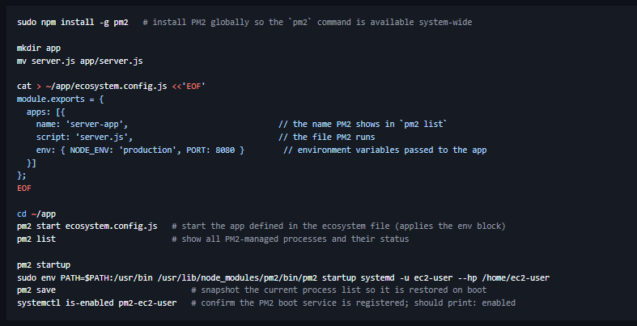
Application not running on restart
Application is not running again after restarting. A manual restart of the application is needed..
Solution
10

Slide 11
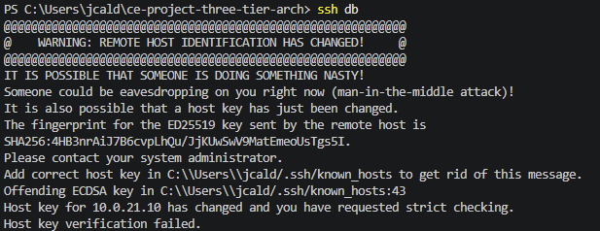
Host key verification failed
Database connection through bastion refused due to warning "Remote host identification has changed!"
Solution
Run ssh-keygen -R DB-PRIVATE-IP to remove any key that the db IP address may have attached.
11

Slide 12
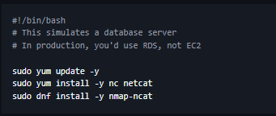
Database simulation failed
Database instance is not running simulated responses
Solution
NCat was not installed properly when running the script in the instance creation.
If the instance is already created, run bash sudo dnf install nmap-ncat to install the dependency.
To solve the issue permanently (create a healthy database instance), modify the userdata script as follows:
12

Slide 13

Cost Analysis

Slide 14
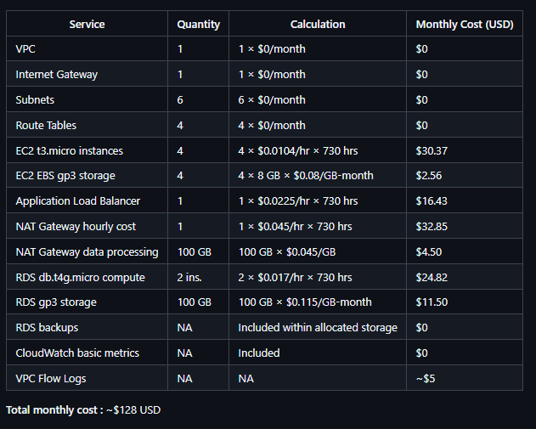
Monthly Cost Breakdown

Slide 15
Cost optimization strategies
Enable auto-scaling to launch only sufficient instances to keep the system working.
Add VPC Endpoints for services such as RDS, Systems Manager, CloudWatch to reduce NAT Gateway usage.
Apply Saving Plans for stable EC2 workloads to reduce On-demand costs.
If acceptable for non-critical workloads, run a Single-AZ RDS instance instead of Multi-AZ (roughly halves the RDS compute cost)
Optimize logging retention
Revisit instance sizes after collecting 30–60 days of CloudWatch metrics
15

Slide 16
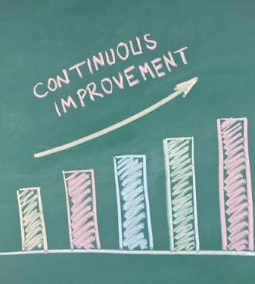
Improvements & Next Steps

Slide 17
Improvements
Short-term
Replace the bastion host with AWS Systems Manager Session Manager
Replace database placeholder with RDS Database
Update health checks in application to monitor CPU Utilization
Add Logging: CloudTrail, ALB Access Logs, NAT Gateway Metrics to improve troubleshooting
Remove unused rules in Security Groups
Long-term
Add VPC Endpoints: Create Interface/Gateway Endpoints for services like S3, DynamoDB, Systems Manager, Secrets Manager
Add Auto-scaling for application tier
Increase security with Zero Trust/Least privilege principle: IAM authentication, Session Manager, service-to-service authentication.
For stricter security requirements, use services like AWS Network Firewall, Stateful Inspection, Domain filtering
17

Slide 18

Live Demo

Slide 19
Q&A

Slide 20
Thank you
Julio Cesar Aldana Almanza

