Slide 1
data
Aesthetic map
MyFavoriteIrisFlowers %>%
ggplot( aes( x= isFavorite, y= MEAN ) ) +
geom_point(size = 3)
Elements are added with a + sign
Elements

Slide 2
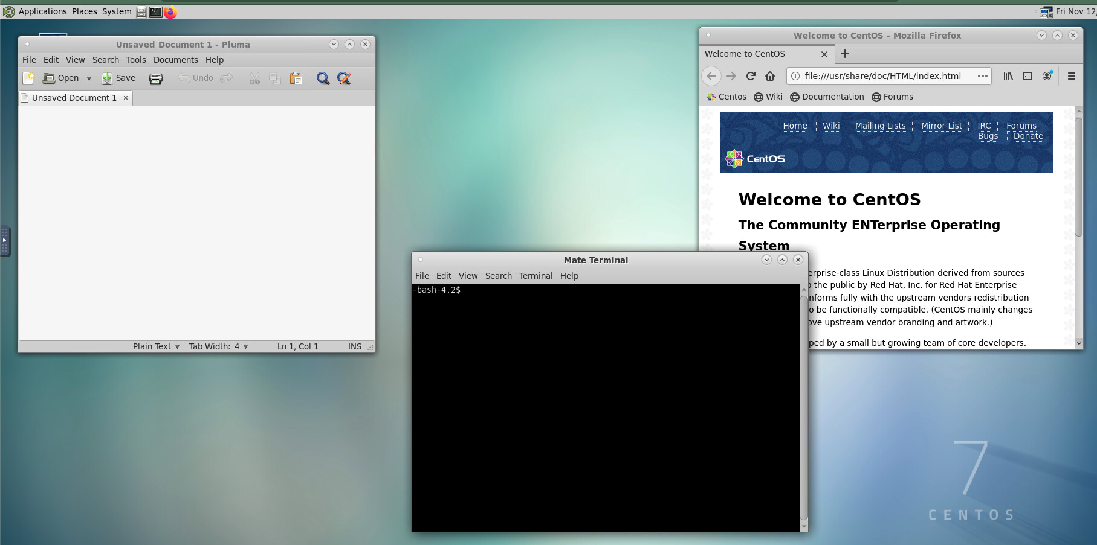
Pluma Editor:
To write code
Terminal:
To execute code
Firefox:
To look up code

