Slide 1
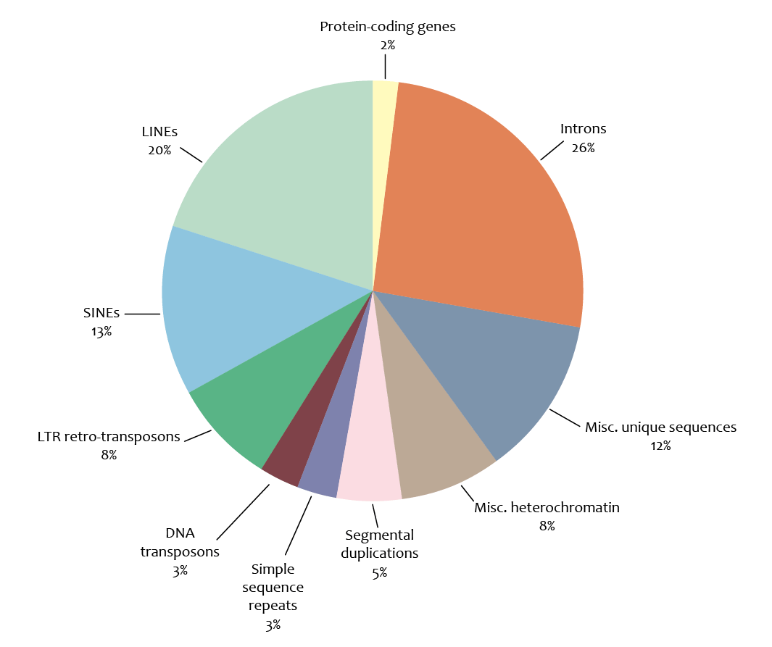

Slide 2
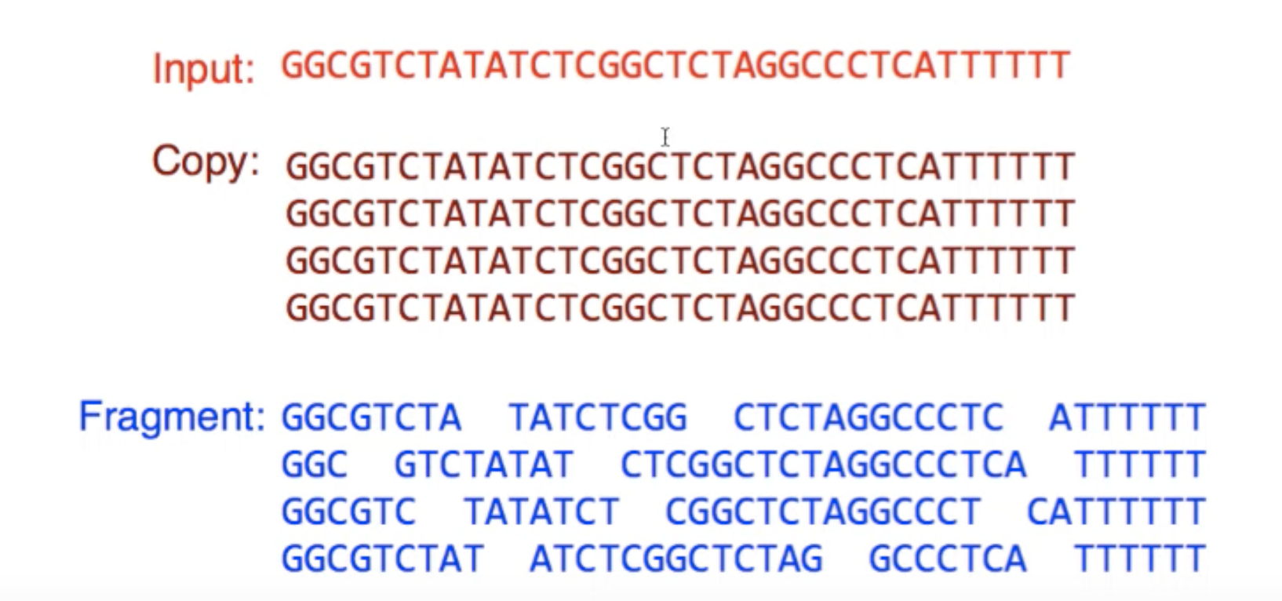
Genome from the cell
Sequencing
Input
Genomes are duplicate many times
Read
Sequencing
Outputs

Slide 3
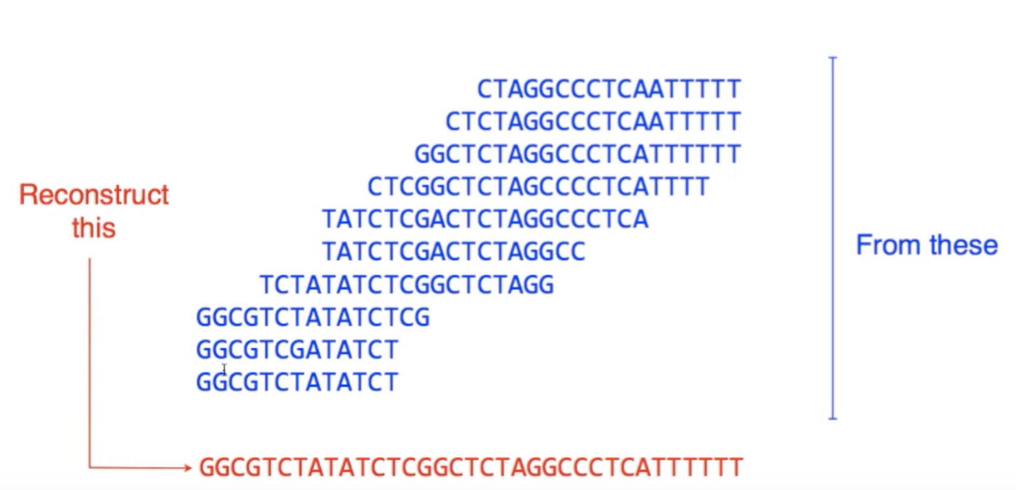
7
3
Coverage
Assembly
goal
4
DNA
reads
3
Original Genome

Slide 4
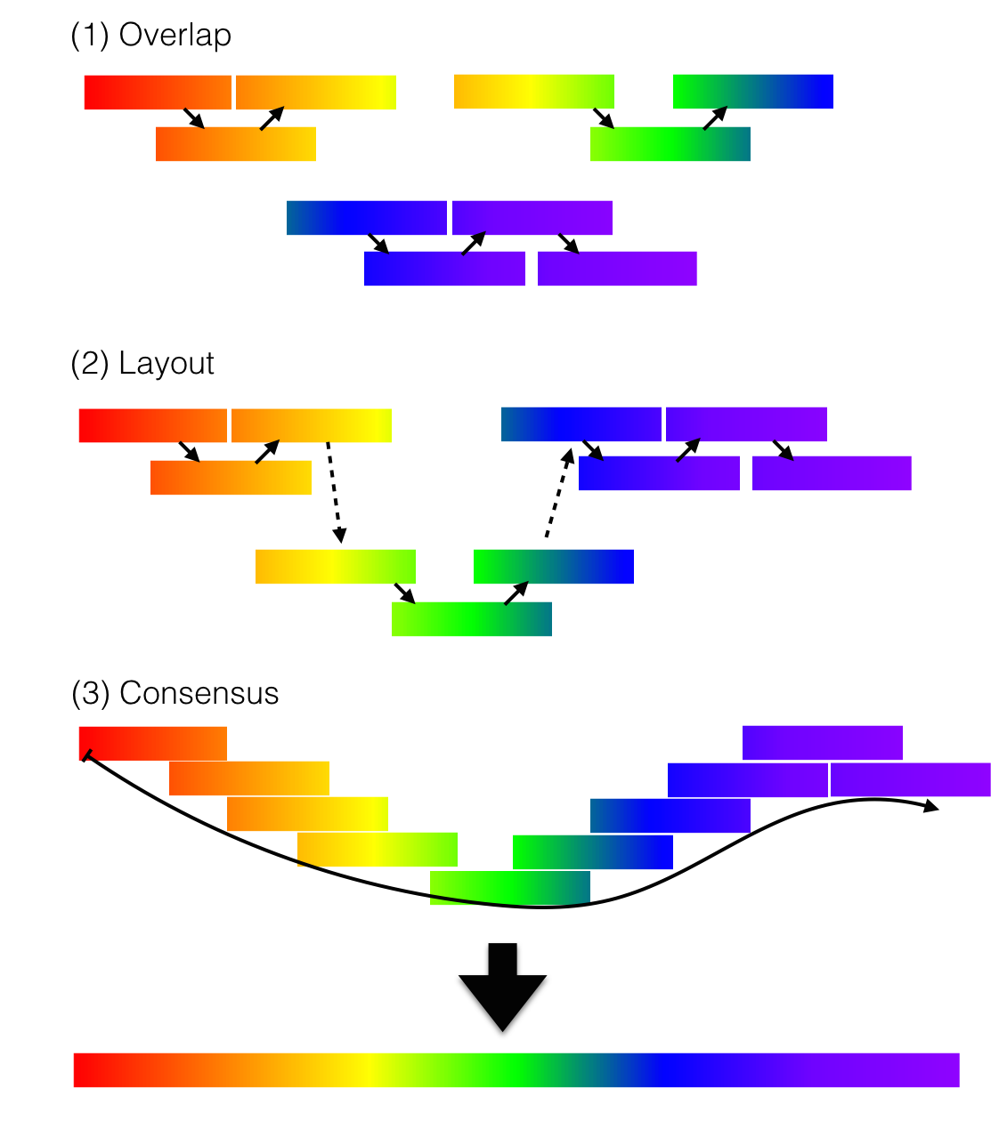

Slide 5
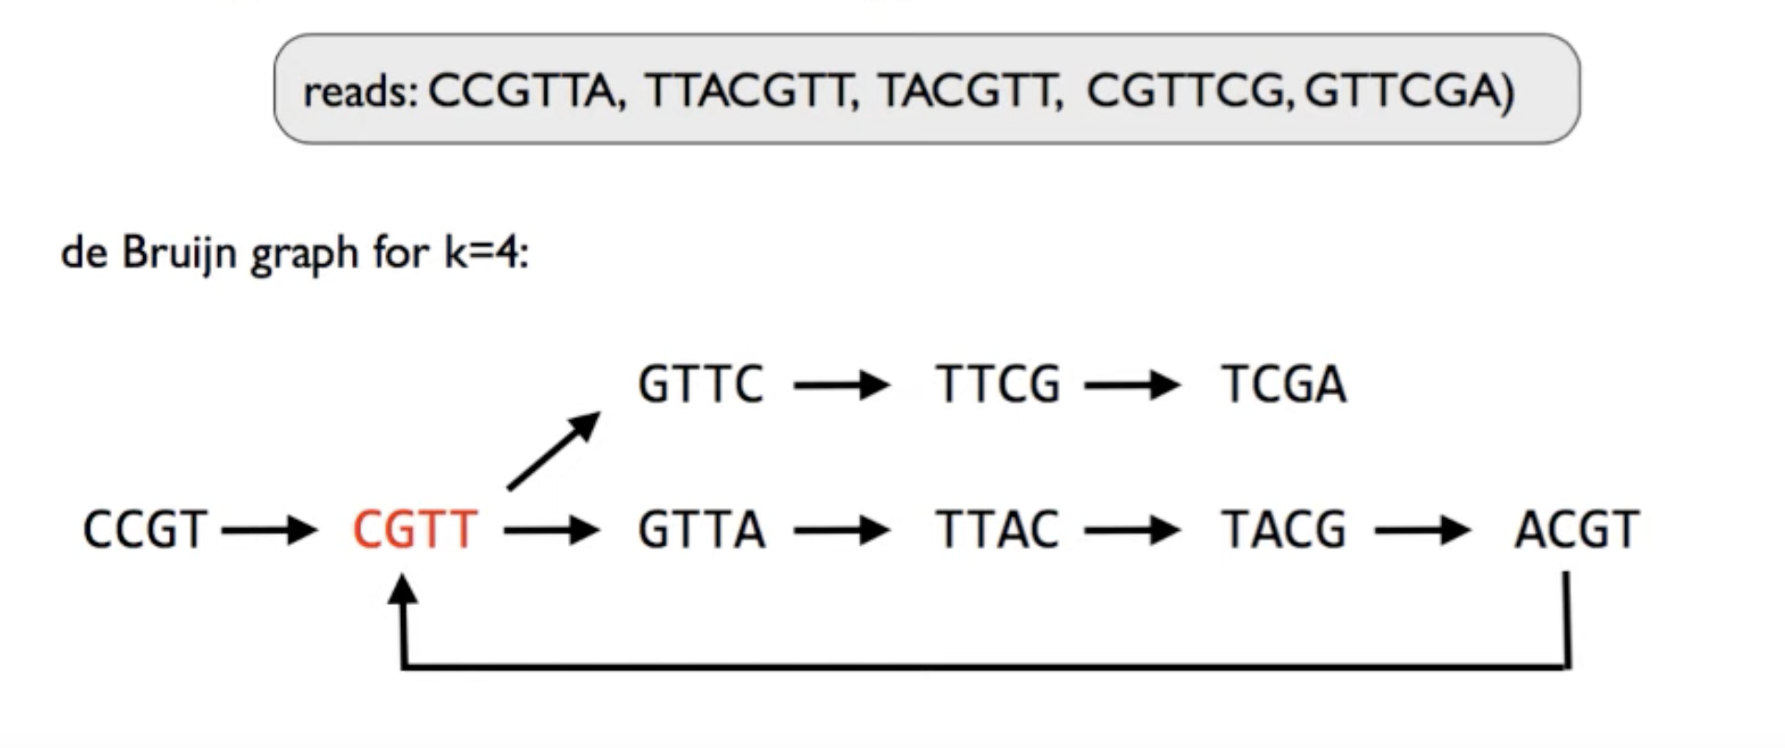

Slide 6
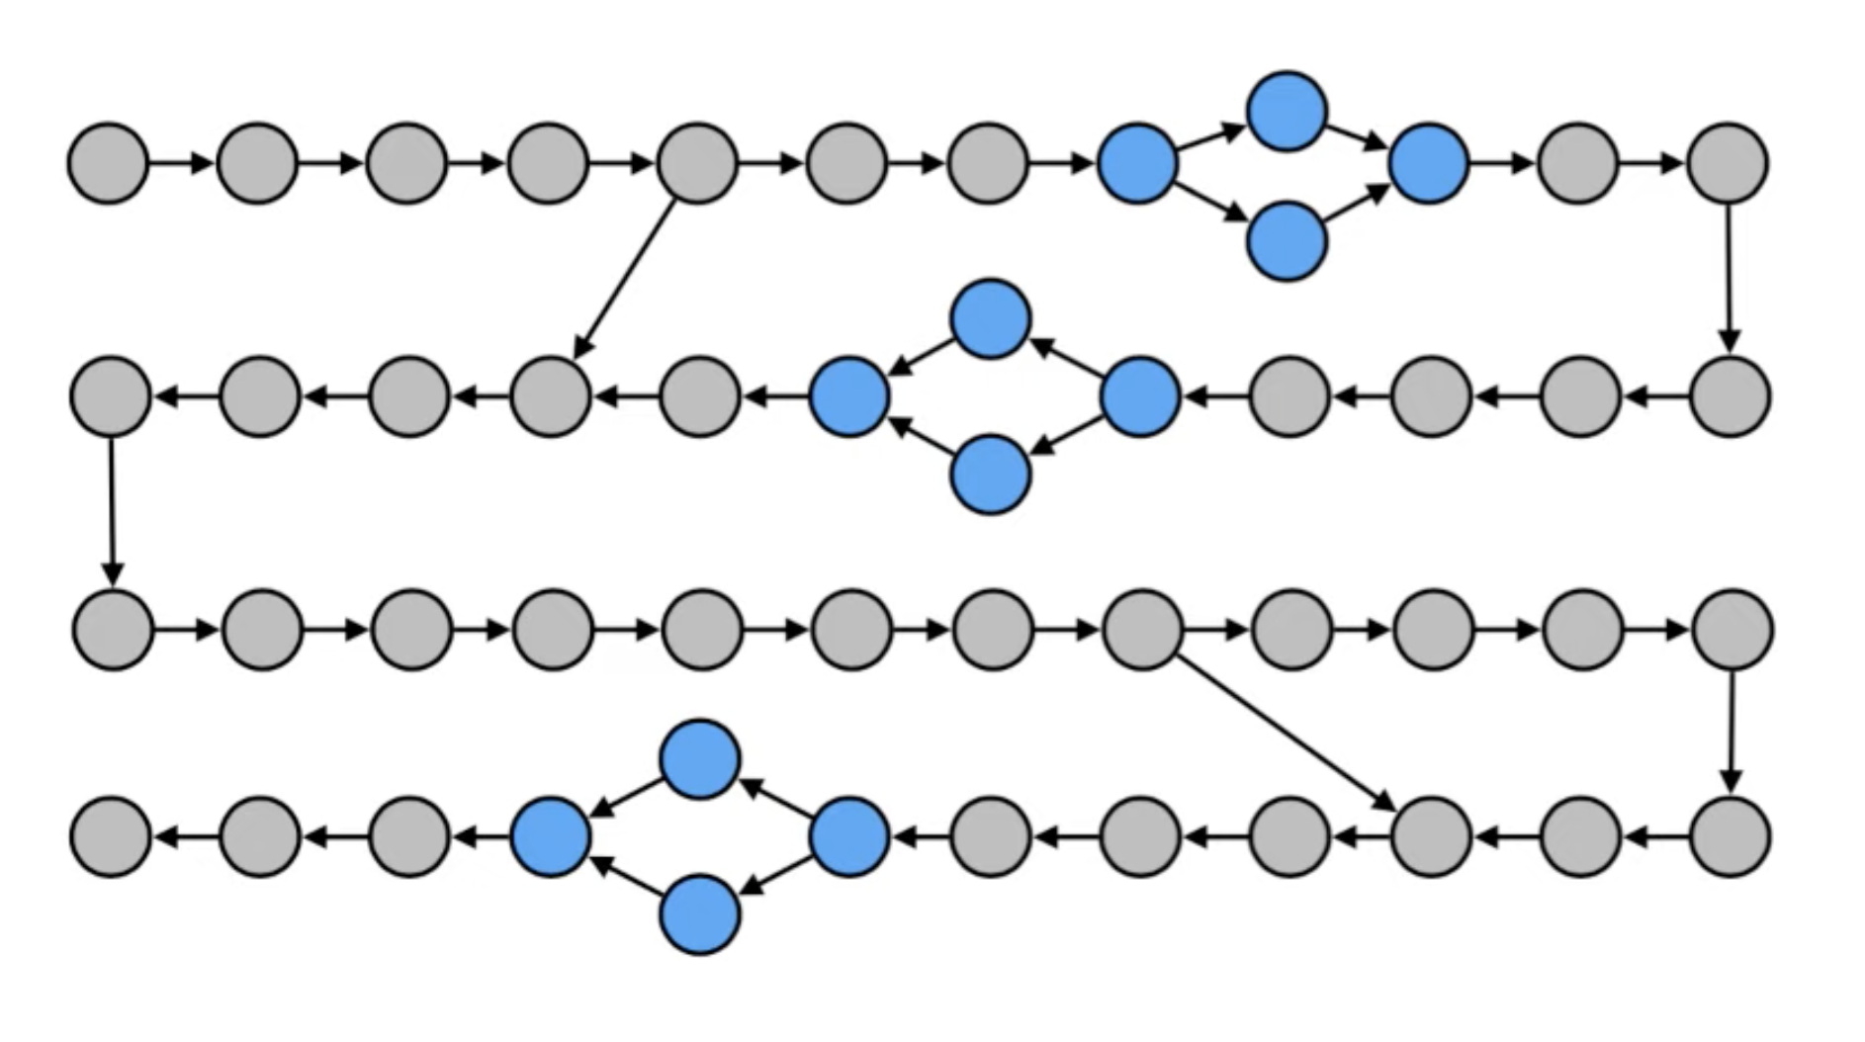
Unsolvable
Branching!
Divergent paths (Pick one)
Divergent paths (Pick one)
Unsolvable
Branching!
Divergent paths (Pick one)

Slide 7
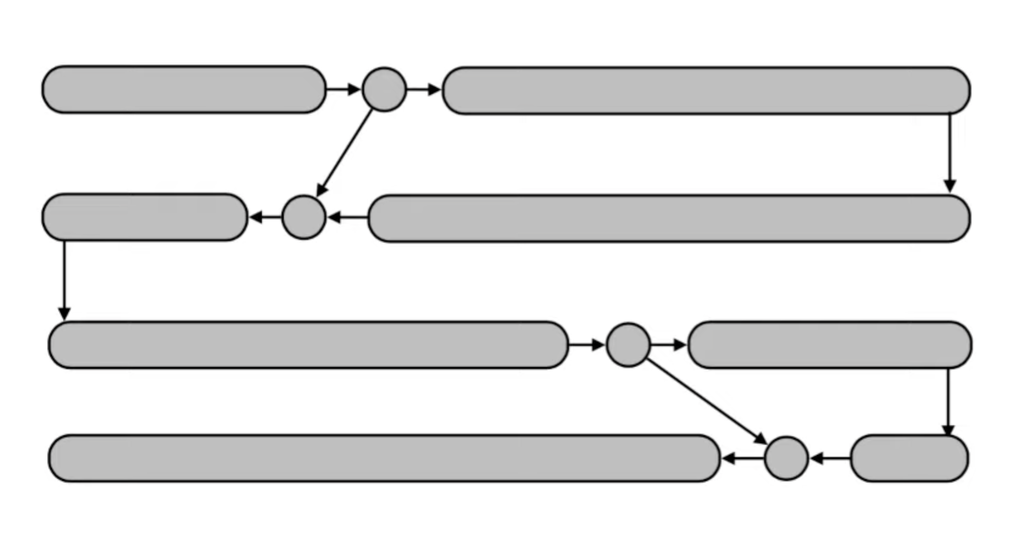
Contig 1
Contig 2
Contig 3
Contig 2 (cont.)
Contig 3 (cont.)
Contig 4
Contig 4 (cont.)

