Slide 1
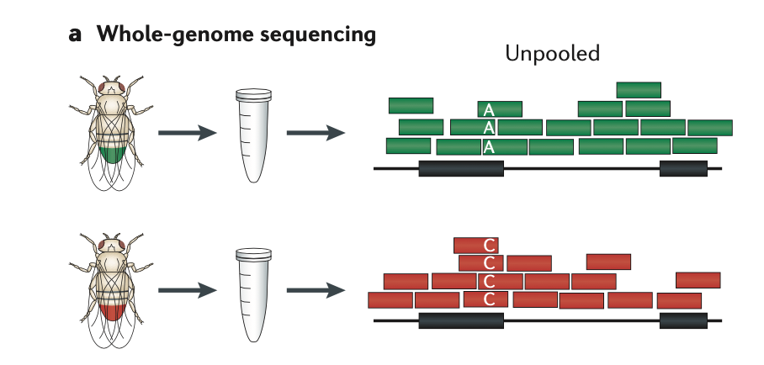
Mutation
Reference Genome

