Slide 1

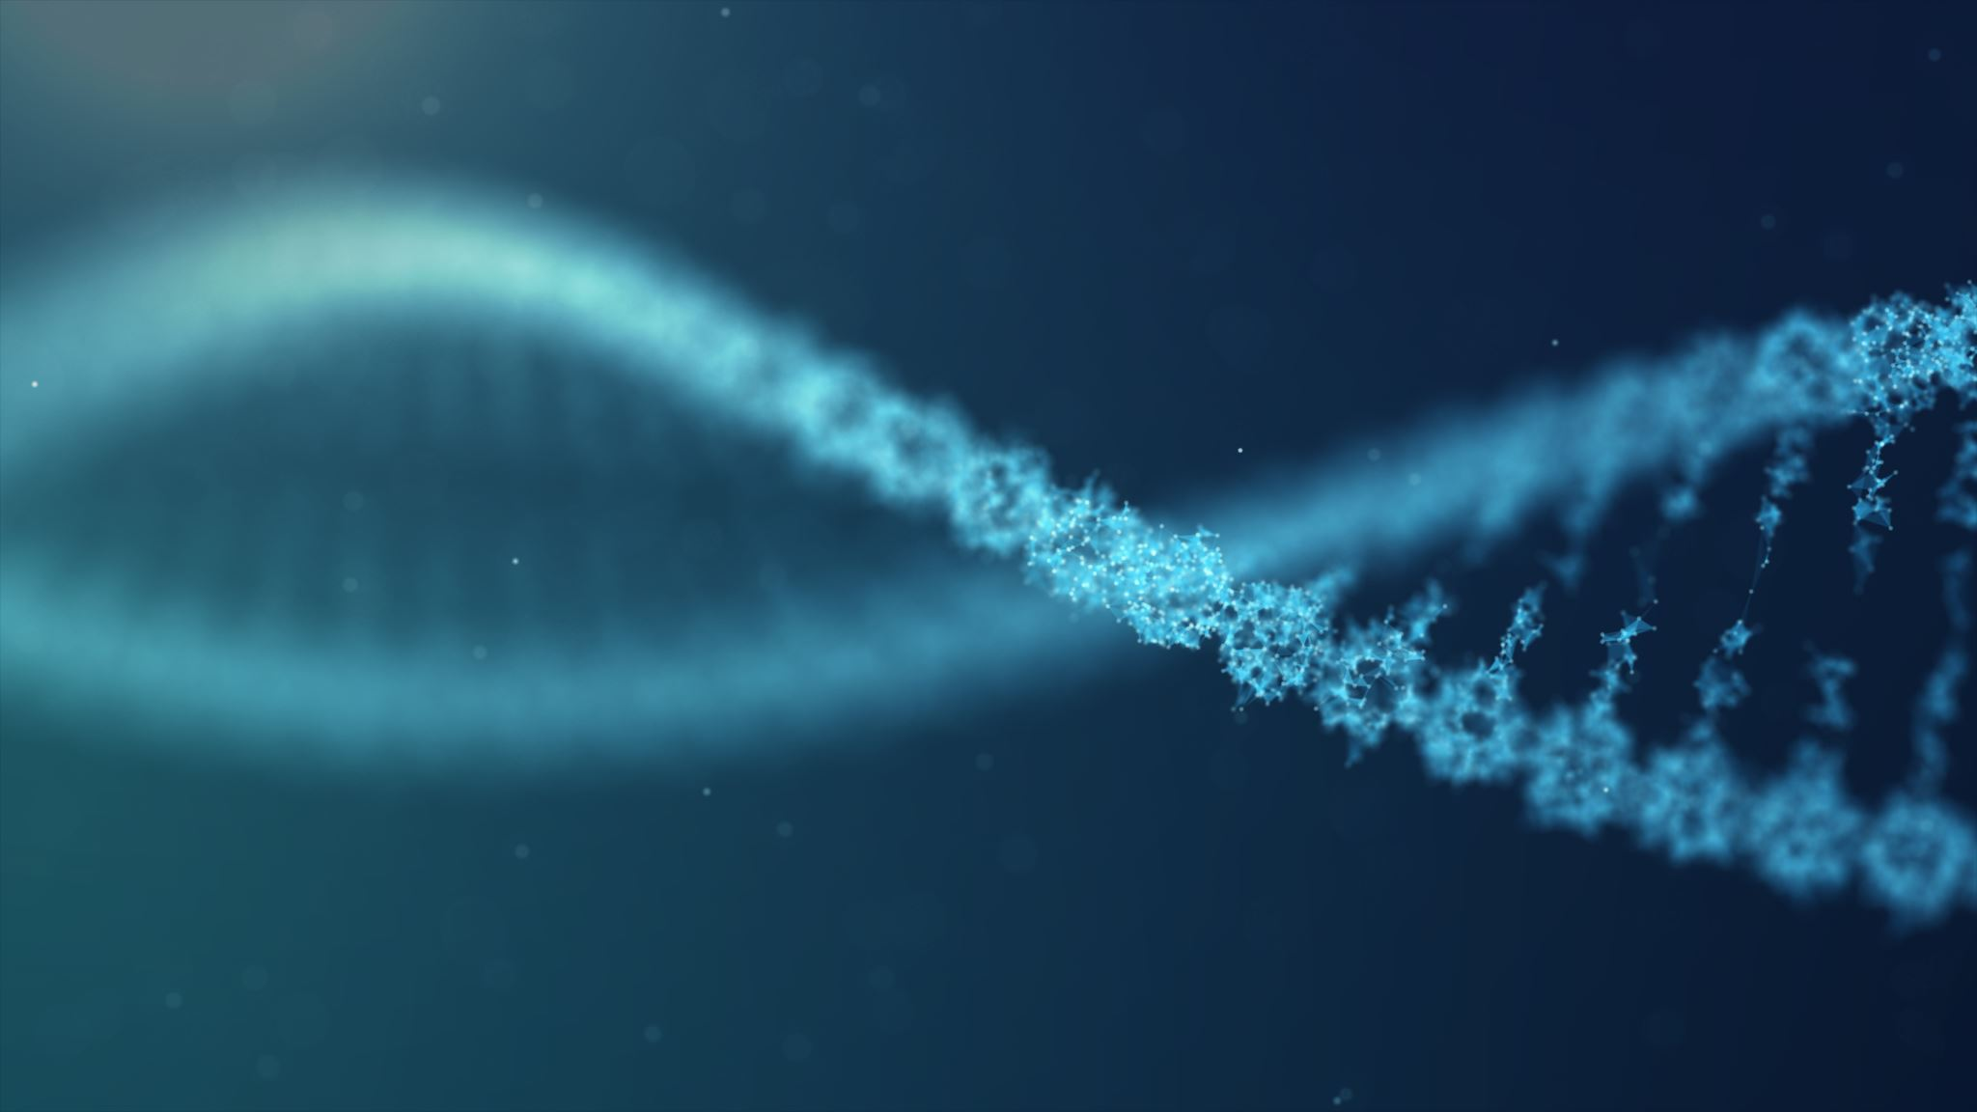
Evolutionary Genomics

Slide 2



Let’s get to know each other

Slide 3
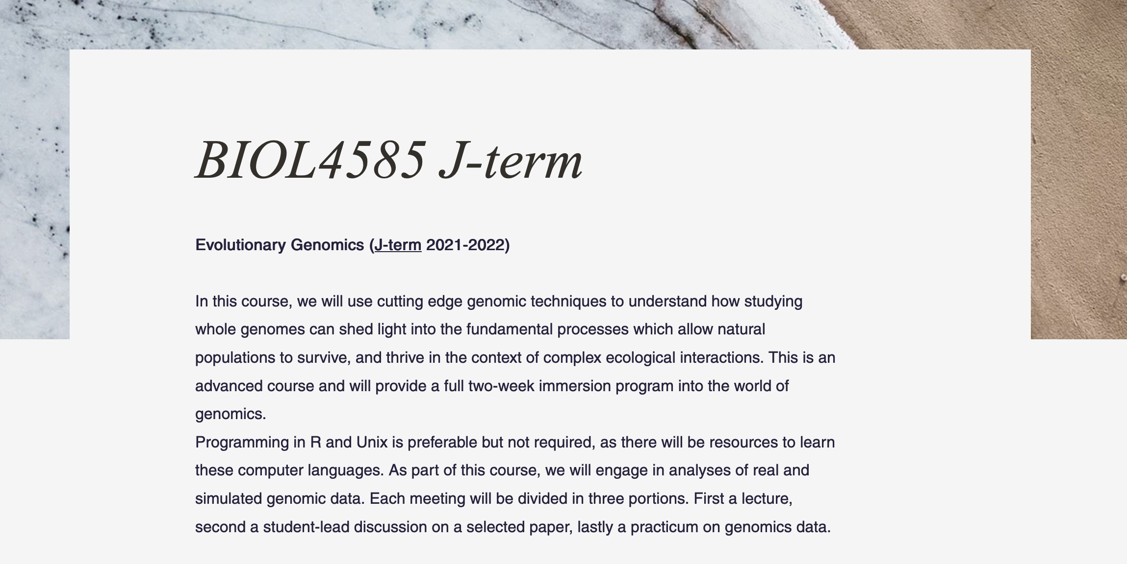

Slide 4
A roadmap for success in this class
Prepare for class and participate each day (50 points)
Today everyone gets 50 points! ☺
Read the assigned paper and write a brief summary piece (due at the beginning of class; 100 x 8 = 800 points)
We will form groups of 2 to do:
Present one daily papers (700 points)
Work on daily practicums (200 points over 2 weeks)
Work on the final project presentation (800 points)

Slide 5
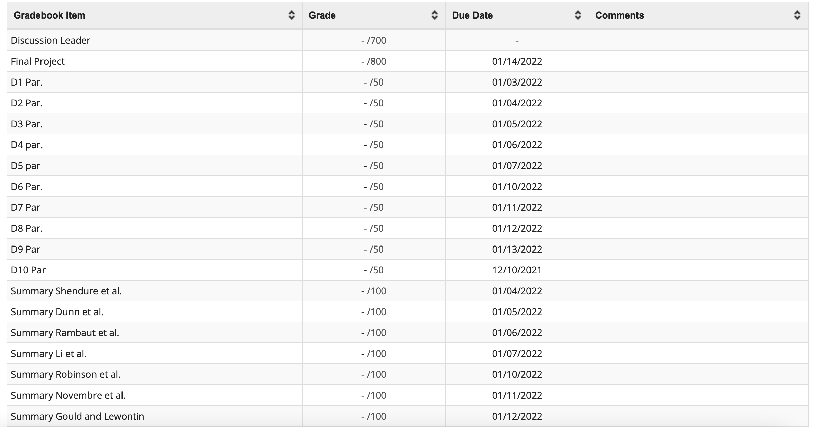
Track your participation score in Collab

Slide 6
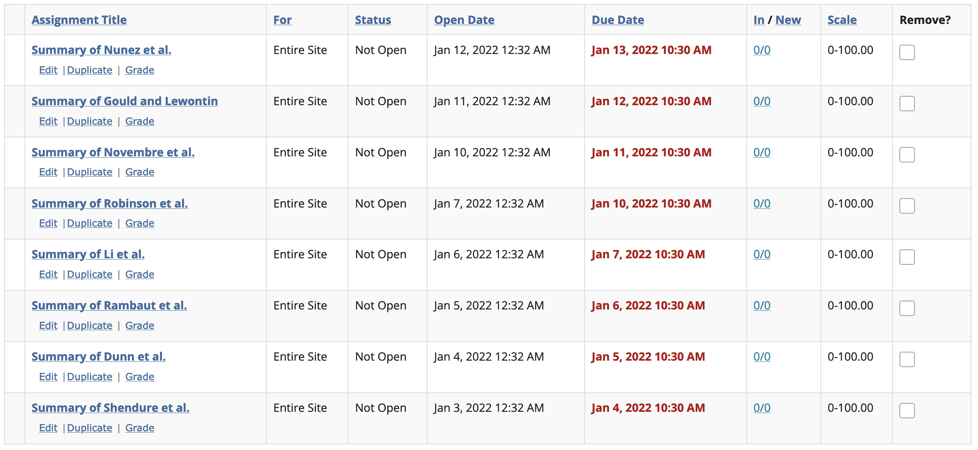
Submit your summaries in Collab

Slide 7


Leading paper discussion
Discuss:
What do you think are the motivations of the authors for writing this paper.
What are the “big” questions they are asking? or, the major concepts/technique they are reviewing?
What is the value of asking this question or this technique?
What are the main findings of the paper?
What are the main conclusions of the paper?
What are the implications of the work?
What is something new or valuable that your learned after finishing the reading?
You can use:
PowerPoint
Project the figures from the paper itself
Use other figures (but you must provide references)

Slide 8
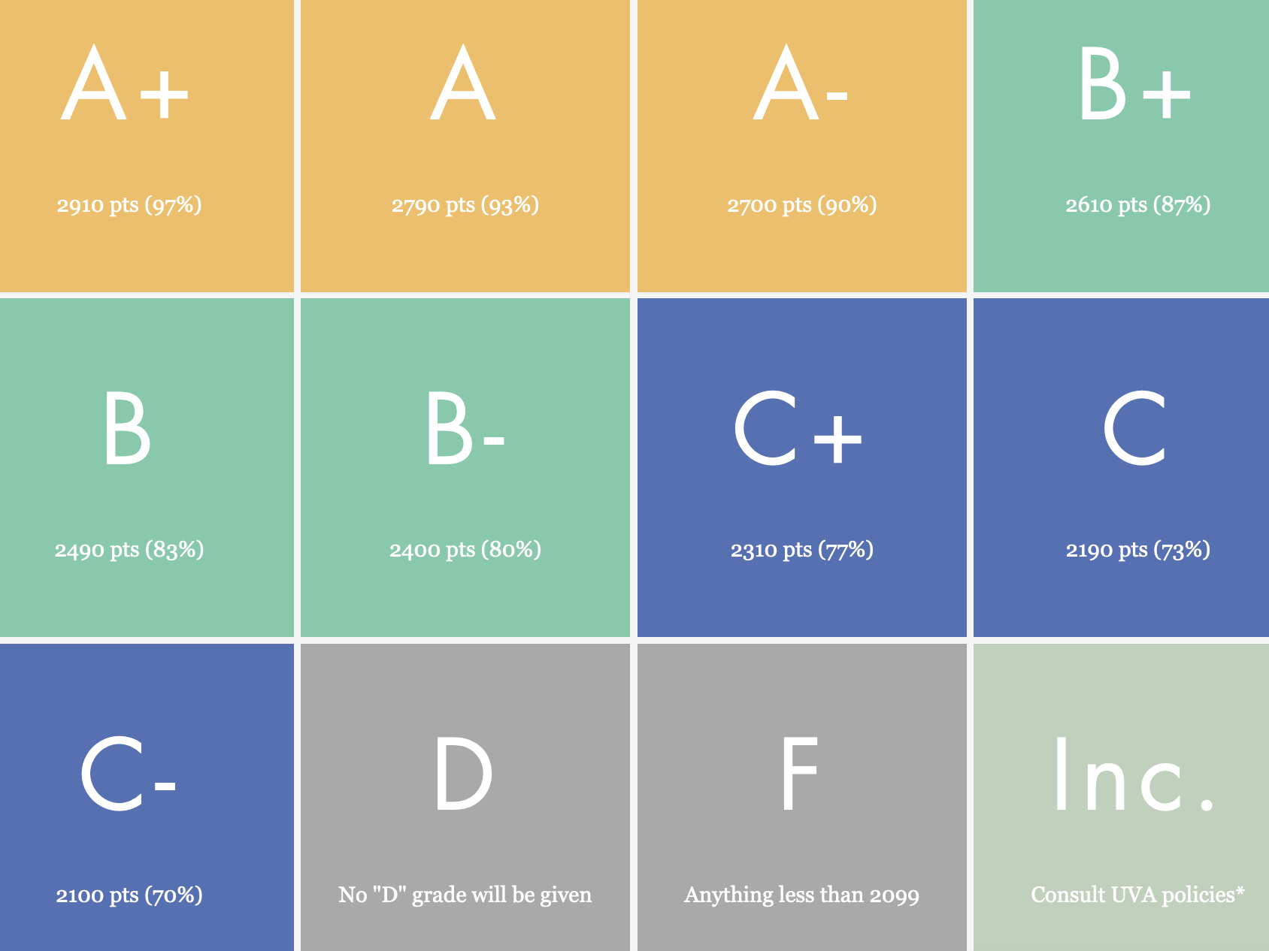
The era of big data biology
This is a highly intensive course!
You have 209 points of flexibility!
Use them strategically
The field of genetics has advanced faster in the last 15 years than in the last 75 years

Slide 9
Class participation (500 pts)
Class discussion leader (700 pts)
Reading summaries (800 pts)
Final presentation (800 pts)
Coding homework (200 pts)

Slide 10
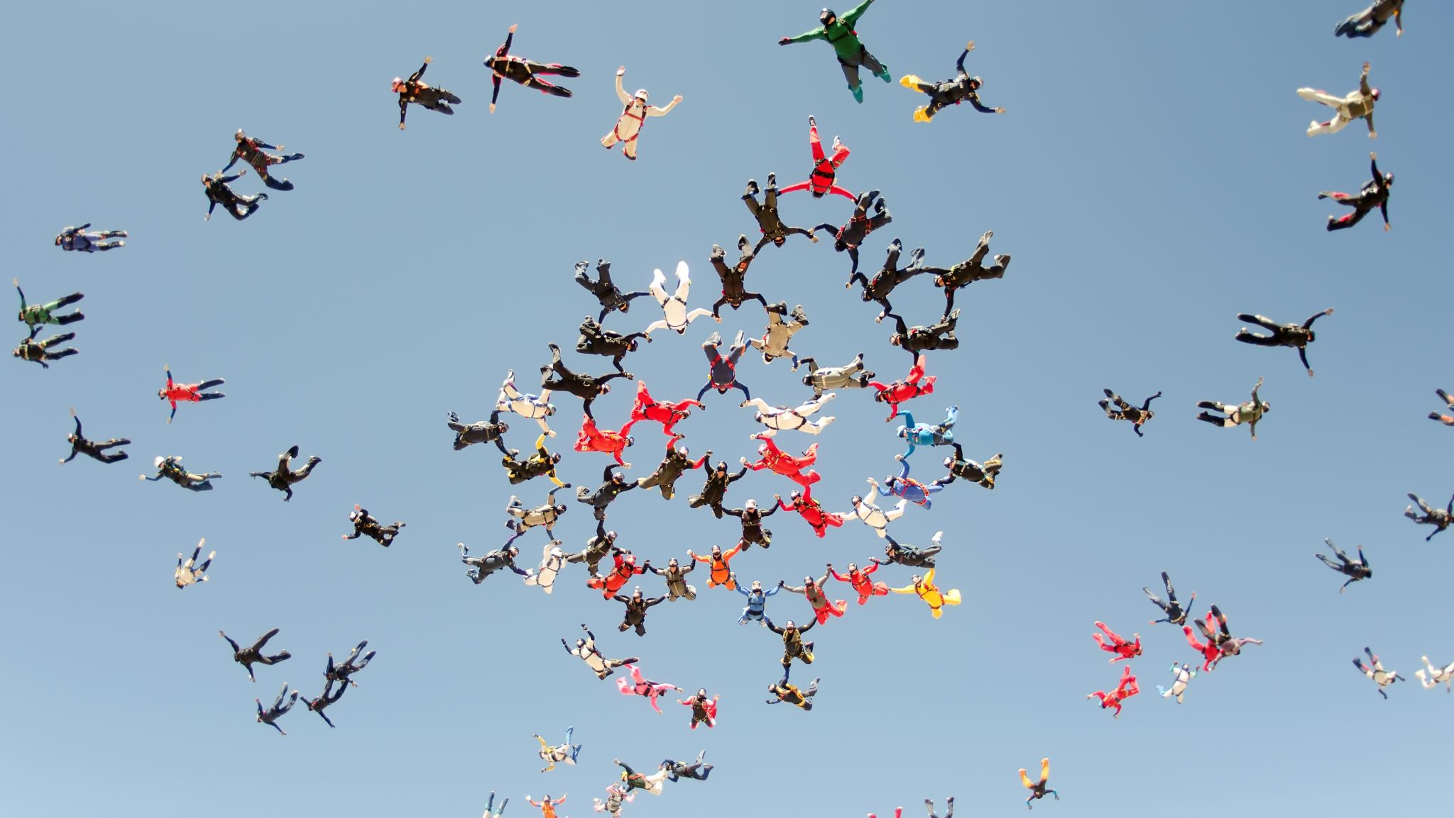
Let's make groups
And decide presentation order!

Slide 11
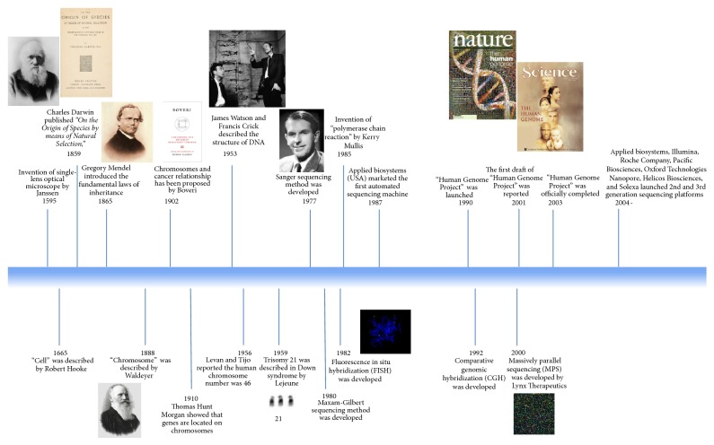
Durmaz et a.. 2015

Slide 12
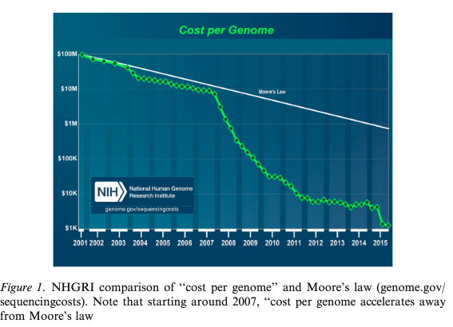
November 2018
I started college
I started graduate school
1 order of magnitude cost change!

Slide 13

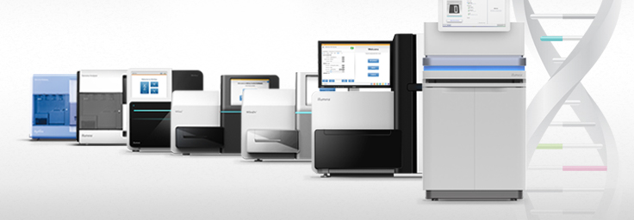
DNA sequencing machines take the biology community by storm starting 2004

Slide 14
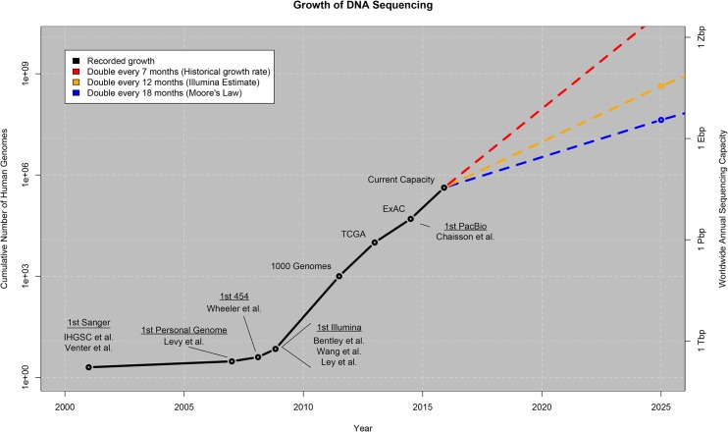
Stephens et al 2015
Notes:
https://www.ncbi.nlm.nih.gov/pmc/articles/PMC4494865/

Slide 15
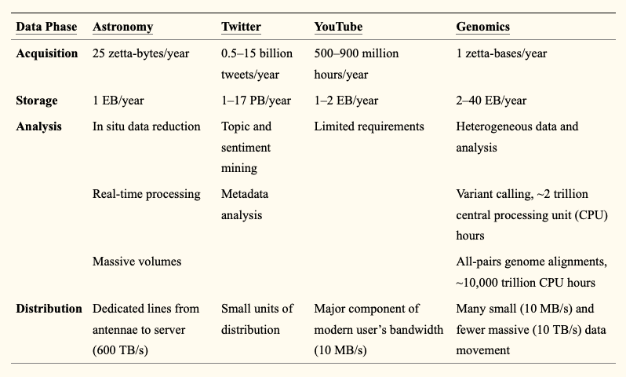
Stephens et al 2015
Notes:
https://www.ncbi.nlm.nih.gov/pmc/articles/PMC4494865/

Slide 16
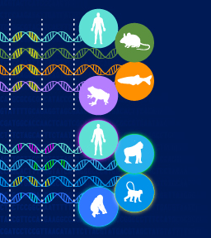
In a not-so-distant past “Big data” used to be a very particular discipline of biology.
Today, biology is “big data”

Slide 17
