Slide 1
Root
Root
Root
Branches
Branches
Branches
Nodes
Nodes
Time
Time
Nodes
Time
Tips
Tips
Equivalent Rotations
Tips

Slide 2
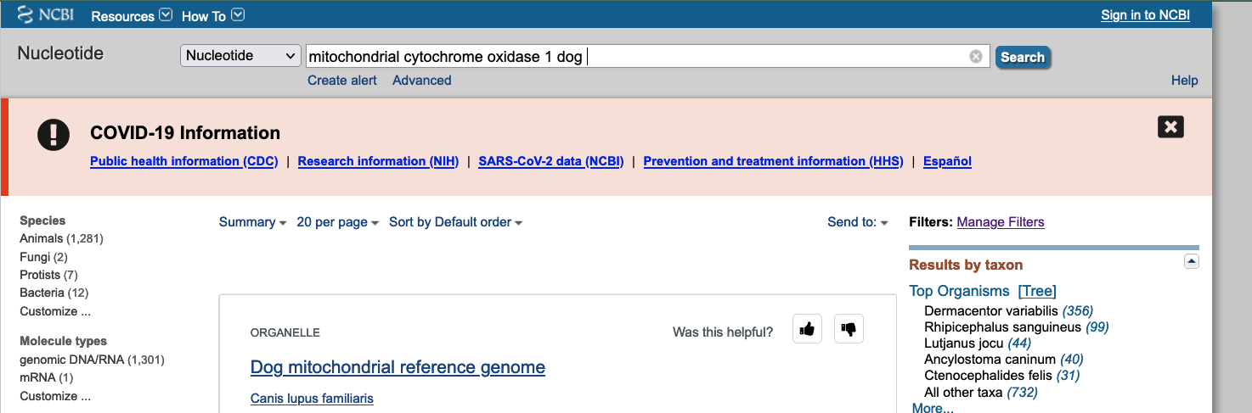

Slide 3
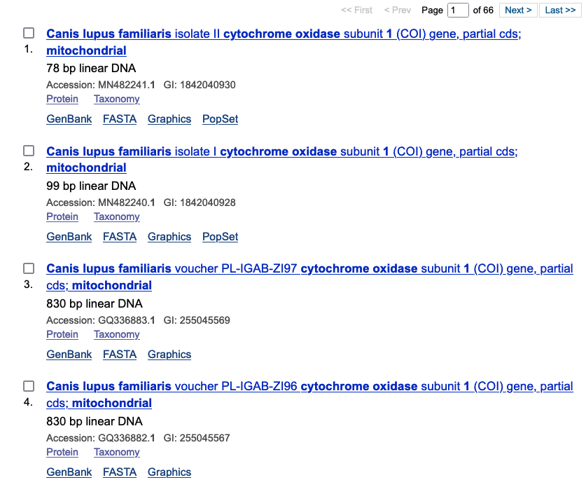

Slide 4
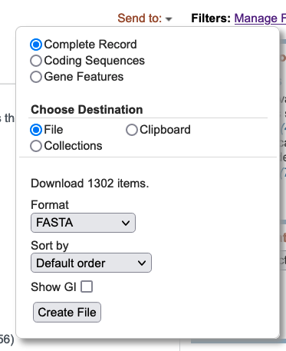

Slide 5
Misaligned sequences
Species 1
ACTGCAACCTTGGAA
Species 2
ACTGAAACCTTGGAA
Species 3
ACTGTAACCTTGGAA
Species 4
ACTGAAACCATGGAA
Well-aligned sequences
Species 1
ACTGCAACCTTGGAA
Species 2
ACTGAAACCTTGGAA
Species 3
ACTGTAACCTTGGAA
Species 4
ACTGAAACCATGGAA

Slide 6
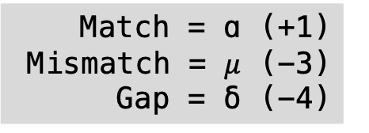
TREE vs REED
TREE
REED
TREE-
-REED
Match = ɑ (+1)
Mismatch = $μ$ (-3)
Gap = δ (-4)

Slide 7
