Slide 1
LLM: The Art of Language Understanding
GPT vs BERT
© 2024 Jongchul Lee, Department of Statistics, Pusan National University. All rights reserved.
Unauthorized reproduction, distribution, or use of this material is prohibited.
202482123 이종철

Slide 2
Contents
01 Introduction
02 Fine-tuning in NLP
03 GPT-1
04 BERT
05 Next steps of GPT & BERT

Slide 3
1. Introduction

Slide 4
The rise of LLM

Slide 5
2. Fine-tuning in NLP

Slide 6
Semi-supervised sequence learning
Pre-training & fine-tuning
MODEL
MODEL
- classification
- regression
...
Pre-trained
weights
Pre-training
Fine-tuning
Large dataset
New dataset

Slide 7
Semi-supervised sequence learning
Semi-supervised Sequence Learning (Google, 2015)
Key point: Pre-training LSTM with unlabeled sequence data
Step1. Self-supervised learning
Step2. Fine-tuning for current task
Be
happy
<eos>
positive
LSTM
LSTM
LSTM
LSTM
LSTM
LSTM
<sos>
Be
happy
I
love
you

Slide 8
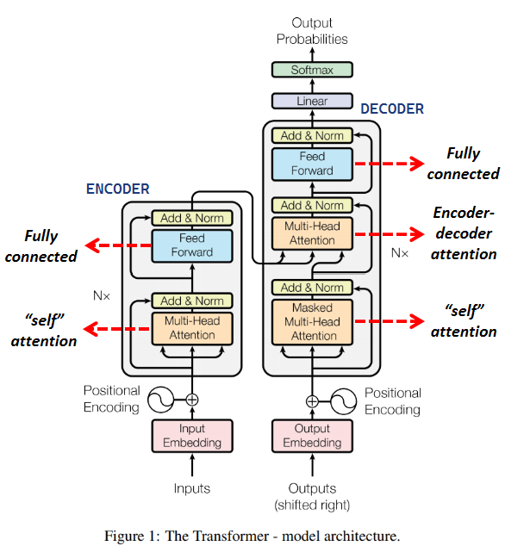
The rise of transformer
Attention Is All You Need (Google, 2017)
Transformer architecture
Masked self-attention in decoder
Contextualized Input
am
<Embedding vector of “it”>
(0.3 x I) +
(0.7 x am) +
(0 x groot) +
self-attention
Masking
it
<Contextualized vector of “it”>

Slide 9
3. GPT-1
(OpenAI, 2018)

Slide 10
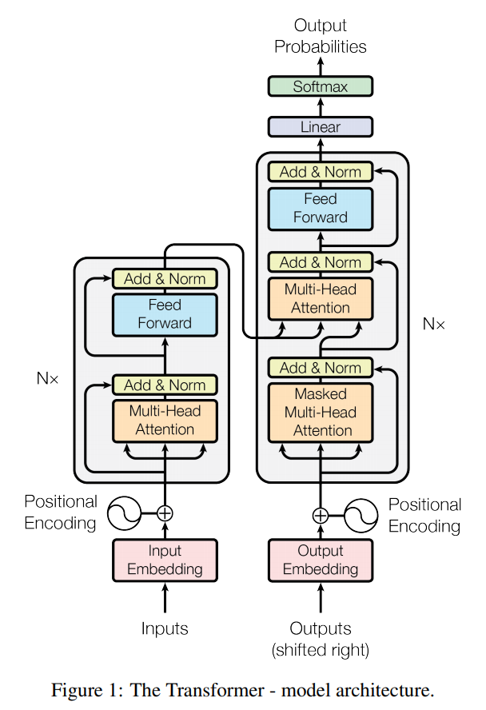
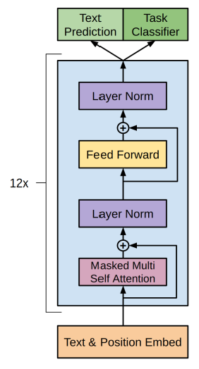
Generative Pre-trained Transformer (GPT)
Improving Language Understanding by
Generative Pre-Training (OpenAI, 2018)
Linear Layer for Pre-training
Linear Layer for Fine-tuning

Slide 11
Generative pre-training
Next token prediction
The way GPT understands human language
live
in
Busan
<eos>
Layers in GPT
I
live
in
Busan
I
live
in
Busan

Slide 12
Fine-tuning for downstream task

Slide 13
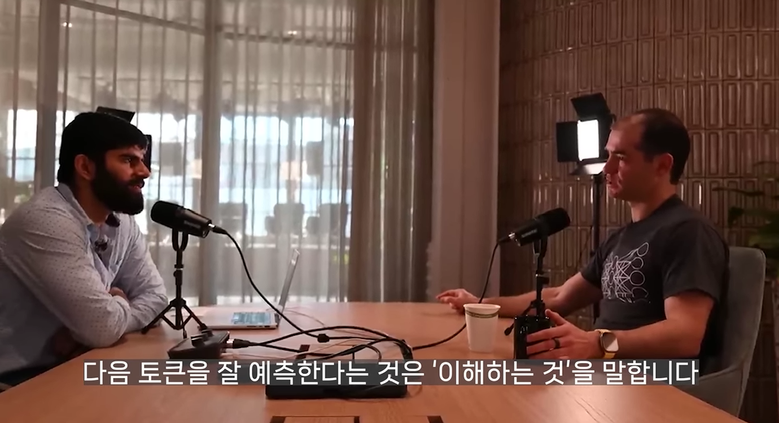
Interview
Ilya Sutskever (OpenAI Chief Scientist until 2024)
One of Geoffrey Hinton's prominent students
AlexNet, Seq2Seq, GPT, DALL-E, ...
“Large language models
transcend statistics,
showing deep language understanding.”

Slide 14
4. BERT
(Google, 2018)

Slide 15
Masked token prediction

Slide 16
Next sentence prediction

Slide 17
Embeddings of BERT

Slide 18
GeLU function

Slide 19
WordPiece tokenizer

Slide 20
Experiments

Slide 21
5. Next steps of GPT and BERT

Slide 22
Developments

Slide 23
Direction

Slide 24
References

