Slide 1
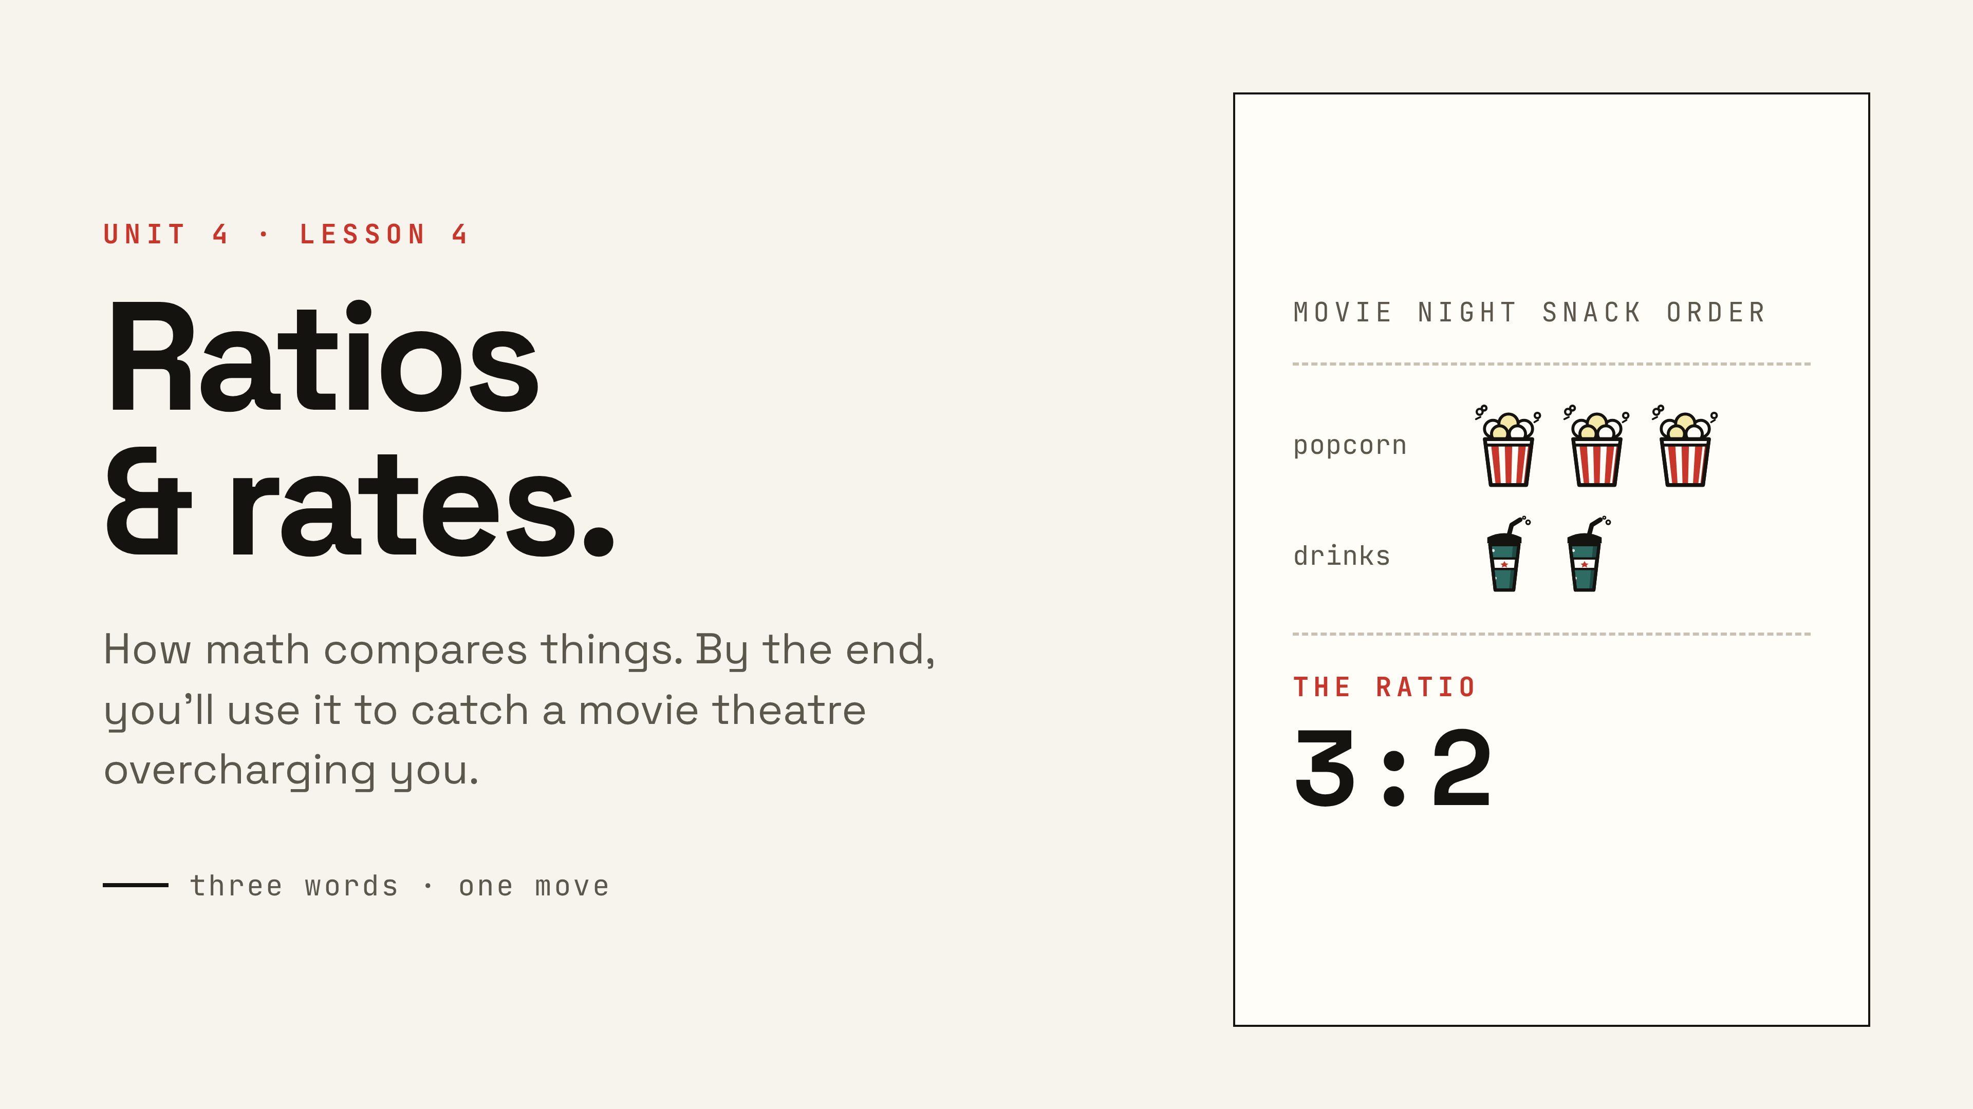
Notes:
Today is about how math compares things. The payoff at the end: they'll be able to prove which movie theatre is the better deal.

Slide 2
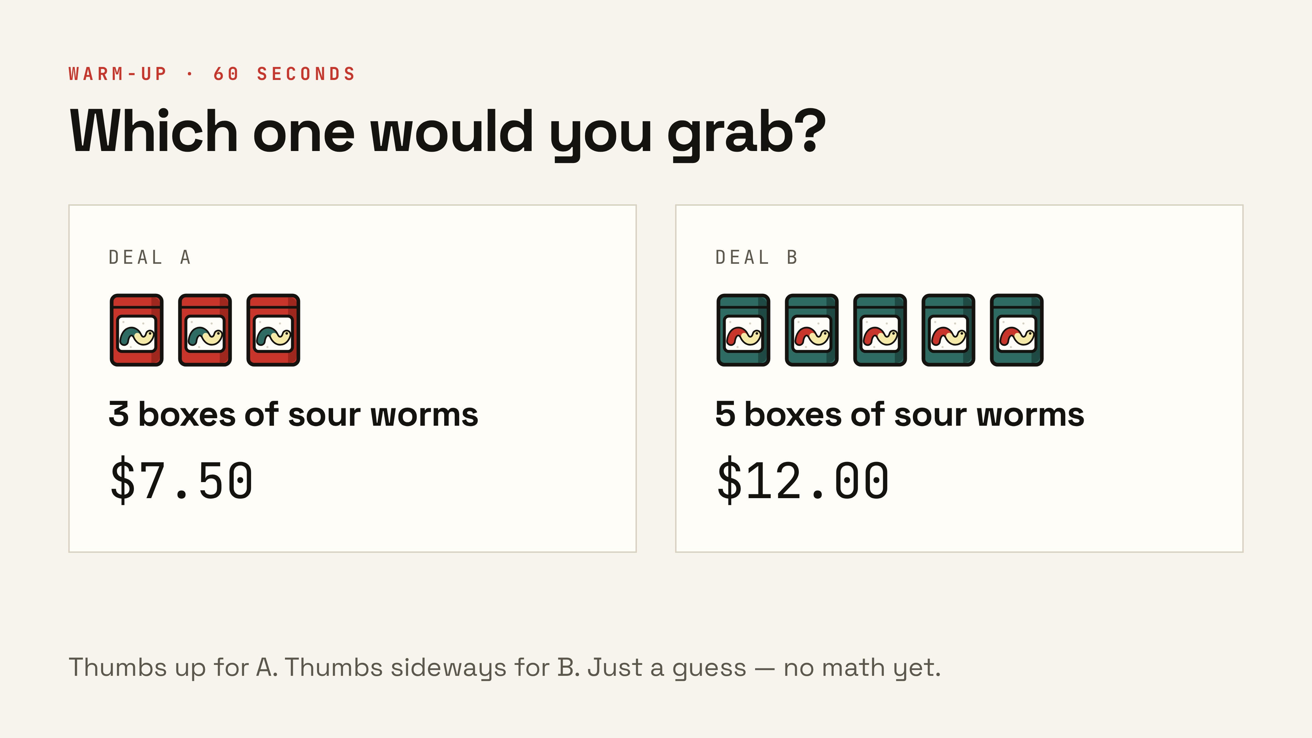
Notes:
No math yet. Thumbs up for A, thumbs sideways for B. Count votes on the board — we settle it with math later in the lesson. (Optional slide — skip if the period runs short.)

Slide 3
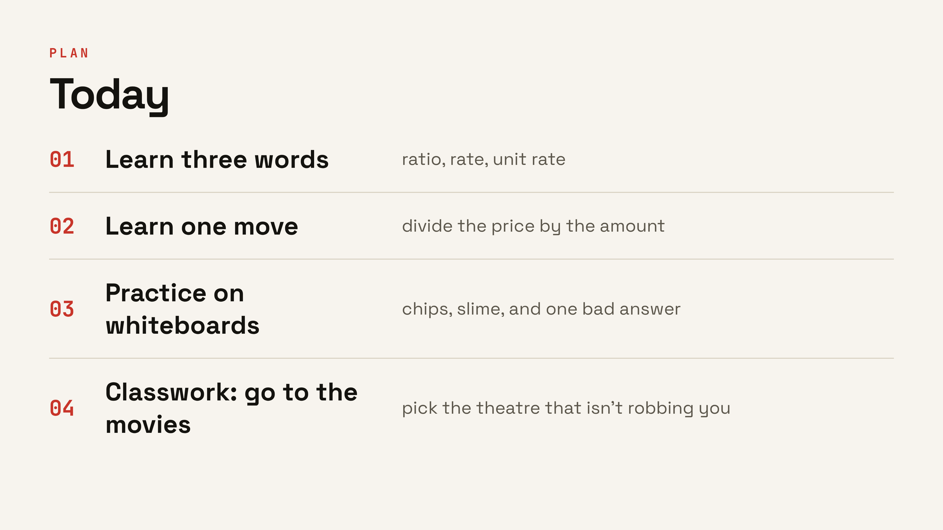
Notes:
Four moves. The classwork at the end is the payoff — everything before it is practice for that.

Slide 4
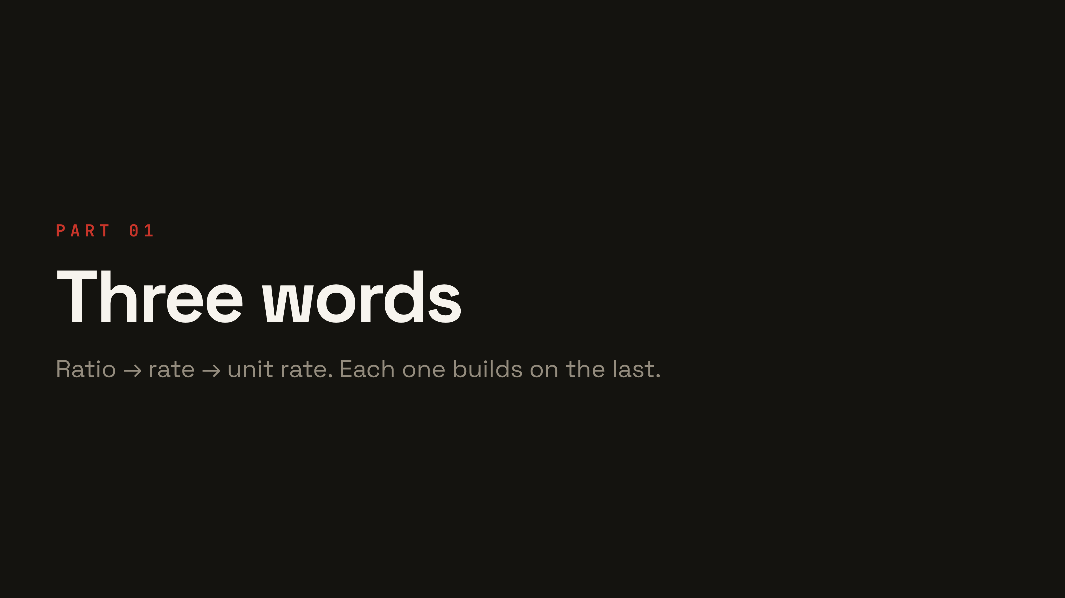
Notes:
Section break. Three vocabulary words, each building on the last. Notebooks open — every yellow WRITE THIS DOWN card gets copied.

Slide 5
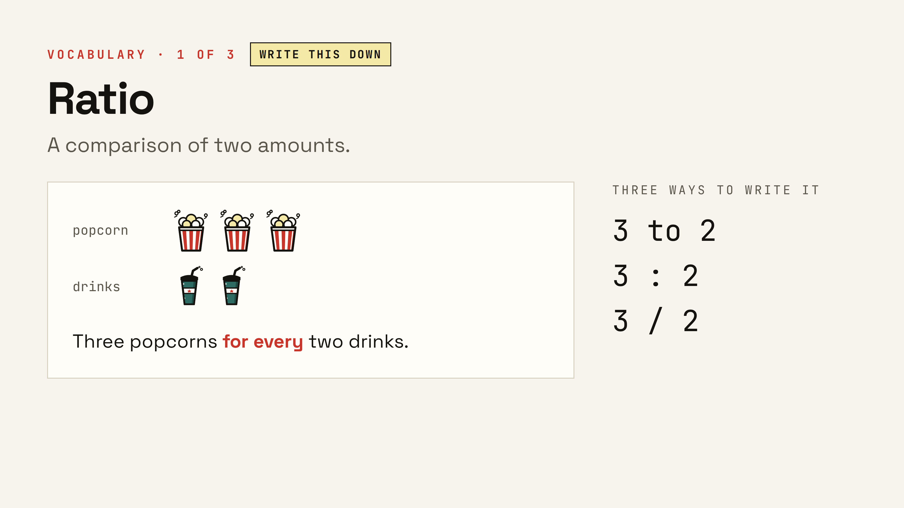
Notes:
First word. Read the tape diagram out loud: three popcorns for every two drinks. Show all three ways to write it — they should copy the yellow card.

Slide 6
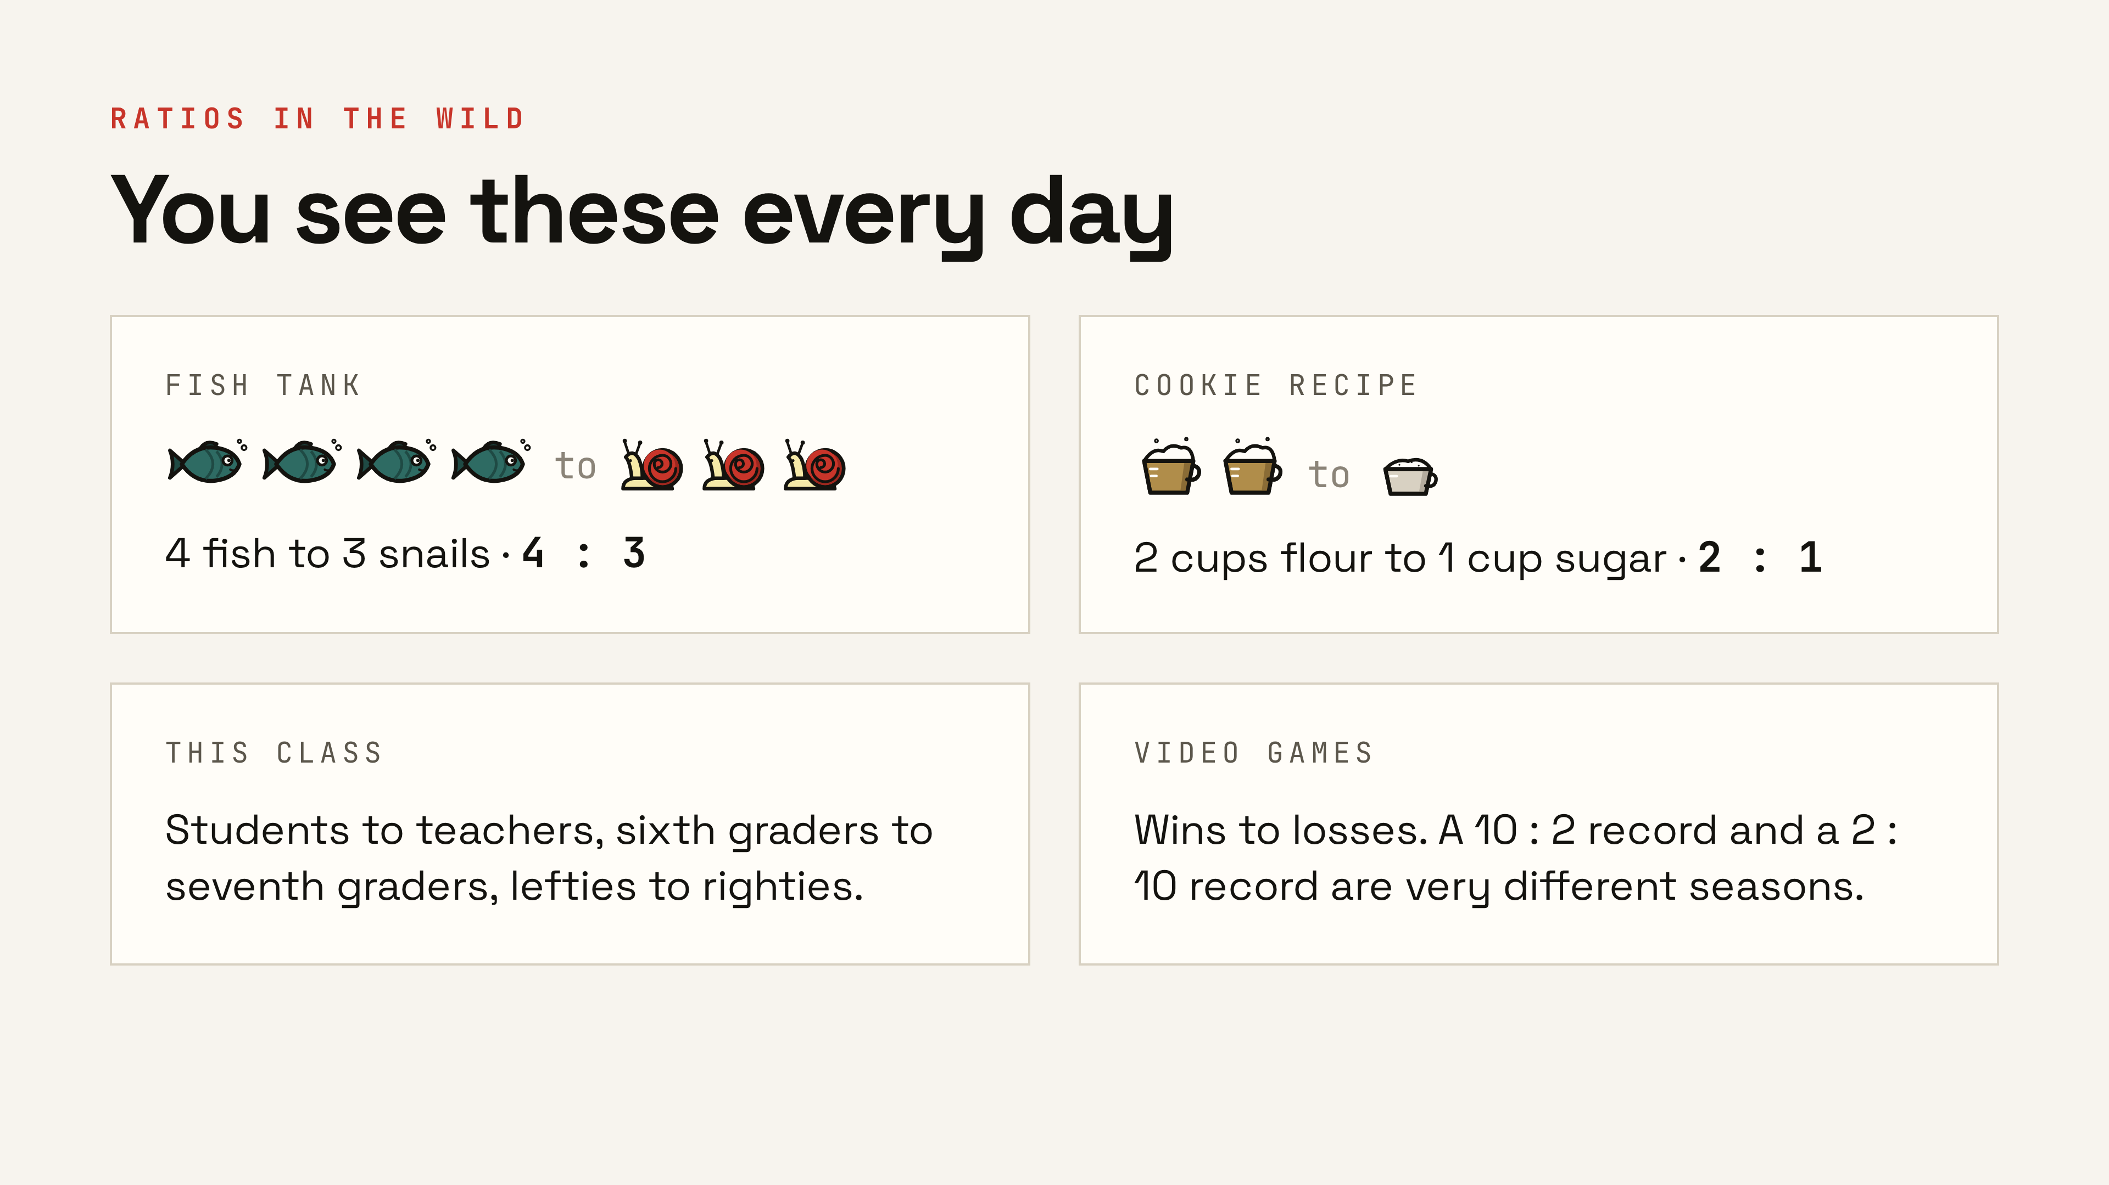
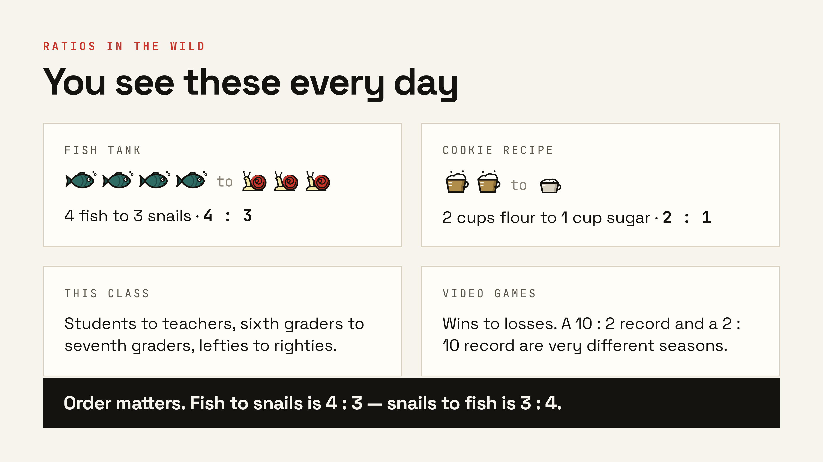
Notes:
Ratios describe almost anything. Read each one together, then the order warning at the bottom — fish to snails is 4 to 3, snails to fish is 3 to 4. Order matters. ▸ Click: the order-matters banner.

Slide 7
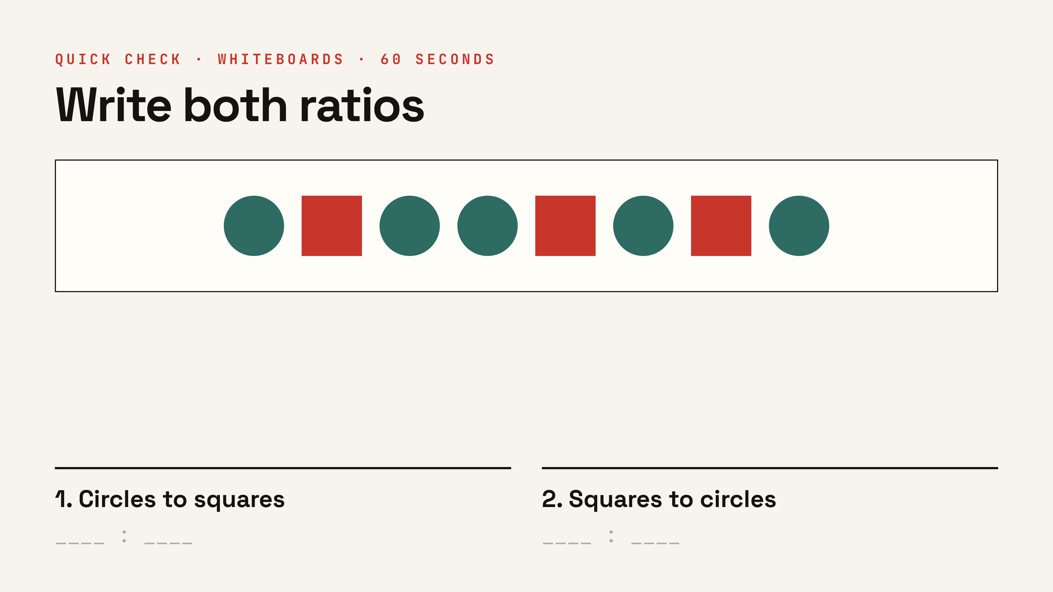
Notes:
Whiteboards, 60 seconds. Answers: circles to squares 5 : 3, squares to circles 3 : 5. Anyone who writes 3 : 5 for the first one just proved why order matters. (Optional slide — skip if the period runs short.)

Slide 8
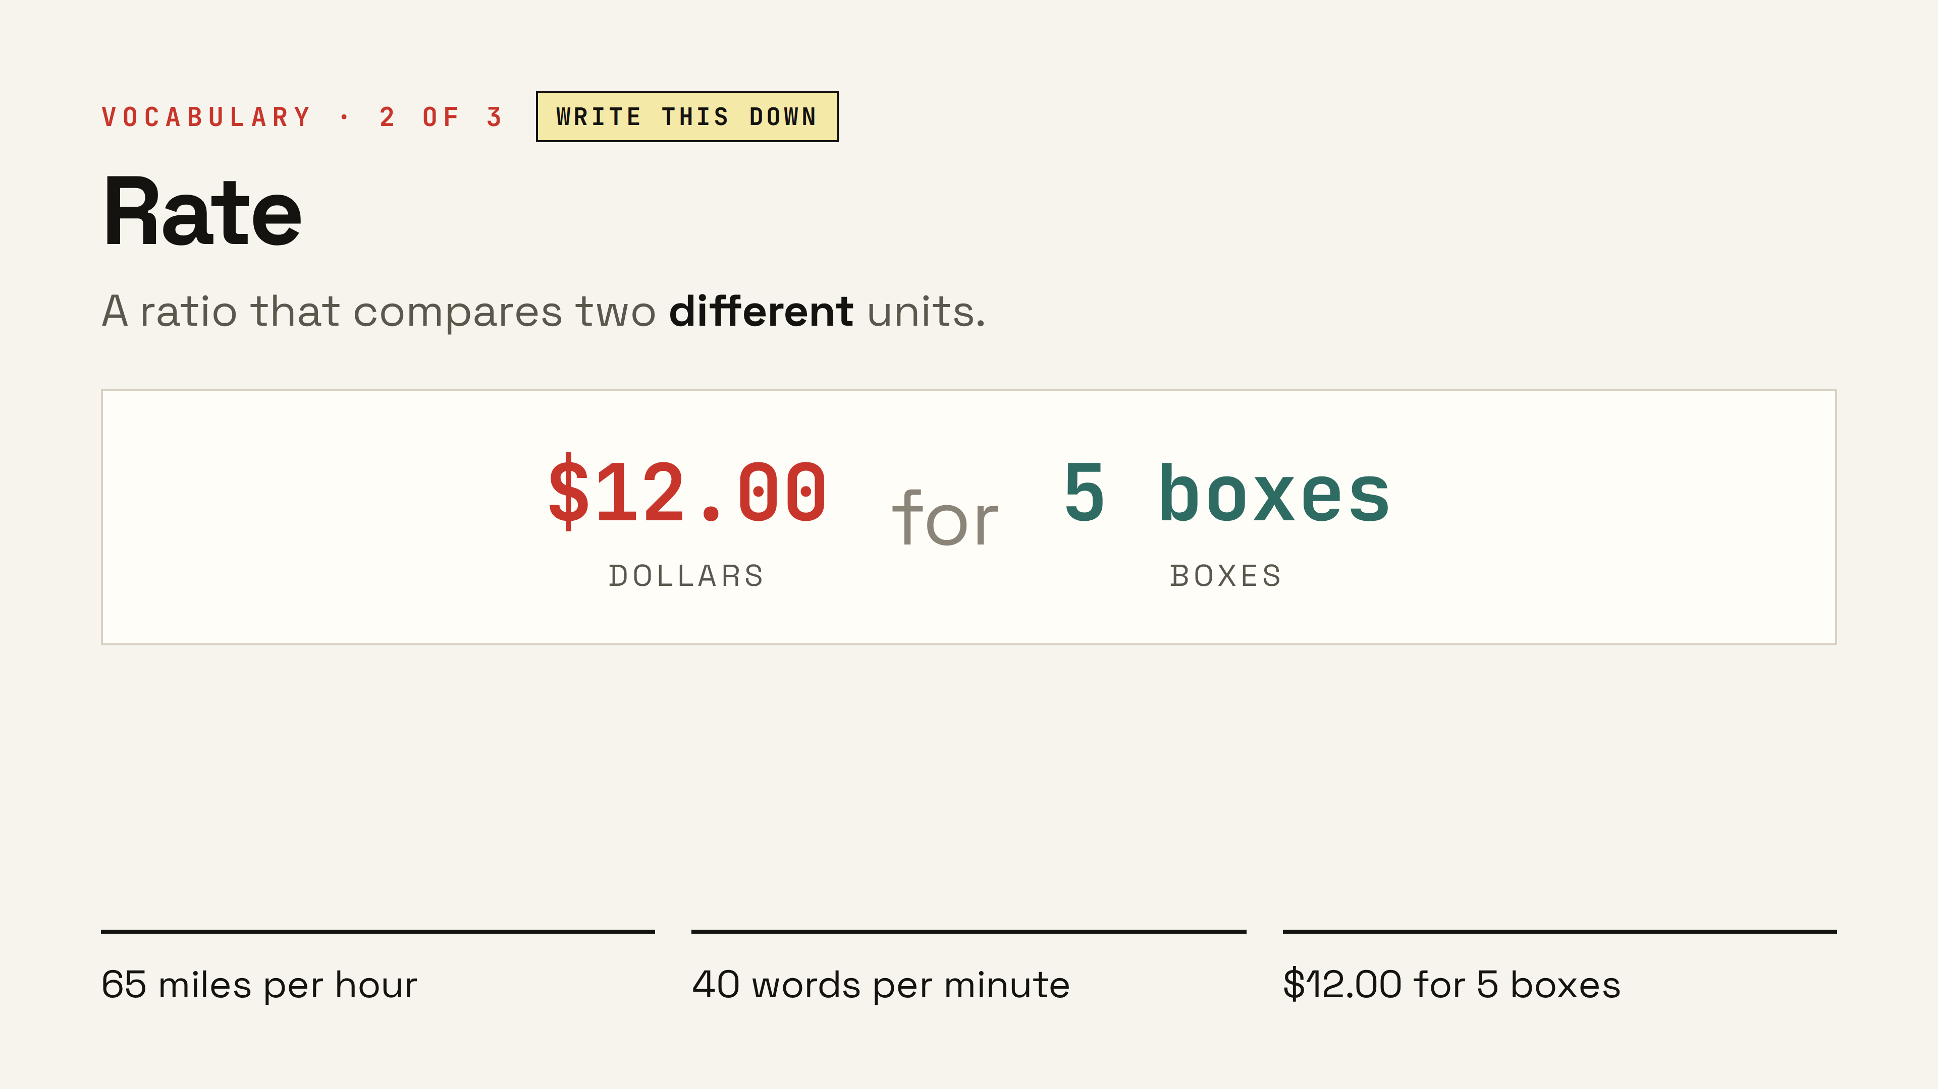
Notes:
Second word. A rate is still a ratio — but now the two things are measured in different units. Dollars and boxes. Miles and hours. Copy the card.

Slide 9
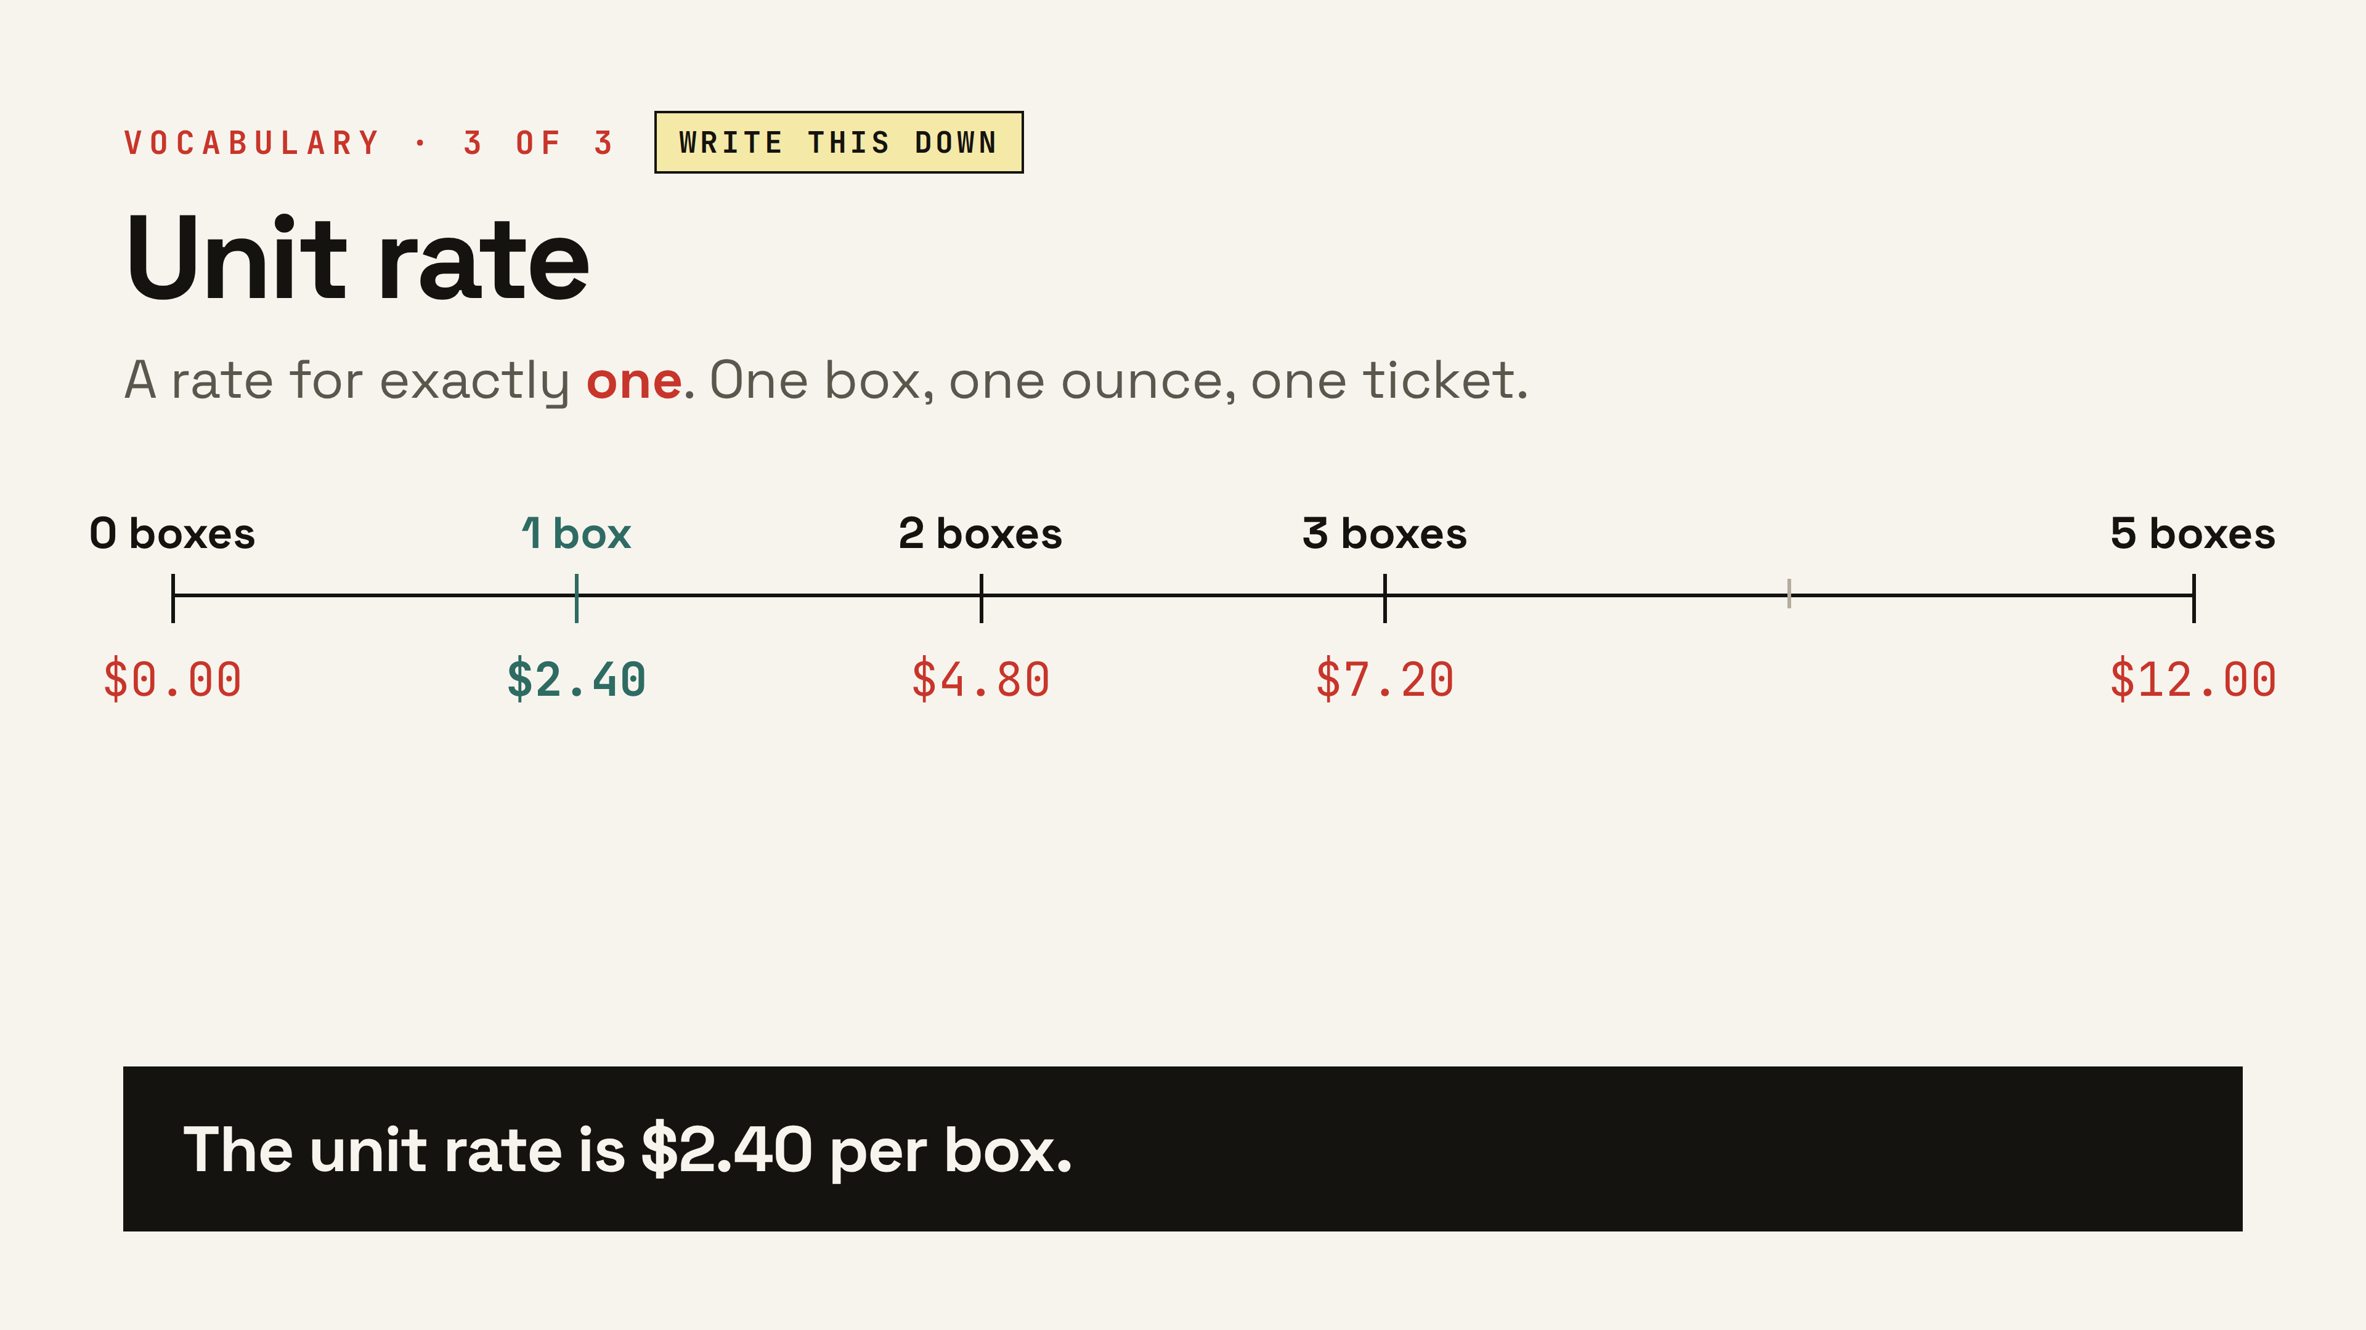
Notes:
Third word — the star of the lesson. Walk the number line left to right: zero boxes costs nothing, one box costs $2.40, and every step right adds exactly one more unit rate. This is Deal B from the warm-up — and Deal A works out to $2.50 a box. Settle the vote: B wins by a dime a box.

Slide 10
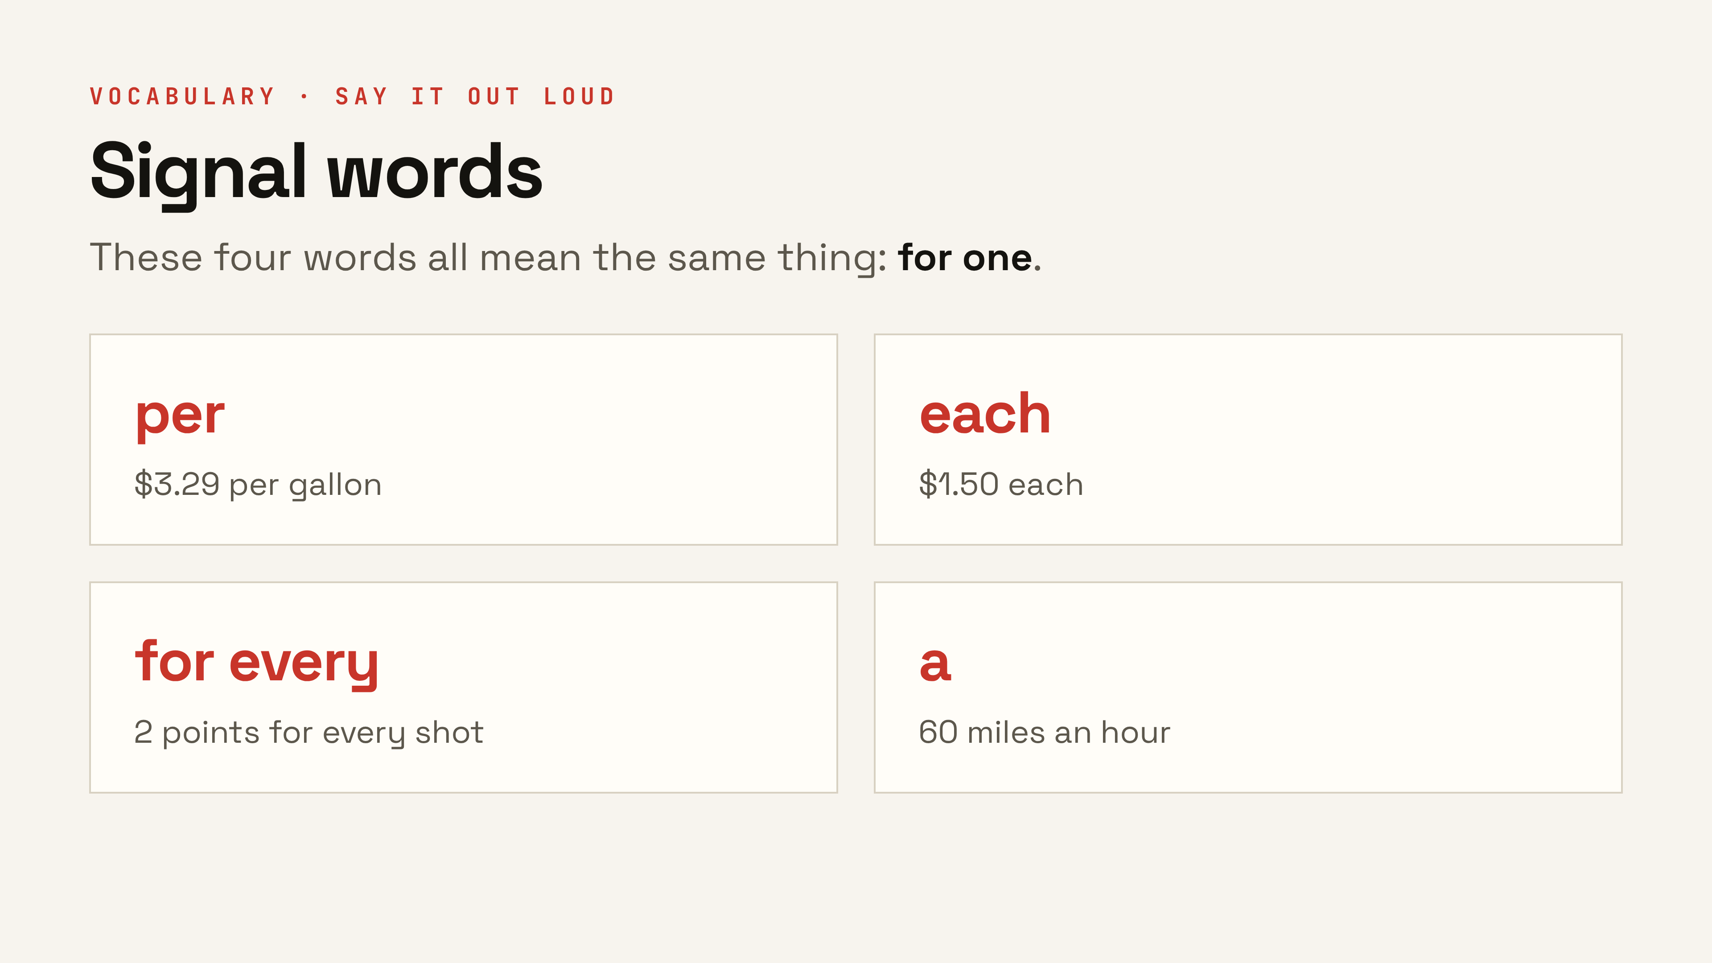
Notes:
Vocabulary you can hear. If a sentence has one of these words, a unit rate is hiding in it. Ask the room for one more example before moving on.

Slide 11
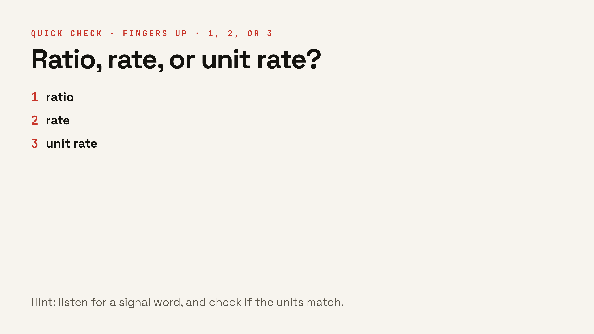
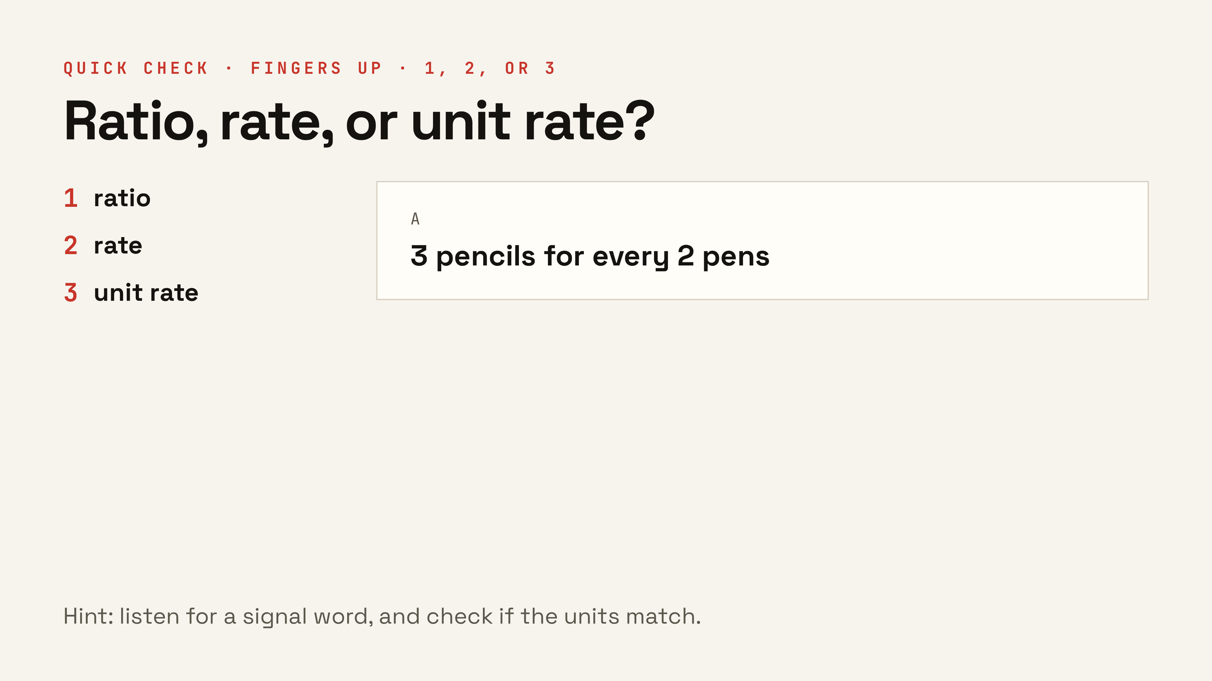
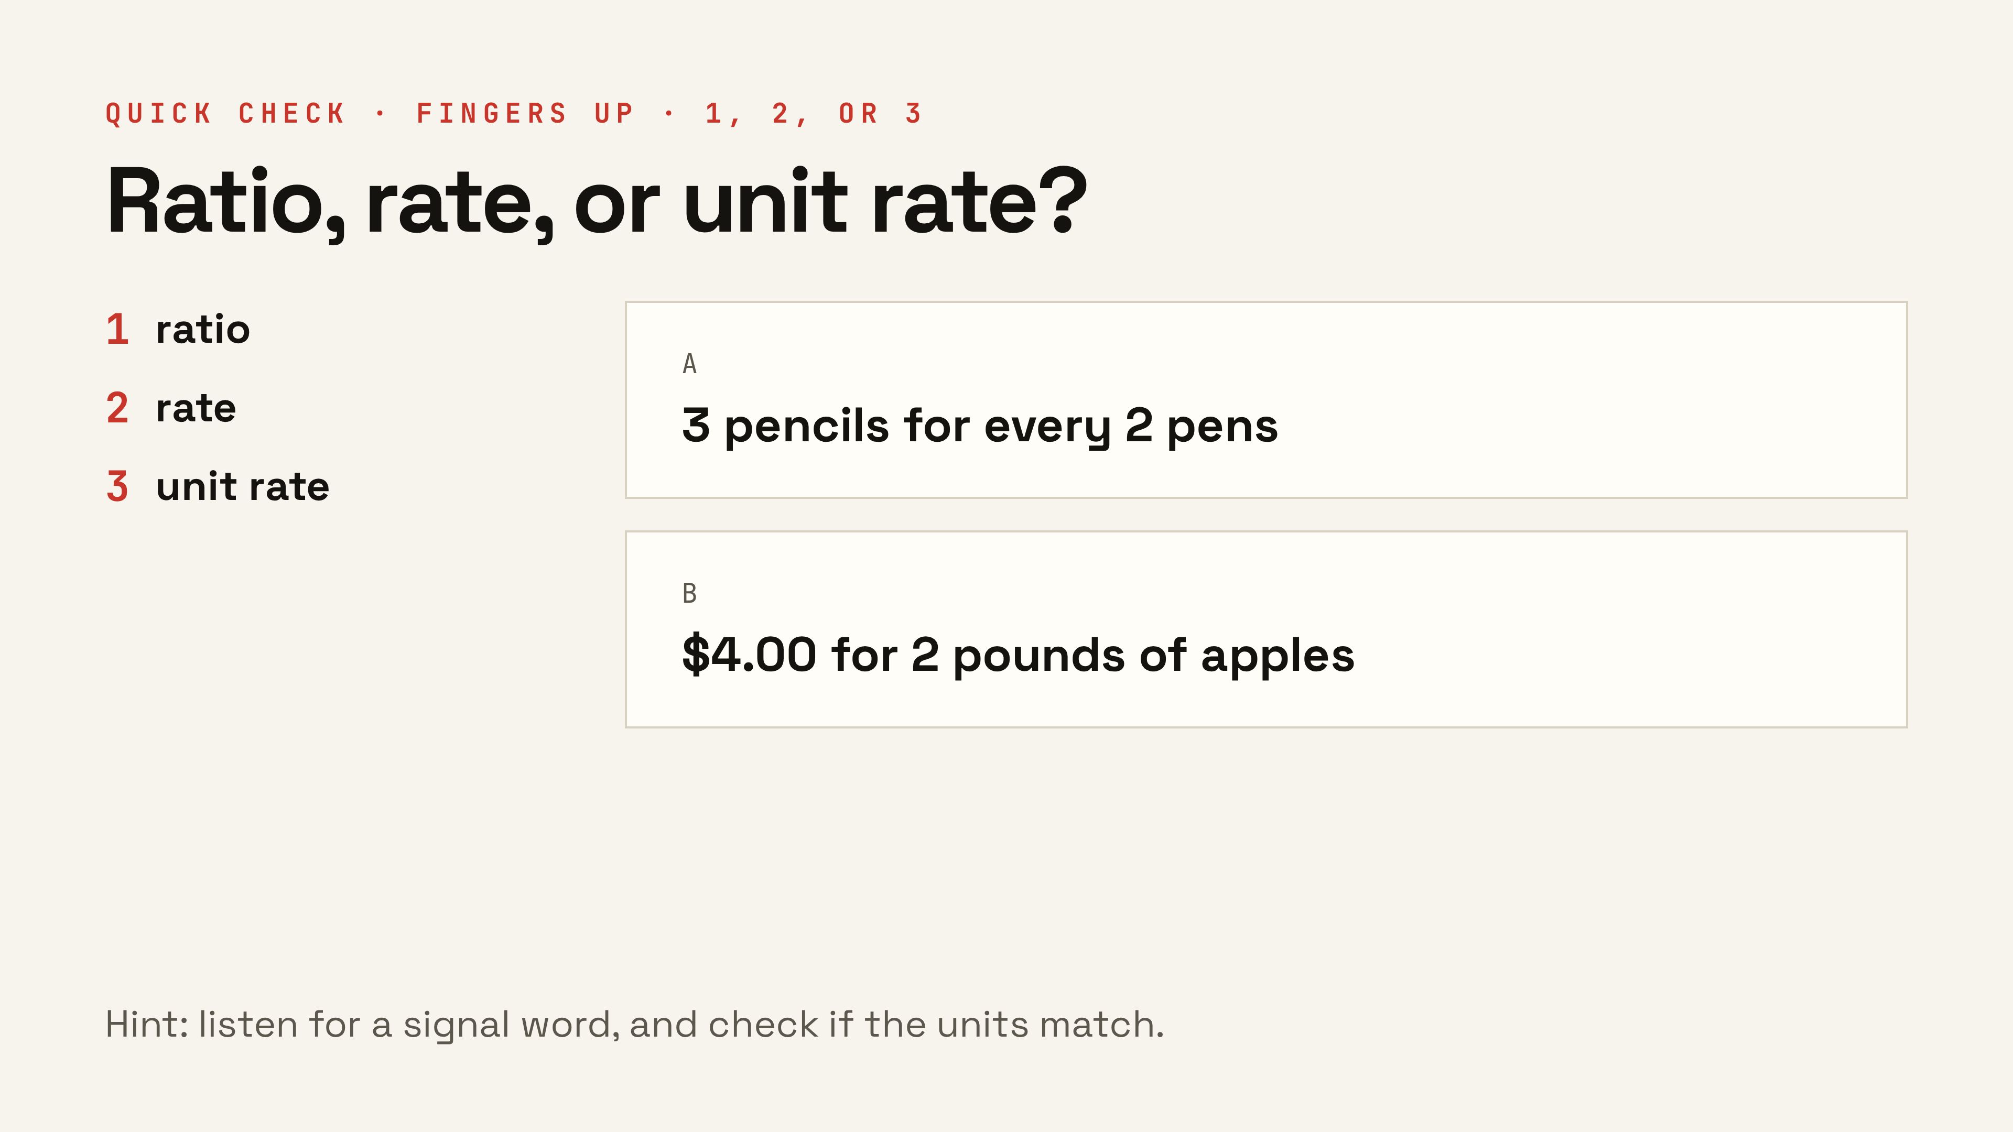
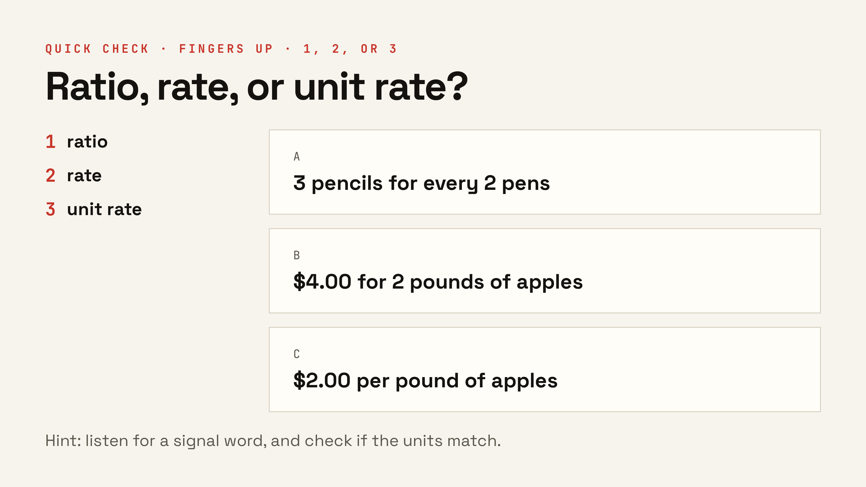
Notes:
Hold up fingers: one for ratio, two for rate, three for unit rate. Answers: A is a ratio (same units, no prices), B is a rate (dollars and pounds), C is a unit rate (per = for one). Do them one at a time. ▸ Clicks: reveal A, then B, then C — one at a time, votes first.

Slide 12
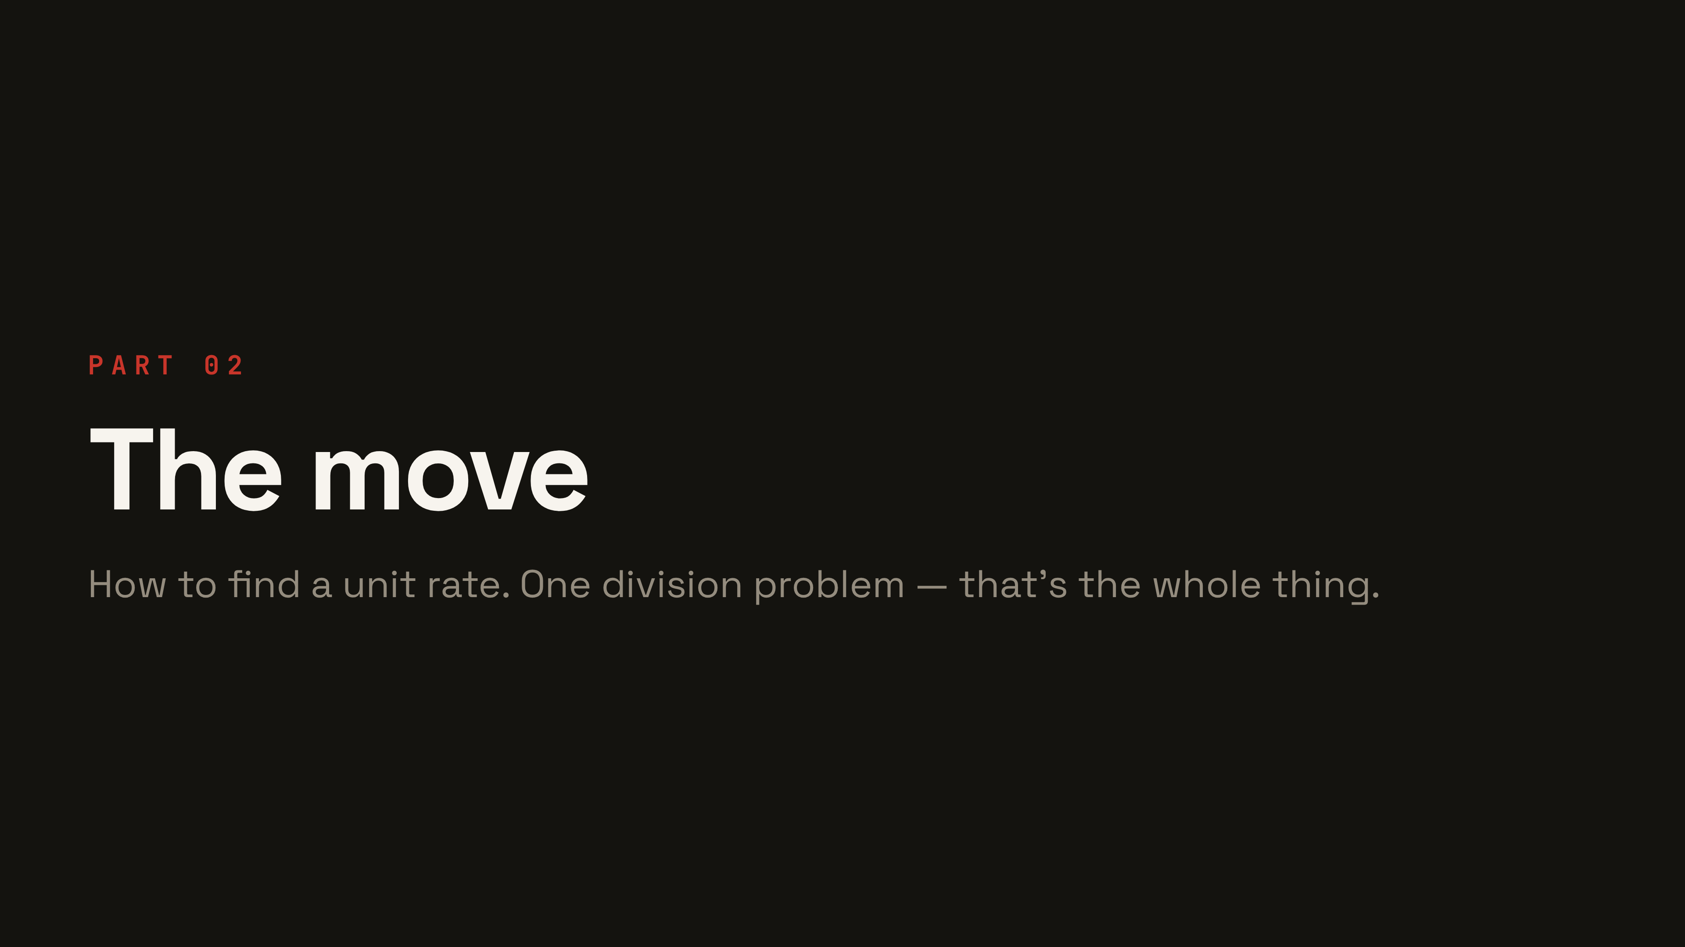
Notes:
Shift from words to procedure.

Slide 13
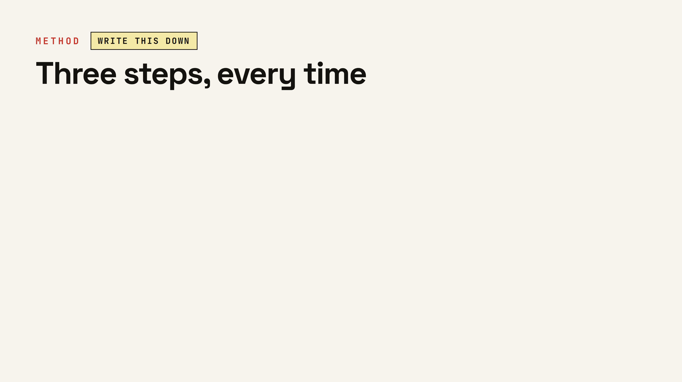
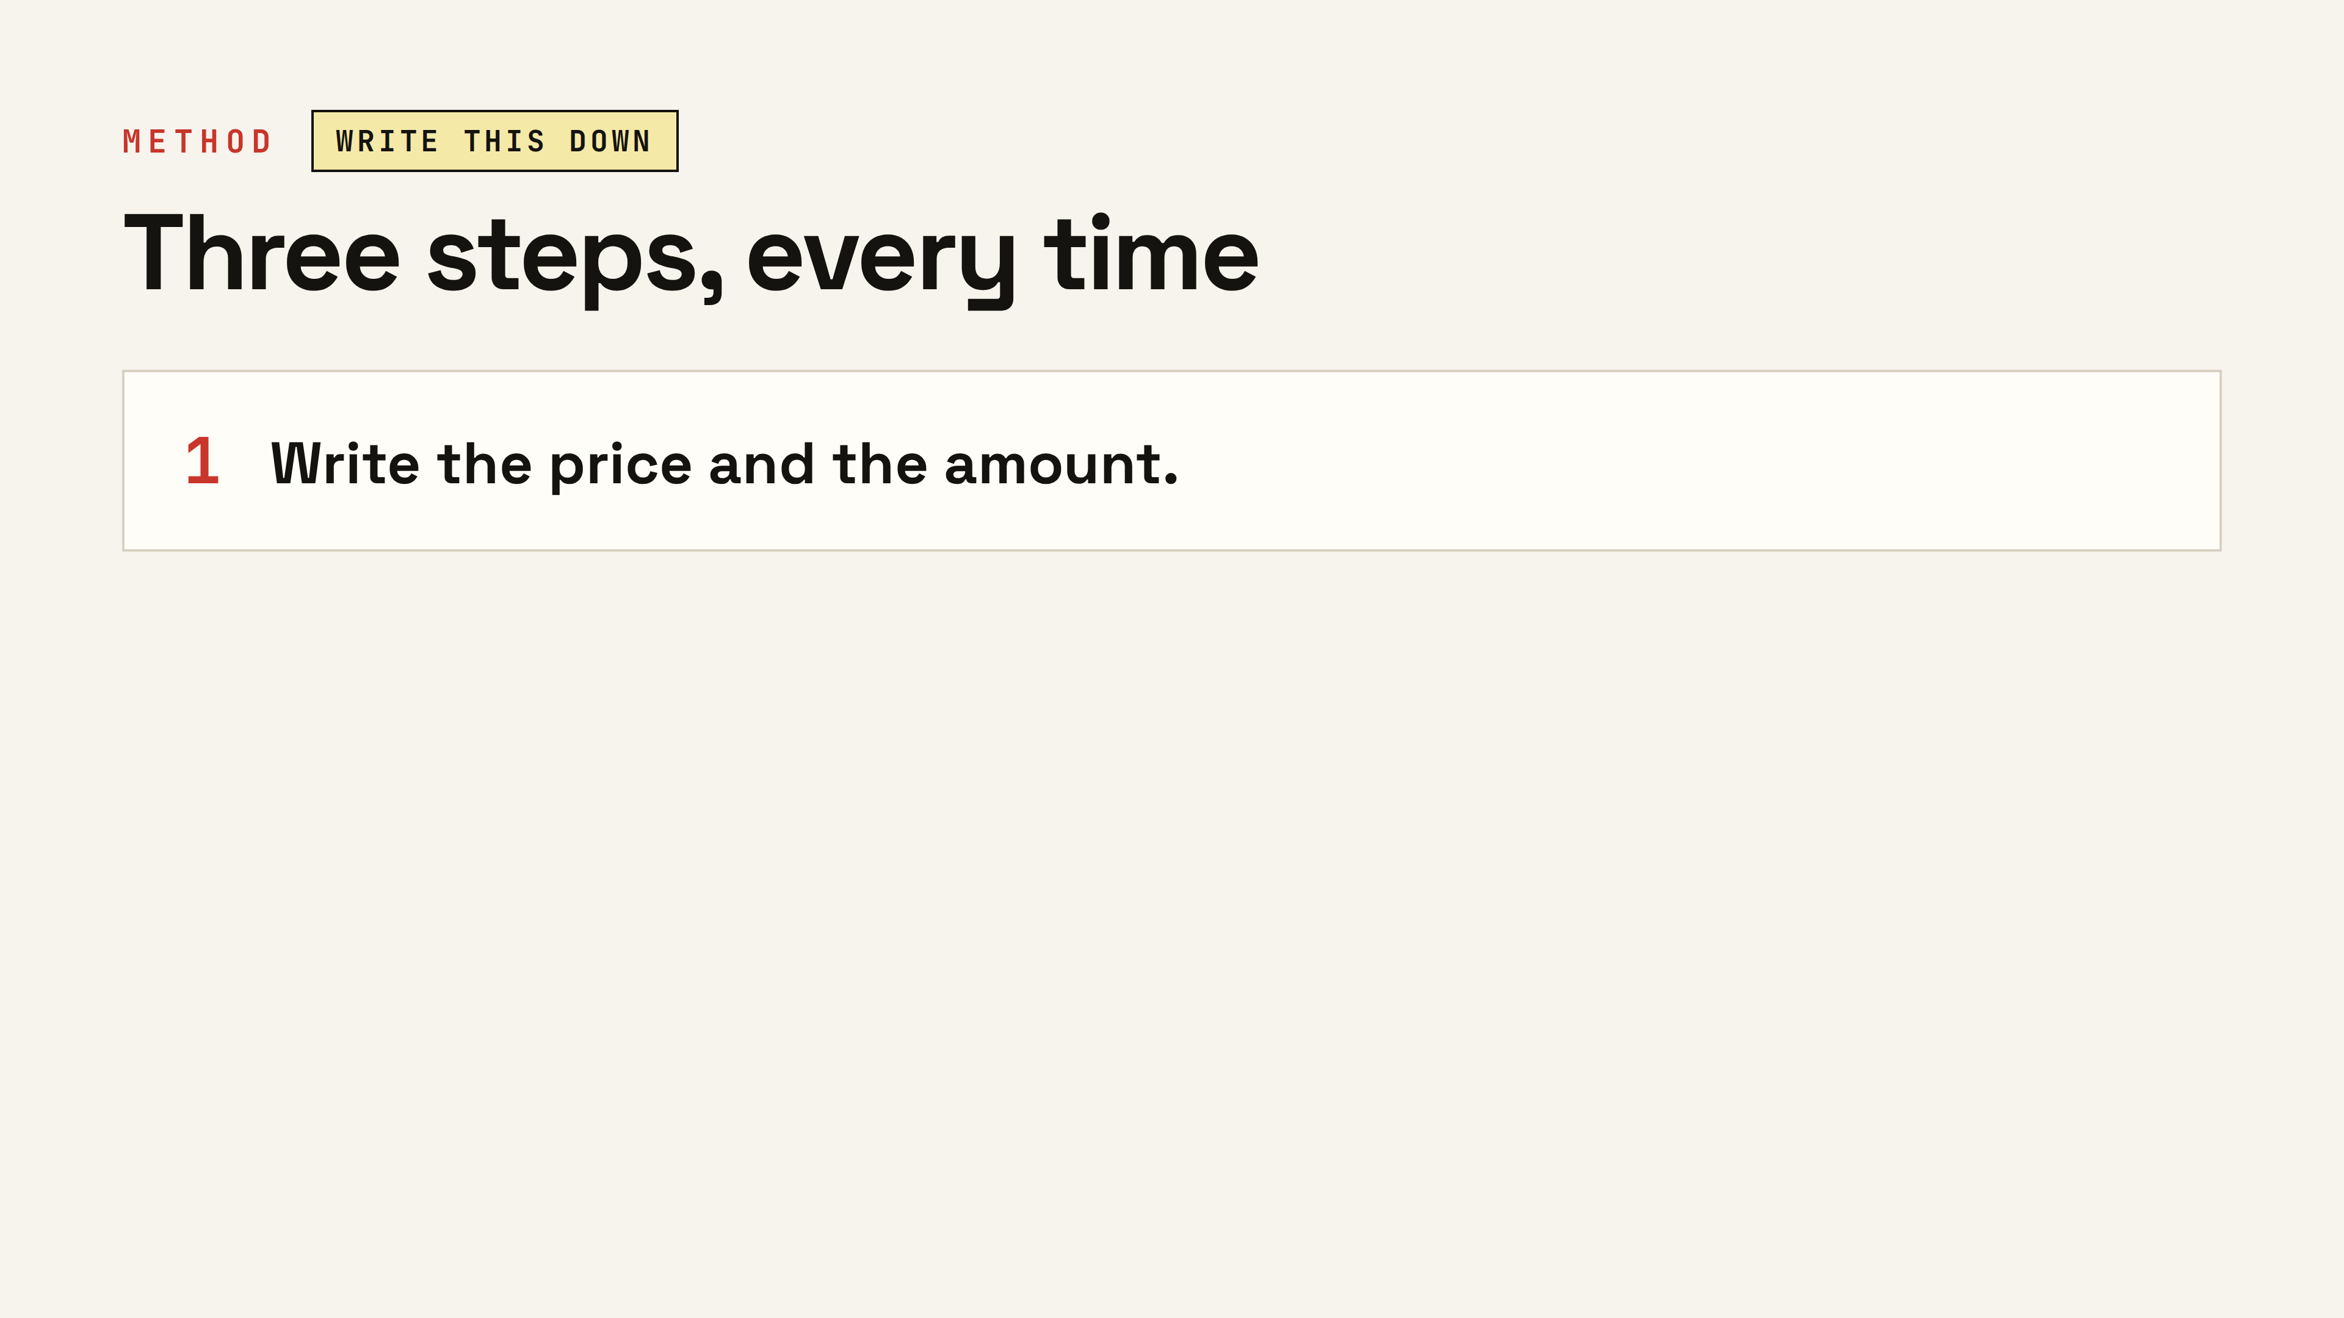
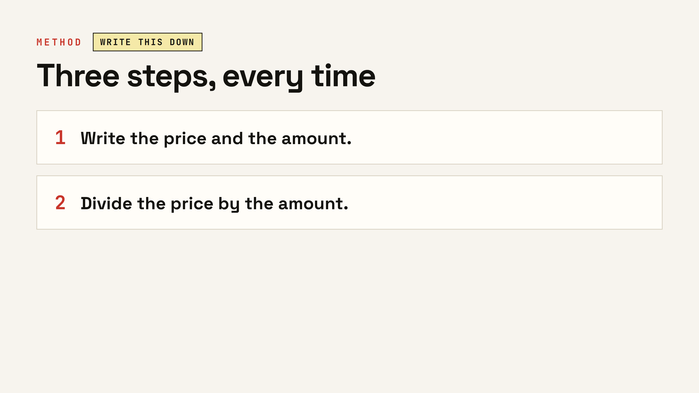
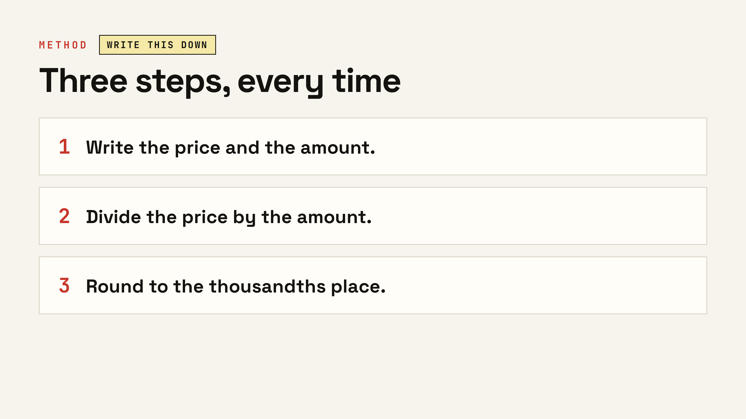
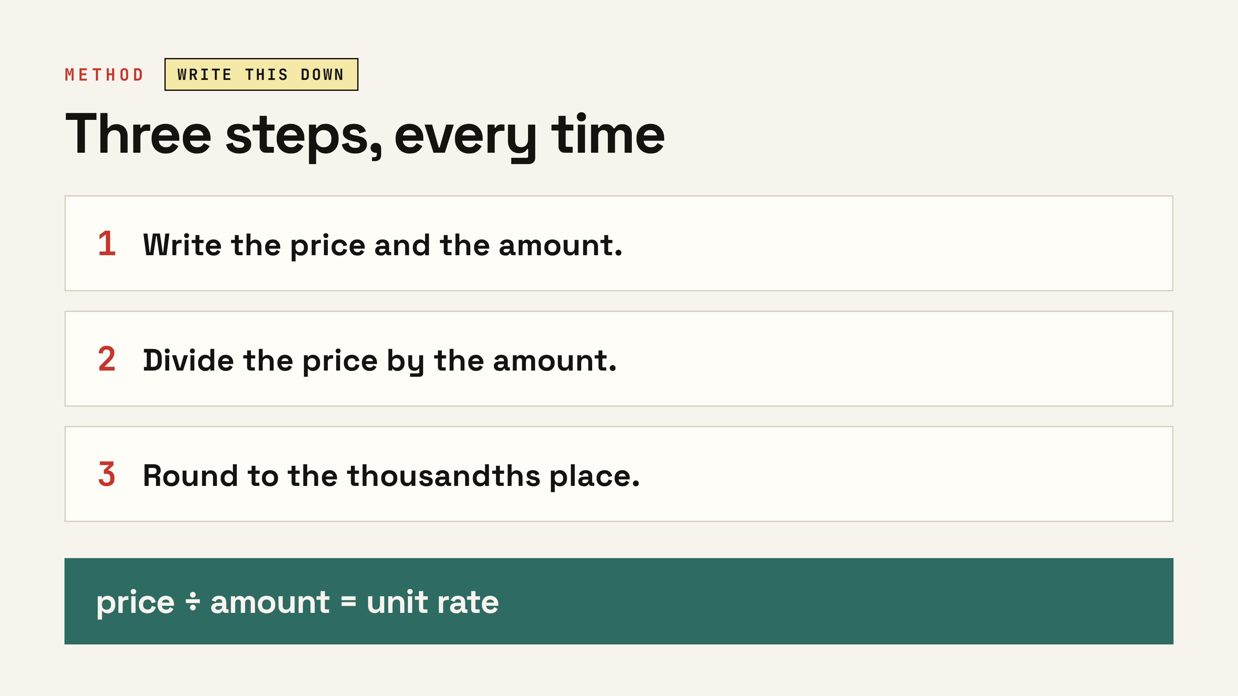
Notes:
The anchor chart for the rest of the unit — have them copy it. Read all three steps, then the rule at the bottom. ▸ Clicks: step 1, step 2, step 3, then the formula banner.

Slide 14
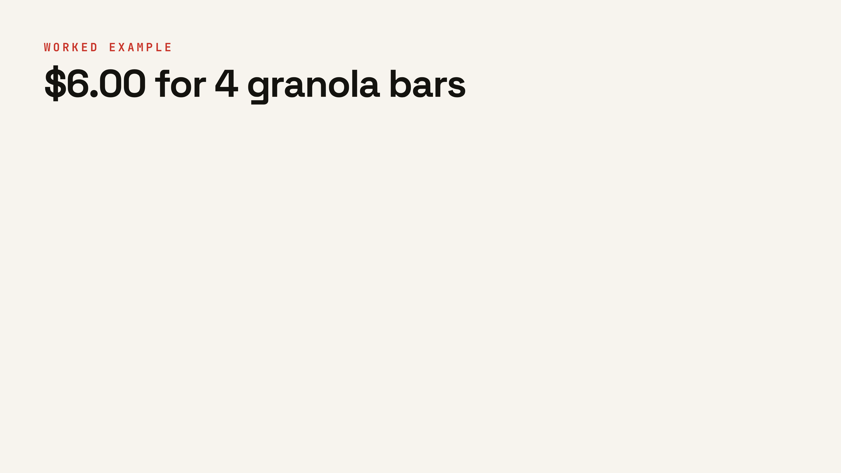
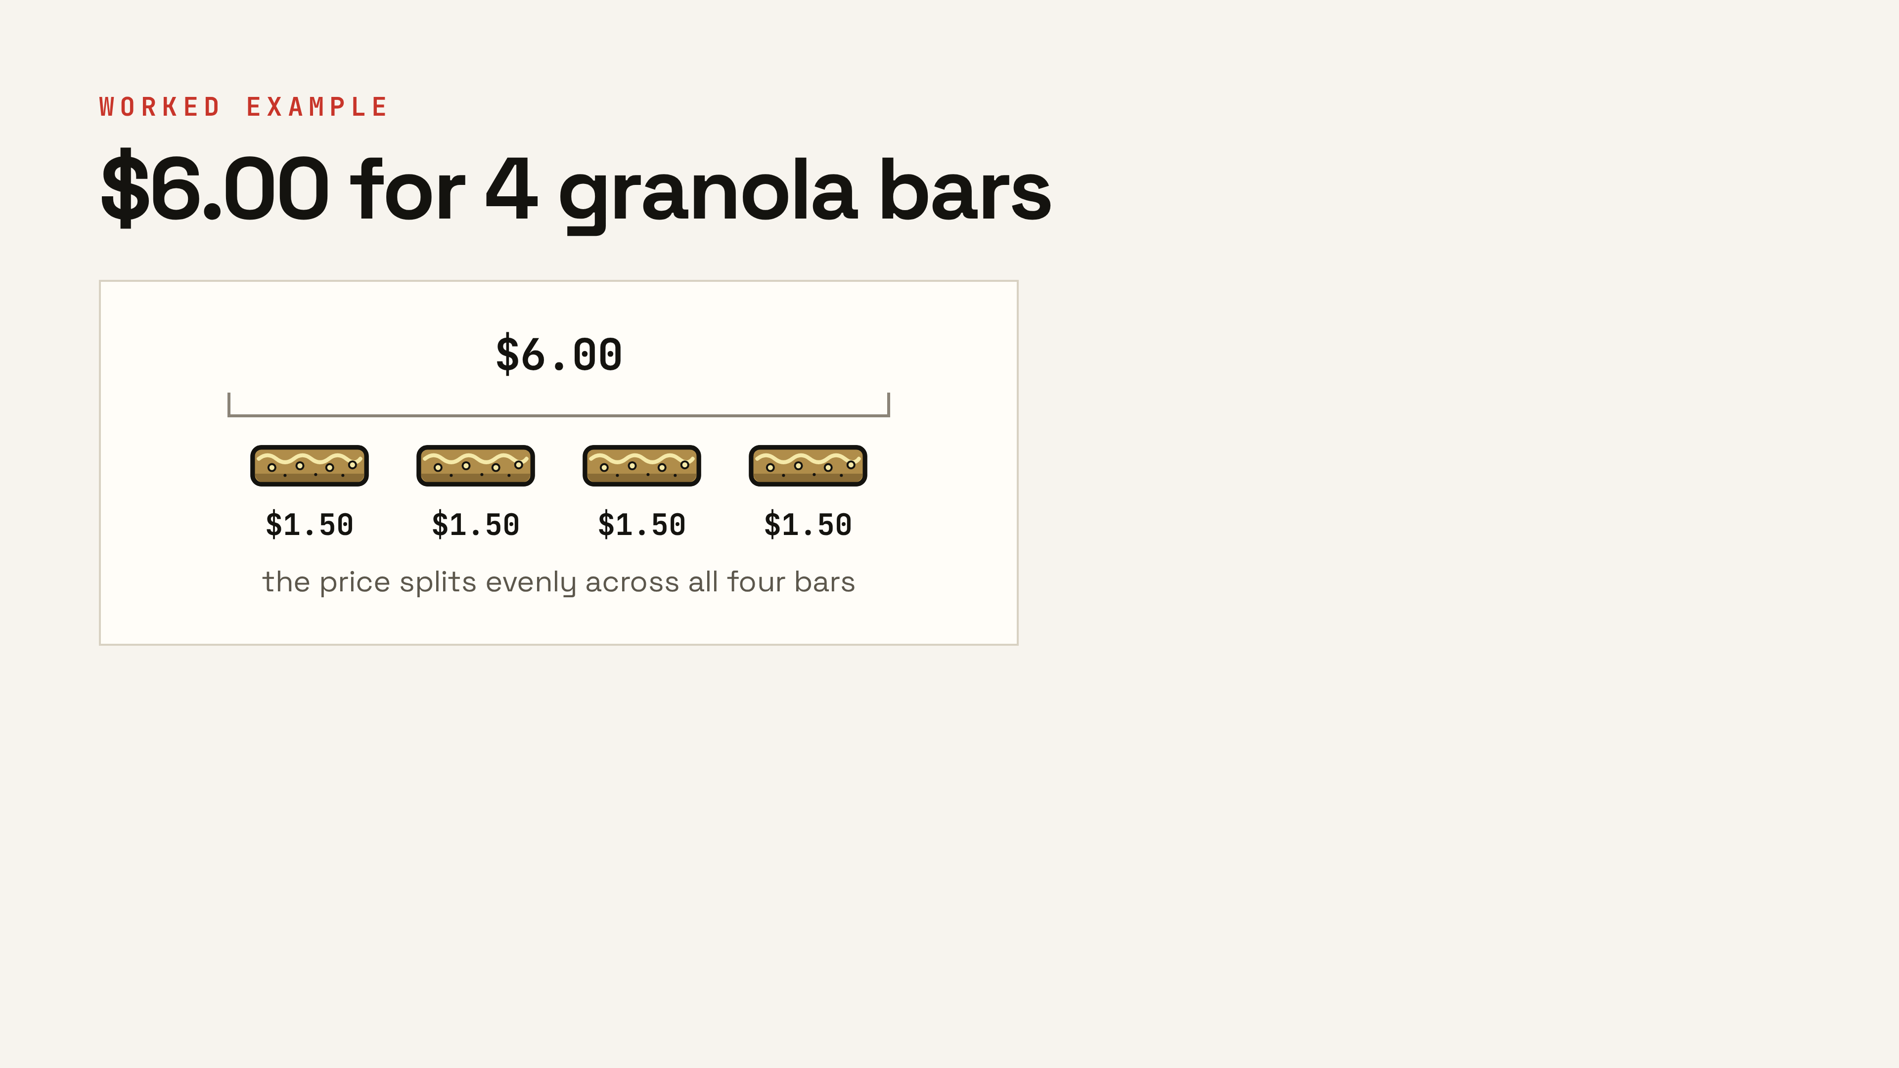
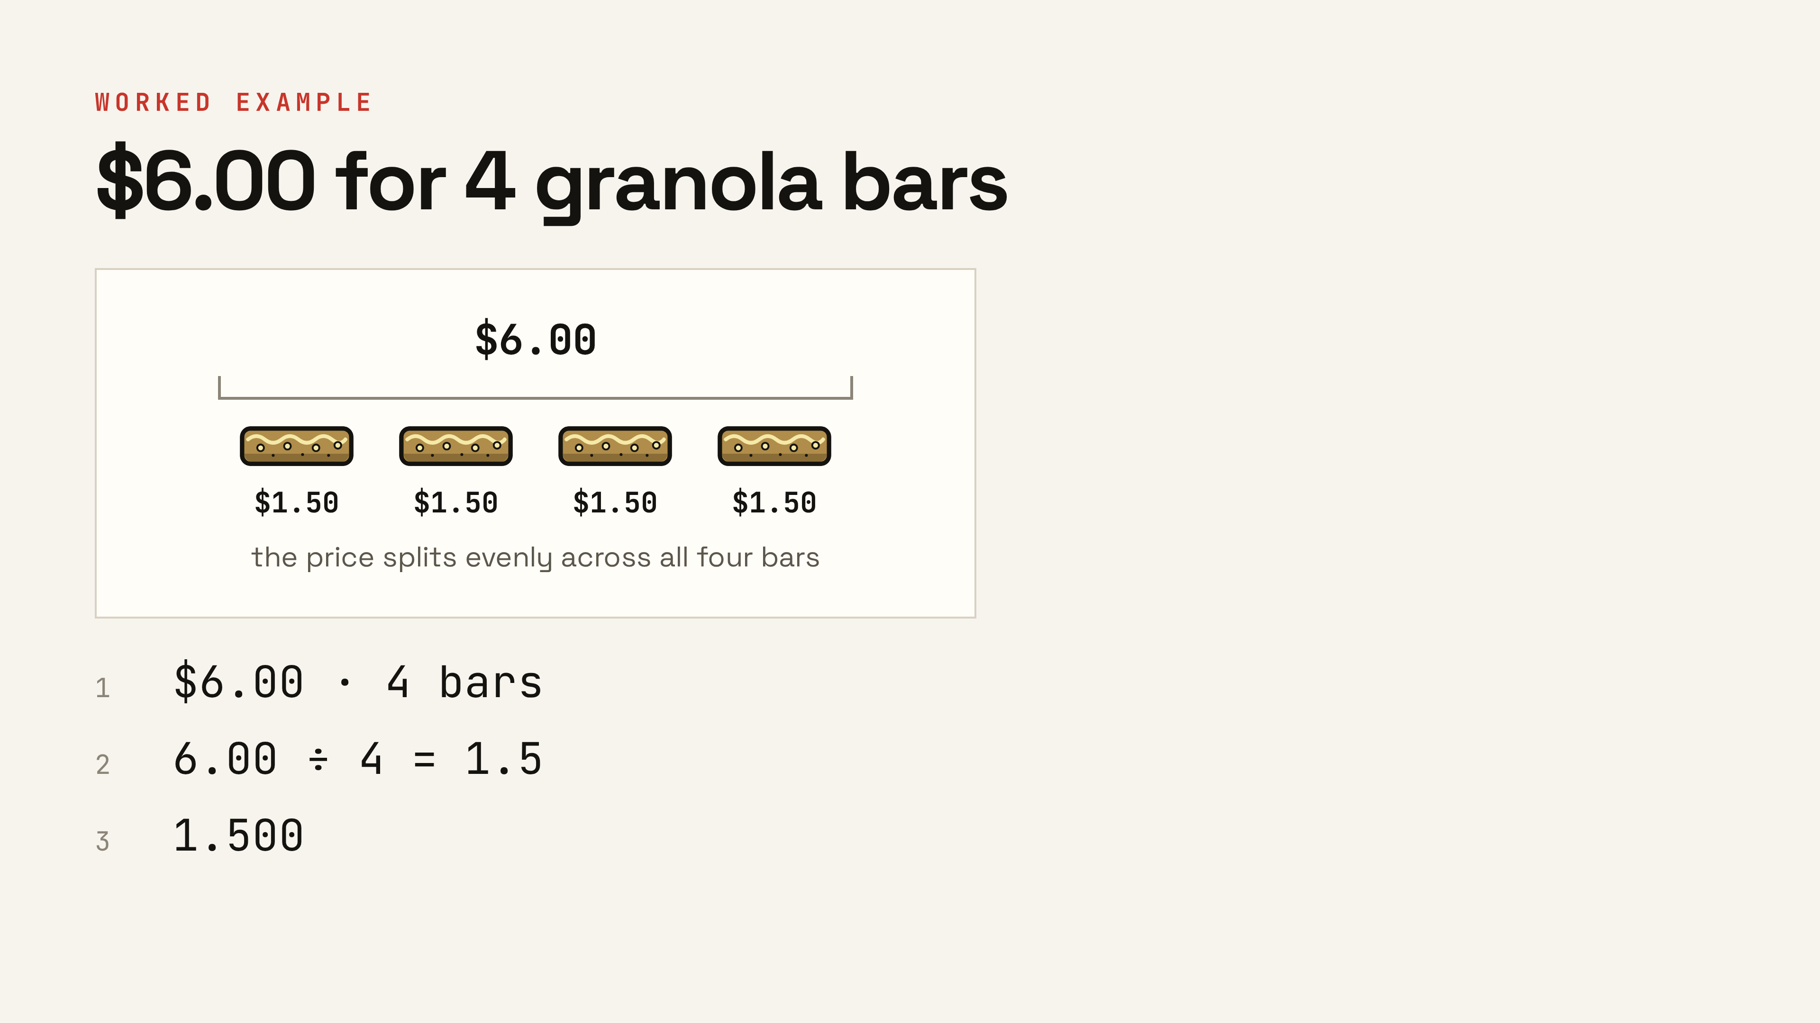
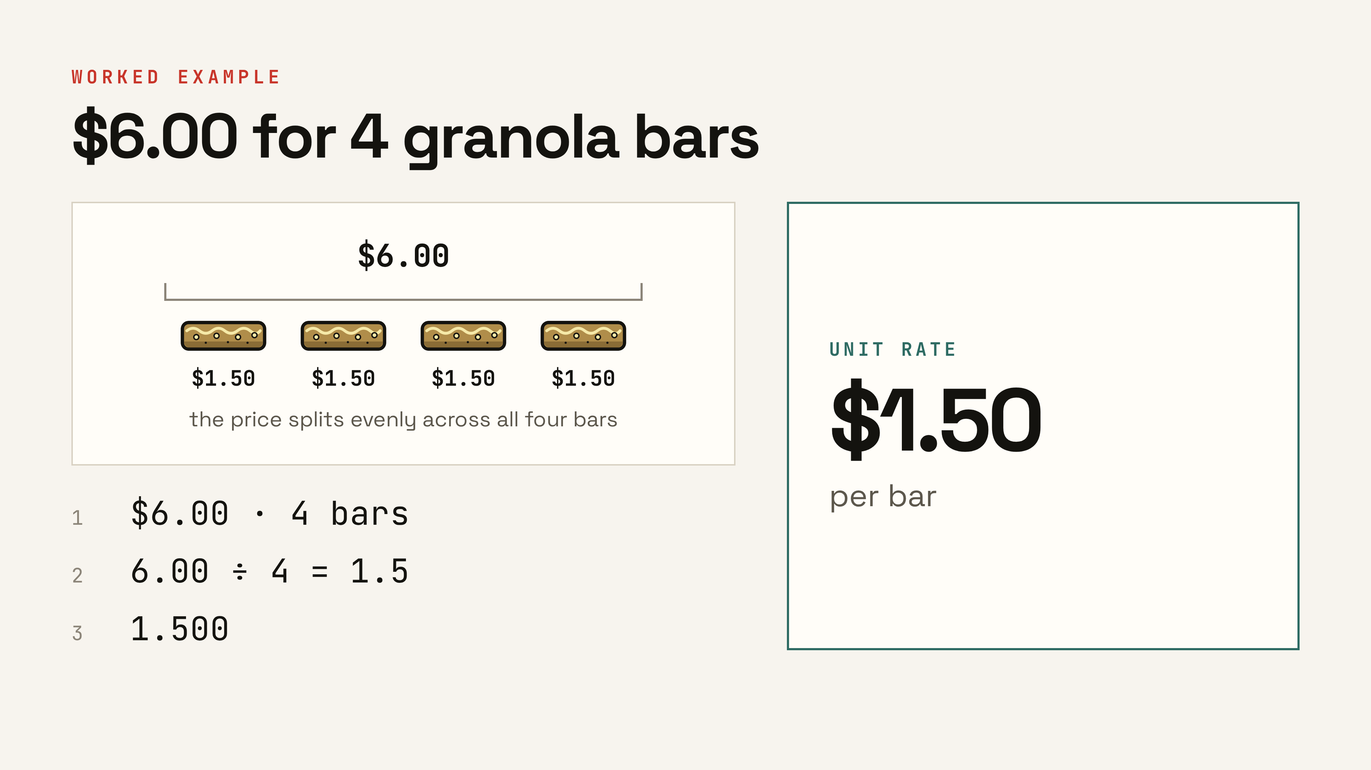
Notes:
Model it slowly with the diagram: six dollars split evenly across four bars — each bar carries $1.50. Say the units at every line: dollars divided by bars gives dollars per bar. ▸ Clicks: 1 the price-splitting picture, 2 the three steps, 3 the unit rate.

Slide 15
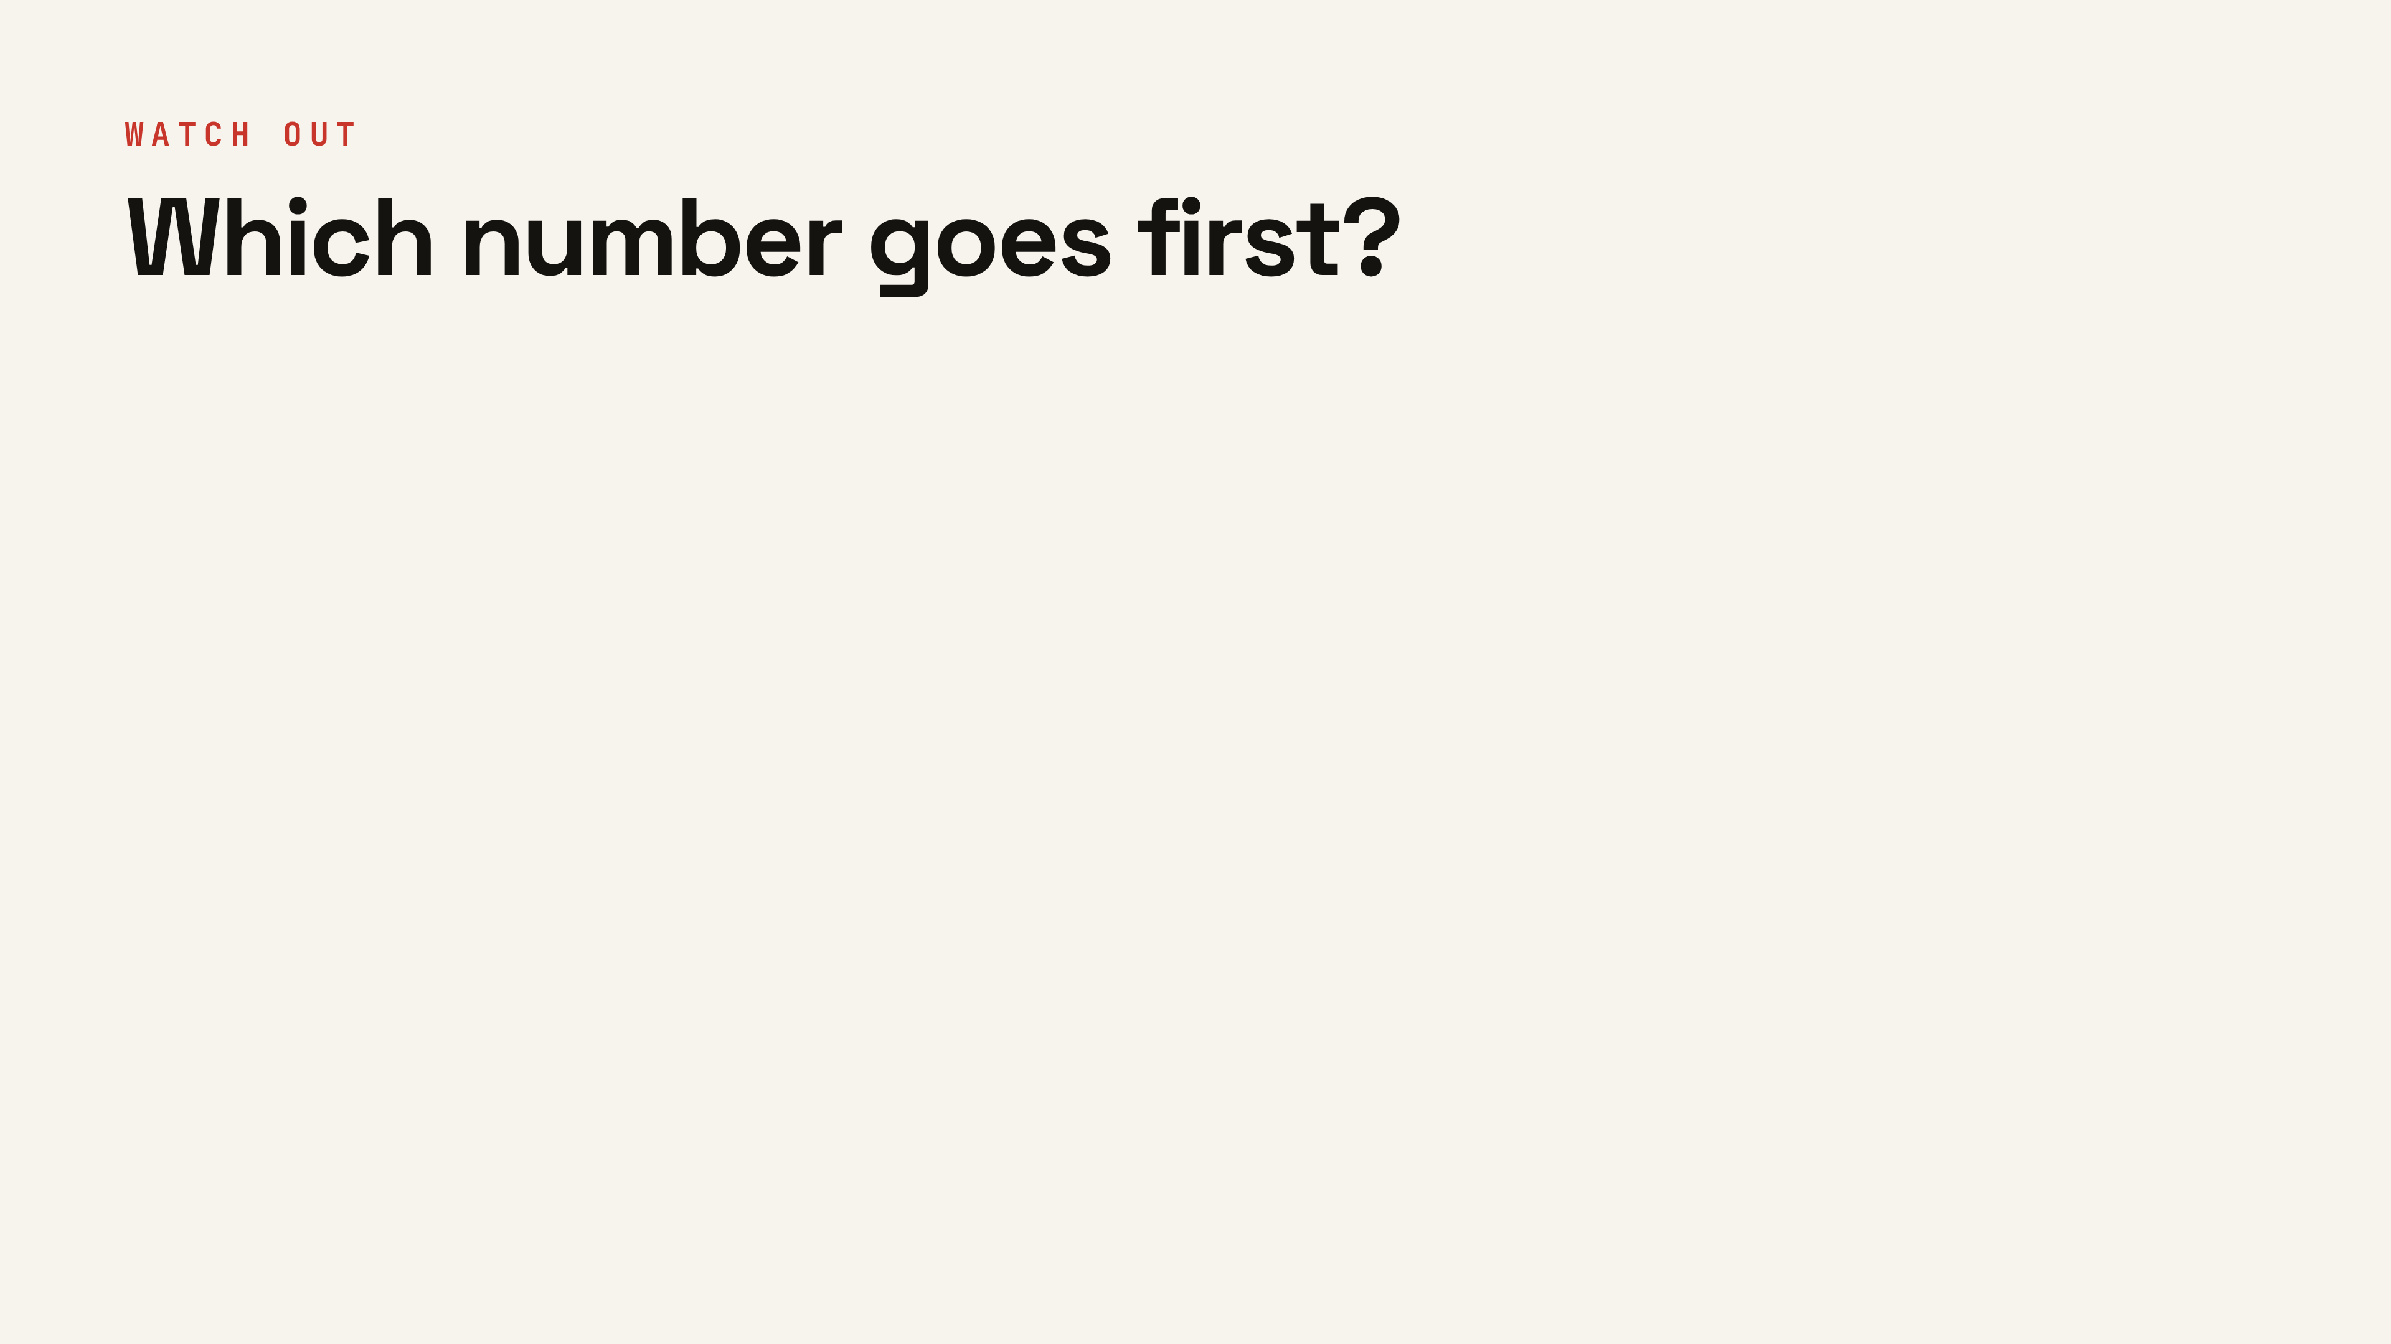
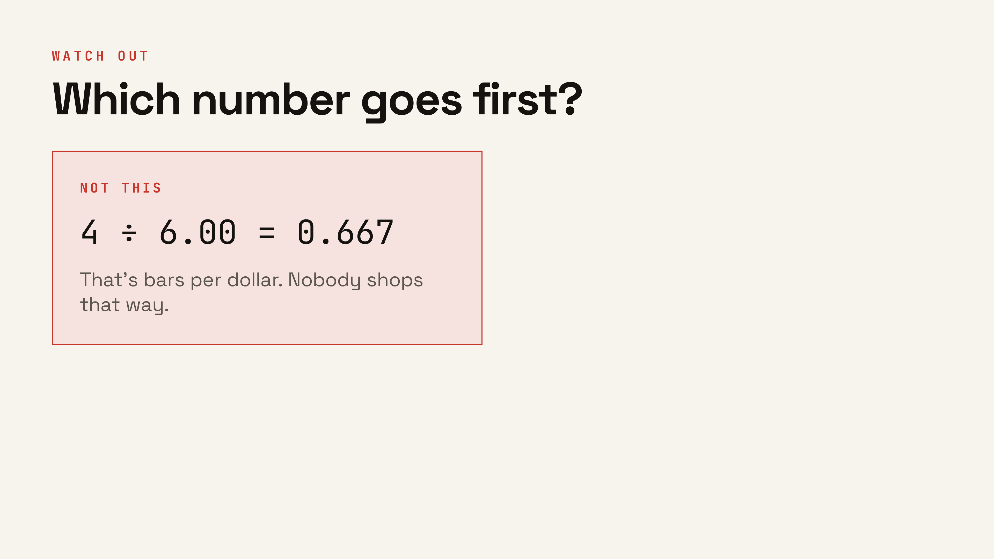
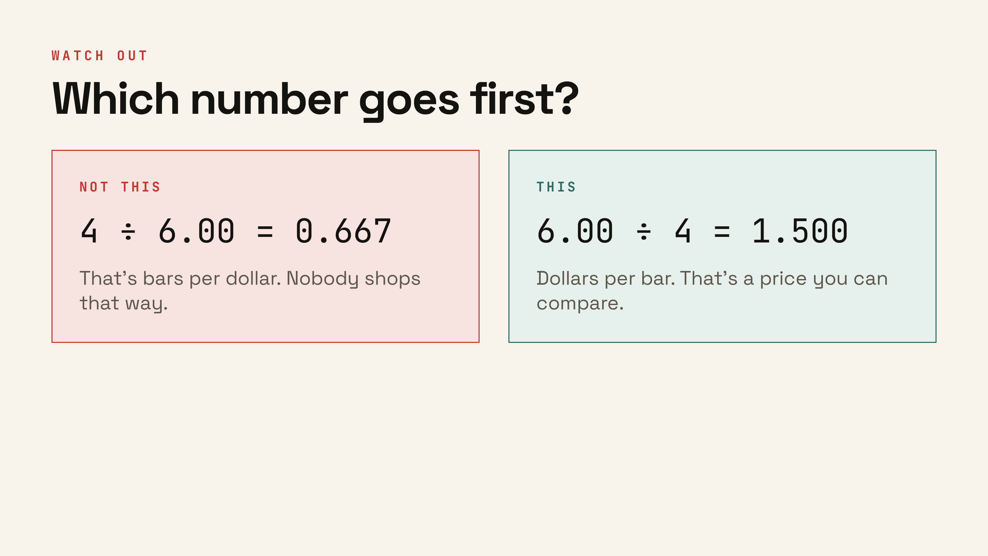
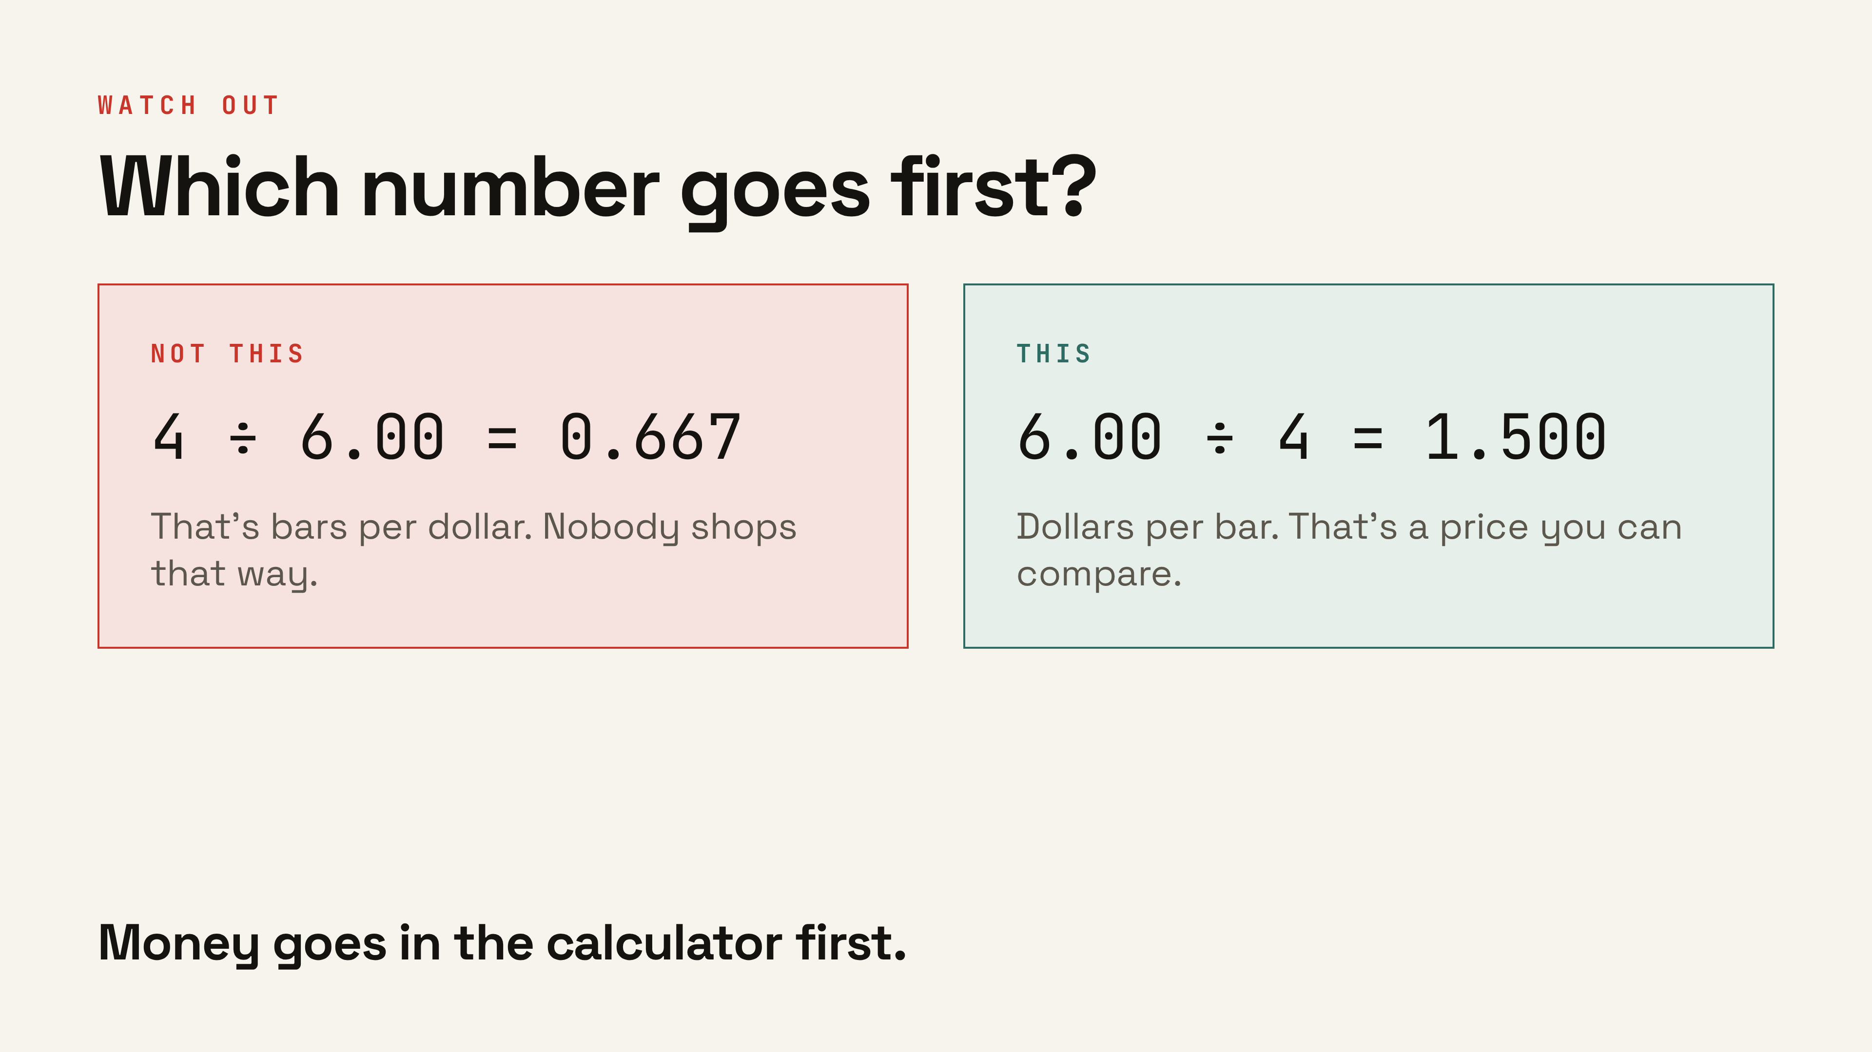
Notes:
The most common error in this unit. Both cards use the same two numbers. Make them say the units — dollars per bar, not bars per dollar. ▸ Clicks: 1 the wrong way, 2 the right way, 3 the calculator rule.

Slide 16
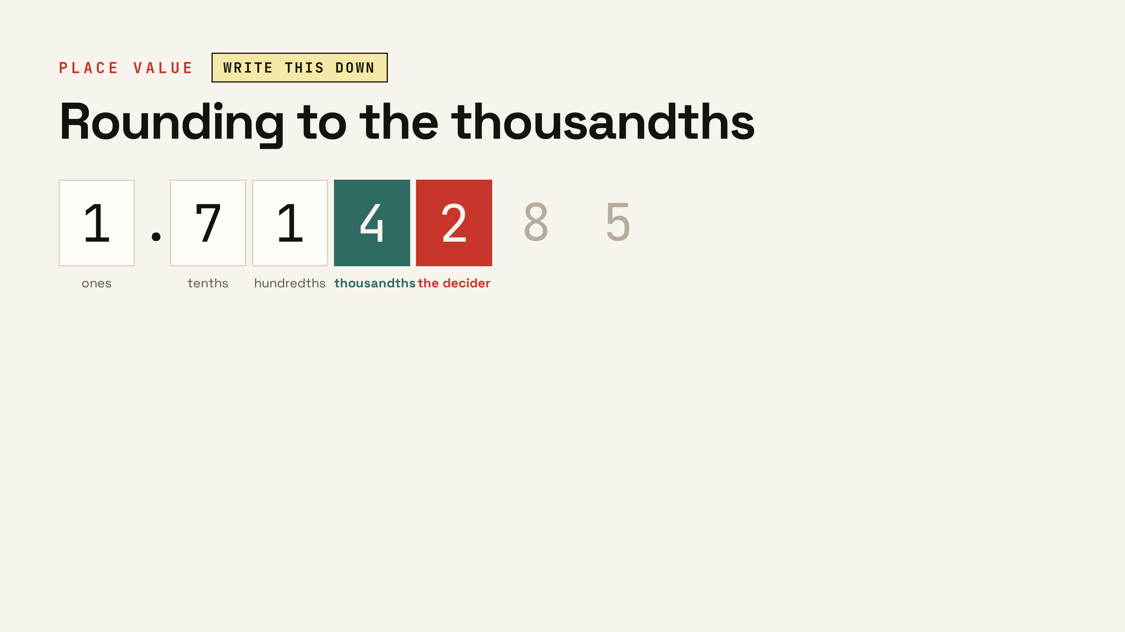
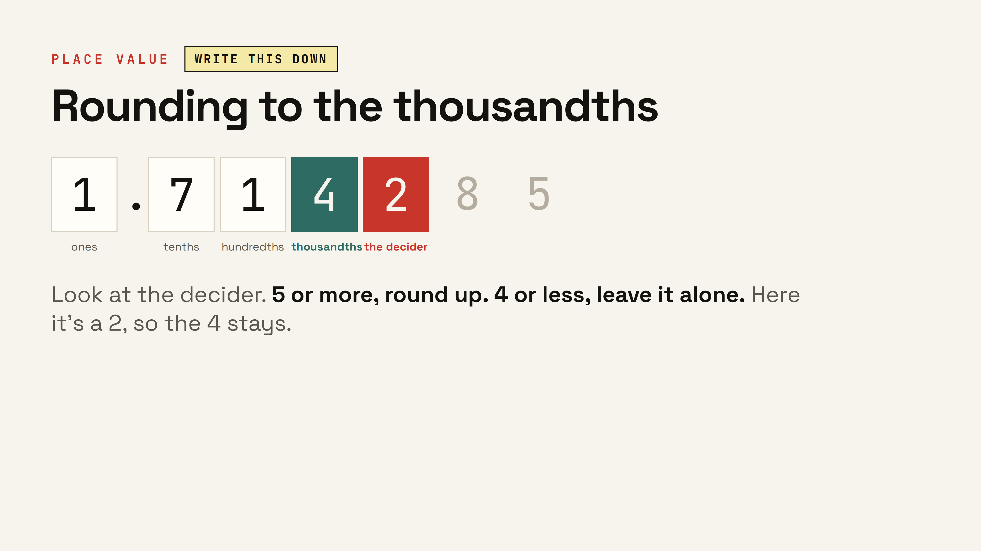
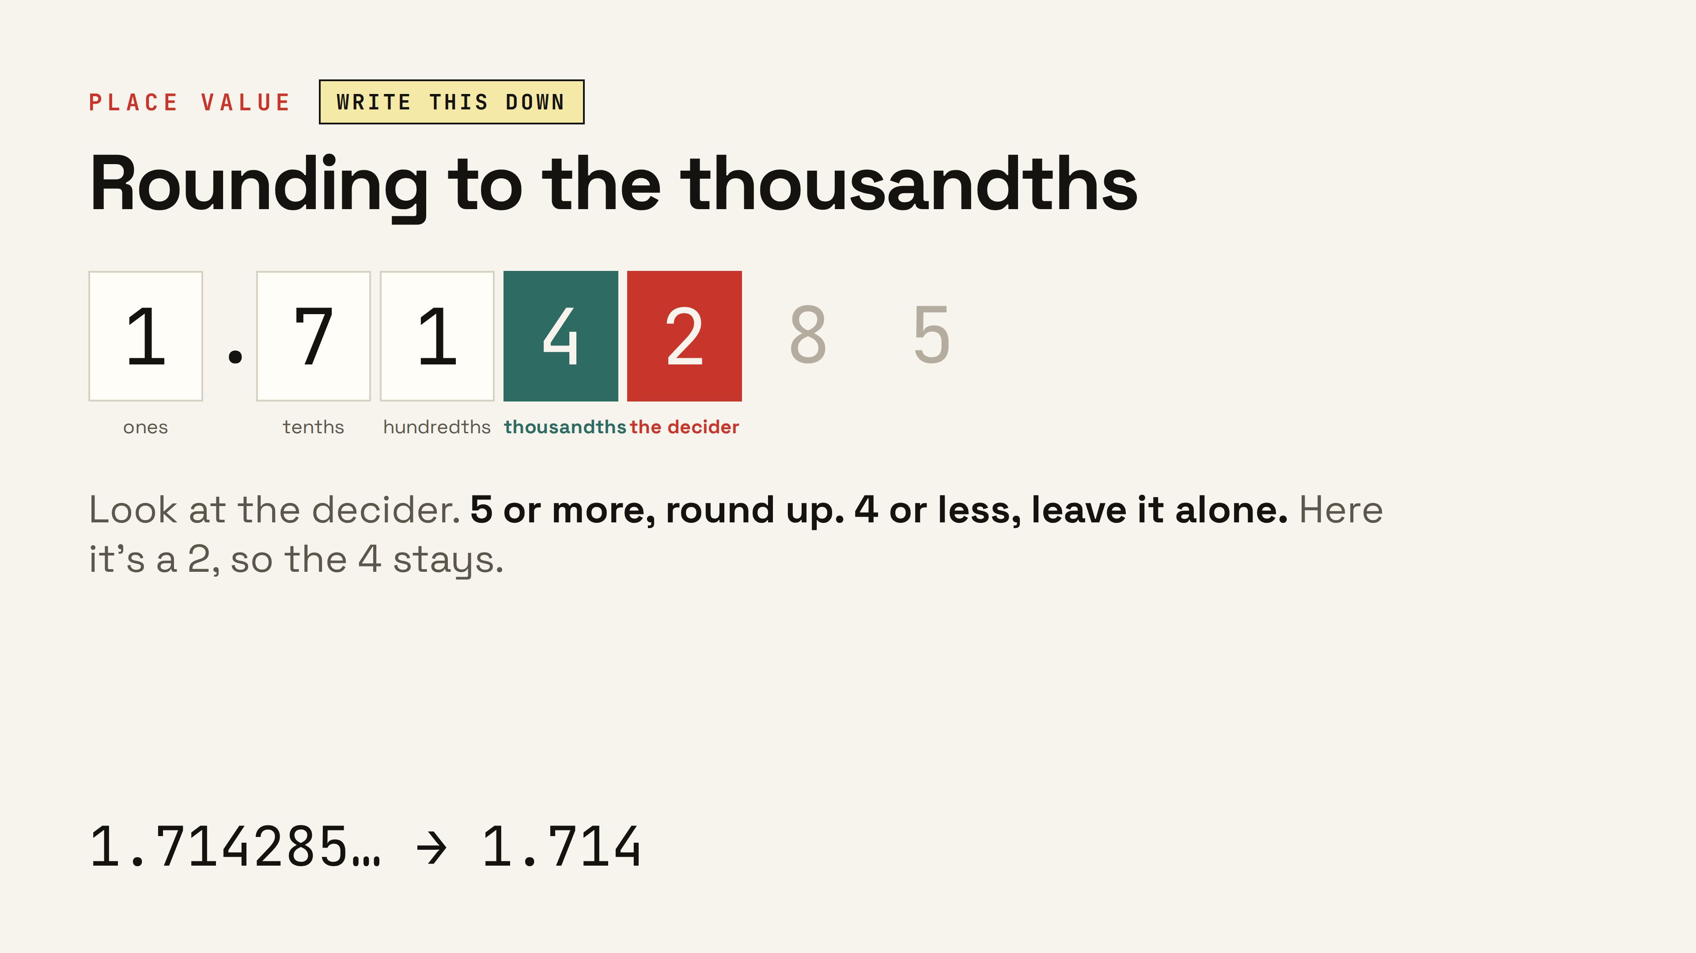
Notes:
Point at the digit after the thousandths — that one decides. Five or more, round up. Four or less, leave it. Then explain why three digits: close calls. ▸ Clicks: 1 the rounding rule, 2 the rounded answer.

Slide 17
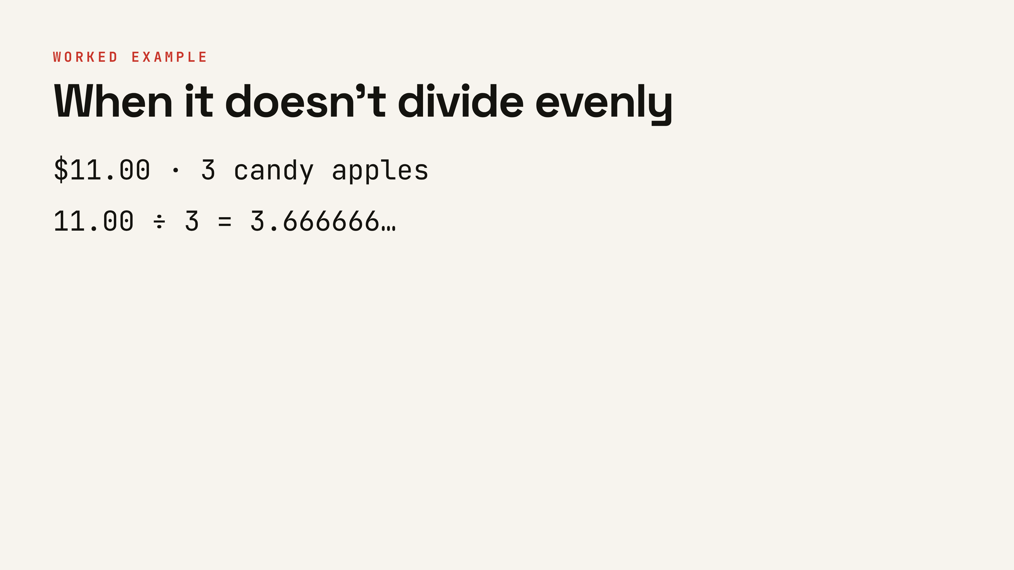
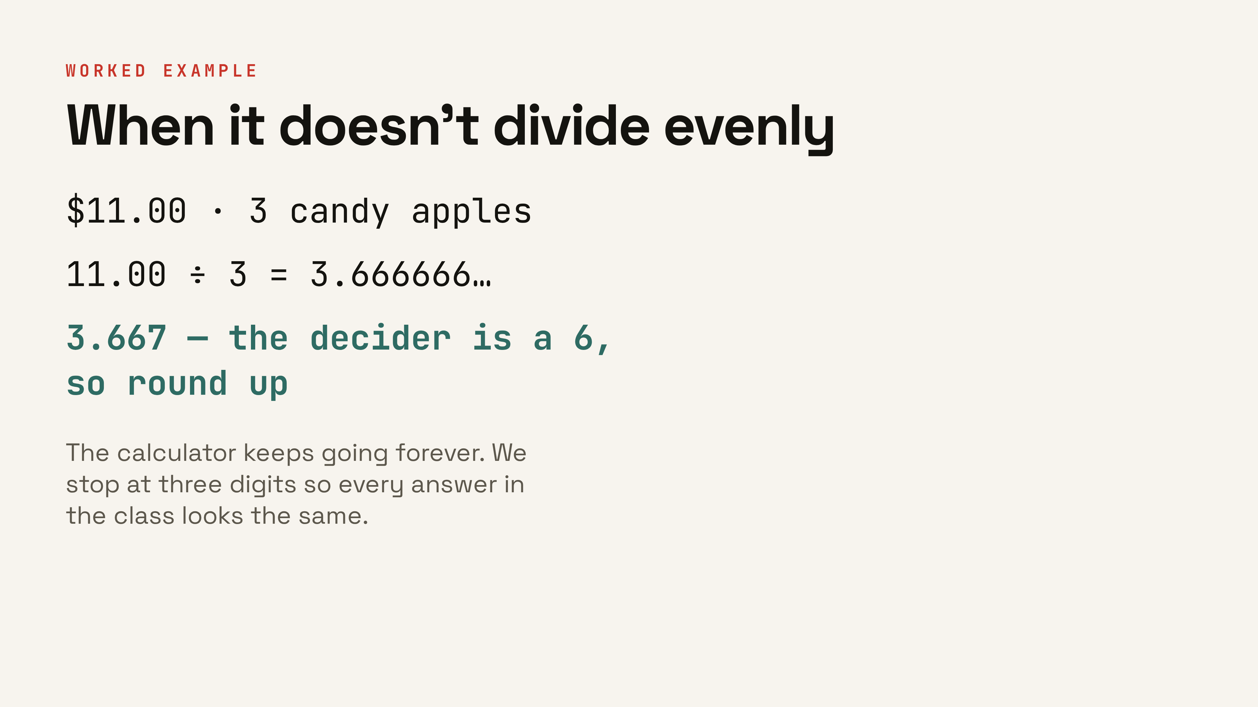
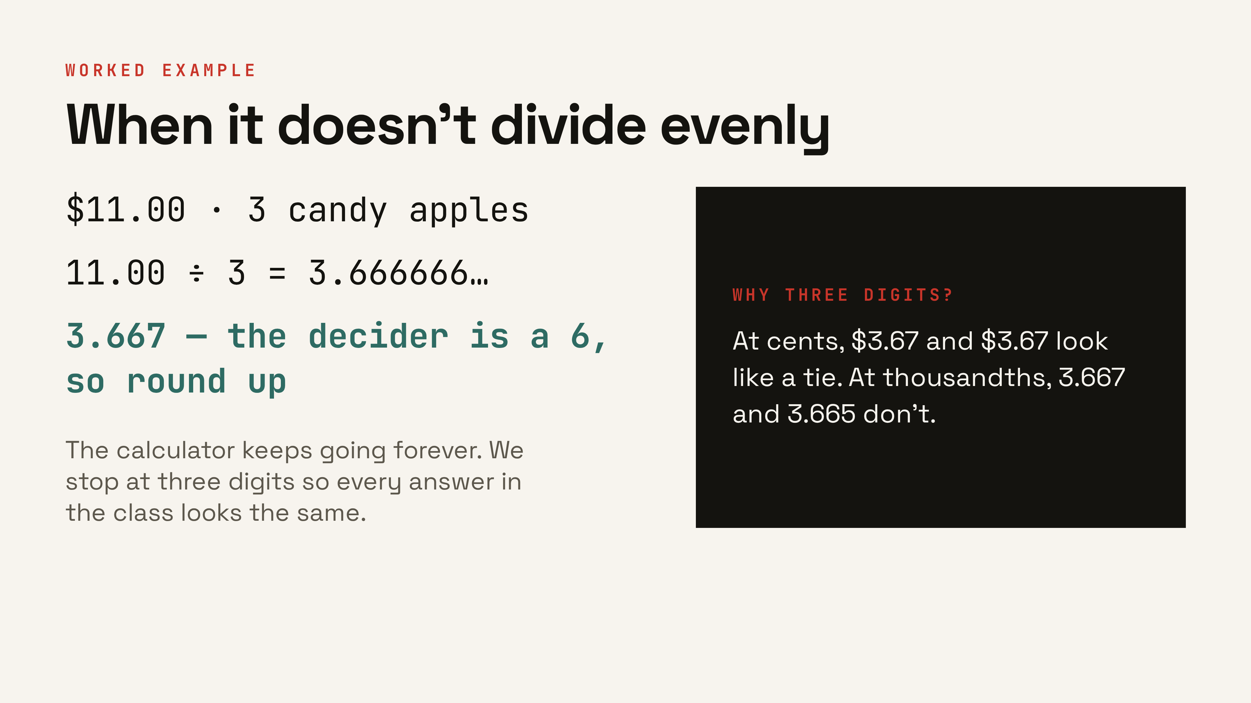
Notes:
Calculators out. This one runs forever and the decider is a 6, so it rounds UP — model that before they hit it in practice. Also note why we keep three digits instead of stopping at cents. ▸ Clicks: 1 the rounded answer, 2 the why-three-digits card.

Slide 18
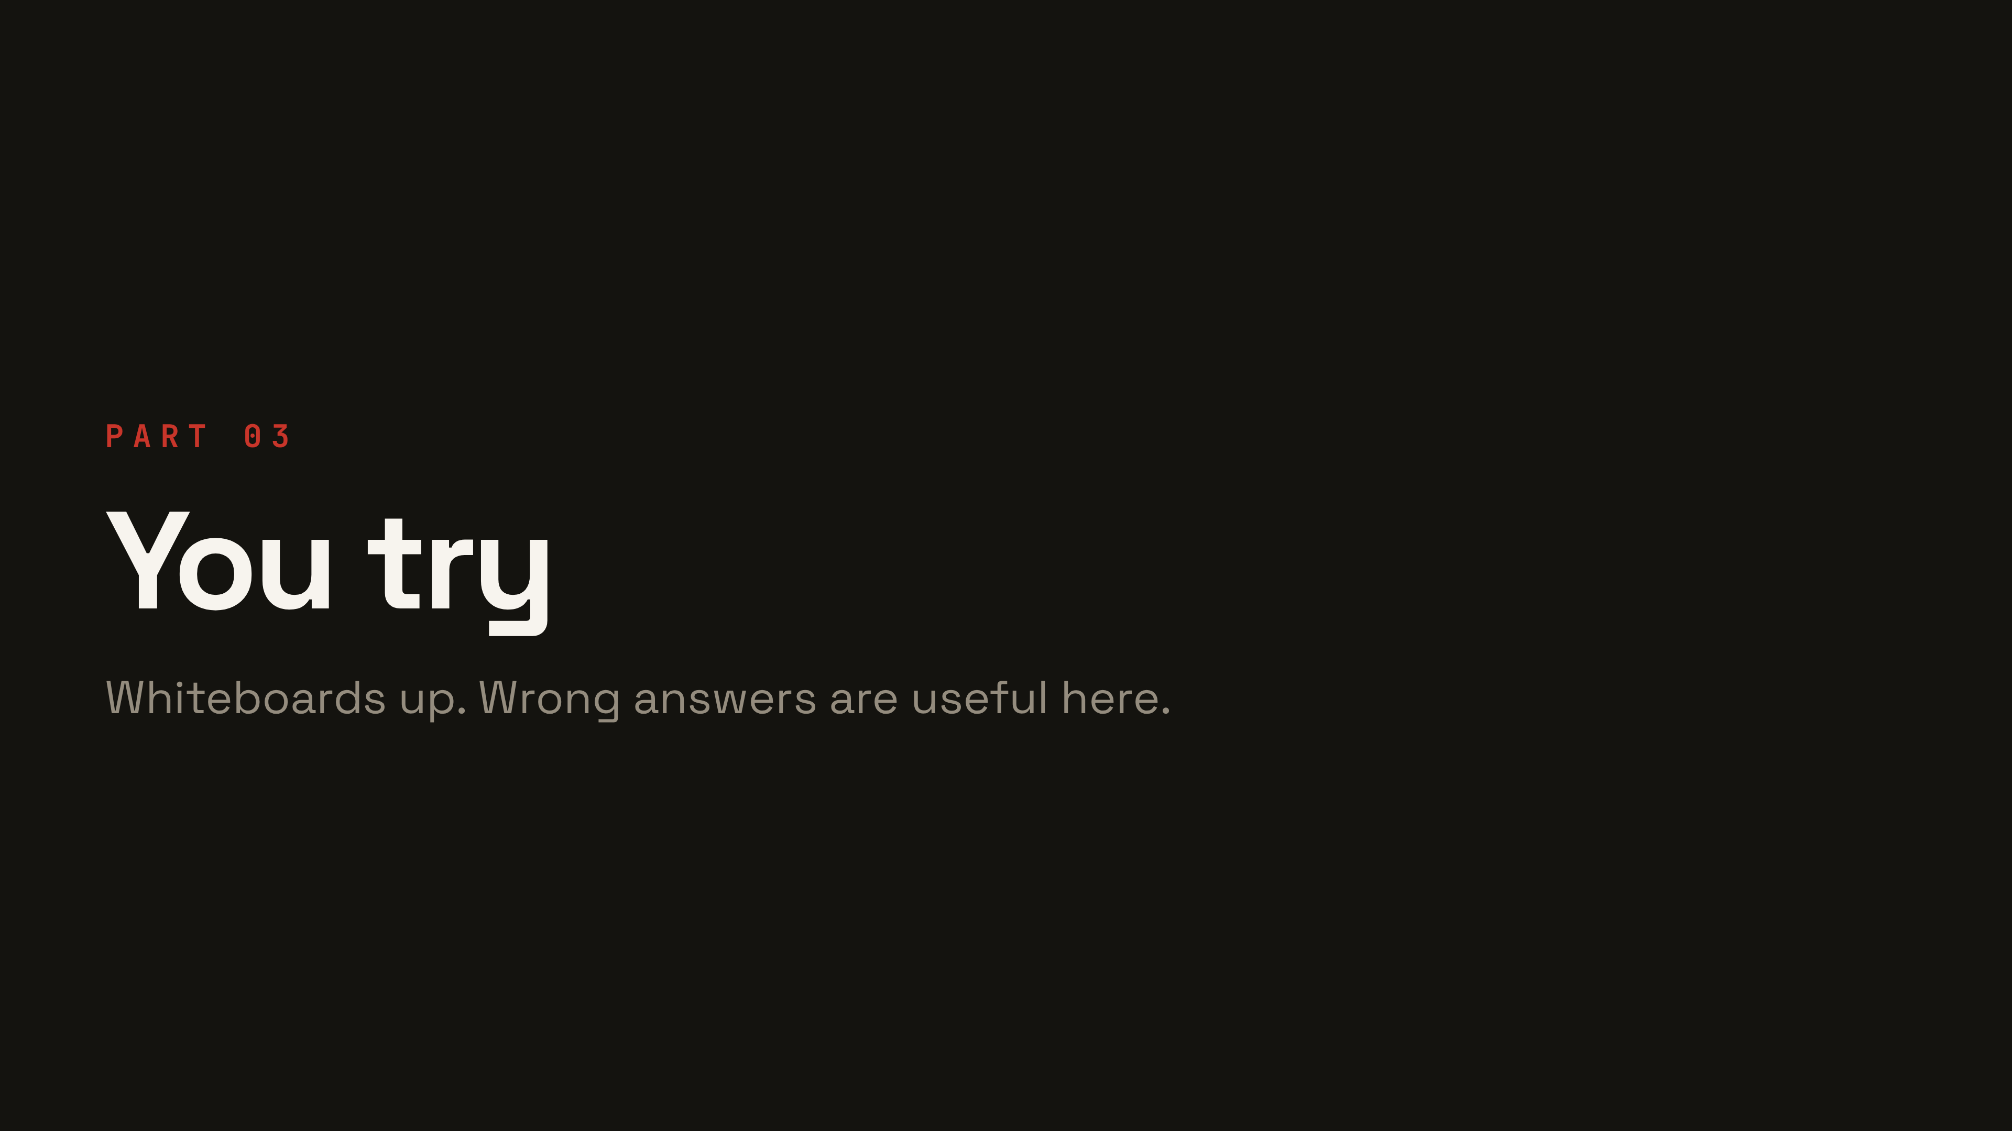
Notes:
Whiteboards out. Everyone writes, everyone holds up.

Slide 19
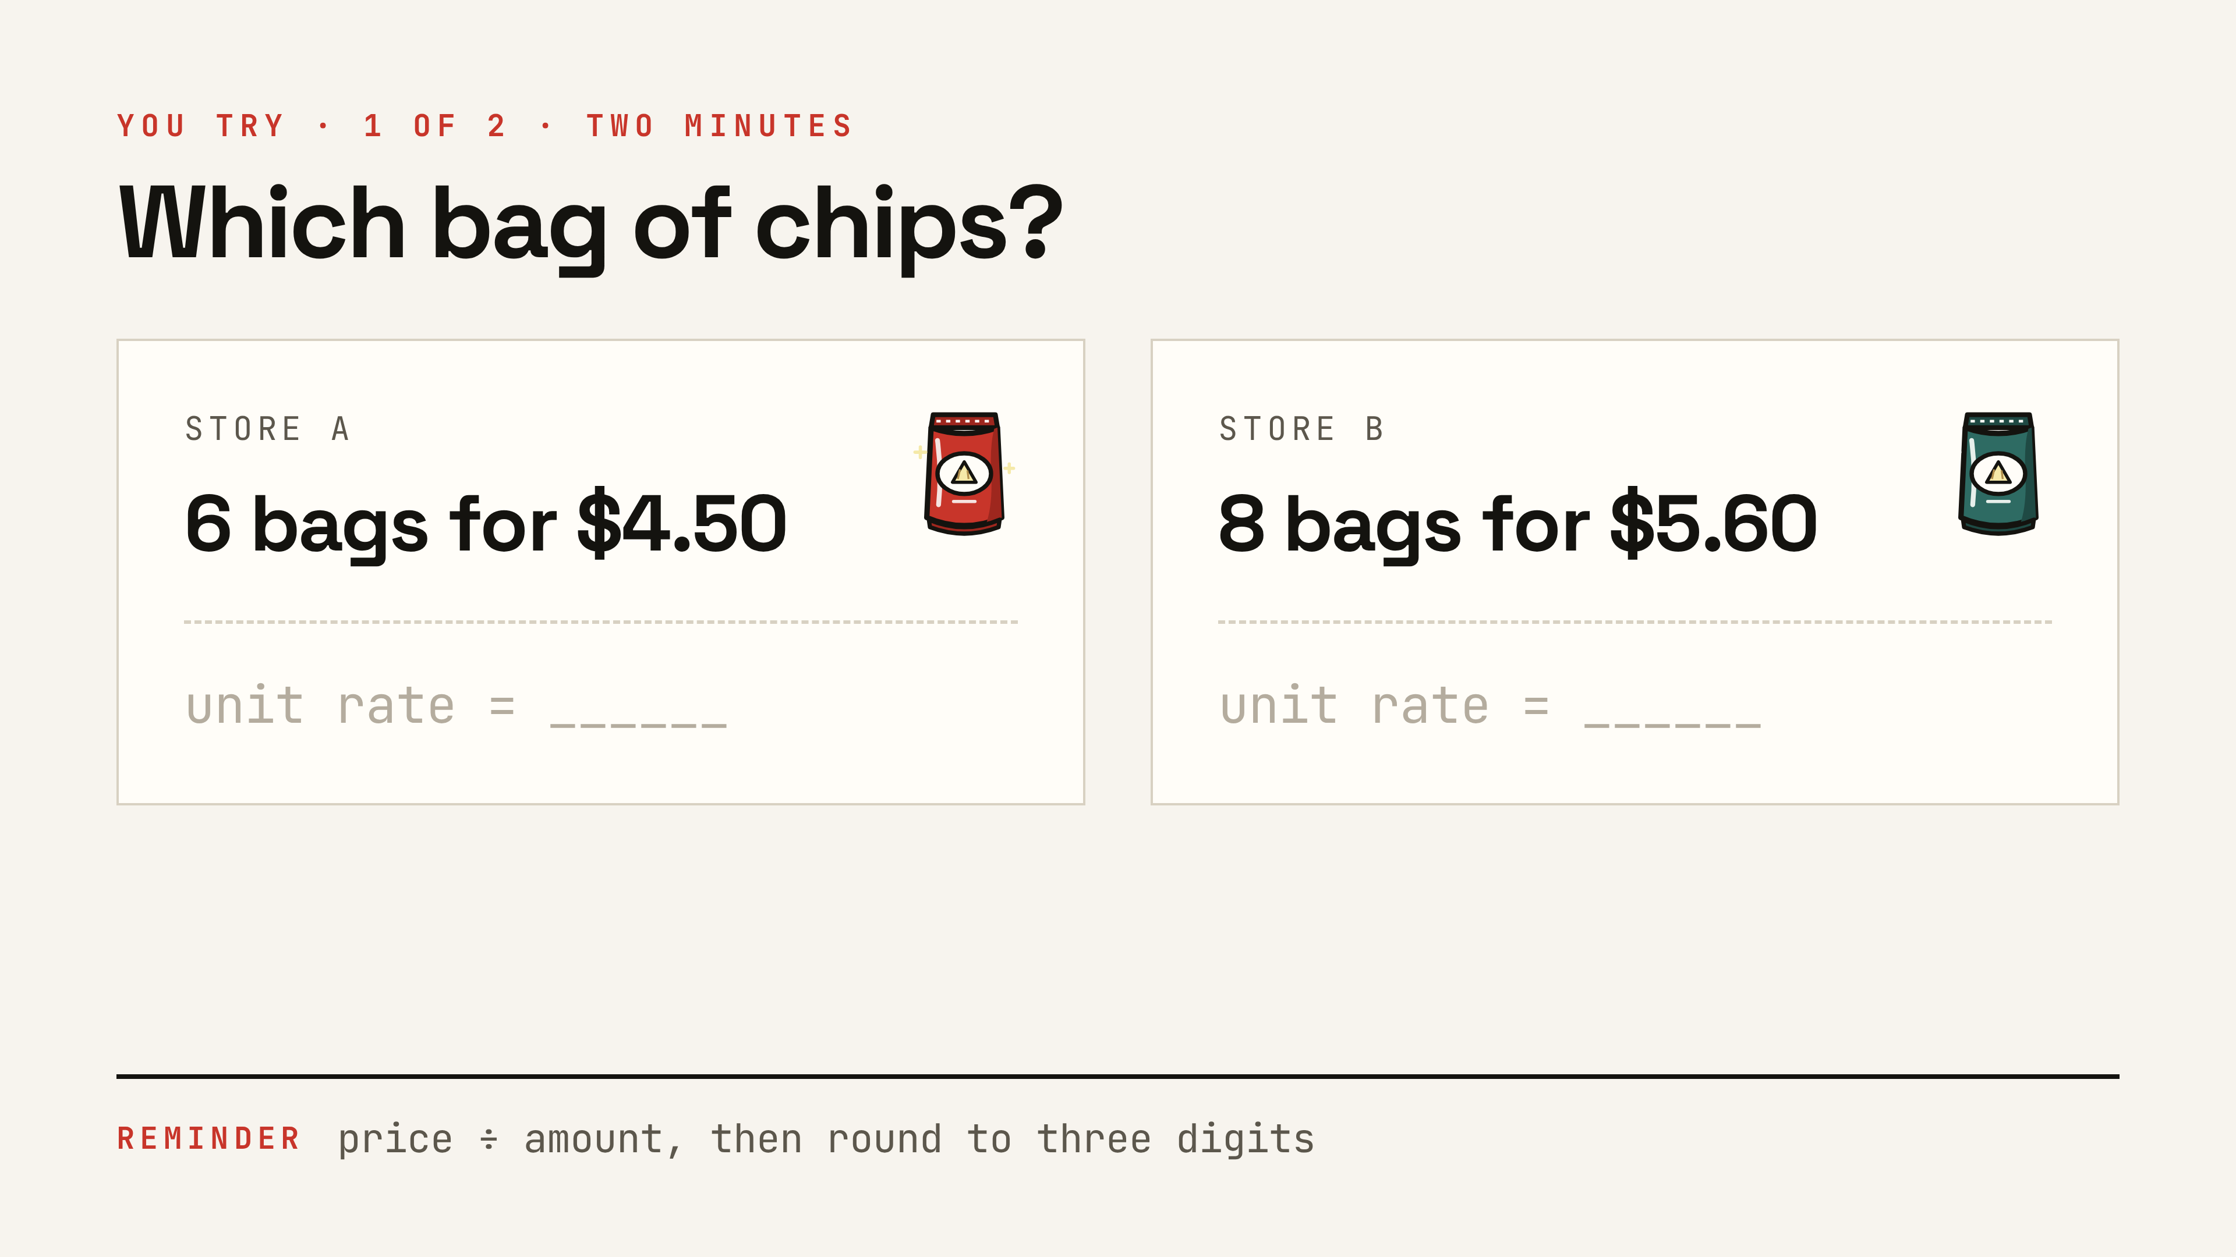
Notes:
Two minutes. Circulate. Look for anyone dividing backwards — that's the one to catch before the check slide.

Slide 20
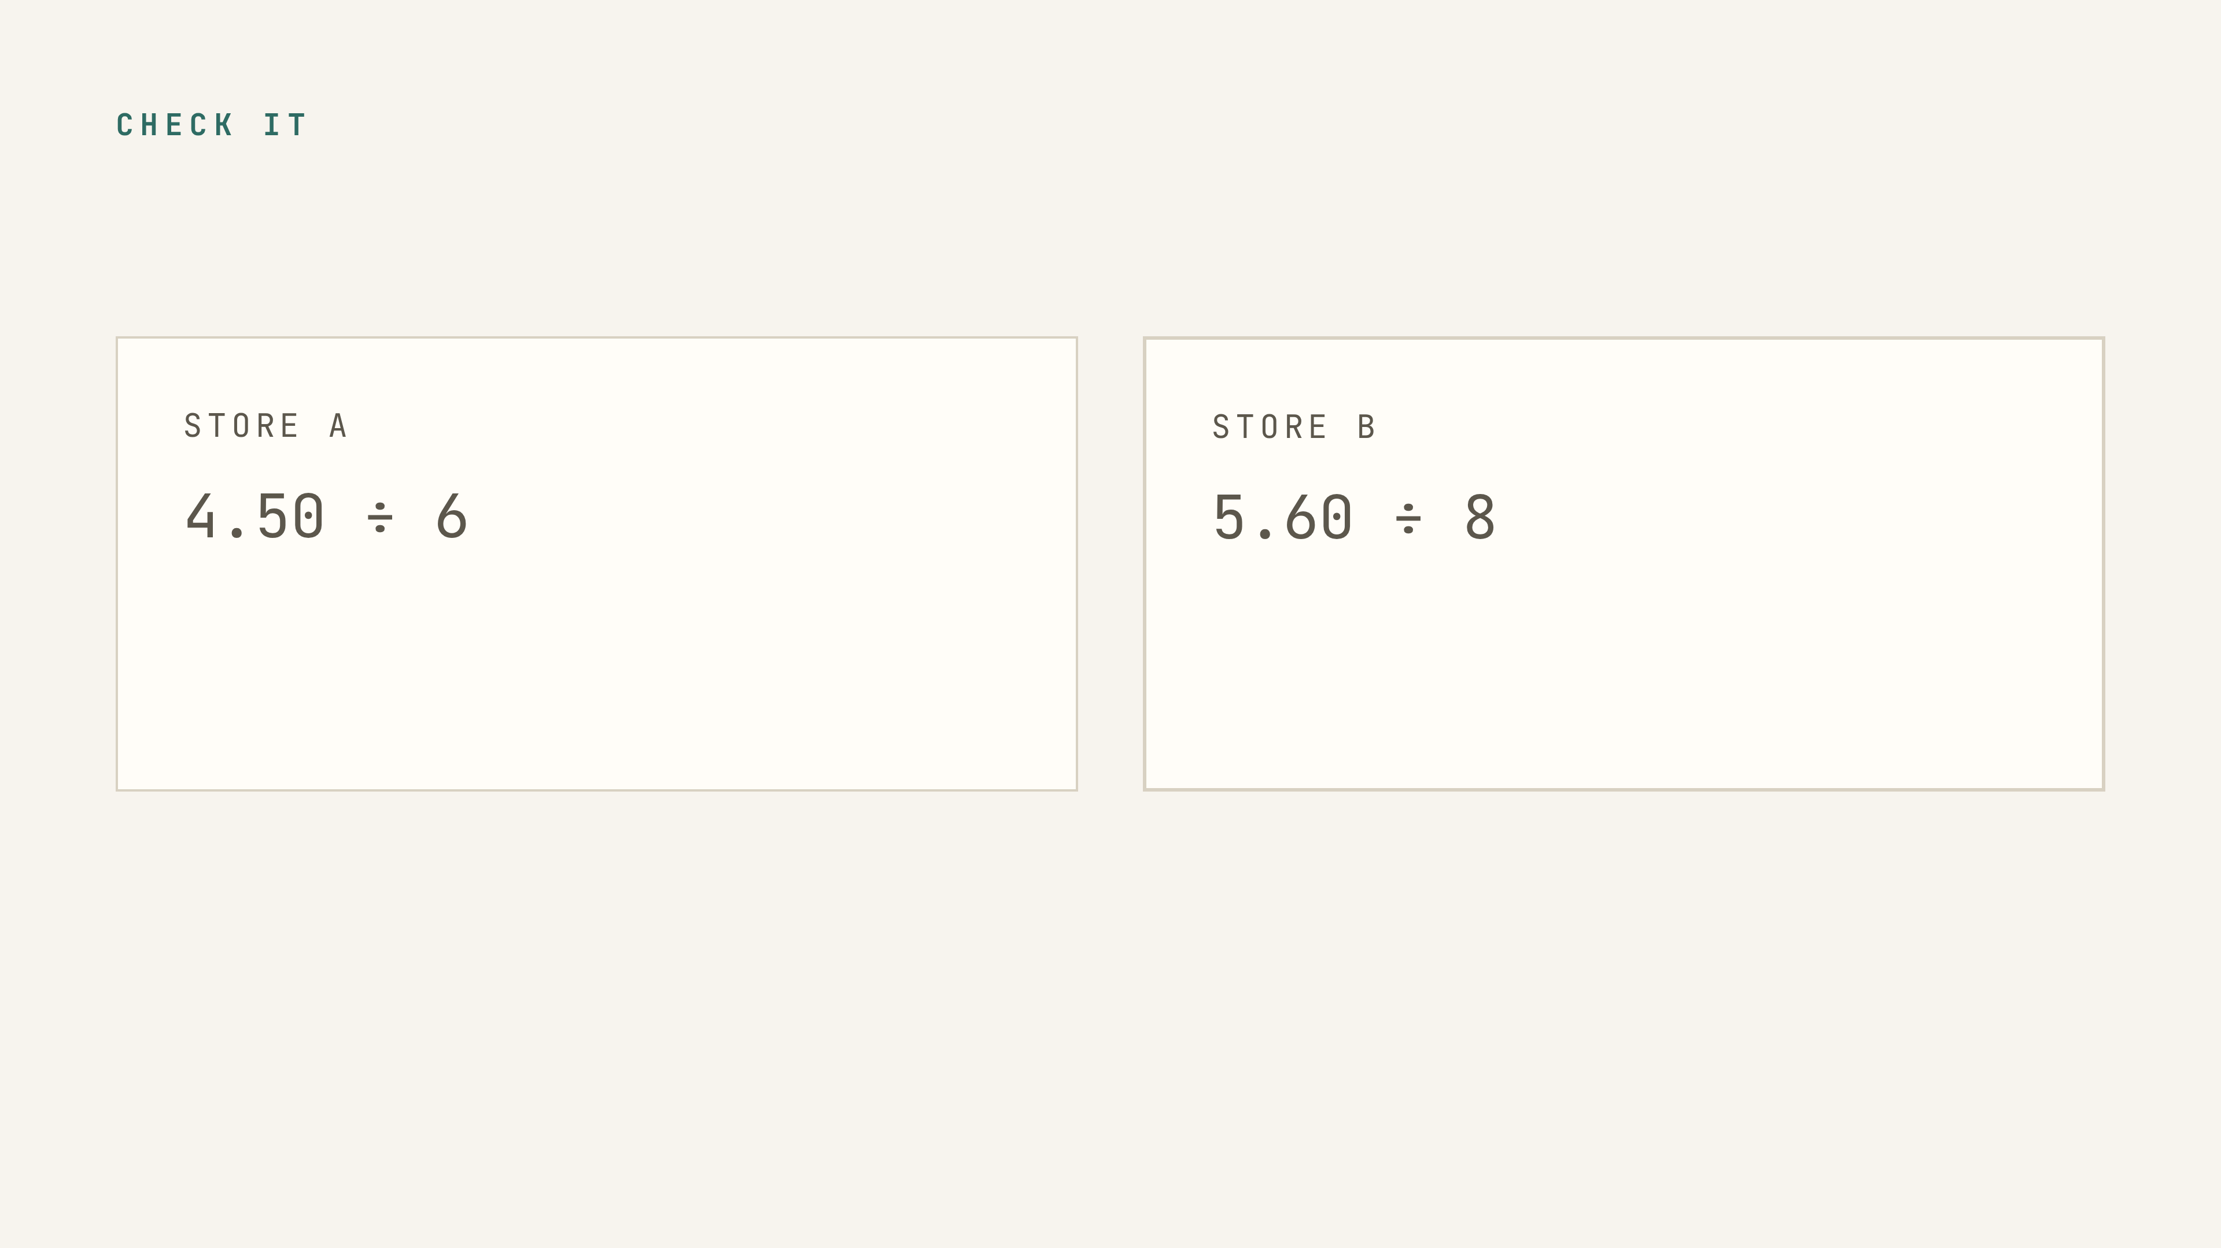
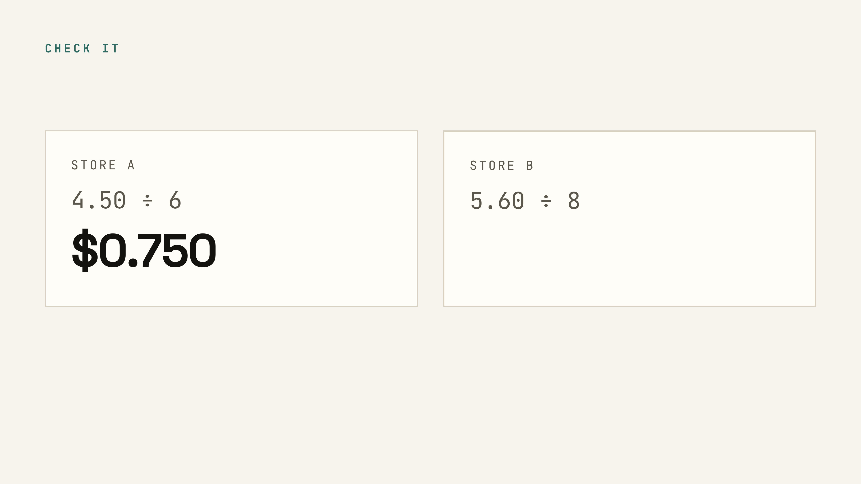
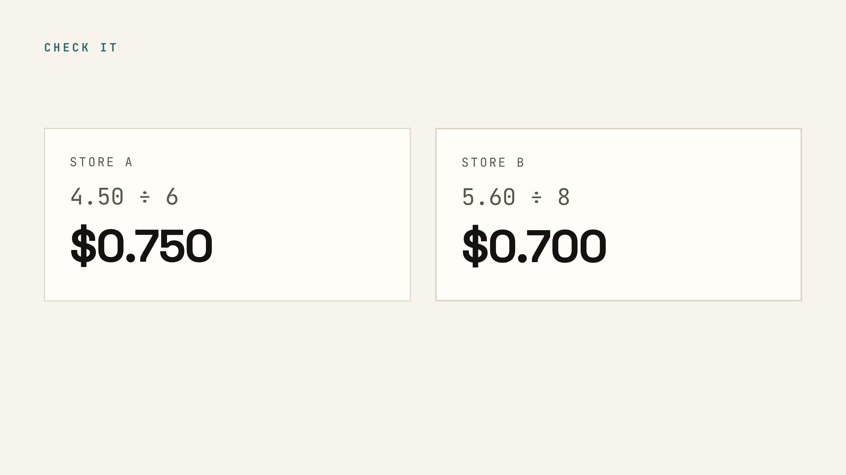
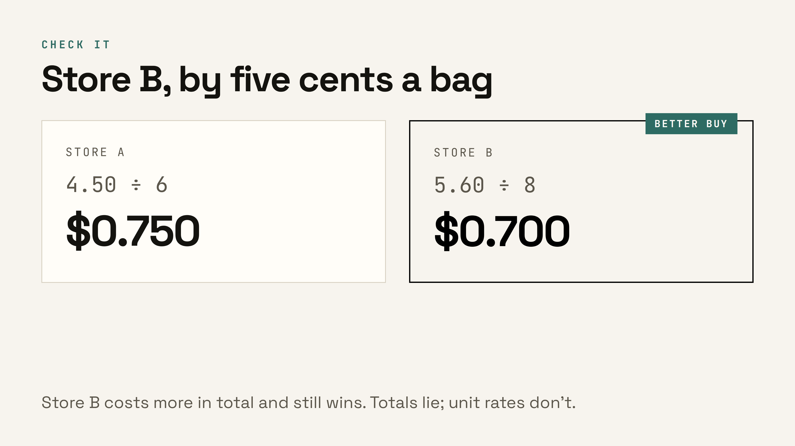
Notes:
Both divide evenly, so nobody should be stuck on rounding. Land the last line — the cheaper-looking total loses. ▸ Clicks: 1 Store A’s rate, 2 Store B’s rate, 3 the verdict — title, tag, and takeaway land together.

Slide 21
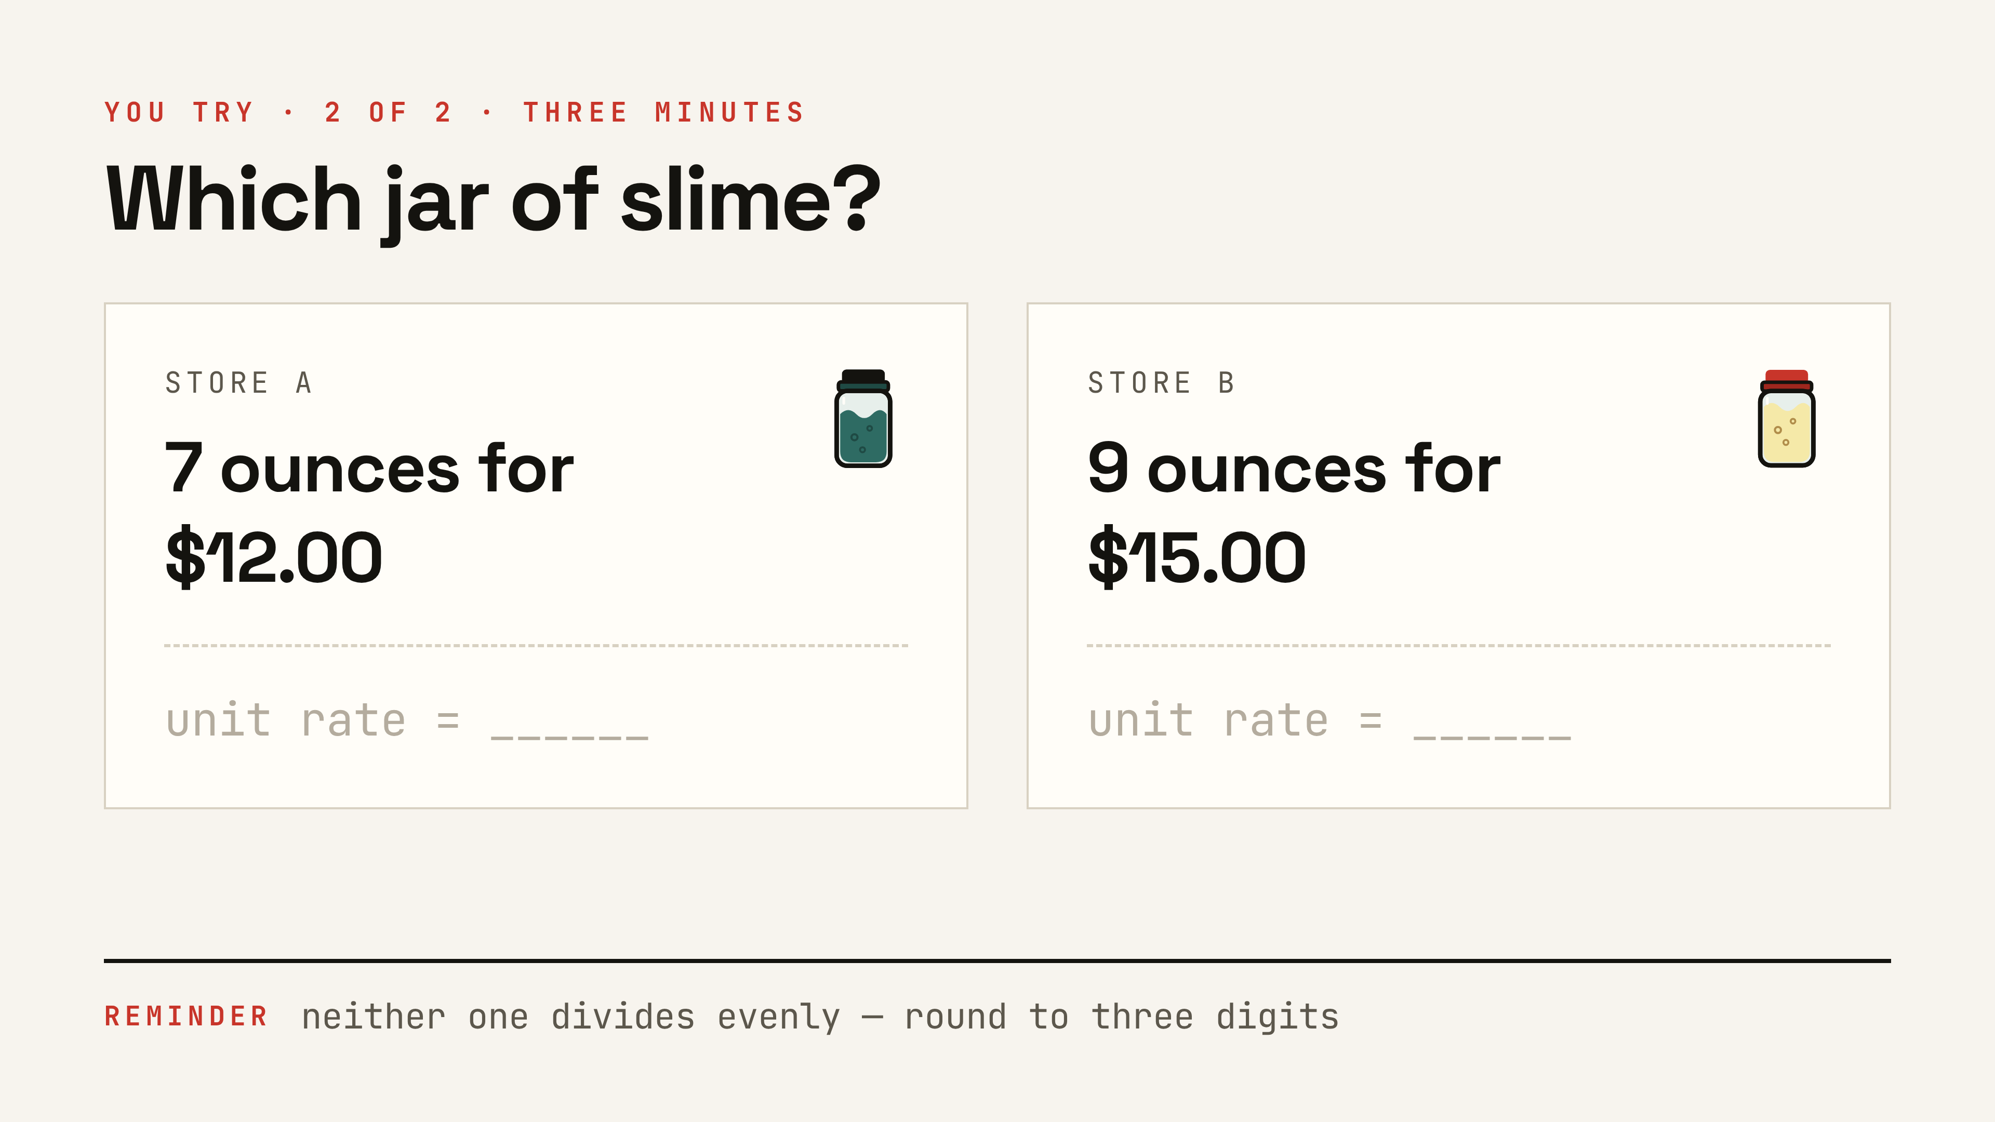
Notes:
The rounding one. Warn them the calculator will fill the screen — that's expected. Three digits only.

Slide 22
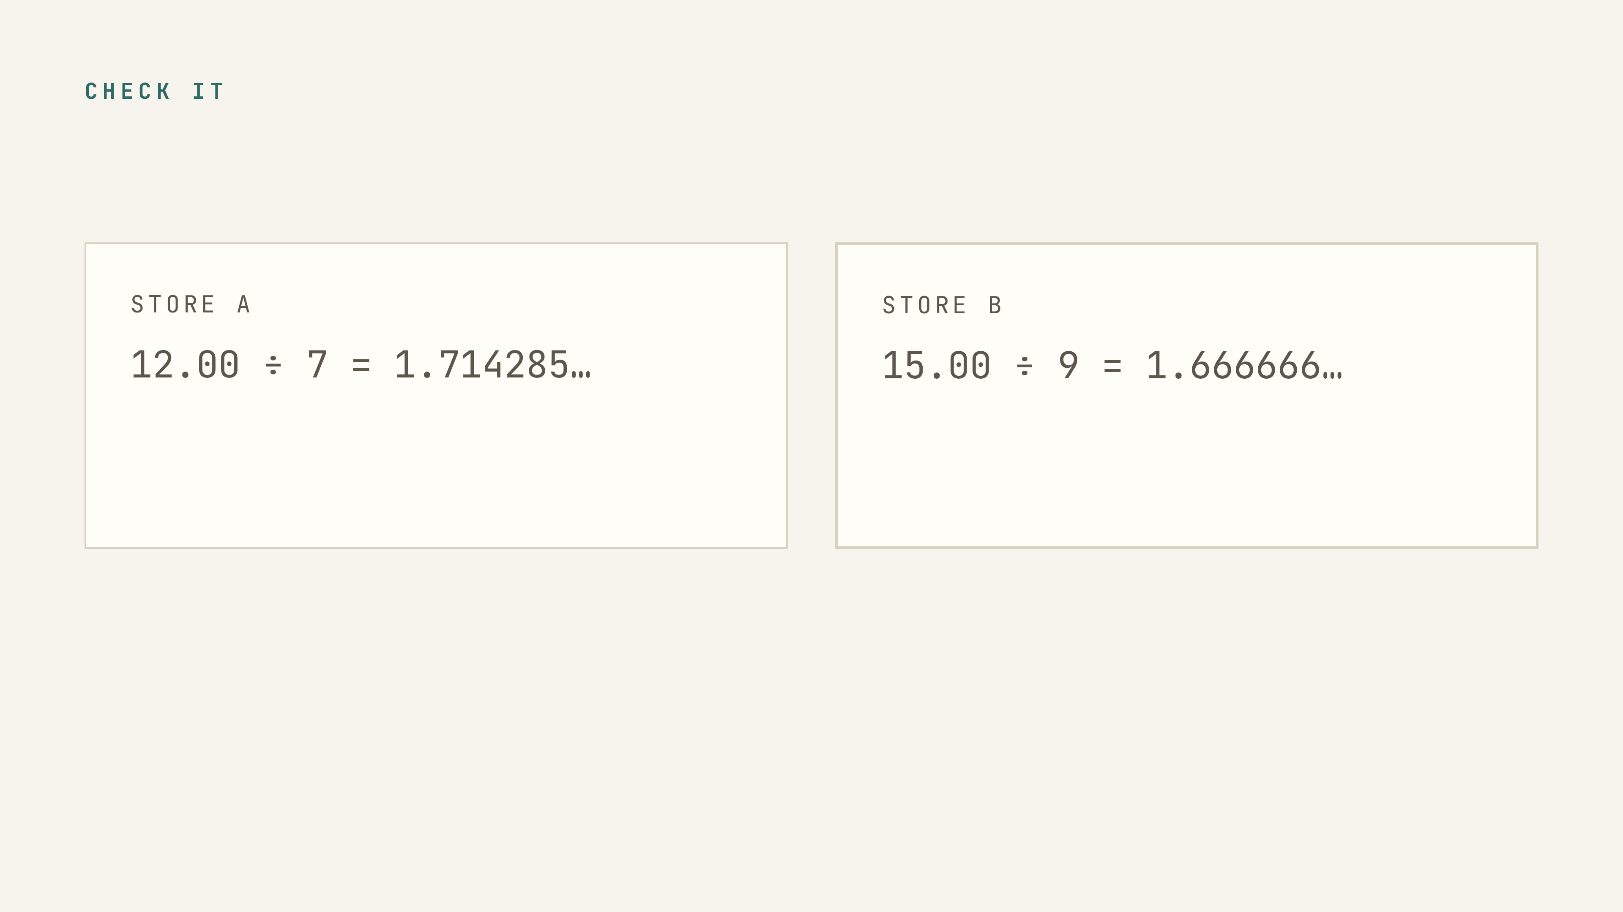
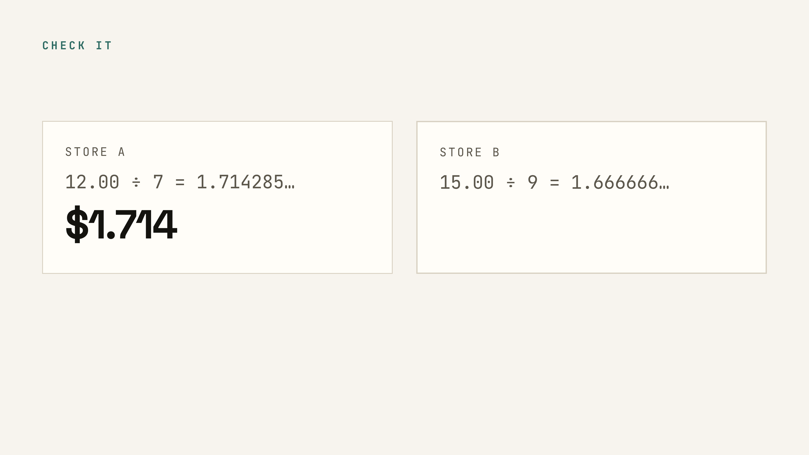
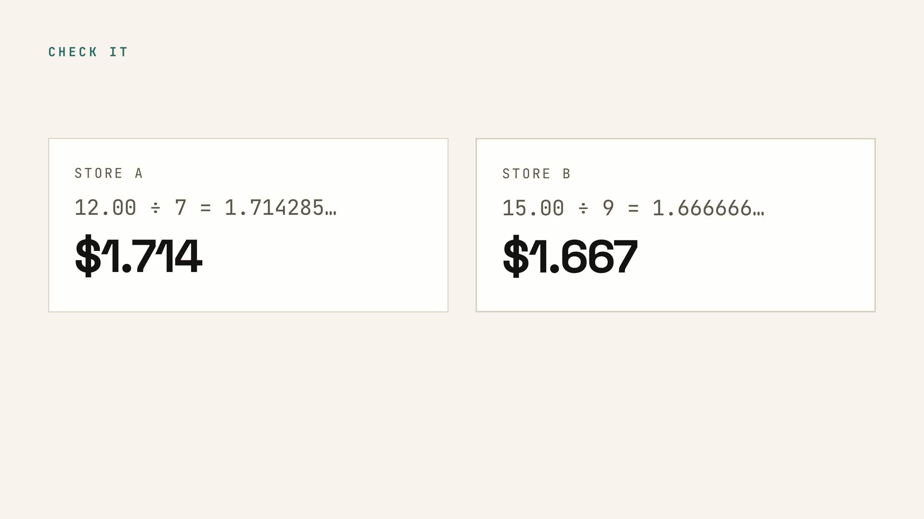
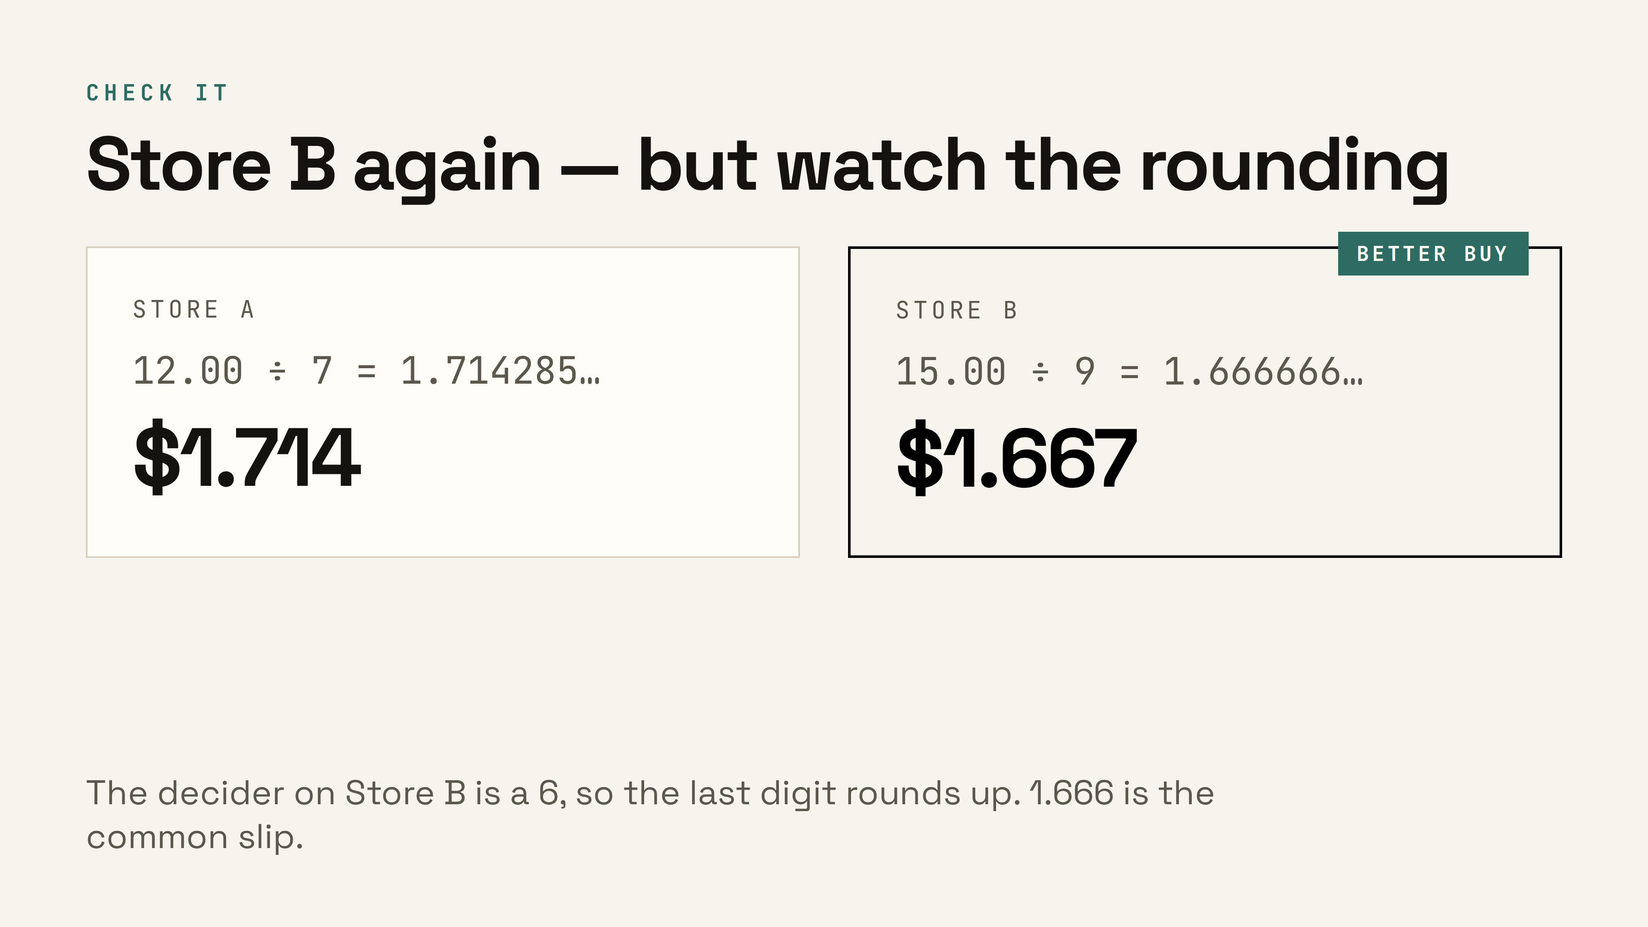
Notes:
Ask who wrote 1.666 — that's the classic slip. The decider is a 6, so it rounds up to 1.667, just like the candy apples. ▸ Clicks: 1 Store A’s rate, 2 Store B’s rate, 3 the verdict — title, tag, and takeaway land together.

Slide 23
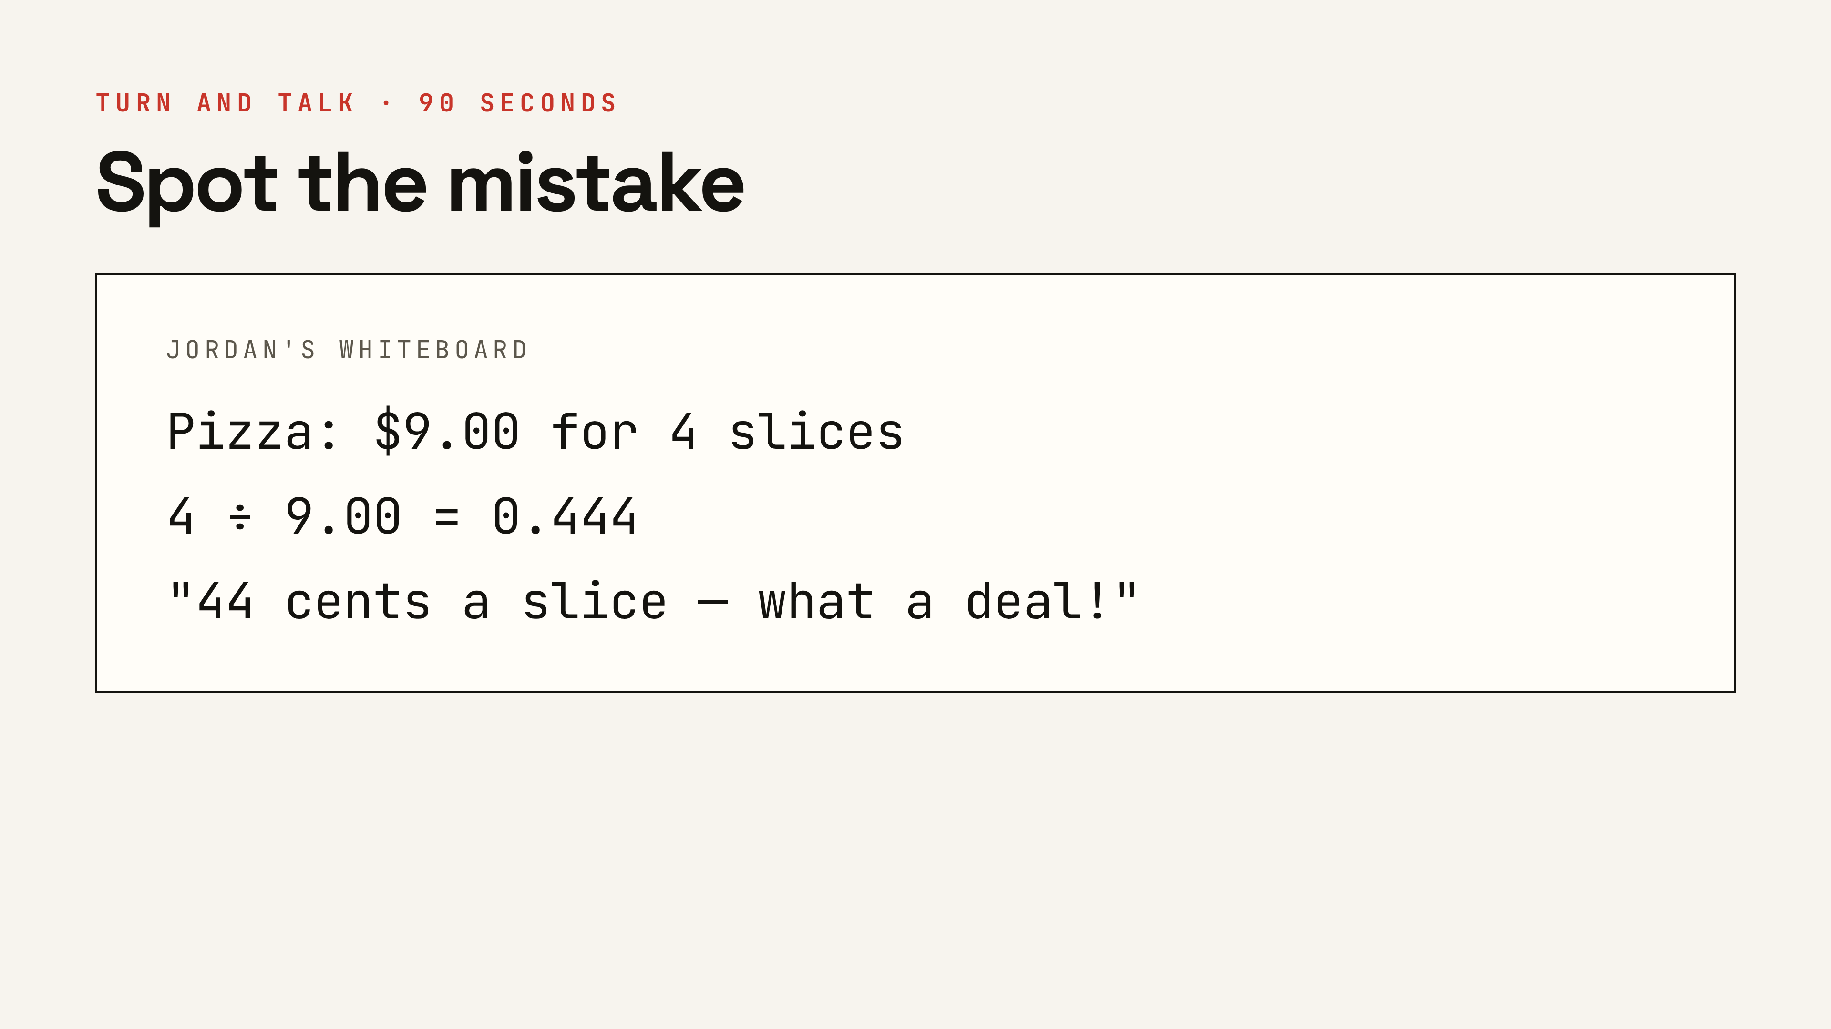
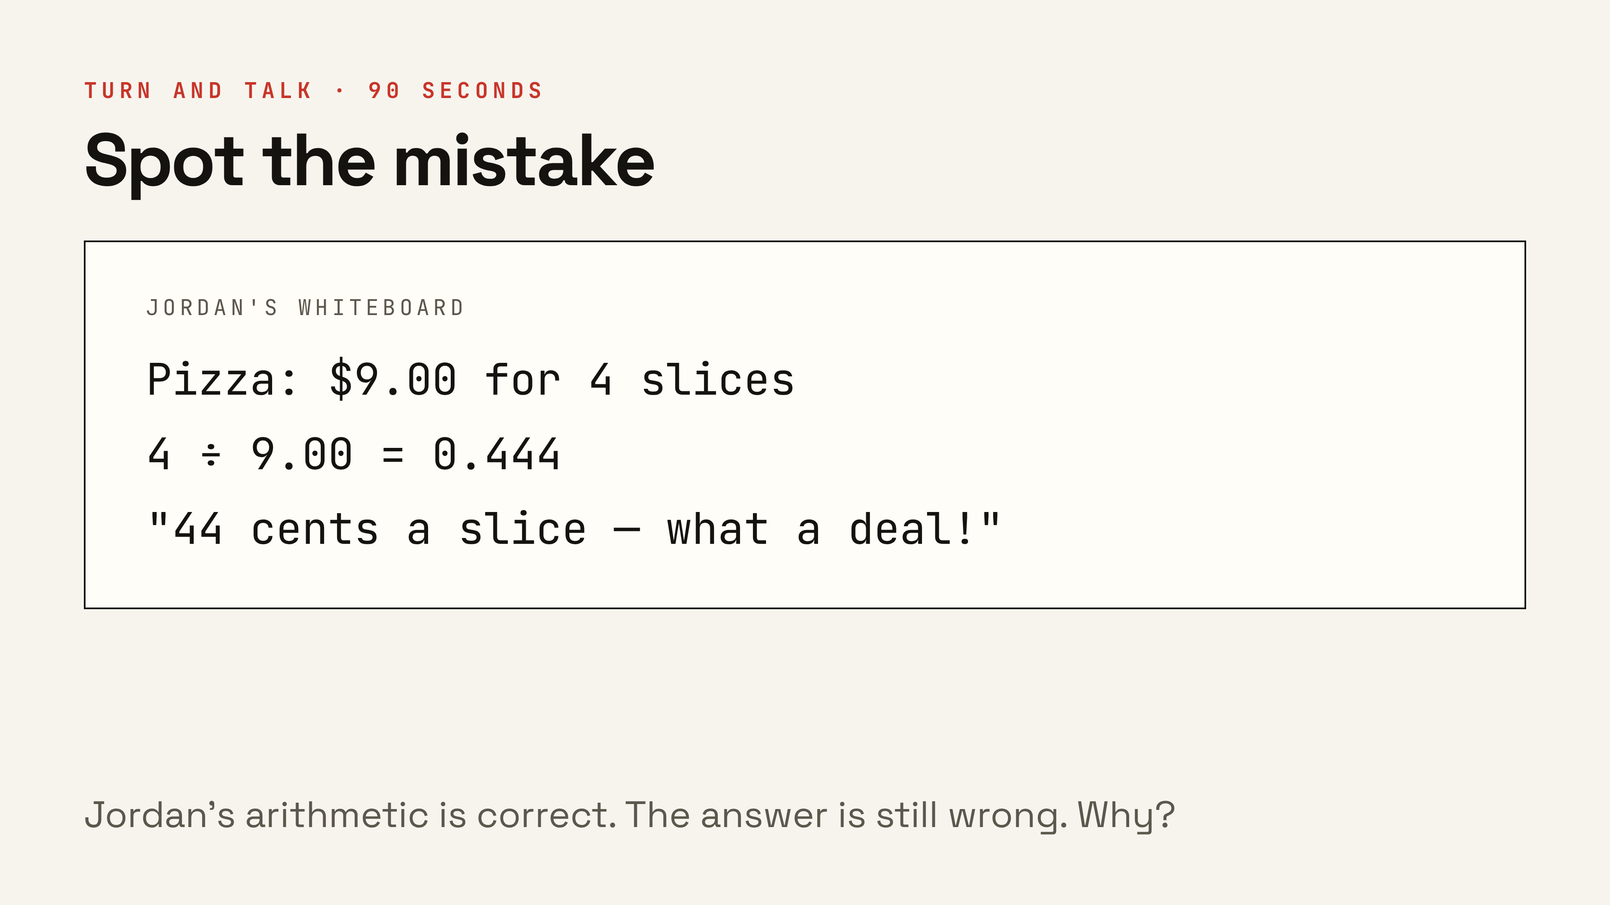
Notes:
Turn and talk, ninety seconds. Don't tell them where it is. Ask a pair to explain it in units, not numbers. ▸ Click: the discussion question, after they’ve stared at the board.

Slide 24
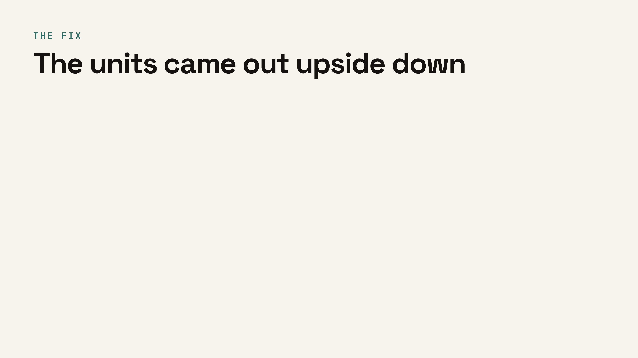
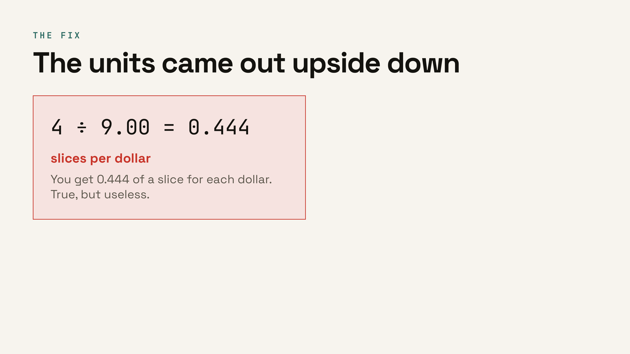


Notes:
Name it plainly: the division was flipped, so the units came out upside down. Forty-four is a real number — it's slices per dollar. ▸ Clicks: 1 the flipped division, 2 the fixed one, 3 the say-the-units habit.

Slide 25

Notes:
The payoff. Everything so far gets used on one worksheet.

Slide 26



Notes:
Last vocabulary word, and the whole point of the worksheet. The pizza from Jordan's board settles it: work out both unit rates, lower one wins — even when the bigger deal looked better. ▸ Clicks: 1 the pizza comparison, 2 the ten-cents-a-slice line.

Slide 27

Notes:
Ask for one more from the room before advancing — streaming plans, gas mileage, points per game. Someone always has a good one.

Slide 28


Notes:
Grocery stores print this in most states. The big number sells; the small number tells the truth. ▸ Click: the yellow unit-price tag and the math behind it. (Optional slide — skip if the period runs short.)

Slide 29




Notes:
Matters for the written explanation on the worksheet. The math finds the lower price; a person decides the purchase. Both belong in a good answer. ▸ Clicks: question 02, question 03, then the bottom line. (Optional slide — skip if the period runs short.)

Slide 30

Notes:
Hand out the worksheet here. Read the four directions, then let them start. Sixteen unit rates total, eight comparisons.

Slide 31

Notes:
Page two of the worksheet, up on the screen while they work. Hot dog, pretzel, pickle — same move every row. Warn them now: the pretzel is the closest call on the whole sheet, so the thousandths place has to be there.

Slide 32

Notes:
Bottom half of page two. The explanation needs real numbers from their table, not vibes — at least two rows. Then the trip: one ticket, three snacks, at whichever theatre they picked. Snacks use the unit-rate price, except popcorn and drink — those are per cup and per ounce, so the sheet says full sticker price. Totals vary by snack choice; grade the arithmetic, not the menu.

Slide 33

Notes:
The standard for full credit. Division sentence, rounded answer, units, and a circle. Leave it up while they work.

Slide 34

Notes:
Thirty-second recap before the exit ticket. Have the class read the four definitions aloud together.

Slide 35

Notes:
Last five minutes. Hand out the half-sheet. They should be able to do this alone — if they can't, that's your reteach group tomorrow.

Slide 36

Notes:
Teacher copy. Skip these four slides when presenting to students, or hide the answer key in Tweaks.

Slide 37






Notes:
Page one of the worksheet. Popcorn and drink are per cup and per ounce — students often divide the wrong way on those two. ▸ Clicks: one answer row at a time, top to bottom.

Slide 38





Notes:
Pretzel is the closest call on the sheet — one cent apart. Good example of why the thousandths place earns its keep. ▸ Clicks: one answer row at a time, then the verdict.

Slide 39

Notes:
Totals vary by snack choice — grade the arithmetic, not the menu. Popcorn and drink use the full sticker price, not the unit rate, per the worksheet directions.

