Slide 1
Data School Capstone Project: New York City Housing Maintenance Violations
Jalil Cooper
Data Analytics Consultant
10/30/2026

Slide 2
TABLE OF CONTENT
1 Project Overview
5 Challenges
2 Data and Data Ingestion
6 Next Steps
3 Data Modeling and Validation
4 Dashboard Demos

Slide 3
1
Project Overview

Slide 4
Overview
Project Objective
Stakeholder
Political Goals
Build a fully-functional data pipeline into a BI software of choice
Develop 2 Dashboards: An Executive and Analyst
New York City Department of Housing Preservation and Development
Stakeholder(s) of Executive View: Zohran Mamdani
Stakeholder of Analyst View: Housing Maintenance Associate
Determine which boroughs suffer the greatest in terms of violation count and severity.
Target housing developments for maintenance equitably
Develop housing policy to mitigate landlord power and improve tenant agency

Slide 5
2
Data and Data Ingestion

Slide 6
Data
US Census American Community Survey ACS 5 (2017-2022)
5-year estimates based on extensive survey data collection from the American people (and institutions).
2,327 rows
NYC Open Data: Housing Code Violations
Dataset containing every single housing violation in New York City
One Year Sample (2022): 857,000 rows

Slide 7
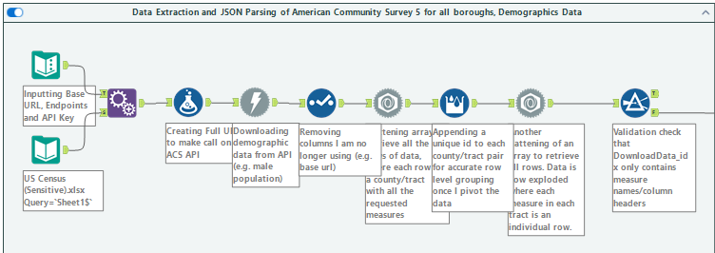
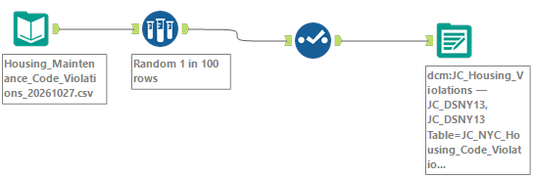
Data Ingestion

Slide 8
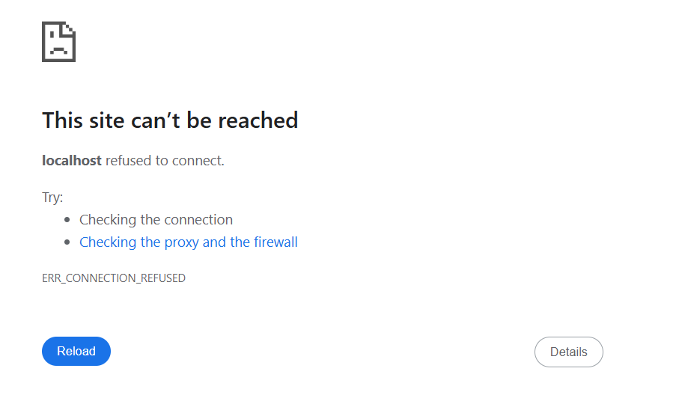
Connecting Alteryx to Snowflake

Slide 9
3
Data Modeling

Slide 10
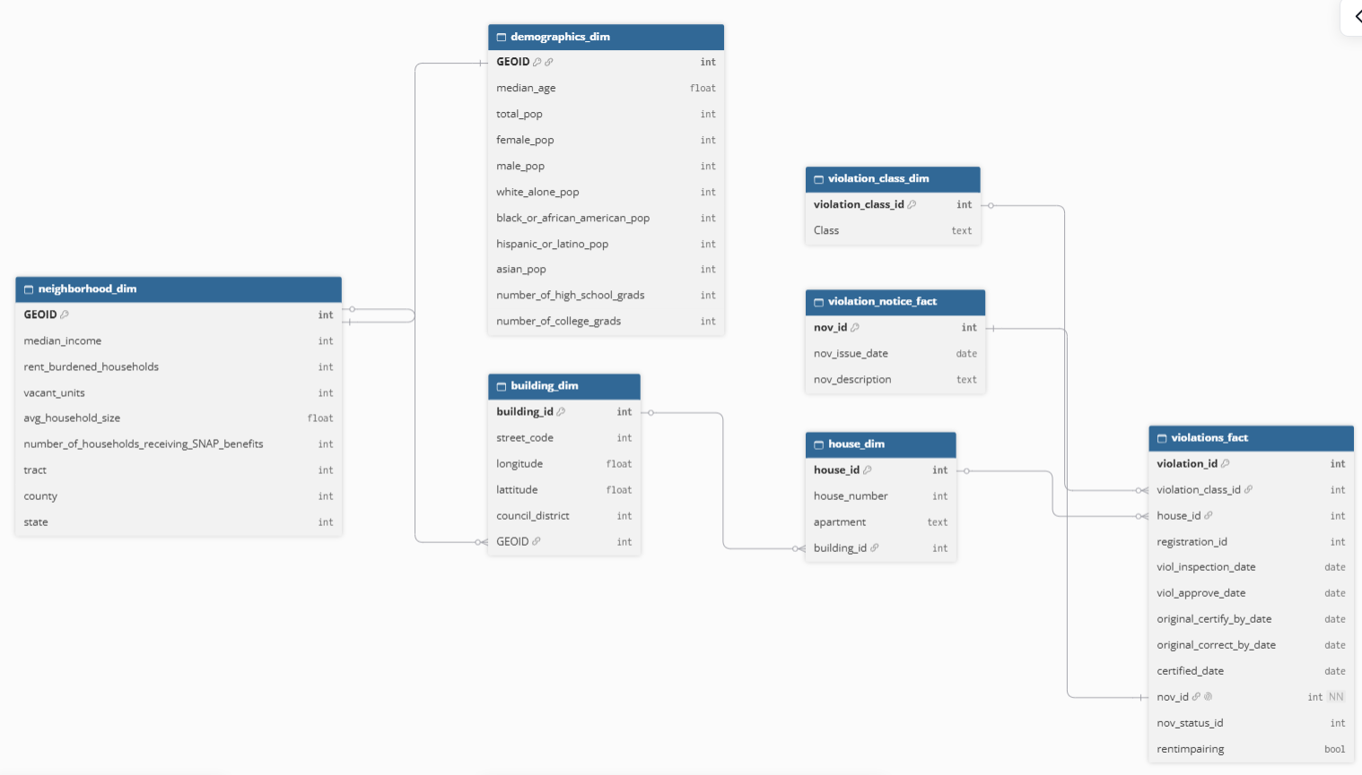

Slide 11
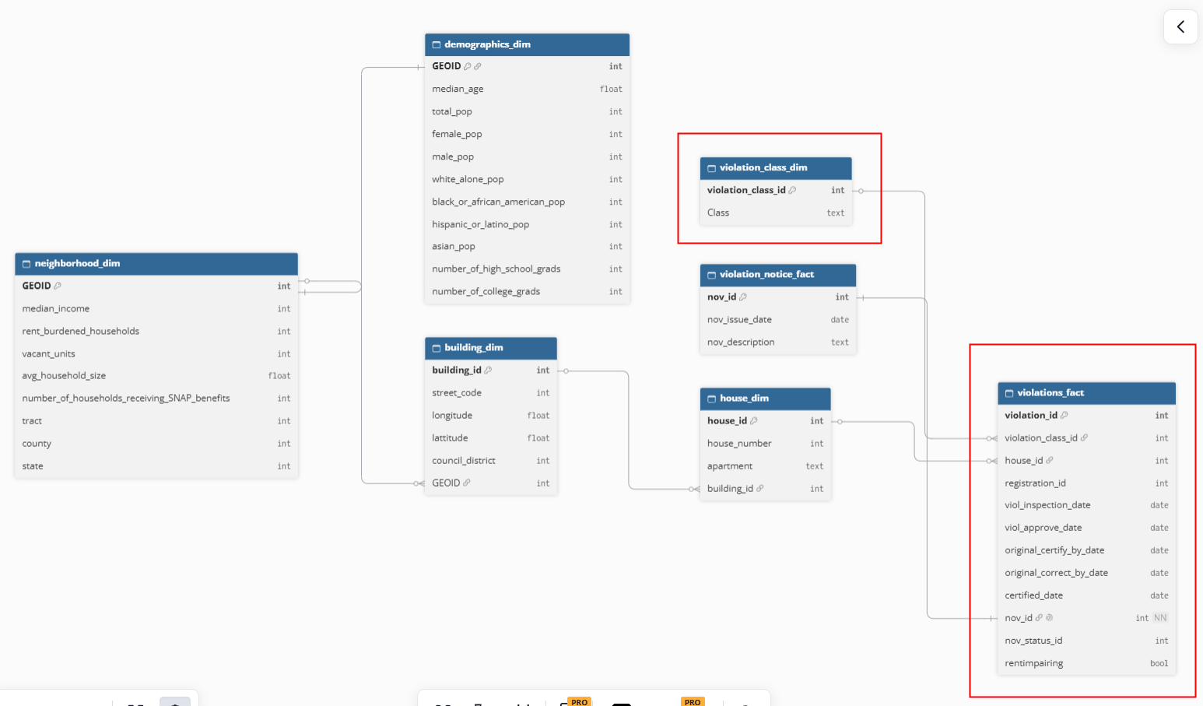
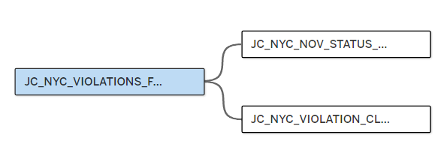
Executive Schema

Slide 12
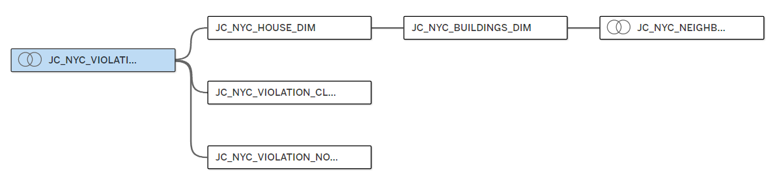
Housing Maintenance Analyst

Slide 13
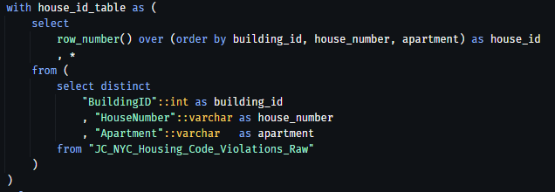
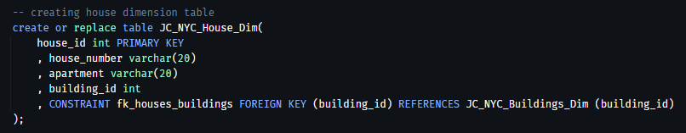
SQL: Table Creation and Data Validation

Slide 14
3
Dashboard Demos

Slide 15
3
Challenges

Slide 16
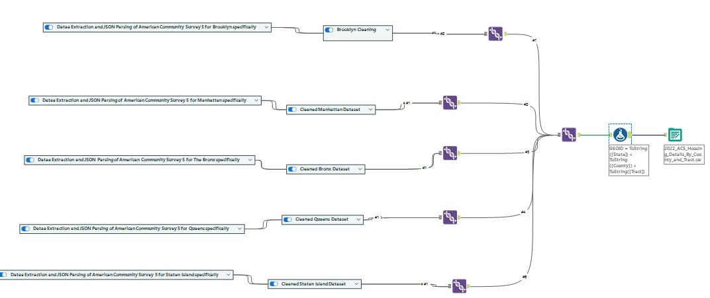
Data Ingestions Challenges
Lost entire Atleryx flow at 5:00 pm on Monday and all work I did after lunch was gone!
Error: The error "Failure when receiving data from the peer" (commonly cURL error 56) means the underlying TCP or TLS connection was abruptly closed or reset by the remote server, proxy, or firewall before the full response data was received.

Slide 17
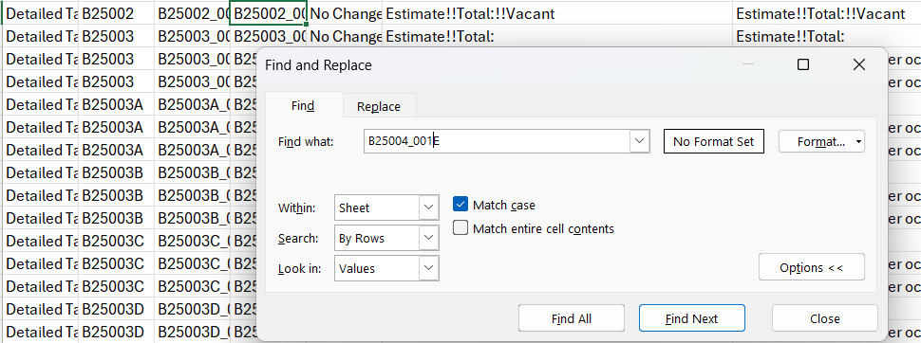
Data Validation Challenges
2024 Table Codes Were Update, had to go one-by-one to ensure I was ingesting the correct data. 19 fields

Slide 18
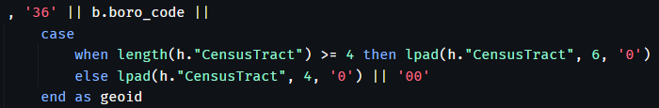
Table Creation Challenges
Tract Number Misalignment: Critical for Creating GEOIDs
American Community Survey Dataset: tract "65" = "65.00" (but with the decimal removed "6500"
NYC Open Data Dataset: tract "65" = "65"
Max Tract Number Length: 4 digits
Had to convert to string instead of int to keep all 11 digits

Slide 19
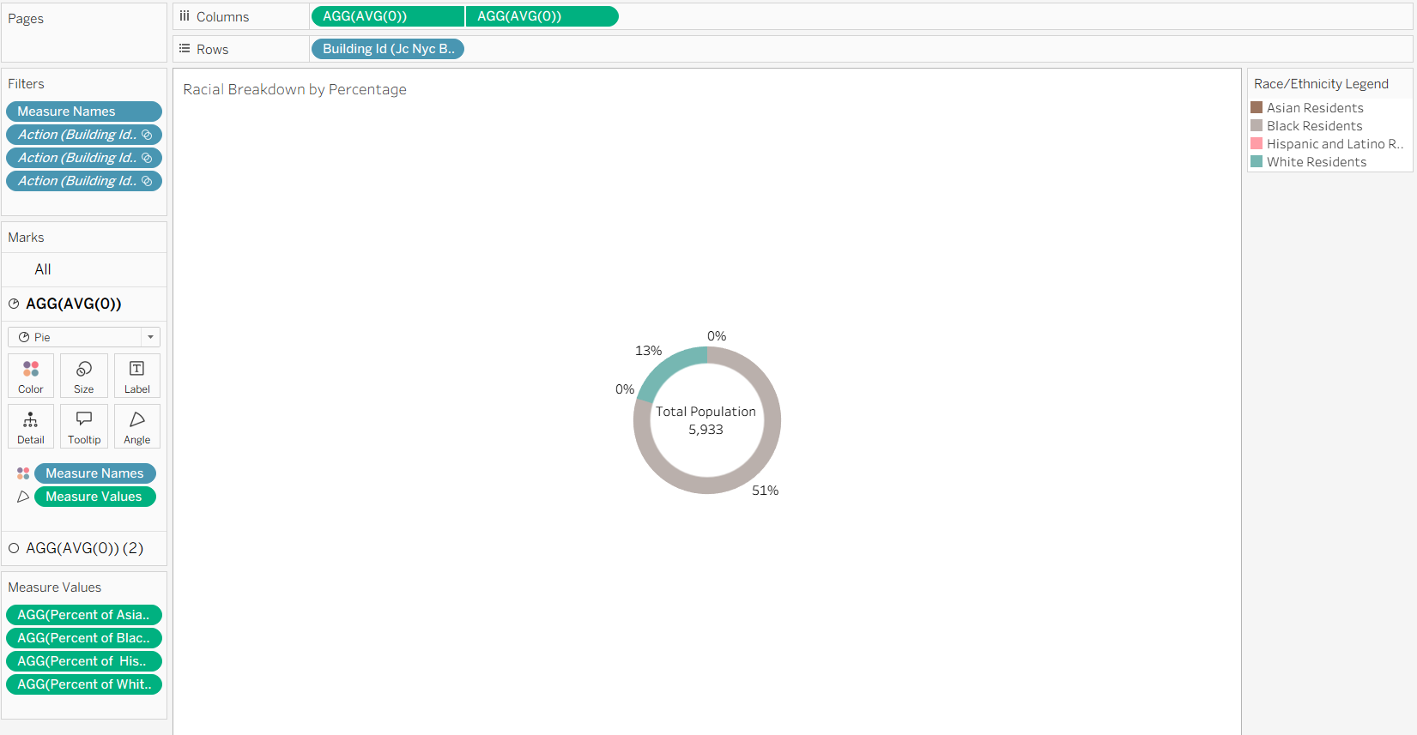
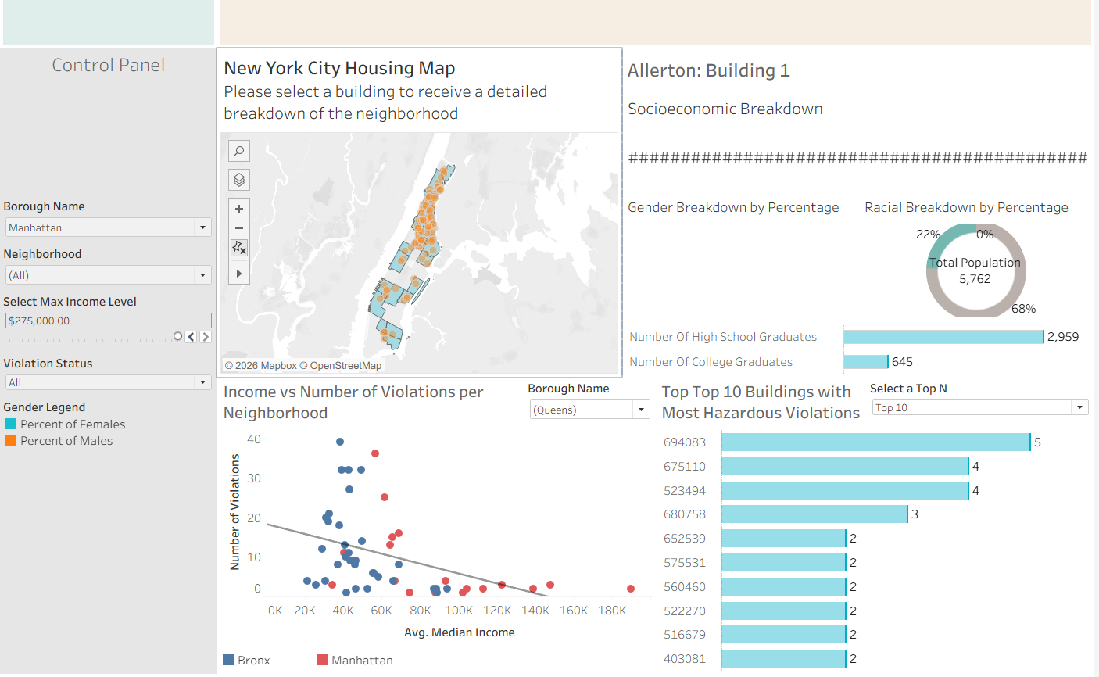
Dashboard Challenges
Perhaps could’ve pivoted but didn’t want to explode

Slide 20
3
Next Steps

Slide 21
Recommendations to Stakeholder
Target the Bronx for mass housing maintenance first.
  Second smallest borough yet the most violations
For equitable resource distribution, focus on neighborhoods where median income is less than 50,000 dollars
  The Bronx: Allerton (majority Black)
Housing Policy Recommendation
  Strict enforcement of civil penalties on landlords to fix violations, especially hazardous ones
  Expected Outcomes: Decrease in time to fix violation in Executive Dashboard

Slide 22
Q&A

