Slide 1
CS 305 Lab Tutorial Lab 15 Layer3 Switch & Daily use of network device
Dept. Computer Science and Engineering
Southern University of Science and Technology
Thanks to Wei WANG
Notes:
、

Slide 2
Topic
Realize interworking between VLANs
802.1Q
Switch(Layer3)
How to use network devices in daily scenarios
How to configure
by console
by telnet
How to monitor and analysis
monitor session on the network device
snippers
Practices

Slide 3
802.1Q and VLAN
802.1Q(abbreviation: dot1q)：
The switch needs to identify the transmission and reception of frames belonging to different VLANs on one trunk link. Therefore, each frame transmitted on the trunk link needs to be assigned a unique VLAN ID. If the frame is to be sent to other trunk links, VLAN ID will remain in the frame header. The switch will not delete the VLAN ID until the frame is sent to an access link.
Frame format in 802.1Q (add VPID and VCI to the frame)
VPID: 0X8100
VCID = priority (3bits) + flag(1bit) + VLAN ID(12bits)
Preamble | Seperator | Dst MAC addr | Src MAC addr | VPID | VCI | type | data | FCS
7B | 1B | 6B | 6B | 2B | 2B | 2B | 46~1500B | 4B
https://ieeexplore.ieee.org/document/1637340

Slide 4
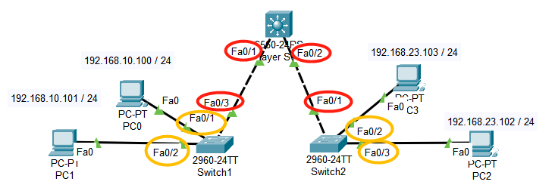
Tag / Trunk VLAN
Access VLAN port:
Fa0/1 and Fa0/2 of Switch1,Fa0/2 and Fa0/3 of Switch2.
Trunk/tag VLAN port:
Fa0/1 and Fa0/2 of MultiLayerSwitch, Fa0/3 of Switch1 and Fa0/1 of Switch2.

Slide 5
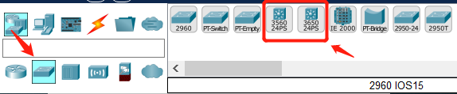
Layer3 Switch
Layer3 Switch：
The Layer 3 switch can be seen as a Layer 2 switch plus a routing module. When forwarding packets, it sends them to the routing module to provide the routing path, and then the switch completes the forwarding.
The routing module is Implemented in hardware, so Layer3 switch is quicker than the route on the forwarding.
The “routing” function is closed by default, it could be opened by “ip routing” command.
Virtual interface on VLAN
Each VLAN could be related to a virtual interface on the switch.
The hosts in each VLAN use the IP address of the virtual interface on the layer 3 switch as the gateway of the VLAN.
https://ieeexplore.ieee.org/document/1637340

Slide 6
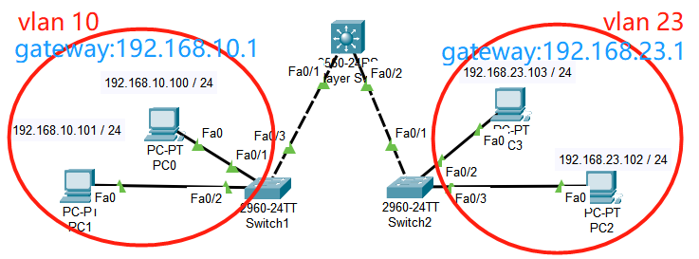
Realize interworking between VLANs(1)
Build the network refer to the following topology ：
1. There are 4 PCs, 2 Layer2 switches and 1 Layer3 switch in the network.
2. There are two VLANs: VLAN 10 with PC0 and PC1 in it, VLAN 23 with PC2 and PC3 in it.
3. The gateway of PC0 and PC1 is 192.168.10.1, the gateway of PC2 and PC3 is 192.168.23.1.
Finish the configuration on the network to make PC2 and PC3 are reachable from PC0 and PC1.
Notes:
三层交换机的特点
三层交换机与二层交换机、路由器之间的比较

Slide 7
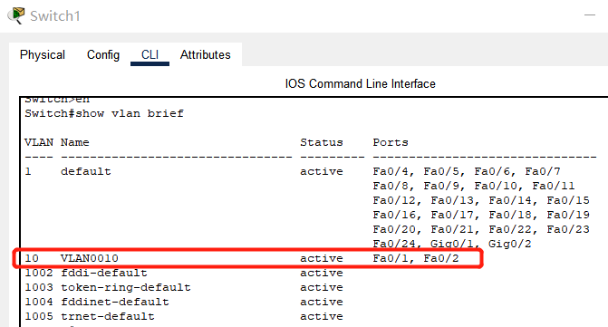
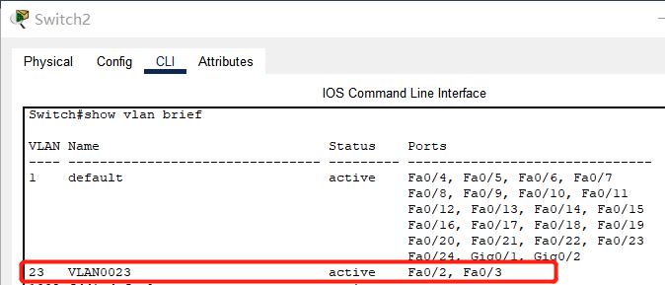
Realize interworking between VLANs(2)
Notes:
三层交换机的特点
三层交换机与二层交换机、路由器之间的比较

Slide 8

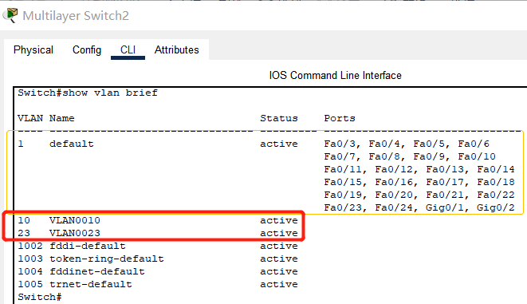
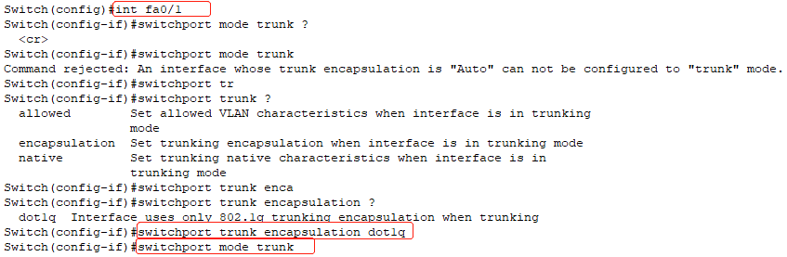
Realize interworking between VLANs(3)
On the Layer 3 switch:
1) Create vlan 10, vlan 23
2) Set the ports connected to “switch1” and “switch2” to trunk.
tips: on Layer3 switch, the encapsulation of switchport trunk MUST be set as “dot1q”.

Slide 9

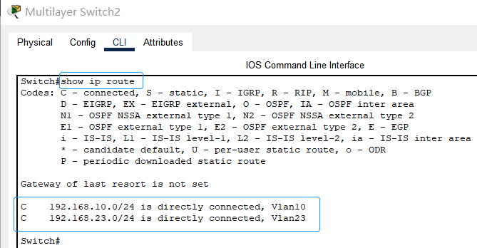
Realize interworking between VLANs(4)
On the Layer 3 switch:
3) Set the virtual interface corresponding to vlan 10 and vlan 23, and set the IP address of the virtual interfaces (the IP address should be the default gateway of the PCs which access to the VLANs)
4) Enable the routing function of the Layer 3 switch by the command “ip routing”
tips: “192.168.10.1” is the gateway of PC1 and PC2

Slide 10
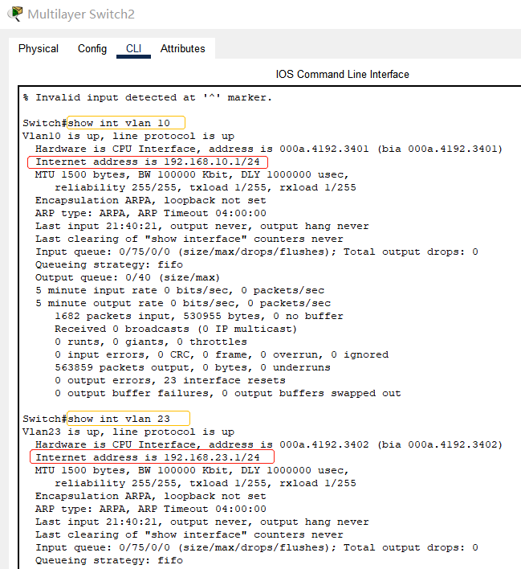
Realize interworking between VLANs(5)
具体的实现方式

Slide 11
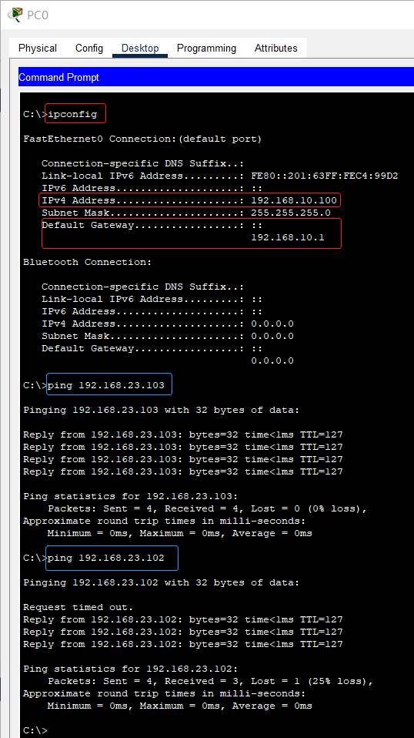
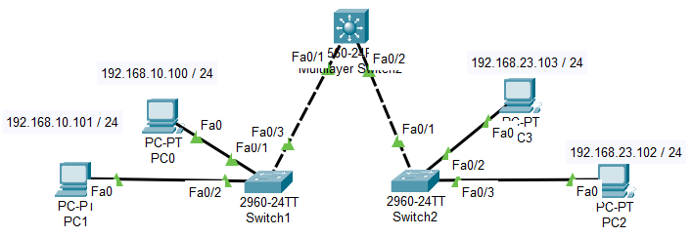
Test interworking between VLANs(1)
There are two VLANs: VLAN 10 with PC0 and PC1 in it, VLAN 23 with PC3 and PC4 in it.
The gateway of PC0 and PC1 is 192.168.10.1, the gateway of PC2 and PC3 is 192.168.23.1.

Slide 12
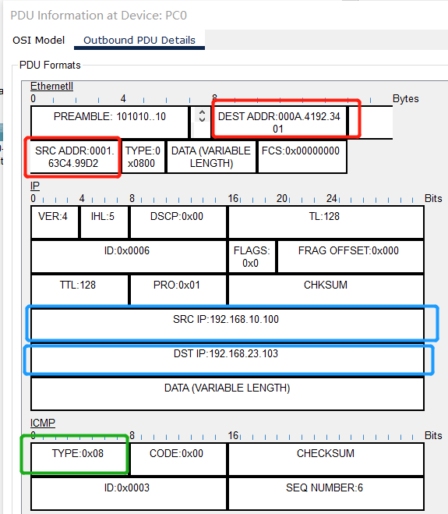
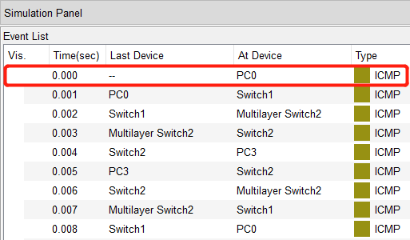
Test interworking between VLANs(2)
On simulation mode, capture the packets and answer the following question:
1) Is this a ICMP request or reply packet?
2) Whose MAC address is the DEST ADDR(000A.4192.3401) here?

Slide 13
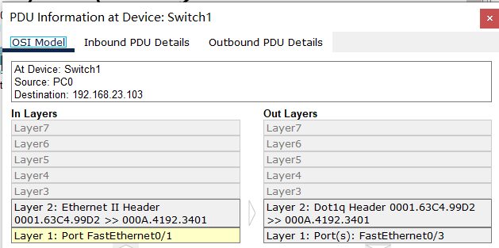
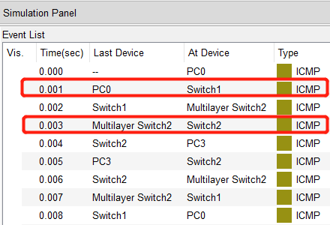
Test interworking between VLANs(3)
3) While Switch1 receive the packet from PC0, is there any fields about 802.1q in the layer2 frame? What are the values of these fields ?
4) While Switch1 send the packet to Multilayer Switch2, is there any fields about 802.1q in the layer2 frame? What are the values of these fields ?

Slide 14
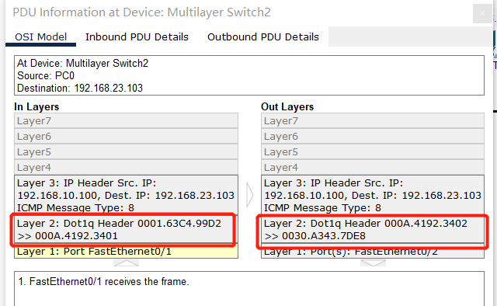
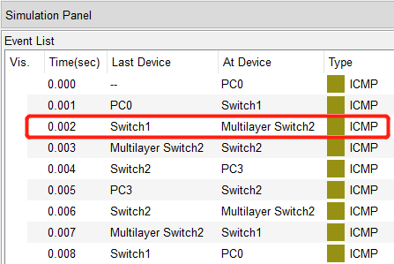
Test interworking between VLANs(4)
1) Which virtural interface of Multilayer Switch2 receive the packet?
2) Is there any routing item in the routing table related to the Dest IP(192.168.23.103) ? what’s the type of the routing item: static, connected, dynamic ?

Slide 15
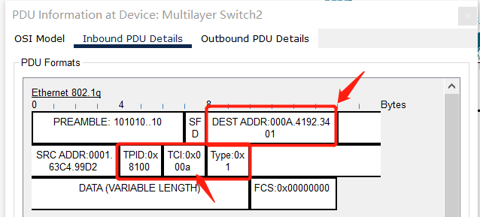
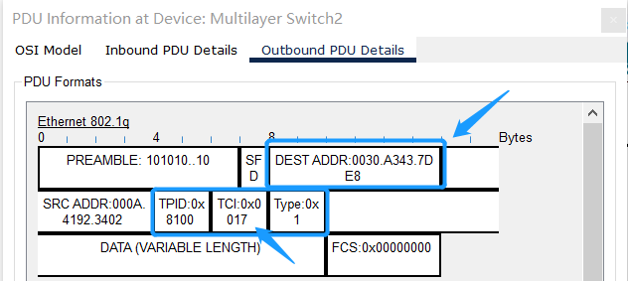
Test interworking between VLANs(5)
1) While Myltilayer Switch2 receive the packet from Switch1, what’s the VLAN ID in layer2 frame?
2) While Myltilayer Switch2 send the packet to Switch2, what’s the VLAN ID in layer2 frame?
3) Whose MAC address is the DEST ADDR
(0030.A343.7DE8) here?

Slide 16

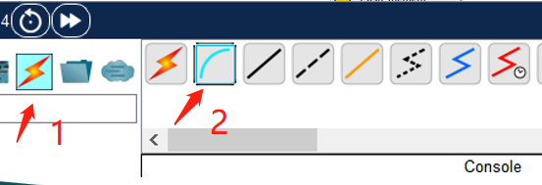
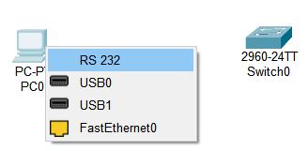
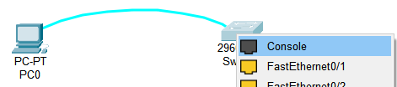

Configure the network device by Console(1)
Step1:
Connect the network device with PC by console cable.
One end of the console cable is connected to the RS232 port of the PC
Another end of the console cable is connected to the console port of the network device

Slide 17
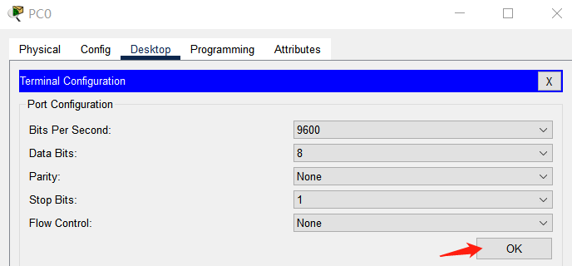
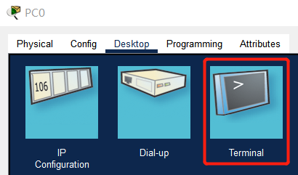
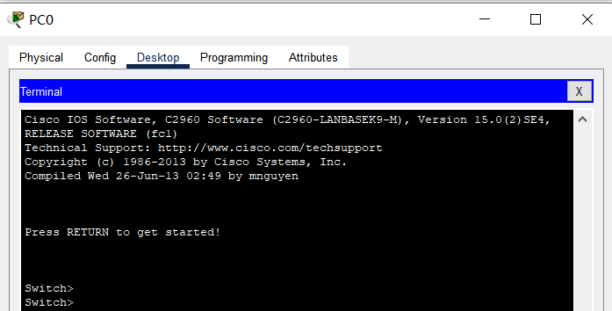
Configure the network device by Console(2)
Step2: Open the “Terminal”on the PC,finish the related configuration on the “terminal”, then click “OK” .

Slide 18
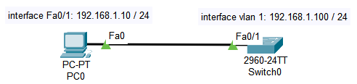
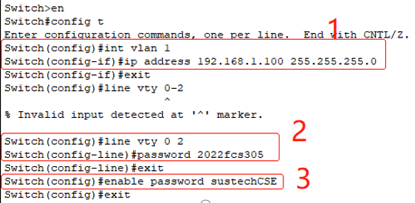
Configure the network device by telnet(1)
Preparation:
The configuration on the network device
Need an IP address
If there is no IP address on the device(e.g. switch), set the ip address on the virtual interface of the vlan 1( which is the default vlan on the device)
Set the line virtual terminal and its login password
If the user need to configure the device by telnet, set the password of “enable”

Slide 19
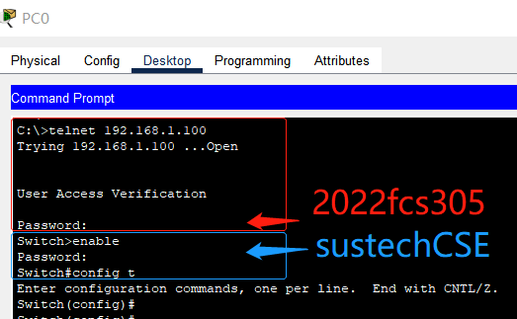
Configure the network device by telnet(2)
The steps on the PC which telnets to the network device:
open a “command window” to invoke “telnet”
telnet the network device, input its IP address and the “login” password
after login the device, you are in the user mode by default, input “enable” to switch to the system mode
input the “enable” password, if the “enable” password is right, it is permit to switch to the system mode by command “config t”.

Slide 20
Configure the network device by telnet(3)

Slide 21
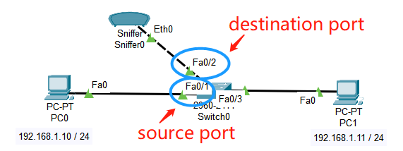
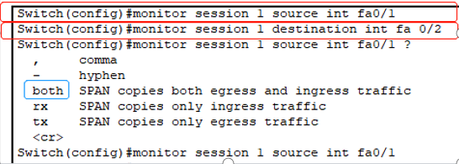
Monitor the ports on the network device(1)
Set a monitor session on the network device and the source port and destination port of the monitor session.
The packets recevied/sent by the source port would be copied to the destination port.
Connect the destination port of the network decive with a PC or Sniffer.
The PC or sniffer could capture the packet so as to monitor the data flow.

Slide 22
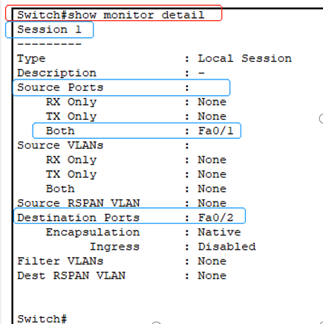
Monitor the ports on the network device(2)
Command“Show monitor detail”is useful to show the details about the monitor settings.

Slide 23
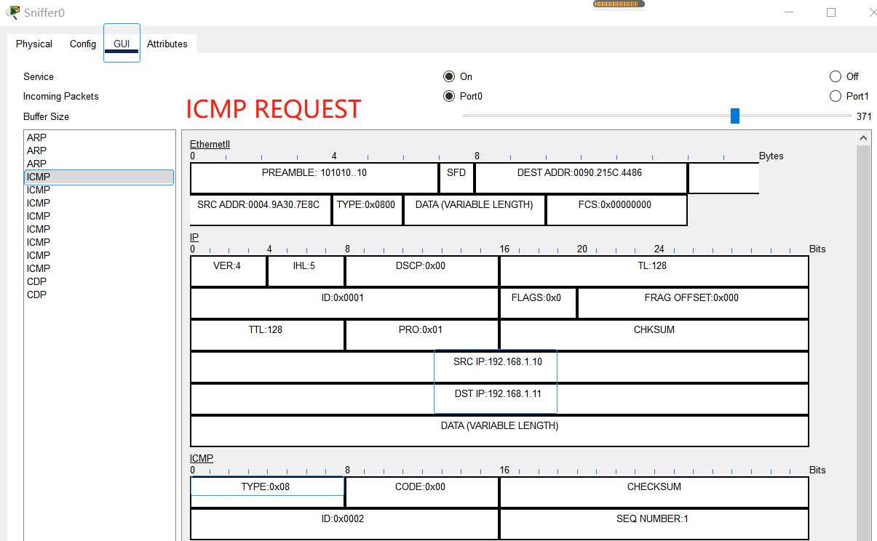
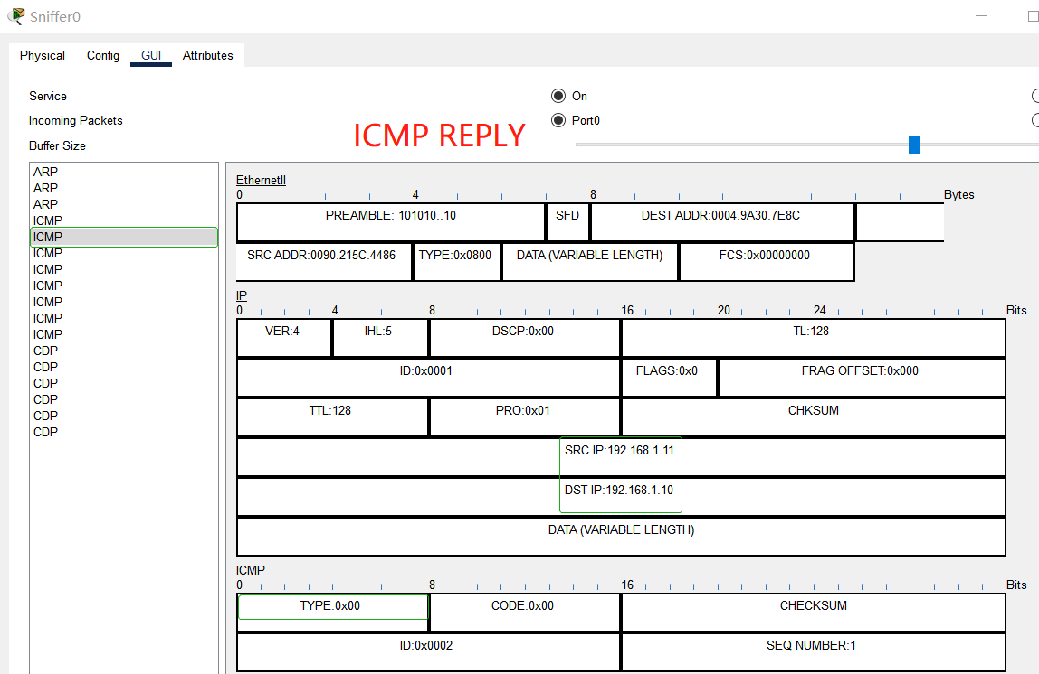
Monitor the ports on the network device(3)
Invoke “ping 192.168.1.11” on PC0,the packets sent and received by the port “Fa0/1”are copied to the “Fa0/2”, the “sniffer0” received and captured the packets.

Slide 24
Practices
1. Finish the configuration to realize interworking between VLANs.
2. Answer the questions on the “test interworking between VLANs”pages.
3. Add a sniffer to the network and capture all the packets received by the interface fa0/2 on the Multilayer Switch2.

