Slide 1
Statistical Learning for Data Science
Lecture 12
唐晓颖
电子与电气工程系
南方科技大学
April 10, 2023

Slide 2
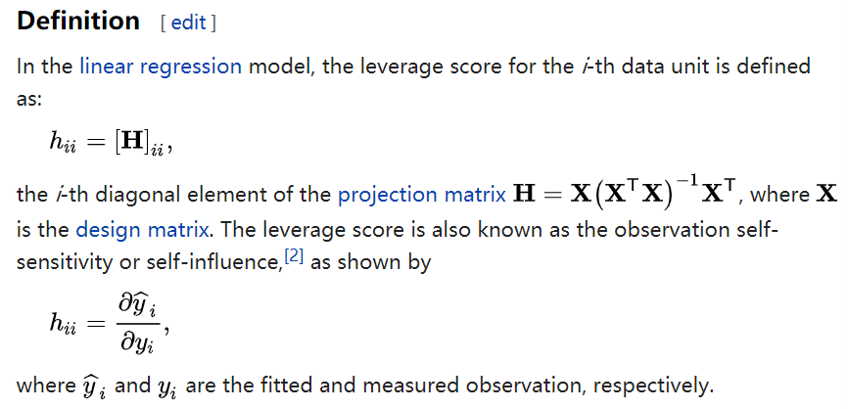
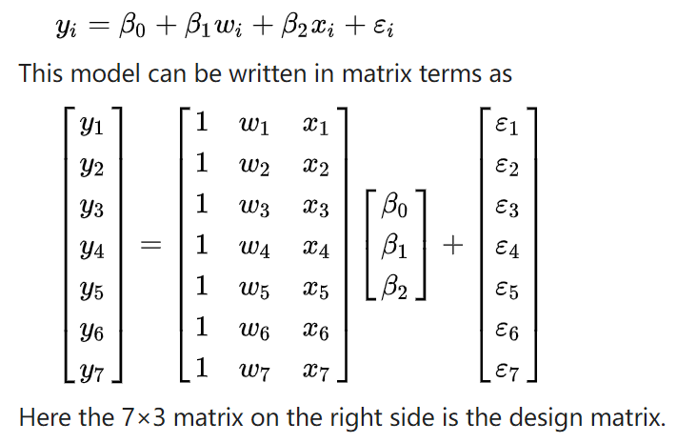
Other considerations in the regression model
Potential problems of fitting a linear regression model
High leverage points
Observations with high leverage have an unusual value for .
--red solid line: the least squares regression fit of all data
--blue dash line: the least squares regression fit after removal of the high leverage point
Removing the high leverage observation has a much more substantial impact on the least squares line than removing the outlier
Notes:
Leverage – 杠杆

Slide 3
Other considerations in the regression model
Potential problems of fitting a linear regression model
High leverage points
Observations with high leverage have an unusual value for .
Note:
High leverage observations tend to have a sizable impact on the estimated regression line.
It is cause for concern if the least squares line is heavily affected by just a couple of observations, because any problem with these points may invalidate the entire fit.
Notes:
Sizable – 可观的，极大的

Slide 4
Other considerations in the regression model
Potential problems of fitting a linear regression model
High leverage points
Observations with high leverage have an unusual value for .
In a simple linear regression, high leverage observations are fairly easy to identify.
In a multiple linear regression with many predictors, it is possible to have an observation that is well within the range of each individual predictor’s values, but that is unusual in terms of the full set of predictors.

Slide 5
Other considerations in the regression model
Potential problems of fitting a linear regression model
High leverage points
Observations with high leverage have an unusual value for .
This problem is more pronounced in multiple linear regression settings with more than two predictors, because then there is no simple way to plot all dimensions of the data simultaneously.

Slide 6
Other considerations in the regression model
Potential problems of fitting a linear regression model
High leverage points
How to identify?
In order to quantify an observation’s leverage, we compute the leverage statistic. A large value of this statistic indicates an observation with high leverage.
For a simple linear regression,

Slide 7
Other considerations in the regression model
Potential problems of fitting a linear regression model
High leverage points
For a simple linear regression,
increases with the distance of from
If a given observation has a leverage statistic that greatly exceeds the average, then we may suspect that the corresponding point has high leverage

Slide 8
Other considerations in the regression model
Potential problems of fitting a linear regression model
High leverage points
Observation 41 stands out as having a very high leverage statistic as well as a high studentized residual. This is a particularly dangerous combination.
This plot also reveals the reason that observation 20 had relatively little effect on the least squares fit: it has low leverage.

Slide 9
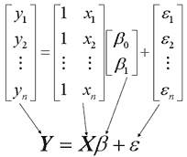
Other considerations in the regression model
Potential problems of fitting a linear regression model
High leverage points
How to identify?
In order to quantify an observation’s leverage, we compute the leverage statistic. A large value of this statistic indicates an observation with high leverage.
For a multiple linear regression,
The design matrix

Slide 10
Other considerations in the regression model
Potential problems of fitting a linear regression model
Collinearity
Collinearity refers to the situation in which two or more predictors/ variables are closely related to each other.
Credit card set
The two predictors limit and age appear to have no obvious relationship.
The predictors limit and rating are very highly correlated with each other, and we say that they are collinear.

Slide 11
Other considerations in the regression model
Potential problems of fitting a linear regression model
Collinearity
Collinearity refers to the situation in which two or more predictors/ variables are closely related to each other.
Credit card set
Since limit and rating tend to increase or decrease together, it can be difficult to determine how each one separately is associated with the response, balance.

Slide 12
Other considerations in the regression model
Potential problems of fitting a linear regression model
Collinearity
Collinearity refers to the situation in which two or more predictors variables are closely related to each other.
The axes for limit and age have been scaled so that the plot includes possible coefficient estimates that are up to four standard errors on each side of the least squares estimates. Thus the plot includes all plausible values for the coefficients. For example, we see that the true limit coefficient is almost certainly somewhere between 0.15 and 0.2
Notes:
A contour plot of the RSS associated with different possible coefficient estimates

Slide 13
Other considerations in the regression model
Potential problems of fitting a linear regression model
Collinearity
Collinearity refers to the situation in which two ore more predictors variables are closely related to each other.
The contours run along a narrow valley; there is a broad range of values for the coefficient estimates that result in equal values for RSS. Hence a small change in the data could cause the pair of coefficient values that yield the smallest RSS – that is, the least squares estimates – to move anywhere along this valley. This results in a great deal of uncertainty in the coefficient estimates.

Slide 14
Other considerations in the regression model
Potential problems of fitting a linear regression model
Collinearity
Collinearity refers to the situation in which two ore more predictors variables are closely related to each other.
[0.15,0.2]
Versus
[-0.2,0.2]

Slide 15
Other considerations in the regression model
Potential problems of fitting a linear regression model
Collinearity
Collinearity reduces the accuracy of the estimates of the regression coefficients.
The standard error for each coefficient estimate grows.
t-statistic = coefficient estimate/SE, a decline in the t-statistic
We might fail to reject the null hypothesis
Conclusion: the power of the hypothesis test – the probability of correctly detecting a non-zero coefficient – is reduced by collinearity

Slide 16
Other considerations in the regression model
Potential problems of fitting a linear regression model
Collinearity
Observations:
SE for limit: 0.005 versus 0.064
p-value for limit: <0.0001 versus 0.7012
The importance of the limit variable has been masked due to the presence of collinearity

Slide 17
Other considerations in the regression model
Potential problems of fitting a linear regression model
Collinearity
How to identify?
The correlation matrix of the predictors
An element of the correlation matrix that is large in absolute value indicates a pair of highly correlated variables, and therefore a collinearity problem in the data.

Slide 18
Other considerations in the regression model
Potential problems of fitting a linear regression model
Collinearity
How to identify?
The variance inflation factor (VIF)
Not all collinearity problems can be detected by inspection of the correlation matrix: it is possible for collinearity to exist between three or more variables even if no pair of variables has a particularly high correlation (multicollinearity).
Notes:
Multicolinearity -- 多重共线性

Slide 19
Other considerations in the regression model
Potential problems of fitting a linear regression model
Collinearity
How to identify?
The variance inflation factor (VIF)
As the name suggests, a VIF quantifies how much the variance is inflated. But what variance? Recall that we learned previously that the standard errors — and hence the variances — of the estimated coefficients are inflated when multicollinearity exists. So, the VIF for the estimated coefficient — denoted — is just the factor by which the variance is inflated.

Slide 20
Other considerations in the regression model
Potential problems of fitting a linear regression model
Collinearity
How to identify?
The variance inflation factor (VIF)
For the model in which is the only predictor
Note that we add the subscript "min" in order to denote that it is the smallest the variance can be

Slide 21
Other considerations in the regression model
Potential problems of fitting a linear regression model
Collinearity
How to identify?
The variance inflation factor (VIF)
For the full model
The R²-statistic obtained by regressing the j^{th} predictor on the remaining predictors

Slide 22
Other considerations in the regression model
Potential problems of fitting a linear regression model
Collinearity
How to identify?
The variance inflation factor (VIF)
The R²-statistic obtained by regressing the j^{th} predictor on the remaining predictors
The greater the linear dependence among the predictor and the other predictors, the larger the value. And, as the above formula suggests, the larger the value, the larger the variance of .

Slide 23
Other considerations in the regression model
Potential problems of fitting a linear regression model
Collinearity
How to identify?
The variance inflation factor (VIF)

Slide 24
Other considerations in the regression model
Potential problems of fitting a linear regression model
Collinearity
How to identify?
The variance inflation factor (VIF)
The smallest possible value for VIF is 1 (complete absence of collinearity).
A VIF exists for each of the p predictors in a multiple regression model.
VIFs exceeding 4 warrant further investigation, while VIFs exceeding 10 are signs of serious multicollinearity requiring correction.

Slide 25
Other considerations in the regression model
Potential problems of fitting a linear regression model
Collinearity
How to identify?
The variance inflation factor (VIF)
Credit card set
There is considerable collinearity in the data!

Slide 26
Other considerations in the regression model
Potential problems of fitting a linear regression model
Collinearity
How to fix?
Drop one of the problematic variables from the regression
e.g. Drop the rating predictor in the credit card data
Combine the collinear variables together into a single predictor
e.g. take the average of the standardized versions of limit and rating in order to create a new variable.

Slide 27
Comparison of Linear Regression with K-Nearest Neighbors
Linear regression is an example of a parametric approach
Advantages:
Easy to fit (only need to estimate a small number of coefficients)
The coefficients have simple interpretations
Tests of statistical significance can be easily performed
Disadvantages:
Make a strong assumption about the form of f(X). If the specified functional form is far from the truth, and prediction accuracy is our goal, then the parametric method will perform poorly.

Slide 28
Comparison of Linear Regression with K-Nearest Neighbors
KNN regression is an example of a non-parametric approach
Definition: Given a value for and a prediction point , KNN regression first identifies the training observations that are closest to , represented by . It then estimates using the average of all the training responses in . In other words,
Advantages:
Don’t explicitly assume a parametric form for f(X), and thereby provide an alternative and more flexible approach for performing regression.

Slide 29
Comparison of Linear Regression with K-Nearest Neighbors
Linear regression is an example of a parametric approach
KNN regression
K = 1
K = 9

Slide 30
Comparison of Linear Regression with K-Nearest Neighbors
Linear regression is an example of a parametric approach
KNN regression
NOTE: In general, the optimal value for K will depend on the bias-variance tradeoff. A small value for K provides the most flexible fit, which will have low bias but high variance. The variance is due to the fact that the prediction in a given region is entirely dependent on just one or several observations. In contrast, large values for K provide a smoother and less variable fit; the prediction in a region is an average of multiple points, and so change one observation has a smaller effect. However, the smoothing may cause bias by masking some of the structure in f(X).

Slide 31
Comparison of Linear Regression with K-Nearest Neighbors
Linear regression is an example of a parametric approach
NOTE: the parametric approach (such as the least squares linear regression) will outperform the nonparametric approach if the parametric form that has been selected is close to the true form of f.
1-NN
9-NN
Linear

Slide 32
Comparison of Linear Regression with K-Nearest Neighbors
Linear regression is an example of a parametric approach
NOTE: the parametric approach (such as the least squares linear regression) will outperform the nonparametric approach if the parametric form that has been selected is close to the true form of f.
Black: the test MSE for linear regression
Green: the test MSE for KNN regression

Slide 33
Comparison of Linear Regression with K-Nearest Neighbors
Linear regression is an example of a parametric approach
NOTE: the parametric approach (such as the least squares linear regression) will outperform the nonparametric approach if the parametric form that has been selected is close to the true form of f.
The test MSE for linear regression is still superior to that of KNN for low values of K. However, for K >= 4, KNN outperforms linear regression.

Slide 34
Comparison of Linear Regression with K-Nearest Neighbors
Linear regression is an example of a parametric approach
NOTE: the parametric approach (such as the least squares linear regression) will outperform the nonparametric approach if the parametric form that has been selected is close to the true form of f.
KNN substantially outperformed linear regression for all values of K.

Slide 35
Comparison of Linear Regression with K-Nearest Neighbors
Linear regression is an example of a parametric approach
In a real life situation in which the true relationship is unknown, one might draw the conclusion that KNN should be favored over linear regression because it will at worst be slightly inferior than linear regression if the true relationship is linear, and may give substantially better results if the true relationship is nonlinear.
Not completely correct!
In reality, even when the true relationship is highly non-linear, KNN may still provide inferior results to linear regression, especially in higher dimensions (p>1).

Slide 36
Comparison of Linear Regression with K-Nearest Neighbors
Linear regression is an example of a parametric approach
Adding noise predictors that are not associated with the response
When p=1 or p=2, KNN outperforms linear regression
When p=3, the results are mixed
When p>=4, linear regression is superior to KNN

Slide 37
Comparison of Linear Regression with K-Nearest Neighbors
Linear regression is an example of a parametric approach
Adding noise predictors that are not associated with the response
The increase in dimension has only caused a small deterioration in the linear regression test set MSE, but it has caused more than a ten-fold increase in the MSE for KNN. This decrease in performance as the dimension increases is a common problem for KNN.

Slide 38
Comparison of Linear Regression with K-Nearest Neighbors
Linear regression is an example of a parametric approach
Adding noise predictors that are not associated with the response
n=100, when p=1, this provides enough information to accurately estimate f(X). However, spreading 100 observations over p=20 dimensions results in a phenomenon in which a given observation has no nearby neighbors – “curse of dimensionality”.
Notes:
curse of dimensionality – 维数灾难

Slide 39
Comparison of Linear Regression with K-Nearest Neighbors
Linear regression is an example of a parametric approach
Suggestions
As a general rule, parametric method will tend to outperform non-parametric approaches when there is a small number of observations per predictor.
Even in problems in which the dimension is small, we might prefer linear regression to KNN from an interpretability standpoint.
Notes:
第3章结束

Slide 40
Classification
Qualitative (categorical) responses taking values in an unordered set
Example:
Classification
Predicting a qualitative response for an observation; it involves assigning
the observation to a category, or class.
Often, we are more interested in estimating the probabilities that the
observation belongs to each category in the set. For example, it is more
valuable to have an estimate of the probability that an insurance claim is
fraudulent, than a classification fraudulent or not.
Notes:
第4章开始；fraudulent – 欺诈的

Slide 41
Classification
Three classifiers:
Logistic regression
Linear discriminant analysis
K-nearest neighbors

Slide 42
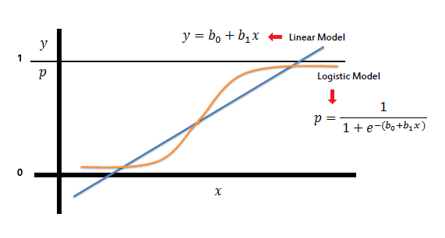
Classification
Three classifiers:
1. Logistic regression
Notes:
放一个图简单展示一下 后面会详细讲解

Slide 43
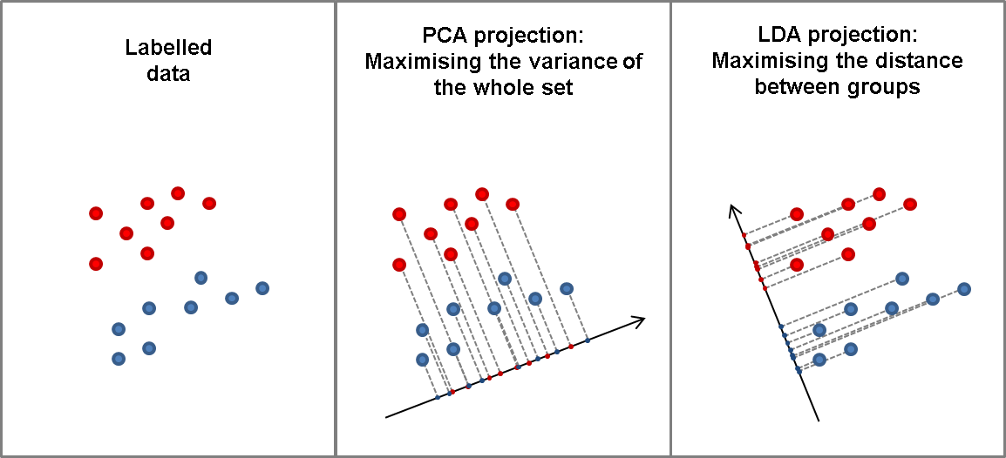
Classification
Three classifiers:
2. Linear discriminant analysis

Slide 44
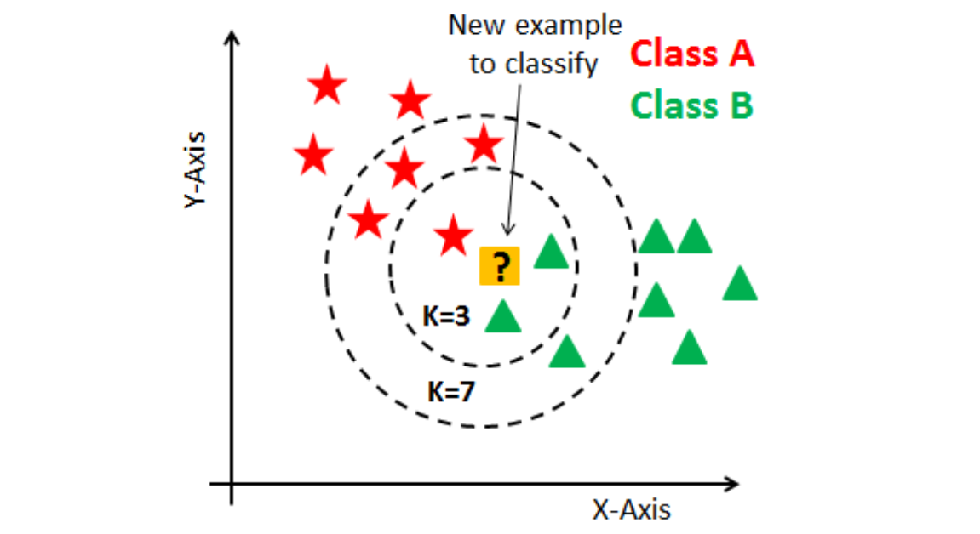
Classification
Three classifiers:
3. K-nearest neighbors

Slide 45
An Overview of Classification
Similar to regression, in classification, we have a set of training data
that we can use to build a classifier.
We want our classifier to perform well not only on the training data, but also on the test observations that were not used to train the classifier.
Goal of classification: train a model that can accurately predict the class of new, unseen data based on its features
Applications of classification: including image and speech recognition, spam filtering, credit scoring, and fraud detection, among others.

Slide 46
An Overview of Classification
Example: the default data set
Goal: we are interested in predicting whether an individual will default on his or her credit card payment, on the basis of annual income and monthly credit card balance.
--orange: default
--blue: non-default
Pattern observed: individuals who defaulted tended to have higher credit card balances than those who did not.
Notes:
Default -- 拖欠

Slide 47
An Overview of Classification
Example: the default data set
We will learn how to build a model to predict default ( ) for any given value of balance ( ) and income ( ).
There is a very pronounced relationship between balance and default in this example. In most real applications, the relationship between the predictor and the response will not be nearly so strong.

Slide 48
Can We Use Linear Regression
Example: the default data set
We code
Can we simply perform a linear regression of on and classify as Yes if ?
In this case of a binary outcome, linear regression does a good job as a classifier, and is equivalent to linear discriminant analysis which we will discuss later.
Since in the population, we might think that regression is perfect for this task.
Why we have ?

Slide 49
Can We Use Linear Regression
Example: the default data set
We code
Can we simply perform a linear regression of on and classify as Yes if ?
However, if we use linear regression, some of our estimates might be outside the [0,1] interval, making them hard to interpret as probabilities. Logistic regression is more appropriate.

Slide 50
Can We Use Linear Regression
Now suppose we have a response variable with three possible values. A patient presents at the emergency room, and we must classify them according to their symptoms.
This coding implies an ordering on the outcomes, putting drug overdose in between stroke and epileptic seizure, and insisting that the difference between stroke and drug overdose is the same as the difference between drug overdose and epileptic seizure. In practice, there is no particular reason that this needs to be the case.
Linear regression is not appropriate here. Multiple Logistic Regression and Discriminant Analysis are more appropriate.
Notes:
Stroke – 中风； drug overdose – 用药过度；epileptic seizure--癲癇突發

Slide 51
Logistic Regression
Rather than modeling the response directly, logistic regression models the probability that belongs to a particular category.
Goal of logistic regression: predict a binary outcome, such as yes or no, true or false, or 0 or 1.
Key idea behind logistic regression: use a logistic function to model the probability of the binary outcome, given the input features.
The logistic function is an S-shaped curve that maps any input value to a probability value between 0 and 1.

Slide 52
Logistic Regression
Rather than modeling the response directly, logistic regression models the probability that belongs to a particular category.
Example: the default data set
Let
To make predictions
To make conservative predictions in individuals who are at risk for default

Slide 53
Logistic Regression
The logistic model
How should we model the relationship between and ?

Slide 54
Logistic Regression
The logistic model
The odds
Values of the odds close to 0 and positive infinity indicate very low and very high probabilities of default, respectively.
Odds are traditionally used instead of probabilities in horse-racing, since they relate more naturally to the correct betting strategy.
Notes:
Odds – 赔率

Slide 55
Logistic Regression
The logistic model
The log-odds or logit
The logistic regression model has a logit that is linear in .
In a logistic regression model, increasing by a one unit changes the log odds by , or equivalently it multiplies the odds by .
The amount that changes due to a one-unit change in will depend on the current value of .

Slide 56
Logistic Regression
Estimating the regression coefficients
Maximum likelihood estimation
A statistical method used to estimate the parameters of a probability distribution by maximizing the likelihood function.
The basic idea of MLE: find the values of the model parameters that make the observed data most likely to occur.
Steps: 1. Specify the probability distribution
2. Write the likelihood function
3. Maximize the likelihood function
4. Check if the model fits

Slide 57
Logistic Regression
Estimating the regression coefficients
Maximum likelihood estimation
Let , then
The (conditional) likelihood function is:
The estimates and are chosen to maximize this likelihood function.

Slide 58
Logistic Regression
Estimating the regression coefficients
Maximum likelihood estimation
The log-likelihood function is:
The estimates and are obtained via numerical optimization methods.

Slide 59
Logistic Regression
Estimating the regression coefficients
Example: the default data set
A one-unit increase in balance is associated with an increase in the log-odds of default by 0.0055 units.

Slide 60
Logistic Regression
Estimating the regression coefficients
Example: the default data set
Many aspects of the logistic regression output are similar to the linear regression output:
We can measure the accuracy of the coefficient estimates by computing their standard errors.

Slide 61
Logistic Regression
Estimating the regression coefficients
Example: the default data set
Many aspects of the logistic regression output are similar to the linear regression output:
The z-statistic plays the same role as the t-statistic; , a large (absolute) value of the z-statistic indicates evidence against the null hypothesis

Slide 62
Logistic Regression
Making predictions
Example: the default data set
Once the coefficients have been estimated, it is a simple matter to compute the probability of default for any given credit card balance.
The default probability for an individual with a balance of $1,000 is
The default probability for an individual with a balance of $2,000 is

Slide 63
Logistic Regression
Making predictions
We can use qualitative predictors with the logistic regression model using the dummy variable approach.
Example: the default data set
Goal: we are interested in predicting whether an individual will default on his or her credit card payment, on the basis of his or her student status.
We create a dummy variable for student

Slide 64
Logistic Regression
Making predictions
We can use qualitative predictors with the logistic regression model using the dummy variable approach.
Example: the default data set
Goal: we are interested in predicting whether an individual will default on his or her credit card payment, on the basis of his or her student status.

Slide 65
Logistic Regression
Making predictions
We can use qualitative predictors with the logistic regression model using the dummy variable approach.
Example: the default data set
Goal: we are interested in predicting whether an individual will default on his or her credit card payment, on the basis of his or her student status.
Students tend to have higher default probabilities than non-students

Slide 66
Logistic Regression
Multiple logistic regression (MLE)
Predicting a binary response using multiple predictors.
The predictors can be either continuous or categorical
MLE estimates the probability of a binary outcome based on the values of the independent variables.
The MLE model can be written as:

Slide 67
Logistic Regression
Multiple logistic regression
Predicting a binary response using multiple predictors.
Similarly
Again, we can use MLE to estimate.

Slide 68
Logistic Regression
Multiple logistic regression
Predicting a binary response using multiple predictors.
Example: the default data set
Goal: we are interested in predicting whether an individual will default on his or her credit card payment, on the basis of balance, income (in thousands of dollars), and student status.

Slide 69
Logistic Regression
Multiple logistic regression
Why is coefficient for student negative (students are less likely to default than non-students) while it was positive (students are more likely to default than non-students) before?

Slide 70
Logistic Regression
Multiple logistic regression
Orange solid line – the average default rates for students as a function of credit card balance
Blue solid line – the average default rates for non-students as a function of credit card balance
Conclusion: For a fixed value of balance and income, a student is less likely to default than a non-student

Slide 71
Logistic Regression
Multiple logistic regression
Orange dash line – the default rates for students averaged over all values of balance and income
Blue dash line – the default rates for non-students averaged over all values of balance and income
Conclusion: the overall student default rate is higher than the non-student default rate

Slide 72
Logistic Regression
Multiple logistic regression
The variables student and balance are correlated, or more correctly, associated.
Students are more likely to have large credit card balances, which, tend to associated with high default rates.
Confounding!
Notes:
Confounding -- 混杂的；Your credit card balance is the amount of money you owe to your credit card company on your account.

