Slide 1

ThisforThat
An app to help buy sell and trade a little of this for a little of that!
Developed By: Laura Unaeze, Tim Pike and Jason Summers

Slide 2

Agenda
Processes
Front End
New Technologies Used - In depth
Future development
DEMo!

Slide 3
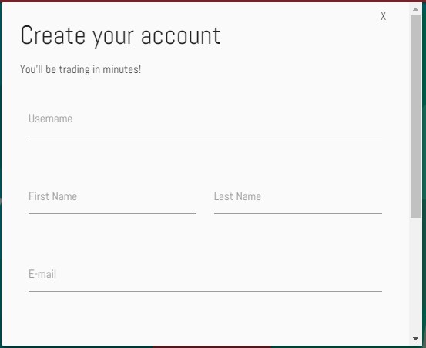
OUR PROCESS
We wanted to create a full stack application in which you can buy, sell or trade items with friends! Mow someone’s lawn for a T.V? Use ThisforThat! Want some sneakers that your buddy is trying to get rid of! USE THISFORTHAT!
LOG IN AND GET TRADING TODAY!

Slide 4




How it works!
Log in
Post a Product
Request a Trade!

Slide 5
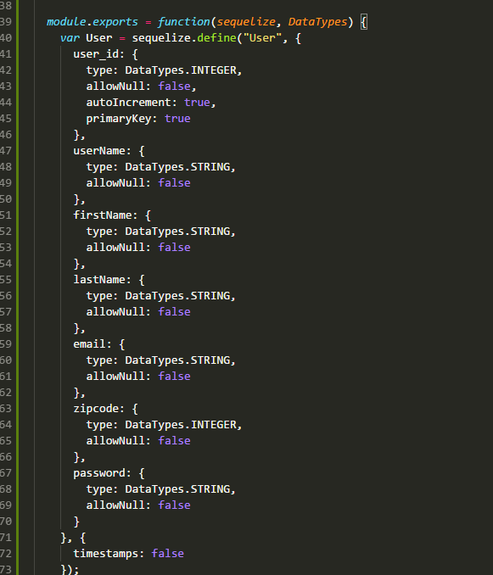
SEQUELIZE
MOdels
Migrations
Seeders
Populating Database
Express routes

Slide 6
Handlebars
Joins
Merges
MySql Queries

Slide 7

Future development
FACEBOOK API integration
Messaging service
PASSPORT
- login with facebook
-log in with google
EDIT Profile
Make a swap

