Slide 1
Video Link
https://youtu.be/ig1SgdCye5s

Slide 2

A1 CMPE 322
Gemini CLI Conceptual Architecture
Jacob Badali, 20jasb1@queensu.ca (GROUP LEADER)
Zhu Yuan, 18zy11@queensu.ca
Chloe Atherton, 20cga3@queensu.ca
Will Pritchard, 21whp2@queensu.ca
Julian Tiqui, 21jtt4@queensu.ca
Connor Rewa, 20car8@queensu.ca

Slide 3
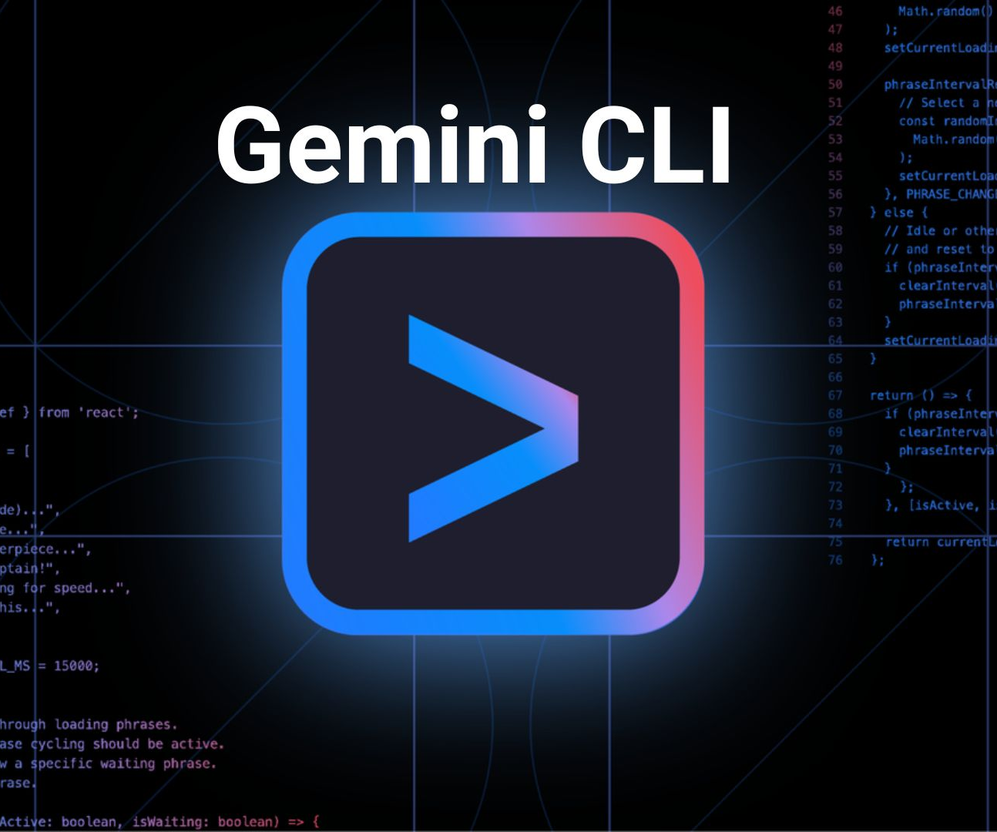
Motivation: What is Gemini CLI?
AI-assisted development from the terminal
More than chat → can act on your machine
Reads/writes files, runs shell commands, searches code, uses web + MCP tools
Bridges natural language → real developer workflows

Slide 4
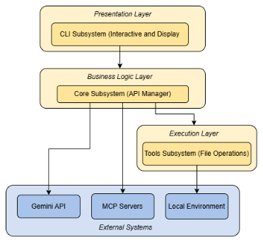
High Level Conceptual Architecture
Presentation Layer - CLI Subsystem
  User input + terminal UI (React + Ink)
  Interactive & headless modes
Business Logic Layer - Core Subsystem
  Orchestration & state management
  Gemini API mediation
  Tool registry + safety policy enforcement
Execution Layer - Tools Subsystem
  File system, shell, web, code search
  Child processes + MCP integration

Slide 5
Key Quality Attributes
Core Design Principles
Performance
  Asynchronous execution
  Parallel tool invocation
  Streaming outputs
  Token caching + native binaries (e.g., ripgrep)
Testability
  Clear layer interfaces
  Extensive unit tests (100k+ lines)
Maintainability & Evolvability
  Modular design
  New models/tools/UI can be added incrementally
Security
  Policy-based restrictions
  User confirmation for destructive actions
  Enforcement in Core layer
Separation of Concerns
  CLI = presentation
  Core = orchestration
  Tools = execution
Extensibility
  Dynamic Tool Registry
  MCP for third-party tools
Portability
  Built on Node.js abstractions
  Platform-specific logic encapsulated

Slide 6
External Interfaces
Define what information crosses system boundaries
Focus on content, direction, and function of exchanges
Not the UI implementation details
Key Interfaces:
User Command Interface (CLI)
Local Development Environment Interface (IDE)
Cloud Model Service Interface (CMI)
MCP Interface
Collaboration Interface

Slide 7
Principles and Mechanisms of Discovery
1) Primary Source Review
2) Secondary Source Analysis
3) Systematic Conceptual Modeling
4) Use-Case Driven Reasoning
5) LLM-Assisted Confirmation
Official Gemini CLI documentation
GitHub repository structure (packages/cli, packages/core)
Public diagrams and descriptions
Technical blog posts (e.g., Medium, Dev.to)
Community architecture breakdowns
Helped interpret interaction patterns (e.g., message bus)
Abstracted a three-layer model (CLI–Core–Tools)
Identified responsibilities per layer
Mapped tools, safety, and orchestration to components
Traced flows in Debugging and Refactoring scenarios
Verified layer roles through sequence diagrams
Used LLMs to:
  Summarize documentation
  Clarify architectural styles
  Cross-check interpretations

Slide 8
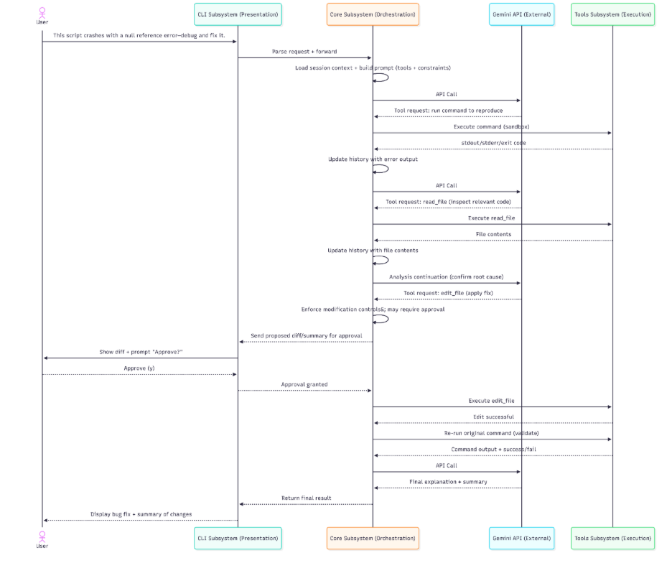

UC1: Debug a Failing Command
“This script crashes with a null reference error , debug and fix it.”

Slide 9
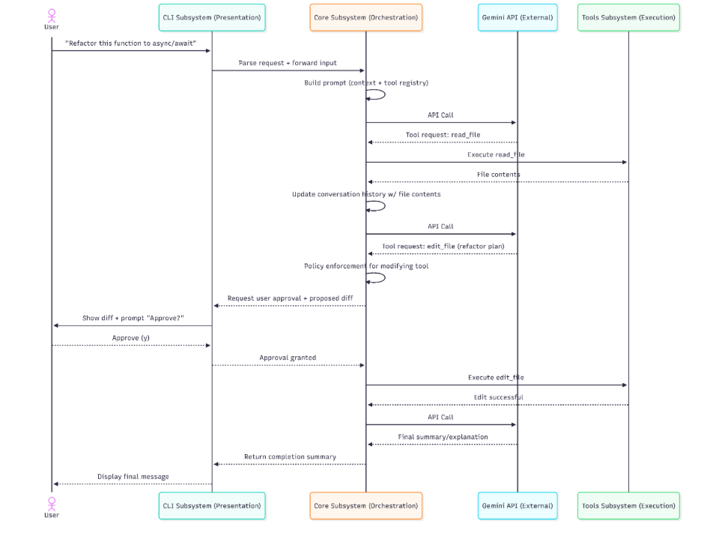

UC2: Refactor code
“Refactor this function from .then() to async/await.”

Slide 10
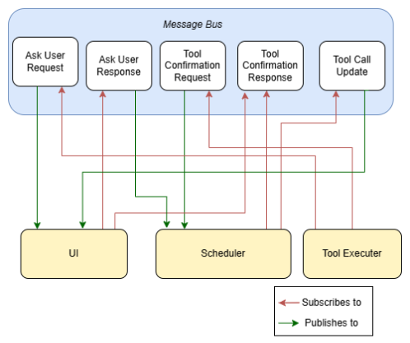
Implicit Invocation
Alternative ARCHITECTURE #1:
Components communicate by publishing typed messages
Other components subscribe to messages they care about
UI listens for:
  Tool Call Updates
  Ask User Requests
Scheduler listens for:
  Tool Confirmation Requests
  Ask User Responses
Layered model defines the primary structural decomposition
Implicit invocation is an internal communication mechanism that operates within the layered boundaries

Slide 11
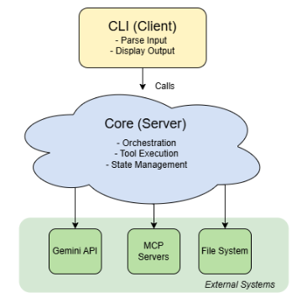
Client server
Alternative Architecture #2:
CLI = Client (frontend)
  Sends requests, renders results
Core = Server (backend)
  Orchestrates work, manages state, mediates tools
CLI requests services from Core, such as AI responses, tool execution, and state queries.
Core processes requests and returns structured responses
Communication is asynchronous (non-blocking)
Layering defines the primary system structure. (Presentation vs. Orchestration vs. Execution)
Client–server describes interaction pattern, not structure. Best seen as operating within the layered boundaries

Slide 12
Lessons learnt
1) Value of Layered Design
Clear separation of concerns
Core decouples orchestration from UI
Enables interactive + headless modes without duplication
2) Extensibility vs. Security Tradeoffs
MCP enables third-party extensions
Requires strong centralized Policy Engine in Core
Human confirmation is essential for destructive actions
3) Importance of Asynchronous Flows
Node.js single-threaded event loop
Streaming responses keep UI responsive
Careful mapping needed to understand data flow
4) UI–Orchestration Boundary
React/Ink keeps presentation separate from logic

Slide 13
Conclusion
It provides a strong foundation for:
Deeper IDE integration
More third-party tools (MCP)
Performance improvements
The layered design in Gemini CLI balances:
Power
Safety
Usability
Thank you for listening!

