Slide 1


DATA SCIENCE PROJECT
What is the secrete of academic success?
BY
KRISHNA JADHAV
VIKAS MATAM

Slide 2
Introduction to data sheet
Data sheet includes school name(GP,MP), sex(male,female), age(15-22), address(rural,urban)
family size(>3 or <3), pstatus(living together-T, living apart-A), (Medu, Fedu gives mother and father education), (Fjob, Mjob gives mother and fathers job)
Reason to choose school
Guardian, traveltime, studytime, failure(no. of past class failure), scholarschip(extra edu support), paid(extra class)
Activities(extra curricular), nursery, higher(wants higher edu or not),internet access at home, romantic(relationship),
Free time after school, goot(going out with friends)
Dalc: workday alcohol consumption(5 being high consumption 1 low consumption)
Walc: weedays alcohol consumption (5 being high consumption 1 low consumption)
Health: How good student feel 5 as best and 1 worst.
Absences: no. Of school absences
G1,G2,G3 are FIRST, SECOND, FINAL GRADES (numeric from 1-20)

Slide 3
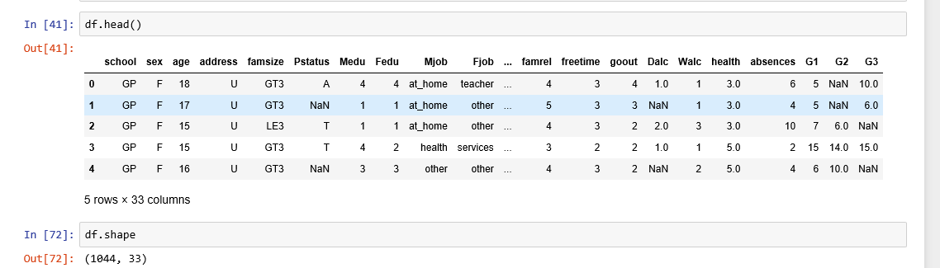
Data sheet
As one can see there are few categorical and numerical missing values.

Slide 4
Data cleaning
Data cleaning: process of detecting and correcting(or removing) current or inaccurate records from a record set table, database and refers to identifying incomplete incorrect ,inaccurate or irrelevant parts of data and then replacing, modifying coarse data.
The data we selected are almost accurate and clean except for few entries which were not entered.which might have been due to some individual mistake or loss of data while entering.

Slide 5
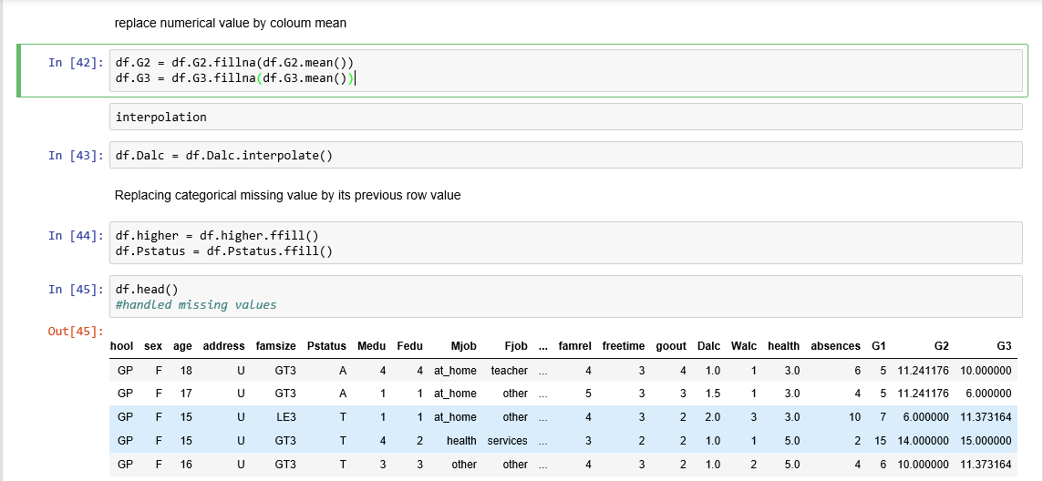
Data set after cleaning.

Slide 6
Descriptive analysis
Descriptive Statistics. Descriptive statistics are used to describe the basic features of the data in a study. They provide simple summaries about the sample and the measures. Together with simple graphics analysis, they form the basis of virtually every quantitative analysis of data

Slide 7
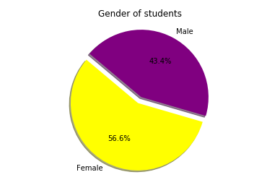
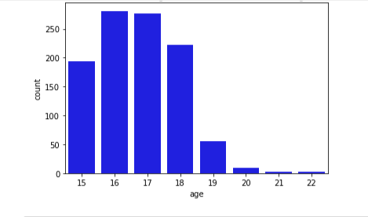
Gender and age Tally.
1)In our dataset , No.of girl students are more than that of boys.
2)In the bar graph shown between count
and age.

Slide 8
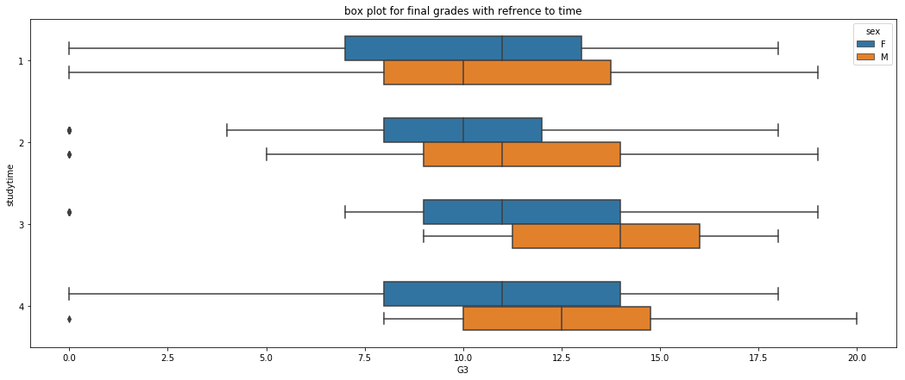
How does study time effect our marks
The number of hours of study is directly proportional to the final grades.
Here there is no ways of differentiate on bases of gender (male and female).
And yet there are some catch.!
Optimal study time is 3hrs (with concentration)

Slide 9
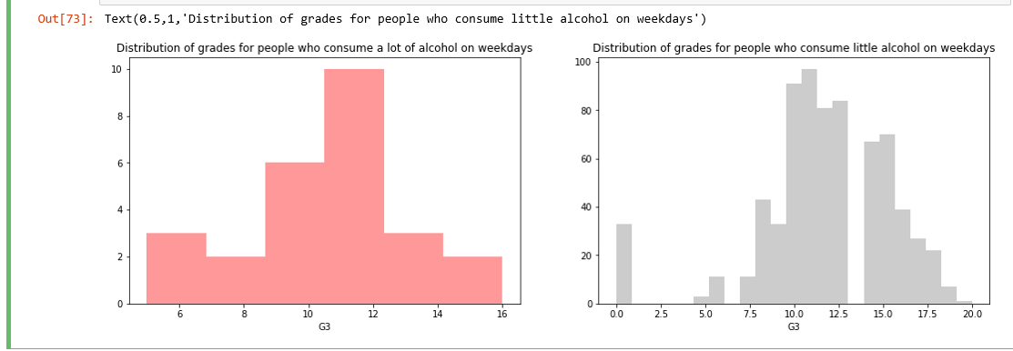
Histogram plot

Slide 10
Even though only few people get drunk in weekdays there is considerable difference in final score with that of people who occasionally drink.

Slide 11
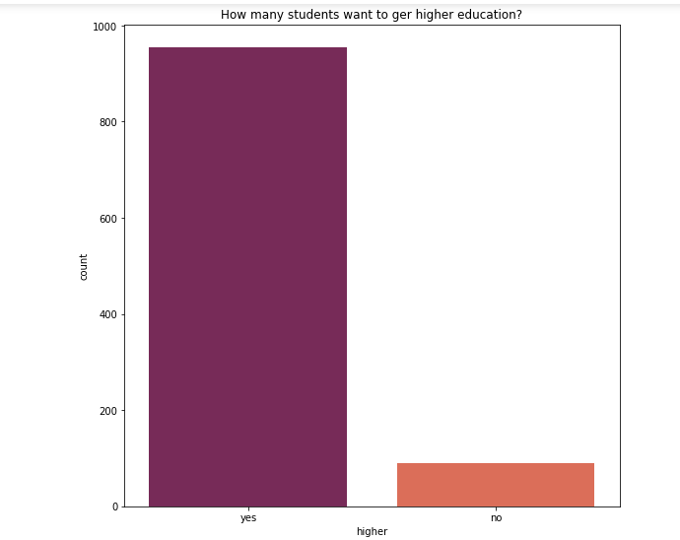
Student on higher education
In our dataset ,when students asked upon their interest in higher education
a majority of them said that they are interested in higher education!

Slide 12
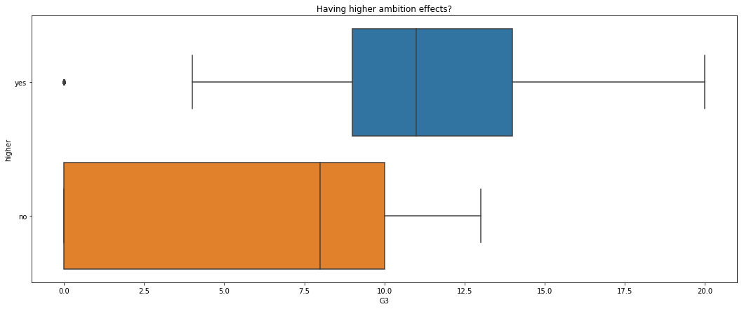
This is interesting..
Students who said yes for higher education are students with high final grades.
And usually people who have deep interest in a field would opt for higher edu.
“Have passion in what you do”.

Slide 13
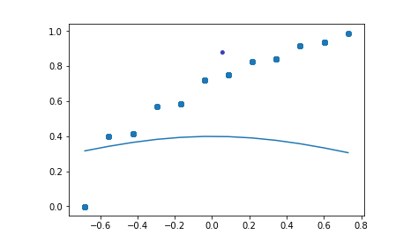
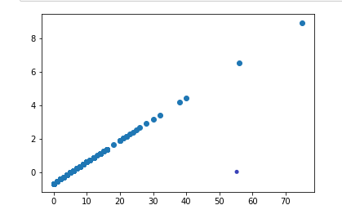
Data cleaning for the raw numerical colum outliers are removed and values are normalized. Below is Q-Q plot for normal distribution.

Slide 14
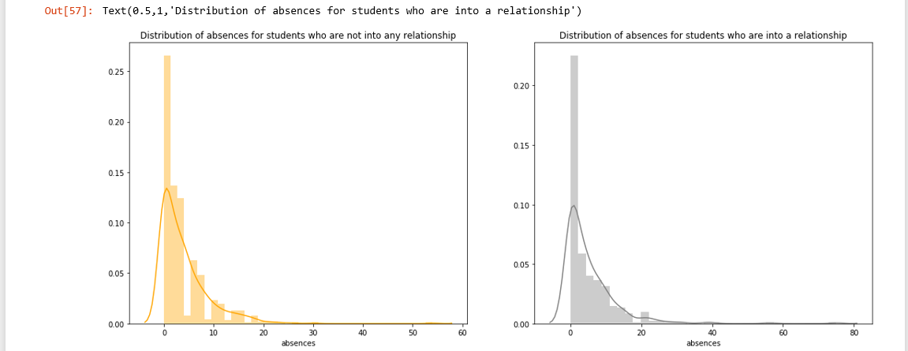
My hypothesis.
H0:there is no significant difference in mean in absence in ppl who are and are not in a relation

Slide 15
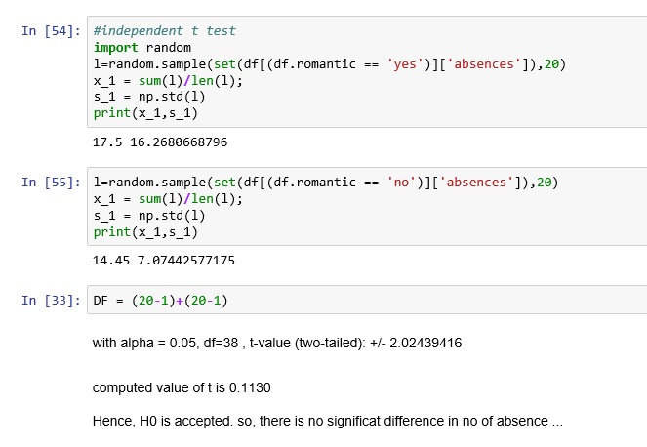
There is no significant difference
Its an two tailed
Independent t test.

Slide 16
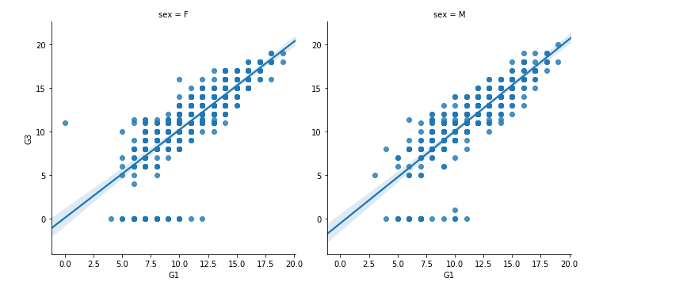
Regressions
There is high dependences on the previous scores for ones final score!!
Study from beginning ;)

Slide 17
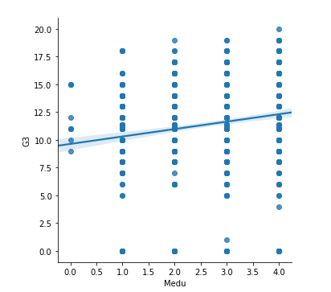
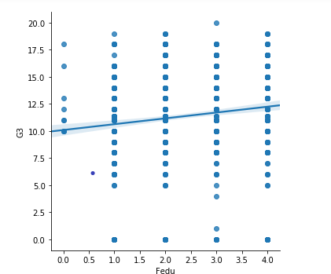
As it is clear, there is almost zero co relation between parents education and students final marks!

Slide 18
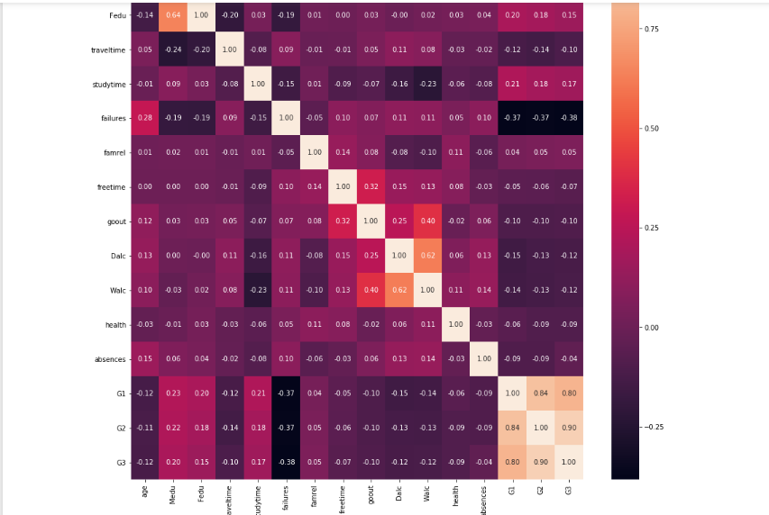
Overall correlations.

Slide 19
These are my results and conclusions
These are the key factors effecting the final score G3
Have high ambition or more importantly interest in what you learn.
Optimal study time is 3hrs/day with few deviations, and as rightly said, “All study and no play makes Jack a dull boy”, don’t over read.
Start studying from beginning , (evident from our regression)your final scores depend significant on your previous test scores.

Slide 20
And there 0 correlation between parents education and ones final marks.(so never blame others )
Drinking is bad , lest case avoid drinking in weekdays.
As funny it sounds there is no significant relation with your relationship status and no of absence.

Slide 21


“without data your just person with opinion.”
THANK YOU

