Slide 1
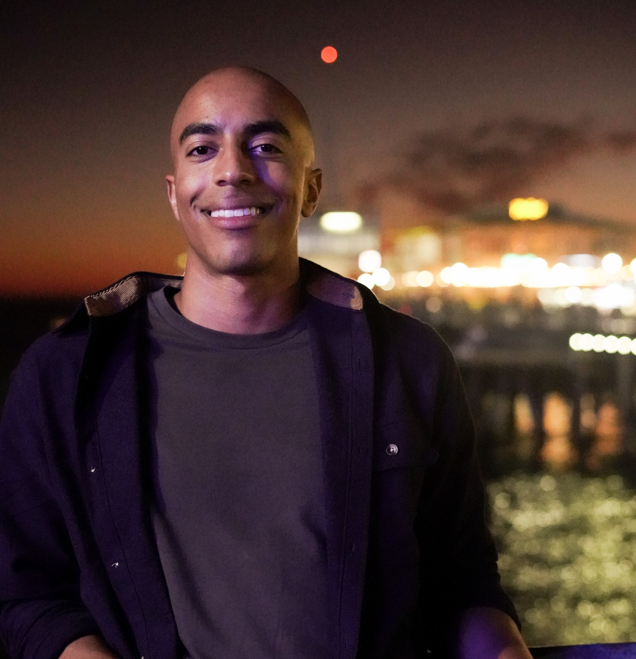
JORDAN DAVIS
Los Angeles-based data analyst interested in leveraging data to answer critical business questions to make the world a better place
DATA ANALYSIS, SCIENCE, & VISUALIZATION
WORK EXPERIENCE
EDUCATION
Salesforce / Senior Analyst - Data Insights & Scalability
October 2021 – Present Los Angeles CA (Remote)
Lead Tableau developer for Salesforce Revenue Operations. Built and maintain various high-exposure dashboards which cross-functionally houses various data in the Quote to Order space
Ensure coordination by acting as a liaison between the data engineering team and various business stakeholders to ensure data accuracy and appropriate visualization/dashboard design
This automated process saves an estimated 7 hours of manual work per month for the Business. I continue to maintain the dashboard and enhance with any requested features (e.g. trending historical data, formatting requests)
Federal Reserve Bank / Analyst – Data Analytics Office
September 2017 – October 2021 [4 Years, 1 Month] Los Angeles CA
Built and design our executive facing analytical products starting with group-based interviews to understand the business need, then leveraging SQL and Python for data exploration and manipulation into readable forms. Visualizing the data into automated Tableau Server dashboards to be continuously leveraged by customers.
Maintained and documented metadata for over 50 unique metrics and measurements across our analytic products. The data stems from eight different business lines and over 35 points of contact within areas including but not limited to Federal Reserve Operations, Cybersecurity, and Customer Satisfaction.
Pharmaceutical Product Development / Data Manager March 2017 – September 2017 [7 Months] Richmond VA
Collaborated and scheduled data transfers directly with our domestic and international pharmaceutical clients to ensure Data Transmission Agreements and Data Transfers met QA/QC standards
Wrote and submitted custom SQL reports for our pharmaceutical clients
Virginia Commonwealth University B.S Bioinformatics, Computer Science Minor
August 2012 – December 2016 (Graduated)
SKILLS
Technical Skills
Tableau (Server and Desktop) (5+ years)
SQL (4+ years)
Python (2+ years)
Excel/Google Sheets (5+ years)
Visio/Lucid Chart (2+ years)
Snowflake (1+ year)
Soft Skills
Actively seeking out and leveraging feedback
Ability to adapt quickly to org. change
Writing & Scoring User Stories
Group-based interviews
Wireframing
A/B testing & experimental design
CERTIFICATIONS
Certified Cloud Practitioner / AWS August 2020 – August 2023
PROJECTS & PORTFOLIOS GitHub / Python based projects jdgithub0112.github.io/Jordans-Portfolio
Tableau Gallery / Tableau visualizations public.tableau.com/app/profile/jordan.davis5657
Film Production / Producer on Short film ‘Hit n Run’ instagram.com/hitnrunproduction
LINKEDIN.COM/IN/JORDANDAVIS0112 | JORDNDAVS@GMAIL.COM | LOS ANGELES, CA

