Slide 1
Velocity
Orientation vector
Lift
Angle of Attack
Orientation

Slide 2
Velocity
Lift
Orientation vector
Angle of Attack (positive)
Orientation
Velocity

Slide 3
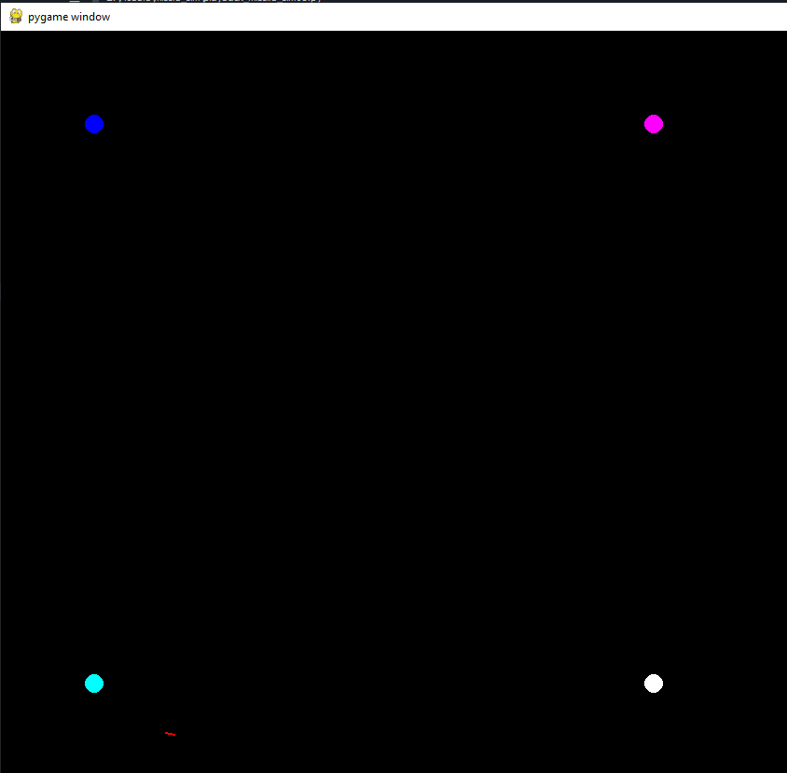
100,100
X
700,100
Y
100,700
700,700

