Slide 1
Best Buy Mobile Web Site Hackathon A Hard Lesson in Data Cleaning
Juan Jose Diaz, and Norge Peña Perez(Mentor)
Miami Dade College, Kendall Campus, Miami, FL

Slide 2
CONTENTS
Introduction
Materials
Methodology
Data Cleaning
Visualizations
Conclusion

Slide 3
INTRODUCTION
The intention of this project is to analyze the data provided by the Best Buy Mobile Hackathon to predict the category/SKU based on a query presented by a user. My intentions were to create a model to predict the category, but I soon realized that this was an impossible task with the tools I had at my disposal. There was over a million categories present in the data, and even more SKUs so reduction of cardinality was extremely difficult. I tried to cluster the data to reduce the size of the dependent variable, but to cluster I needed power to run through the data which I didn’t have. I also needed to overcome other elements such as difficulties in cleaning the data, and generating more attributes that are to be engineered to improve an eventual model. Overall, the process did teach me a lot of hard lessons which I will take with me on upcoming projects.

Slide 4
Materials
The materials provided to me by the Hackathon was a python file to attain popular SKU, a csv containing popular SKU, a csv containing test data, a csv containing train data, and a zip file containing a couple of files. The files extracted include in the zip file will be explained below.

Slide 5
“Product_Data” directory:
categories 3MB
An XML File containing all products
products 8.2GB
Multiple XML files containing product data
reviews 153MB
Multiple files containing product review data

Slide 6
Methodology
Step 1
Step 2
Step 3
Step 4
Step 5
Download and Extract Files
Convert XML Files to CSV
Upload Files to Databricks File Store
Clean and Join Data sets
Generate Visualizations

Slide 7
Data Cleaning
https://databricks-prod-cloudfront.cloud.databricks.com/public/4027ec902e239c93eaaa8714f173bcfc/2288159899266085/1349607630973675/5965777620663870/latest.html

Slide 8
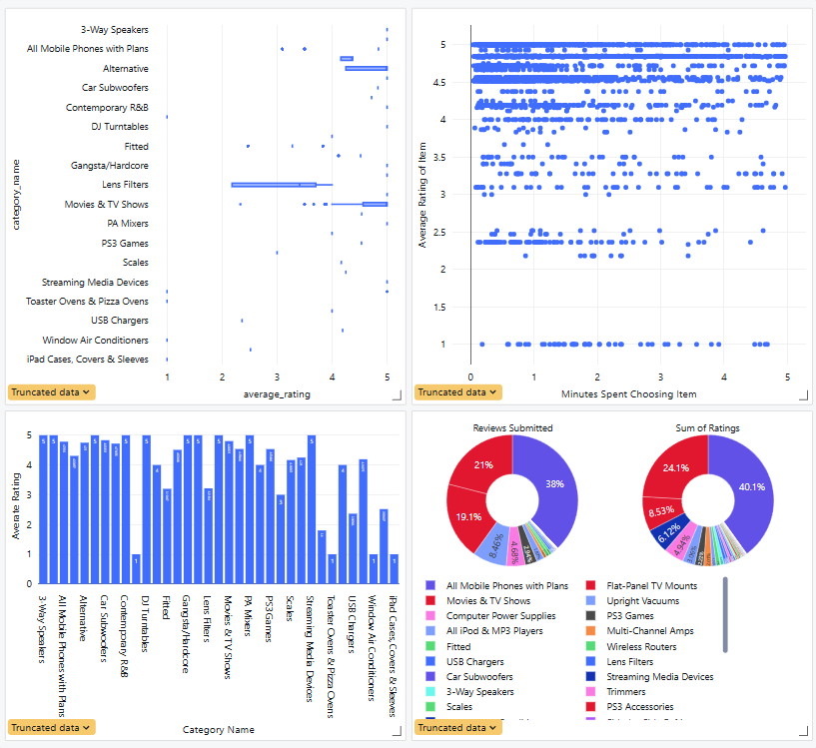
Visualizations

Slide 9
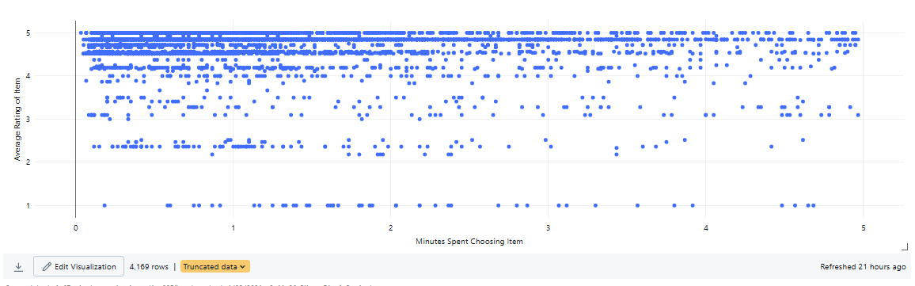
Time on Item Choice vs Average Rating

Slide 10
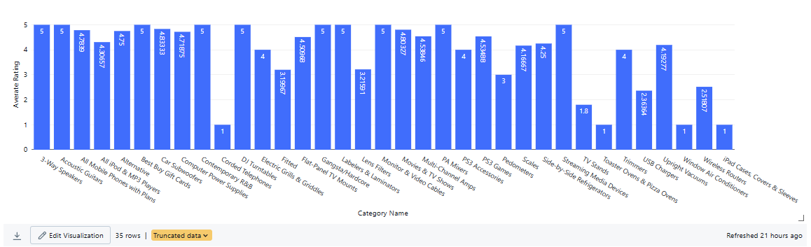
Average Rating by Category

Slide 11
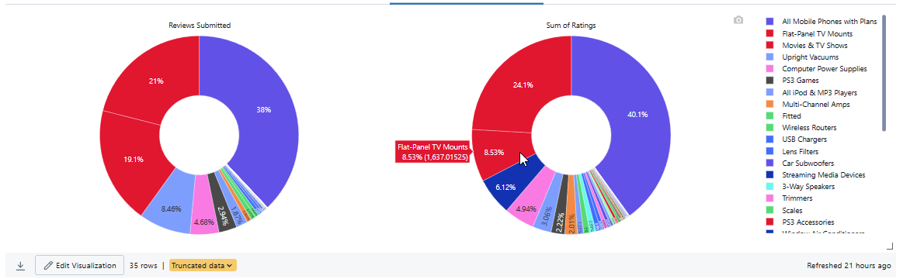
Rating Summary per Category

Slide 12
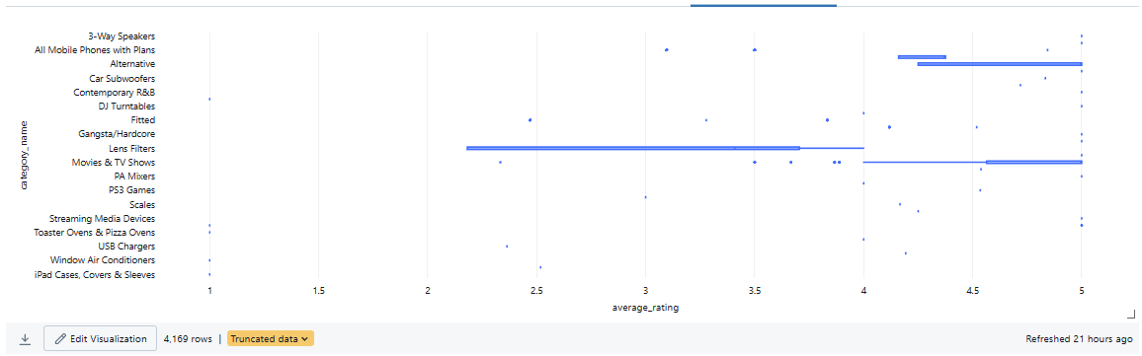
Category Variability

Slide 13
Conclusion
In conclusion the visualization is a representative sample, but you can see the sample yielded faster clicks depending on rating. This leads me to believe the higher the satisfaction of the product the faster someone is likely to choose it. This is important information when creating a model for prediction as we can train the model in speed of click, and average rating among other attributes we have yet to discover. I can see there is high variation of ratings in categories like lens filters using a box plot and see some work needing to be done on tv wall mount rating. The wall mounts seem to have high engagement, but lower rating than expected. If I had the capabilities to create a machine learning model to predict a category/SKU depending on some key factors, I would do so, but my attempts to create one have failed.

Slide 14
THANK YOU
Juan Diaz
Miami-Dade College
Bachelors in Data Analytics Program

