Slide 1








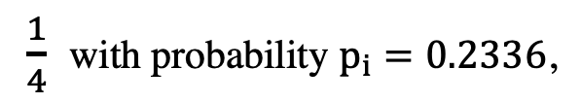

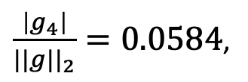






$$sign \left(g\right)$$
-3.39
1.78
10.87
-2.22
10.9
1.12
-32.1
12.5
-1 | 1 | 1 | -1 | 1 | 1 | -1 | 1
Let $0≤l<s=4$
$$sign \left(g_{4}\right)$$
$$g_{4}$$
$${\tilde{g}}_{4}=Q_{4}\left(g_{4}\right)=− 38.0062∗ξ_{4} \left(\left|g_{4}\right|, ||g||_{2}\right)=0$$
$$||g||_{2}$$
$\frac{1}{4}$ with probability $p_{i}=0.2336$,
$\frac{\left|g_{4}\right|}{||g||_{2}}=0.0584$,
$ξ_{4} \left(\left|g_{4}\right|, ||g||_{2}\right)$ =
$0$ with probability $1−p_{i}=0.7664.$
$$p_{i}=0.2336$$
$$0$$
$$0.0584$$
$$\frac{1}{4}$$
$$\frac{1}{2}$$
$$\frac{3}{4}$$
$$1$$
Original
Gradient (g)
$${1−p}_{i}=0.7664$$

