Slide 1
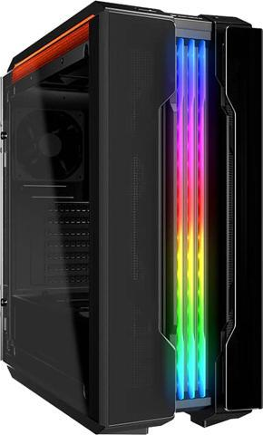





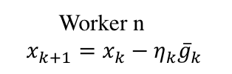




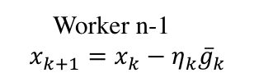

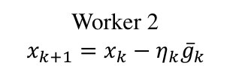



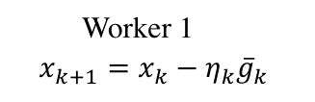



Parameter server
$${{\overline{g}}_{k}=\frac{1}{n}∑\overline{g}}_{k}^{(n)}$$
Worker 1
Worker 2
$${\overline{g}}_{k}^{(1)}$$
$${\overline{g}}_{k}$$
$${\overline{g}}_{k}^{(n)}$$
$${\overline{g}}_{k}^{(2)}$$
$${\overline{g}}_{k}^{(1)}$$
$${\overline{g}}_{k}$$
$${\overline{g}}_{k}$$
$${\overline{g}}_{k}^{(n−1)}$$
$${\overline{g}}_{k}^{(1)}$$
$${\overline{g}}_{k}^{(3)}$$
$${\overline{g}}_{k}^{(2)}$$
$${\overline{g}}_{k}$$
$${\overline{g}}_{k}^{(2)}$$
$${\overline{g}}_{k}^{(3)}$$
Worker n
$$x_{k+1}=x_{k}−η_{k}{\overline{g}}_{k}$$
Worker 1
$$x_{k+1}=x_{k}−η_{k}{\overline{g}}_{k}$$
…
Worker 3
Worker 2
$$x_{k+1}=x_{k}−η_{k}{\overline{g}}_{k}$$
…
Worker n-1
$$x_{k+1}=x_{k}−η_{k}{\overline{g}}_{k}$$
(a)
(b)

