Slide 1
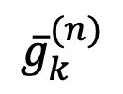
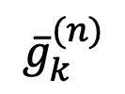

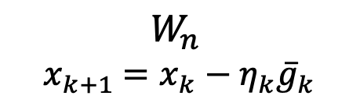

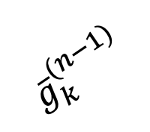
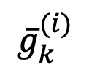
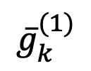

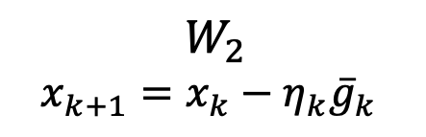
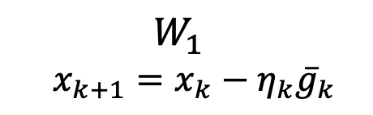

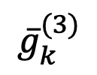
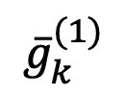

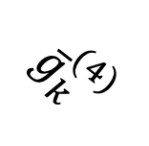

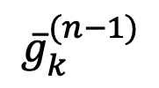
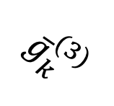

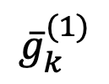


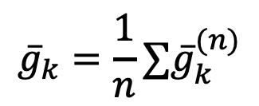
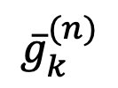
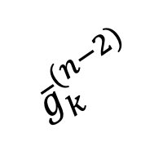

$${{\overline{g}}_{k}=\frac{1}{n}∑\overline{g}}_{k}^{(n)}$$
$${\overline{g}}_{k}^{(2)}$$
$${\overline{g}}_{k}^{(1)}$$
$$W_{2}$$
$$W_{3}$$
$${\overline{g}}_{k}^{(3)}$$
$${\overline{g}}_{k}^{(3)}$$
Parameter
server
$${\overline{g}}_{k}^{(n)}$$
$${\overline{g}}_{k}^{(2)}$$
$${\overline{g}}_{k}^{(4)}$$
$${\overline{g}}_{k}$$
$${\overline{g}}_{k}^{(1)}$$
$${\overline{g}}_{k}$$
$W_{n}$
$${ x}_{k+1} =x_{k}−η_{k}{\overline{g}}_{k}$$
$$W_{1}$$
…
$W_{1}$
$$x_{k+1}=x_{k}−η_{k}{\overline{g}}_{k}$$
$${\overline{g}}_{k}^{(i)}$$
$${\overline{g}}_{k}$$
$${\overline{g}}_{k}^{(1)}$$
…
…
$${\overline{g}}_{k}^{(n−1)}$$
$${\overline{g}}_{k}^{(n)}$$
$${\overline{g}}_{k}^{(n)}$$
$W_{2}$
$$x_{k+1}=x_{k}−η_{k}{\overline{g}}_{k}$$
$${\overline{g}}_{k}^{(n−2)}$$
$$W_{n}$$
$$W_{n−1}$$
$${\overline{g}}_{k}^{(n−1)}$$
(a)
(b)

