Slide 1
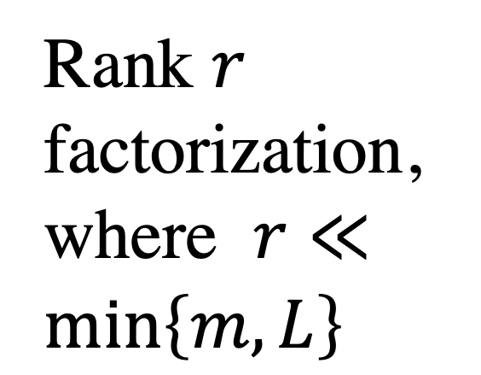

L
r
L
r
Q
m
M
$$≈$$
m
P
Rank $r$ factorization,
where $r≪\min\left\{m,L\right\}$

