Slide 1



SYSEN 5888
Measuring AI Acceleration Over Time
Amine Amirouche (BAA93)
Andrew Littlefield (DAL352)
Angela Li (YL3937)
Jack Bush (JLB662)
Jonathan Lloyd (JSL384)
4 May 2026

Slide 2

SYSEN 5888 FINAL PROJECT
Measuring the AI acceleration: Measurable impact of improvements
Neural networks span decades. The last decade made their progress visible enough to test.
1980s-90s
2006
2012
2015
2017-19
2020s
Backprop and early neural nets
Deep learning revival
CNN/ImageNet moment
Piczak CNN on ESC-50
Transfer learning matures
Pretrained representations at scale
We use a 2015 benchmark as a time capsule: can later neural-network techniques produce measurable gains?
01
Notes:
we wanted to search out a means of showing how the evolution of neural network models would result in measurable accuracy increases over time. We then searched for a clean data set of a manageable size and good quality that could serve as that vehicle. Piczak's work gave us that, and with it we were able use his same data set to perfrom the same task and, walking them forward through the model eras - CNNs trained from scratch to transfer learning with pretrained CNN and finally to transfer learning with pretrained audio transformers. At each step we were able to compare against a known baseline.

Slide 3
Hypothesis, test design, and roadmap
Hypothesis
Measurement lens
Modern AI techniques will outperform the Piczak 2015 baseline on ESC-50.
Final 5-fold test accuracy
Clip-level accuracy is used for segment-based models
Loss to help interpret the magnitude of gains…if any.
2015 benchmark
Model eras
Measured outcomes
Piczak CNN
technical progression
accuracy | loss
Roadmap
Training from scratch
Transfer learning: pretrained CNN
Transfer learning: pretrained transformers
Piczak CNN | Variations | LSTM
VGGish | YAMNet
AST | BEATs
02
Notes:
Main job: tell the audience exactly what we tested and how to judge success. Narrative: Our hypothesis was that the modern neural-network techniques would out-perform the original model. To test it, we re-created Piczak’s model to set a baseline. We then left the problem set the same and evolved the analysis model using the final five-fold test accuracy with clip-level voting where required. Ultimately, we used the results from the long segments with probability voting as the comparator to ensure an apples-to-apples comparison. This was done across three different eras of neural network design – from a training-from-scratch approach, to utilizing transfer learning with a pre-trained CNN and final to transfer learning models with pre-trained transformers.

Slide 4
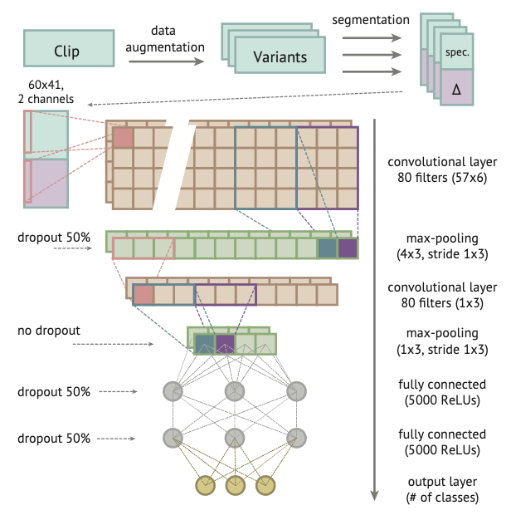
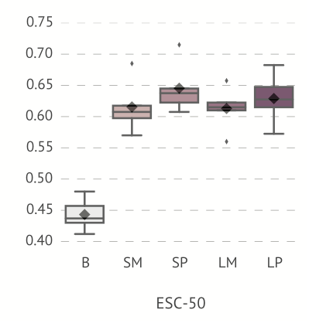
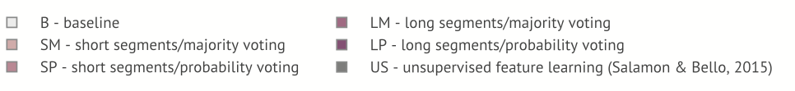
THE BASELINE
Piczak and ESC-50
Experiment Summary
ESC-50
Piczak’s 2015 model converts each 5-second ESC-50 audio clip into log-mel spectrogram segments, classifies those segments with a two-layer CNN trained from scratch, then aggregates segment predictions into a clip-level prediction using voting. It established a strong neural baseline for environmental sound classification.
2,000
50
labeled audio clips
balanced classes
5
5 sec
official folds
per clip
Experiment Significance
Environmental sound classification lagged speech and music processing.
ESC-50 gave researchers a clean, repeatable benchmark.
Official folds support direct comparison with published results.
03
Notes:
Describe the baseline: Here we’ve got details about the baseline and the dataset. We chose Piczak’s ESC-50 because we felt his work took a relatively unstudied segment, which was audio sound training, and that would do well to represent the growth in neural network capabilities from that point. He also had a robust yet compact data set that was well organized – 2000 audio samples, 50 classes, 5 folds – and they were of a manageable size at 5 seconds per clip, which presented manageable data set to run our multiple different models against. Looking specifically at what he did with it, Piczak converted audio clips into log-mel spectrogram segments, classified each segment, and then used clip-level voting to produce one prediction per audio clip. That gave us the fixed baseline we needed

Slide 5
FIRST TECHNICAL ERA
Era 1: training from scratch
Training from scratch
Transfer learning: pretrained CNN
Transfer learning: pretrained transformers
Piczak CNN | Variations | LSTM
VGGish | YAMNet
AST | BEATs
Constraint
All useful audio knowledge must be learned from ESC-50.
ESC-50
2,000 clips
Feature learning
Classifier
This era establishes what small labeled audio data can support before importing external knowledge.
04
Notes:
In this block we are looking at neural network models that rely solely on the data set for training. That means it has to first learn the features of the audio clips themselves, the acoustic patterns in the spectogram that would help distinguish classes - short bursts of sound like a dog bark, repetitive textures like a bird chirp, or changes over time. Then it has to learn the classifier, meaning mapping those patterns to the labels from ESC-50.
Here we look at first recreating Piczak’s model to build our baseline, then we run a series of CNN variations before introducing an LSTM extension.

Slide 6
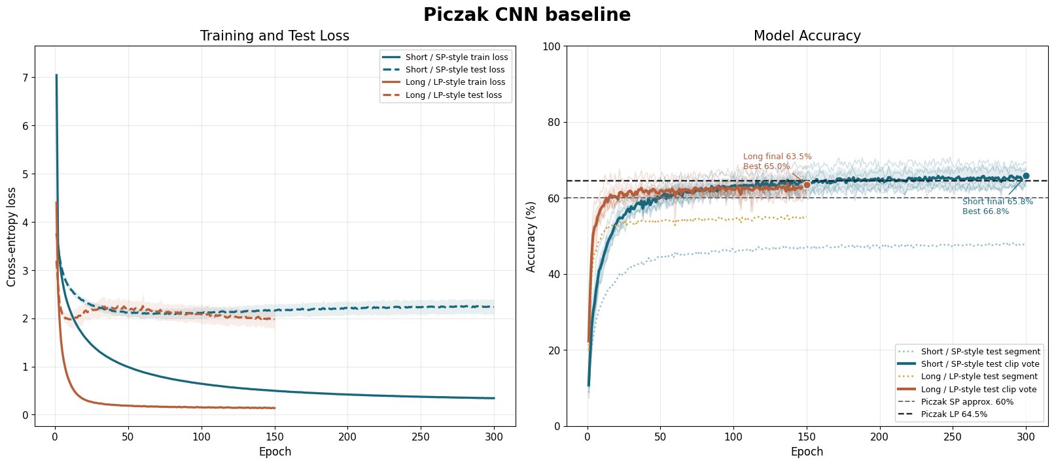
ERA 1: TRAINING FROM SCRATCH
Piczak CNN baseline
Training from scratch
Transfer learning: pretrained CNN
Transfer learning: pretrained transformers
Piczak CNN | Variations | LSTM
VGGish | YAMNet
AST | BEATs
Baseline
We recreated Piczak’s CNN experiment to establish a defensible reference point. The comparison anchor is Piczak’s LP run: long spectrogram segments aggregated with probability voting into one clip-level prediction.
Piczak Model Architecture
Step | Parameters / implementation
Input | ESC-50 waveform -> log-mel spectrogram + delta, shape (2, 60, T)
Segments | Short: 41 frames, hop 20; Long: 101 frames, hop 10
Conv block 1 | Conv2d 2->80, kernel 57x6; ReLU; Dropout 0.5; MaxPool 4x3
Conv block 2 | Conv2d 80->80, kernel 1x3; ReLU; MaxPool 1x3
Dense head | Flatten -> FC 5000 ReLU Dropout -> FC 5000 ReLU Dropout -> FC 50
Optimization | CrossEntropyLoss; SGD lr 0.002/0.01; momentum 0.9; Nesterov; weight decay 0.001
Evaluation | Softmax per segment; average probabilities by filename for clip-level vote
64.5%
63.5%
Results
Piczak published LP clip-level reference
Baseline Replication
We successfully recreated Piczak’s original model.
The rerun slightly underperformed vs. the original baseline, which may reflect implementation and library differences over the decade since the original work.
The reproduced baseline is a sufficient representation of Piczak’s model
05
05
Notes:
Here is where we established the baseline from which subsequent models would be evaluated. We needed to re-create it to ensure we had a solid understanding of how it was created as well as to use that as the springboard for other models. What you'll see in the baseline model accuracy curves is the various runs that were performed, again, recreating the original model. However, it was ultimately the Long-Segment, clip level run that was highlighted by Piczak and will serve as the basis of comparison goign forward. We underran slightly at 63.5%, but felt that was close enough to treat as a credible baseline and accurate enough replication of his work.

Slide 7
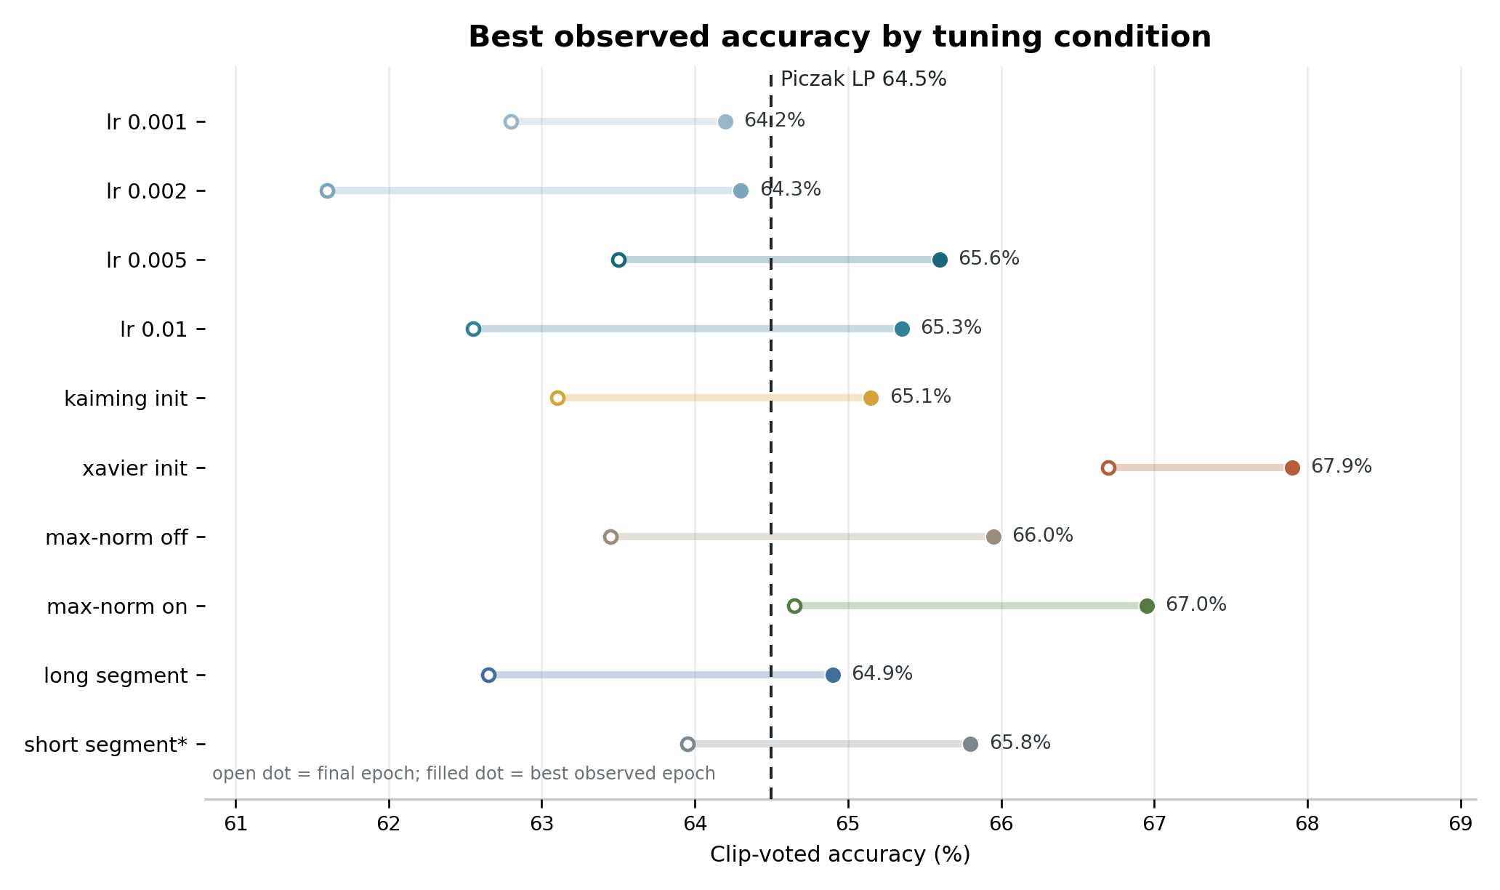
ERA 1: TRAINING FROM SCRATCH
Piczak CNN variations
Training from scratch
Transfer learning: pretrained CNN
Transfer learning: pretrained transformers
Piczak CNN | Variations | LSTM
VGGish | YAMNet
AST | BEATs
What changed?
Multiple iterations of hyperparameter tuning were performed to observe the impact of small changes to the original model.
Variation matrix
Dimension | Conditions | Best observed
Learning rate (4) | 0.001, 0.002, 0.005, 0.010 | 65.6% at LR 0.005
Initialization (2) | Kaiming, Xavier | 67.9% with Xavier
Max-norm (2) | off, on | 67.0% with max-norm on
Segment length (2) | long, short* | 65.8% short*; 64.9% long
Result
Best observed was 67.9% with Xavier initialization relative to Piczak's 64.5% LP baseline.
Resulted in a measurable improvement, but still the same from-scratch CNN performance band.
Hyperparameter tuning helped but did not create a step-change improvement
64.5%
67.9%
Piczak published LP clip-level reference
best 5-fold clip-level accuracy
Era 1
06

Slide 8
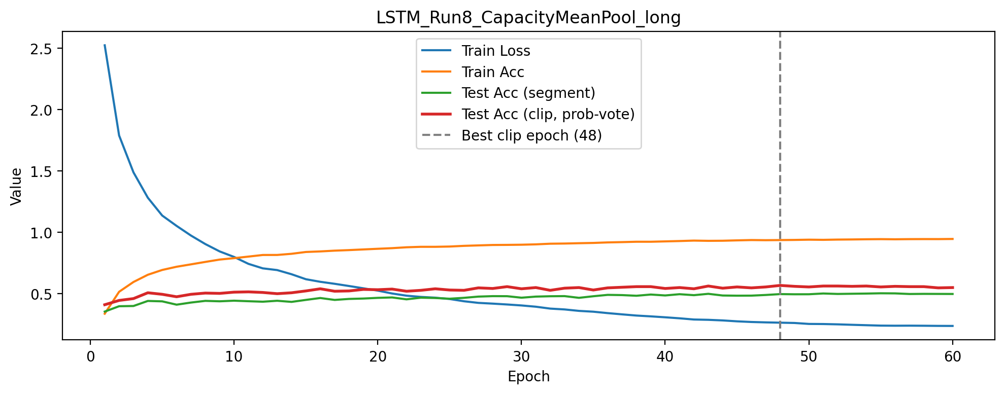
ERA 1: TRAINING FROM SCRATCH
LSTM extension
Training from scratch
Transfer learning: pretrained CNN
Transfer learning: pretrained transformers
Piczak CNN | Variations | LSTM
VGGish | YAMNet
AST | BEATs
What changed?
From local spectrogram patterns to temporal sequence modeling – LSTM baseline defined, Design of Experiments created to vary 4 factors
LSTM architecture
Model Step | LSTM Baseline Parameters / implementation
Input | Piczak log-mel + delta segment tensor, shape (B, 2, 60, T)
Reshape | (B, 2, 60, T) -> (B, T, 120); one sequence step per time frame
Recurrent | 2-layer bidirectional LSTM; hidden size 128; Xavier/orthogonal init
Pooling | Final pooling
Head | Dropout 0.3 -> Linear 512->50 logits
Optimization | CrossEntropyLoss; Adam lr 1e-3; weight decay 1e-4; cosine LR; grad clip 1.0
Evaluation | Clip-level probability voting; 60 epochs ran but accuracy reported at best value attained over all epochs; batch size 64
Experimental Factor | Baseline Value | Levels Tested
hidden_size | 128 | 64, 128, 256
num_layers | 2 | 1, 2, 3
bidirectional | True | True, False
pooling | Final | Final, Mean
64.5%
56.8%
Piczak published LP clip-level reference
final 5-fold clip-level accuracy
Results
LSTM architectures performed worse than CNN baseline.
Some reasons may include:
CNNs are inherently designed for 2D time-frequency patterns like audio clips
Dataset not large enough for LSTM
5 second audio clips not long enough to take advantage of LSTM’s strengths in modeling long temporal dependencies
Run | hidden | layers | bidir | pooling | Question
8 | 256 | 1 | True | mean | Does mean pooling substitute for depth?
06
06

Slide 9
SECOND TECHNICAL ERA
Era shift: transfer learning with pretrained CNN models
Training from scratch
Transfer learning: pretrained CNN
Transfer learning: pretrained transformers
Piczak CNN | Variations | LSTM
VGGish | YAMNet
AST | BEATs
Shift
Learn the representation elsewhere. Adapt it here.
Large audio datasets
pretraining
Pretrained
CNN-style encoder
ESC-50
fine-tuning
ESC-50 is small for learning robust audio features from scratch.
Transfer learning imports representations learned from much larger audio datasets.
This era tests pretrained CNN-style audio models before transformer-based audio encoders.
07

Slide 10
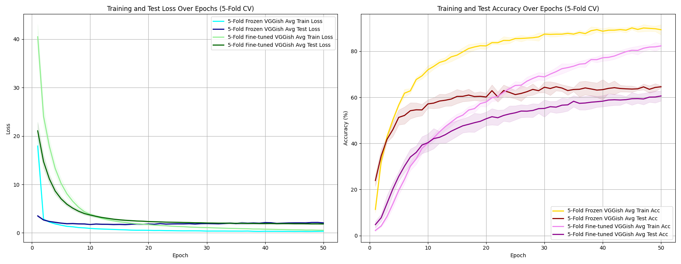
ERA 2: PRETRAINED CNN MODELS
VGGish
Training from scratch
Transfer learning: pretrained CNN
Transfer learning: pretrained transformers
Piczak CNN | Variations | LSTM
VGGish | YAMNet
AST | BEATs
What Changed?
VGGish as a pretrained model has already trained to detect acoustic patterns and differences between sound types (speech, music, etc.) This acts as a catalyst for feature extraction on the ESC-50 dataset.
VGGish architecture
Step | Parameters / implementation
Input | 16 kHz waveform -> VGGish log-mel examples
Encoder | Pretrained VGGish CNN embedding network; output 128-d vector
Head | Linear 128->256; ReLU; Dropout 0.3; Linear 256->50
Frozen run | Freeze VGGish; train classifier only; Adam lr 1e-3
Fine-tuned run | Train VGGish + classifier; Adam lr 1e-4
Training | CrossEntropyLoss; batch size 32; 50 epochs; 5 official folds
Results
91.69 %
While training accuracy improved significantly, pretraining is not automatically enough; representation fit and optimization choices matter. Test accuracy performed much lower at 64.5% and 61% for Frozen and Fine-Tuned models respectively
64.5%
Frozen final 5-fold accuracy
Piczak published LP clip-level reference
82.94%
Fine-tuned final 5-fold accuracy
08
08

Slide 11
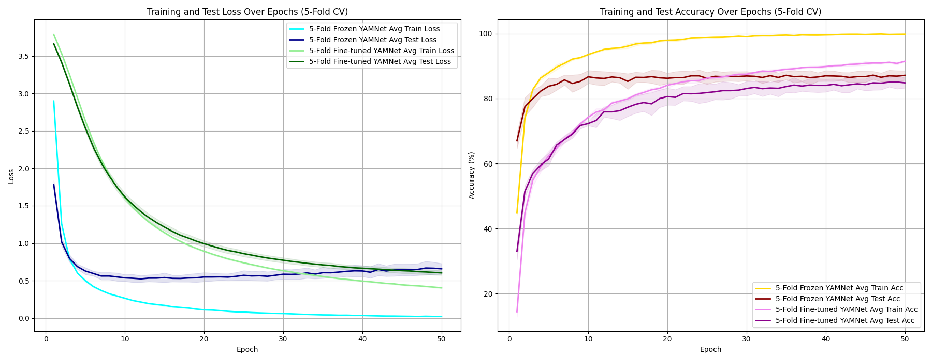
ERA 2: PRETRAINED CNN MODELS
YAMNet
Training from scratch
Transfer learning: pretrained CNN
Transfer learning: pretrained transformers
Piczak CNN | Variations | LSTM
VGGish | YAMNet
AST | BEATs
What Changed?
Lightweight pretrained model that is 20x smaller than VGGish, but works well with real-time audio event classification.
YAMNet architecture
Step | Parameters / implementation
Input | 16 kHz mono waveform
Encoder | TF Hub YAMNet, AudioSet-pretrained; output 1024-d embedding
Head | Linear 1024->256; ReLU; Dropout 0.3; Linear 256->50
Frozen run | Train classifier on fixed embeddings; Adam lr 1e-3
Classifier tune | YAMNet remains fixed; new classifier trained with Adam lr 1e-4
Training | CrossEntropyLoss; batch size 32; 50 epochs; 5 official folds
Results
99.81%
Transfer learning quality matters: a stronger domain-pretrained model moves the result well beyond the from-scratch range. Transfer learning on large pretrained models can pose overfitting issues that can negatively affect the prediction results.
64.5%
Frozen final 5-fold accuracy
Piczak published LP clip-level reference
91.56%
Fine-tuned final 5-fold accuracy
09
09

Slide 12

THIRD TECHNICAL ERA
Era shift: transfer learning with pretrained audio transformers
Training from scratch
Transfer learning: pretrained CNN
Transfer learning: pretrained transformers
Piczak CNN | Variations | LSTM
VGGish | YAMNet
AST | BEATs
Shift
Pretrained representations plus broader context.
Audio Waveform
Local filters
Attention over
larger context
ESC-50
adaptation
Still transfer learning: the backbone starts with external audio knowledge.
Different period: attention and foundation-style encoders support broader context.
AST and BEATs represent two modern paths through the same idea.
10

Slide 13
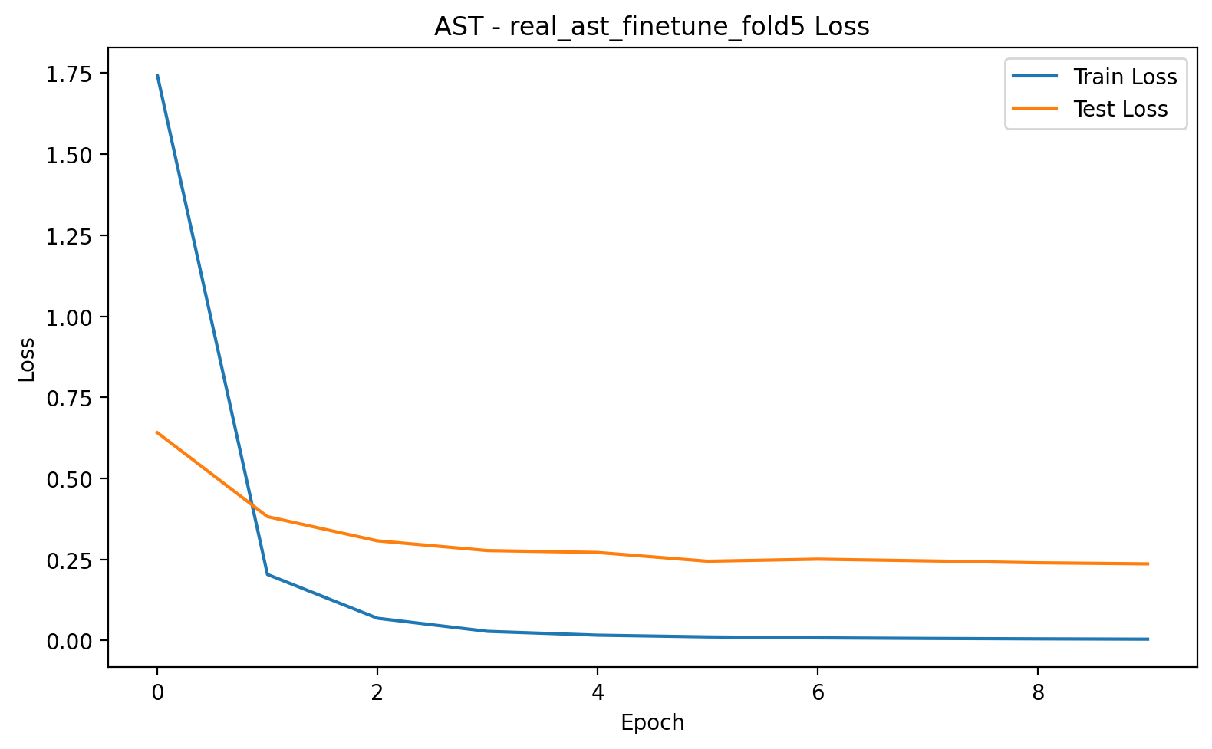
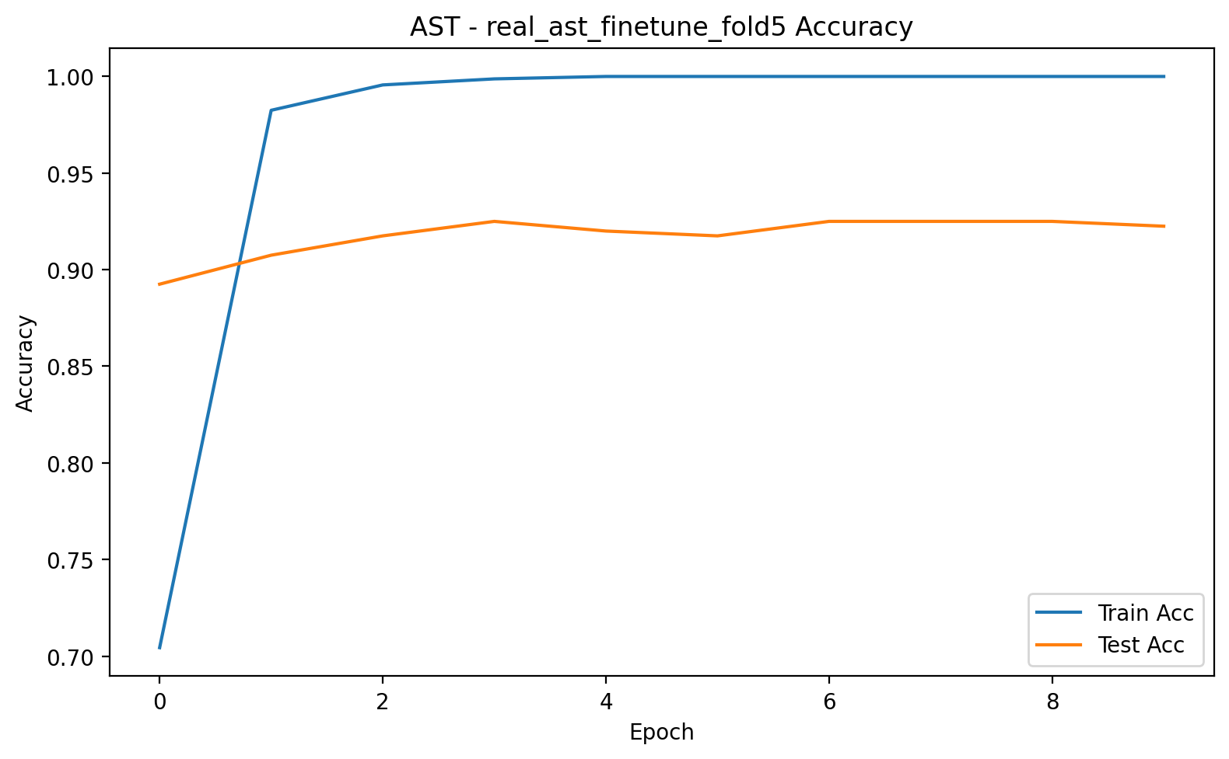
ERA 3: PRETRAINED AUDIO TRANSFORMERS
AST
Training from scratch
Transfer learning: pretrained CNN
Transfer learning: pretrained transformers
Piczak CNN | Variations | LSTM
VGGish | YAMNet
AST | BEATs
What Changed?
AST processes the full 5-second audio clip using a pretrained transformer backbone with self-attention, allowing direct clip-level prediction with much stronger pretrained audio representations.
AST architecture
Step | Parameters / implementation
Input | Full ESC-50 clip resampled to 16 kHz
Feature extractor | AutoFeatureExtractor builds spectrogram-like transformer inputs
Backbone | MIT/ast-finetuned-audioset-10-10-0.4593, AudioSet-pretrained
Head | Classifier replaced/reinitialized for 50 ESC-50 labels
Fine-tuning | freeze_backbone=False; full backbone adapts to ESC-50
Optimization | Model cross-entropy loss; AdamW lr 1e-5; weight decay 1e-4; batch 8; 10 epochs
Validation | 5 official folds; final mean test accuracy 95.25%, best 95.65%
64.5%
95.25%
Piczak published LP clip-level reference
final 5-fold accuracy
Results
AST keeps the spectrogram representation, but replaces a small CNN trained from scratch with a pretrained transformer backbone.
11
11

Slide 14
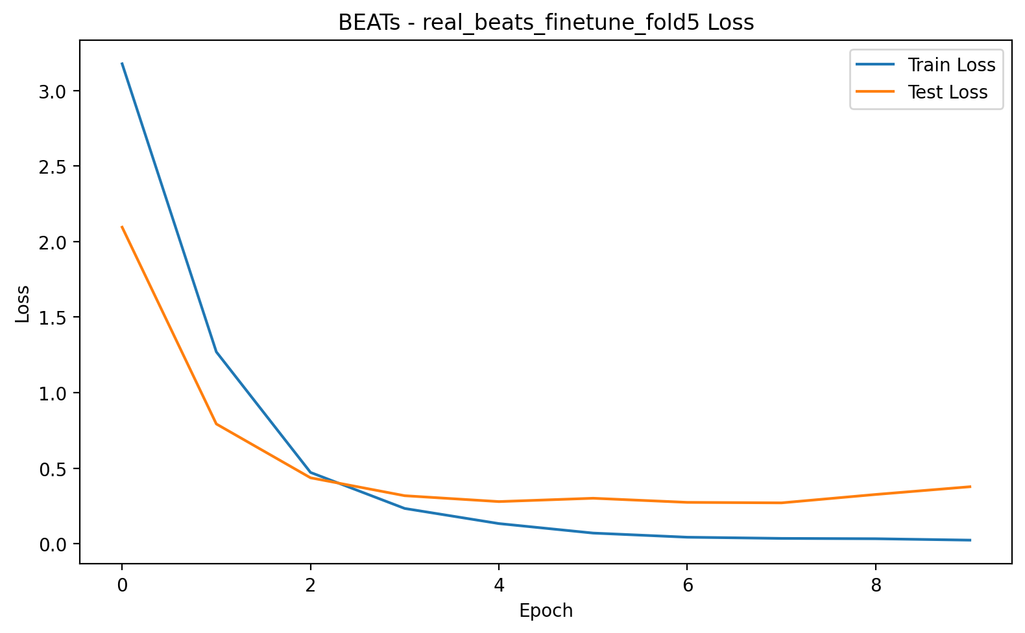
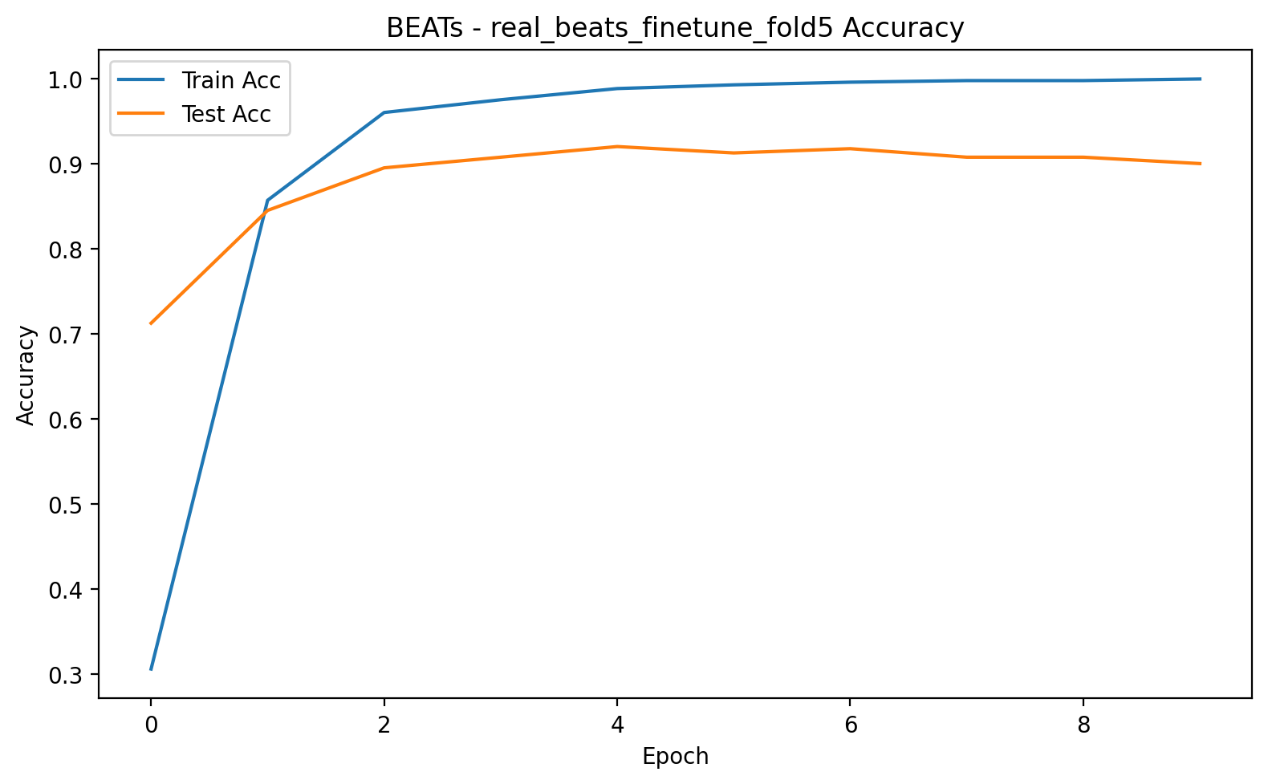
ERA 3: PRETRAINED AUDIO TRANSFORMERS
BEATs
Training from scratch
Transfer learning: pretrained CNN
Transfer learning: pretrained transformers
Piczak CNN | Variations | LSTM
VGGish | YAMNet
AST | BEATs
What Changed?
BEATs uses a large pretrained foundation audio encoder learned from massive external datasets and further shows that the real gain is pretrained audio representation learning.
BEATs architecture
Step | Parameters / implementation
Input | Full 5-s mono waveform, resampled to 16 kHz
Backbone | BEATs_iter3_plus_AS2M checkpoint, pretrained on large audio data
Features | BEATs.extract_features returns frame-level transformer features
Pooling | Mean pooling over time
Head | LayerNorm hidden_dim; Dropout 0.2; Linear hidden_dim->50
Fine-tuning | freeze_backbone=False; full backbone adapts to ESC-50
Optimization | CrossEntropyLoss; AdamW lr 1e-5; weight decay 1e-4; grad clip 1.0; batch 4; 10 epochs
Validation | 5 official folds; final 94.40%, best 95.55%; mean training time 152.37 sec
64.5%
94.4%
Piczak published LP clip-level reference
final 5-fold accuracy
Results
BEATs confirms that modern performance gains come primarily from pretrained representations, not only from attention or architecture choice.
12
12

Slide 15
Final takeaway and lessons learned
The biggest factors in accuracy were where the model learned its audio knowledge and the applicability of the model to the task at hand
Lessons learned
What went well
ESC-50 gave a clean benchmark; transfer learning created a clear contrast; AST/BEATs provided strong modern endpoints.
Piczak CNN published LP
64.5%
Piczak CNN Variations
67.9%
LSTM long
56.8%
What did not
Baseline replication required careful protocol matching and was difficult to reproduce one-to-one based on the evolution of libraries, protocols, etc.
Comparison discipline was initially overlooked. The creation of apples-to-apples comparison required intentional model setup and evaluation…as well as last second re-runs
VGGish frozen
56.5%
YAMNet fine-tuned
83.4%
BEATs
94.4%
What we would change
AST
95.3%
Lock evaluation protocol first; use fewer variants with deeper analysis; include a random forest analysis; utilize run time as a metric in addition to accuracy.
13
Notes:
Our results did not show the smooth chronological improvement we initially expected. Instead, the central lesson was that model fit mattered more than model age
CNNs were a strong baseline because spectrogram audio naturally aligns with convolutional feature learning.
Hyperparameter tuning and added architecture complexity helped only a small amount when the model still had to learn from ESC-50 alone, the results aligning to the importance of model selection when also looking at the impacts of the LSTM.
The major gains appeared when the model brought in prior audio knowledge from large-scale pretraining.
What went well was the dataset choice: ESC-50 gave us a compact, clean, repeatable benchmark.
What did not go well was reproducibility and comparison discipline. A 2015 baseline was harder to recreate than expected, and small choices like voting, folds, and final-versus-best accuracy changed the story.
If we repeated this project, we would lock the evaluation protocol earlier, run fewer variants more deeply, include a classical non-neural baseline, and add runtime or cost as a second performance dimension.

