Slide 1
ENGI 301 Poker Card Dealer Proposal
September 25, 2022
Jonathan Lloyd

Slide 2
Background Information
I initially wanted to make this a combo shuffler-dealer, but after doing further research, implementing both would be a significant design challenge and would be unlikely to be completed over the course of this class
Between these two subsystems, I decided that the auto-dealer component would be a better design challenge because poker deck shufflers are commercially available devices and constitute a multi-billion dollar industry. Dealing machines are uncommon if in existence, as casinos generally stick to human dealers at their tables
I propose an auto-dealing robot that can, at the press of a button, deal a given number of players a starting hand and continue to deal cards on the table at future prompting. Stretch goals are to add Ok Google/Google Home integration and mechanical functionality to flip cards
Existing solution: https://www.hackster.io/yongsaancern/fantastic-card-82cf4f?f=1#
Inefficient shuffle
Clunky in size
Dealing has too many voice prompts and does not place cards on the table, cards are visible when dealing
Does not dispense cards during gameplay, only to start
Uses LEGO HW/SW instead of PocketBeagle, but has Python code available for reference
PROS – voice activated, mobile

Slide 3
System Block Diagram
I am unsure which pins would be best suited for my parts as I have not selected any at this time. Would like to discuss further at project meeting for specific recommendations. I have treated this slide instead as a workflow diagram.
Diagram on next page, horizontal for better zoom/resolution
The manual card deal button, although not explicitly mentioned in system diagram, exists for debugging purposes as well as fulfilling a real time game play for “running it twice.” This case arises if, for example, two players go all in with 4 cards on the table and decide to split the pot into two hands. Two 5th cards are played instead of one, and half the pot goes to the winner of each hand’s iteration. Although not officially allowed in legitimate competition, it is used in casual play when players have a low probability high reward hand that could be won on the 5th card. It can also be done as “running it three times” or more, although these cases are much less common.

Slide 4
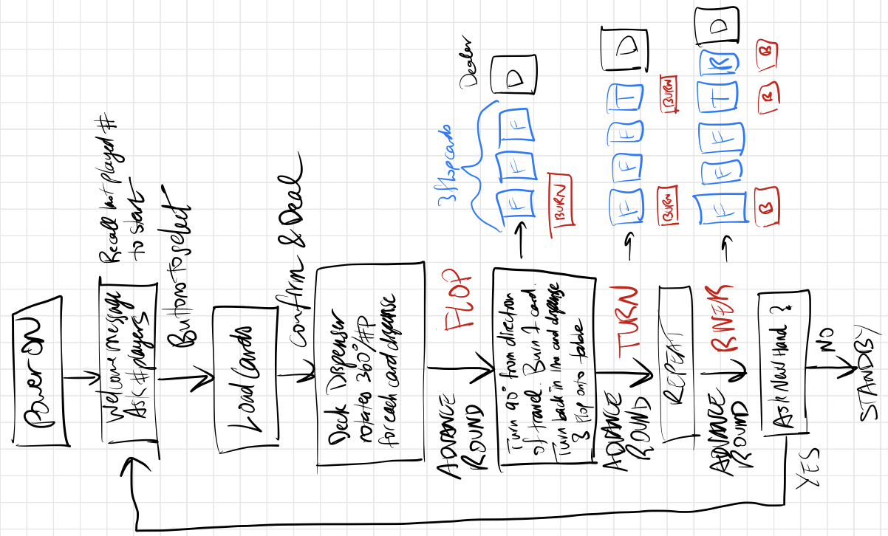

Slide 5
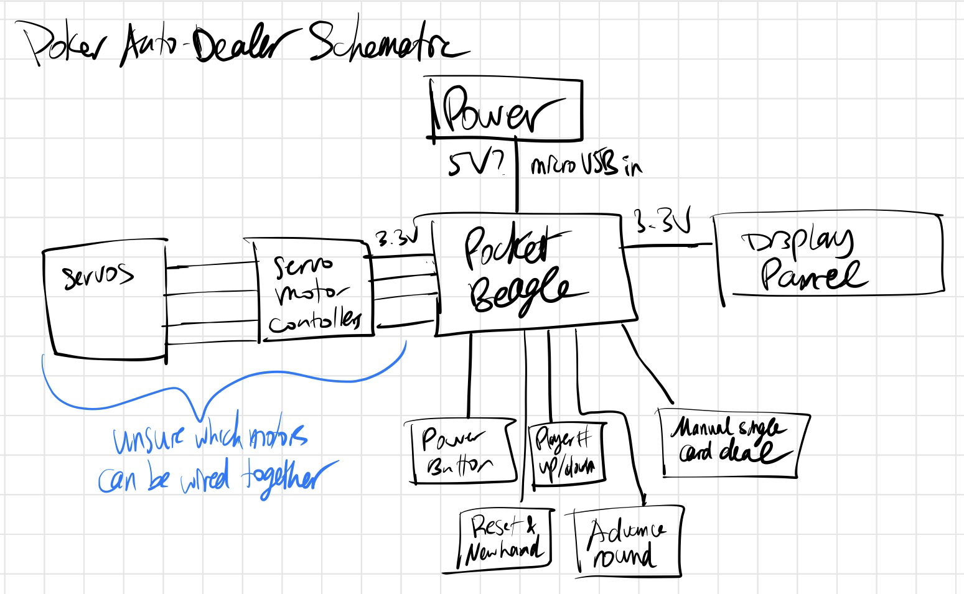
Power Block Diagram
PocketBeagle GPIO pins are 3.3 V
Uncertain about which models/types of components I will need. Would like to discuss further at project meeting for specific recommendations

Slide 6
Components / Budget
Component | Need to Buy | Cost
Wood/3D Print for body | FROM OEDK | $0
MOTORS:
Stepper motor https://www.adafruit.com/product/324 | 1 | $14
DC motor https://www.adafruit.com/product/3777 | 1 | $2.95
Motor controller https://www.digikey.com/en/products/detail/adafruit-industries-llc/3297/6419360?s=N4IgjCBcoLQBxVAYygMwIYBsDOBTANCAPZQDa4ArAEwIC6AvvYVWSAMxUCcA7CA0A | 2 | $4.95
DC motor wheel https://www.adafruit.com/product/3763 | 1 | $1.50
Servo Motor (From Parts Kit) | 0 | $0
https://learn.adafruit.com/adafruit-drv8833-dc-stepper-motor-driver-breakout-board
Need all components to be purchased by instructor listed; additional components may be purchased by student

Slide 7
Components / Budget
Component | Need to Buy | Cost
SENSORS:
Light sensor https://www.adafruit.com/product/4681 | 1 | $4.50
4-wire cable https://www.adafruit.com/product/4210 | 2 | $0.95
Touchscreen https://www.adafruit.com/product/1770 | 1 | $29.95
Touchscreen controller https://www.adafruit.com/product/5423 | 1 | $4.95
WiFi Dongle https://www.adafruit.com/product/4827 | 1 | $14.95
POWER:
Rechargeable power bank https://www.amazon.com/TalentCell-Rechargeable-3000mAh-Lithium-External/dp/B01M7Z9Z1N/ | 1 | $28.79
Need all components to be purchased by instructor listed; additional components may be purchased by student

Slide 8
Components / Budget
Component | Need to Buy | Cost
SLIDE RAIL SYSTEM: Overview | Bluetooth Controlled Motorized Camera Slider | Adafruit Learning System
Stepper Pulley https://www.adafruit.com/product/1253 | 1 | $11.95
Pulley Belt https://www.adafruit.com/product/1184 | 1 | $9.95
Ball Bearings https://www.adafruit.com/product/1178 | 1 | $6.95
Sliding Pillow Block https://www.adafruit.com/product/1866 | 1 | $24.95
Slide Rail https://www.adafruit.com/product/1861 | 1 | $29.95
Plus 3D printed parts | 0 | 0
PROJECT GRAND TOTAL |  | $176.79
OTHER NEEDED PART: an adapter to go from 12V output cable to bare wire to power multiple motors | ? | ?
Need all components to be purchased by instructor listed; additional components may be purchased by student

