Slide 1

Football teams database
Query wizards
Zero Nelson, Jabin Wade, kolade Shofoluwe, RAKSHITH Puligundla Venugopal

Slide 2




Team Introduction

Slide 3

Mission statement
Our mission is to develop and maintain a Football Database, a comprehensive and innovative database system, with a primary focus on the Southwestern Athletic Conference (SWAC) division. This database is designed to be a valuable resource for both the improvement of existing services and the development of new services within football analytics.
We aim to provide a centralized repository for SWAC Division football data.
Enhancing Player Performance
Enriching Fan Engagement
Informing Strategy and Decision-Making
Encouraging Innovation

Slide 4
Agenda
Introduction
Who are the Who’s?
ER Model and Architecture
Relations
Common Questions and Queries
Live Demonstration
Execution of Queries, triggers, webpage etc...

Slide 5
Users / CLients
Colleges and Team Staff
Players
Sports Analysts and Journalists
Enthusiasts and Fans
Colleges and Scouts

Slide 6
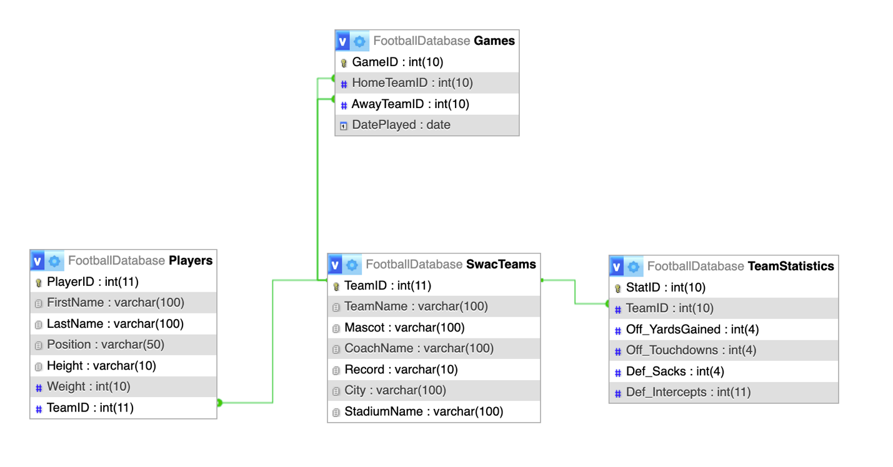
Entity-relational Diagram and Architecture

Slide 7
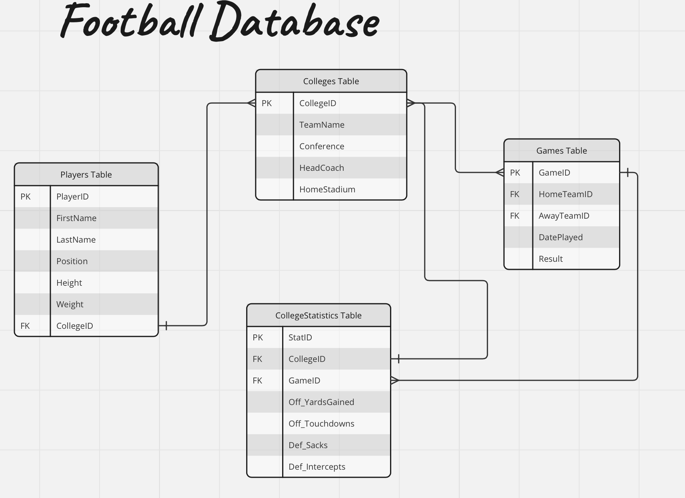
Entity-relational Model

Slide 8
SWAC TEAMS table
Attributes
TeamID (PK)
TeamName
Mascot
CoachName
Record
City
StadiumName
CREATE TABLE `SwacTeams` (
`TeamID` int(11) NOT NULL AUTO_INCREMENT,
`TeamName` varchar(100) DEFAULT NULL,
`Mascot` varchar(100) DEFAULT NULL,
`CoachName` varchar(100) DEFAULT NULL,
`Record` varchar(10) DEFAULT NULL,
`City` varchar(100) DEFAULT NULL,
`StadiumName` varchar(100) DEFAULT NULL,
PRIMARY KEY (`TeamID`)
)

Slide 9
Players table
Attributes
PlayerID (PK)
FirstName
LastName
Position
Height
Weight
TeamID (FK)
CREATE TABLE `Players` (
`PlayerID` int(11) NOT NULL AUTO_INCREMENT,
`FirstName` varchar(100) DEFAULT NULL,
`LastName` varchar(100) DEFAULT NULL,
`Position` varchar(50) DEFAULT NULL,
`Height` varchar(10) DEFAULT NULL,
`Weight` int(10) DEFAULT NULL,
`TeamID` int(11) DEFAULT NULL,
PRIMARY KEY (`PlayerID`),
KEY `TeamID` (`TeamID`),
CONSTRAINT `fk_Team`
FOREIGN KEY (`TeamID`)
REFERENCES `SwacTeams` (`TeamID`)
)

Slide 10
GAMES TABLE
Attributes
GameID (PK)
HomeTeamID (FK)
AwayTeamID (FK)
DatePlayed
CREATE TABLE `Games` (
`GameID` int(10) NOT NULL AUTO_INCREMENT,
`HomeTeamID` int(10) DEFAULT NULL,
`AwayTeamID` int(10) DEFAULT NULL,
`DatePlayed` date NOT NULL,
PRIMARY KEY (`GameID`),
CONSTRAINT `fk_AwayTeam` FOREIGN KEY (`AwayTeamID`) REFERENCES `SwacTeams` (`TeamID`)
)

Slide 11
Team statistics table
Attributes
StatID
TeamID
Off_YardsGained
Off_Touchdowns
Def_Sacks
Def_Intercepts
CREATE TABLE `TeamStatistics` (
`StatID` int(10) NOT NULL,
`TeamID` int(10) DEFAULT NULL,
`Off_YardsGained` int(4) DEFAULT NULL,
`Off_Touchdowns` int(4) DEFAULT NULL,
`Def_Sacks` int(4) DEFAULT NULL,
`Def_Intercepts` int(11) DEFAULT NULL,
PRIMARY KEY (`StatID`),
KEY `TeamID` (`TeamID`),
CONSTRAINT `fk_TeamStatistics`
FOREIGN KEY (`TeamID`)
REFERENCES `SwacTeams` (`TeamID`)
);

Slide 12
Database relations
SWAC Teams to Team Statistics (One-to-Many):
- Each college in the `Colleges` table can have multiple records in the `TeamStatistics` table. This relationship is established through the `PlayerID` foreign key in the `PlayerStats` table, which references the `PlayerID` primary key in the `Players` table.
SWAC Teams to Games (One-to-Many):
- Each team in the `Teams` table can have multiple associated games in the `Games` table. This relationship is established through the `TeamID` foreign key in the `Games` table, which references the `TeamID` primary key in the `Teams` table for both the home and away teams.
Games to Team Stats (One-to-Many):
- Each game in the `Games` table can have multiple associated statistical records in the `TeamStatistics` table. This relationship is established through the `GameID` foreign key in the `PlayerStats` table, which references the `GameID` primary key in the `Games` table.
Players to SWAC Teams (Many-to-Many):
- While not explicitly defined in the table structures provided, there's an implicit many-to-many relationship between players and teams. A player can be associated with multiple teams over their career, and a team can have multiple players.

Slide 13
Queries / Business questions pt. 1
Select players who play the ‘QB’ position and retrieve their personal information along with team name.
Retrieve College Information for Player
SELECT
Players.FirstName,
Players.LastName,
Players.Position,
SwacTeams.TeamName,
SwacTeams.Record
FROM
Players
JOIN
SwacTeams ON Players.TeamID = SwacTeams.TeamID
WHERE
Players.Position = 'QB';

Slide 14
Queries/Business questions pt. 2
Retrieve College Information for Player
SELECT p.FirstName, p.LastName, p.Position, c.TeamName, c.Conference, c.Coach, c.HomeStadium
FROM Players p
JOIN Colleges c ON p.CollegeID = c.CollegeID
WHERE p.PlayerID = [PlayerID];
Find All Games Played at a Specific Location
SELECT GameID, DatePlayed
FROM Games
WHERE Location = '[Location]’;
Retrieve Player’s Height and Weight
SELECT Height, Weight
FROM Players
WHERE PlayerID = [PlayerID];

Slide 15

Live demonstration
Spearheaded by Lone Wolf,
Mr. coe, Jabin Wade

