Slide 1
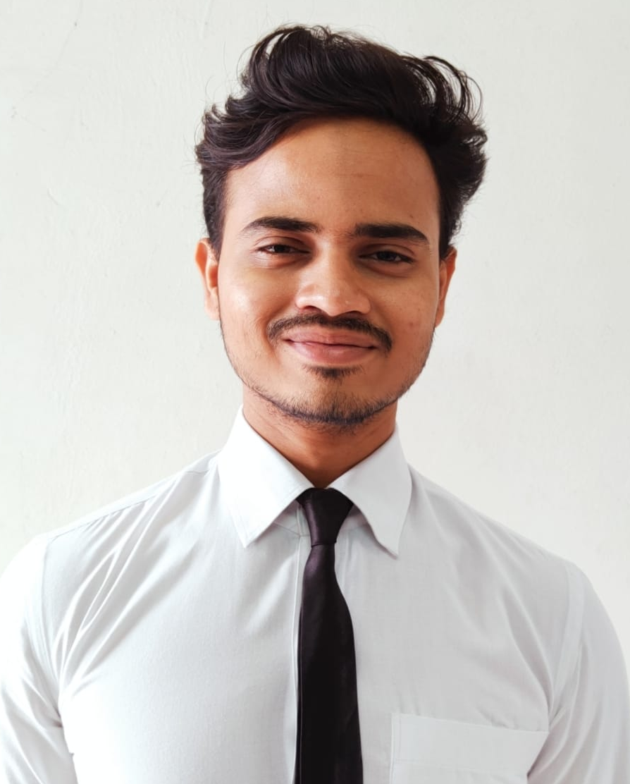
Summary
Dedicated Java Full Stack developer with 1.9 years of hands-on experience in software development in Capgemini. Proficient in Java programming, Spring Boot, RESTful APIs and Angular. Proficient in building Java FullStack Microservice Architecture with SpringBoot +MongoDB(Backend) and Angular(Frontend); Proven ability to thrive in fast-paced environments and collaborate effectively in cross-functional teams.
Professional Experience & Key Projects
Charter: Mobile IT (K8s) Migration:
Hands-on experience on Core Java, Java 8, SpringBoot, Spring Cloud, MicroServices, Junit, OOPS Concepts, Collections.
Ability to deliver high-quality code, troubleshoot complex problems, and collaborate effectively within agile teams
Working experience Swagger, JMeter, Postman. GIT Hub
Developed and maintained applications using core Java, SpringBoot, and MicroServices architecture, ensuring robust and scalable solutions
Working on containerizing the legacy code and developing backend REST APIs, microservices in Spring boot to deliver it to client on time using Core java 8, Spring boot, Swagger, Security and data ,REST API, and hands on experience on Jenkins and tools like Bitbucket, STS, VScode and testing data through API URLs in postman
Took complete ownership of the complex UI module migration from Virtual Machine to Kubernetes platform across 15 environments - includes 7 UI applications Configuration changes, Deployments along with basic validations using Server links
Also worked on Configurations changes, Deployments of backend modules along with basic validations using CURLs, Swagger & Postman
Implemented a solution which involves deploying the existing spring boot applications to both VMs and K8s with minimal code changes (k8s common build)
Implemented basic swagger authorization for all services. and implemented probe changes
Continuous monitoring migrated microservices deployed in various environments on Datadog
Updating the chalk-page on the latest updates and prod deployments status on communication platform
Implemented common config changes across all environment
Charter: SDP (Sales Delivery Platform) Fusion Application:
Project Description:-This project focuses on managing fallout resolution through automated and manual processes, ensuring all fallouts are identified, categorized, and monitored. Key principles include resolving fallouts early, at the origin, and prioritizing automated workflows
Microservice architecture was followed while building this application.
Took complete ownership of the UI (Angular) and added multiple new features to the legacy code.
Resolved more than 20 tickets with hands on experience using Bootstrap & Angular- Material.
Developed Microservices using Core java 17, Spring boot, Swagger and testing data through API URLs in postman.
Accomplishments:
Capgemini’s Falcon Innovation Challenge (2023) - 3rd Position
AWS Certified Solutions Architect SAA-C03 (10/2024)
AWS Certified Cloud Practitioner CLF-C01 (09/2023)
Microsoft Certified: Azure Fundamentals AZ-900 (11/2023)
Level 1 (Beginner) / Level 2 (Practitioner) certified in J2EE- OCEAN cloud and custom APPS
Hrishikesh Prakash Sarate
hrishikesh.prakash-sarate@capgemini.com
+91 9702905375
Education:
Master of Computer Applications (MCA) from Pune
Skills: Java 8 /17, Spring REST, SpringBoot, MicroServices, Swagger, Spring Cloud, Git, GitHub, MongoDB, Basic SQL
UI: Angular 16, HTML5, CSS3, Bootstrap, Angular material
DevOps Tools: Kubernetes, Jenkins
Other Tools: STS, Maven, Postman, Jira, DataDog, Bitbucket, Chalk

