Slide 1
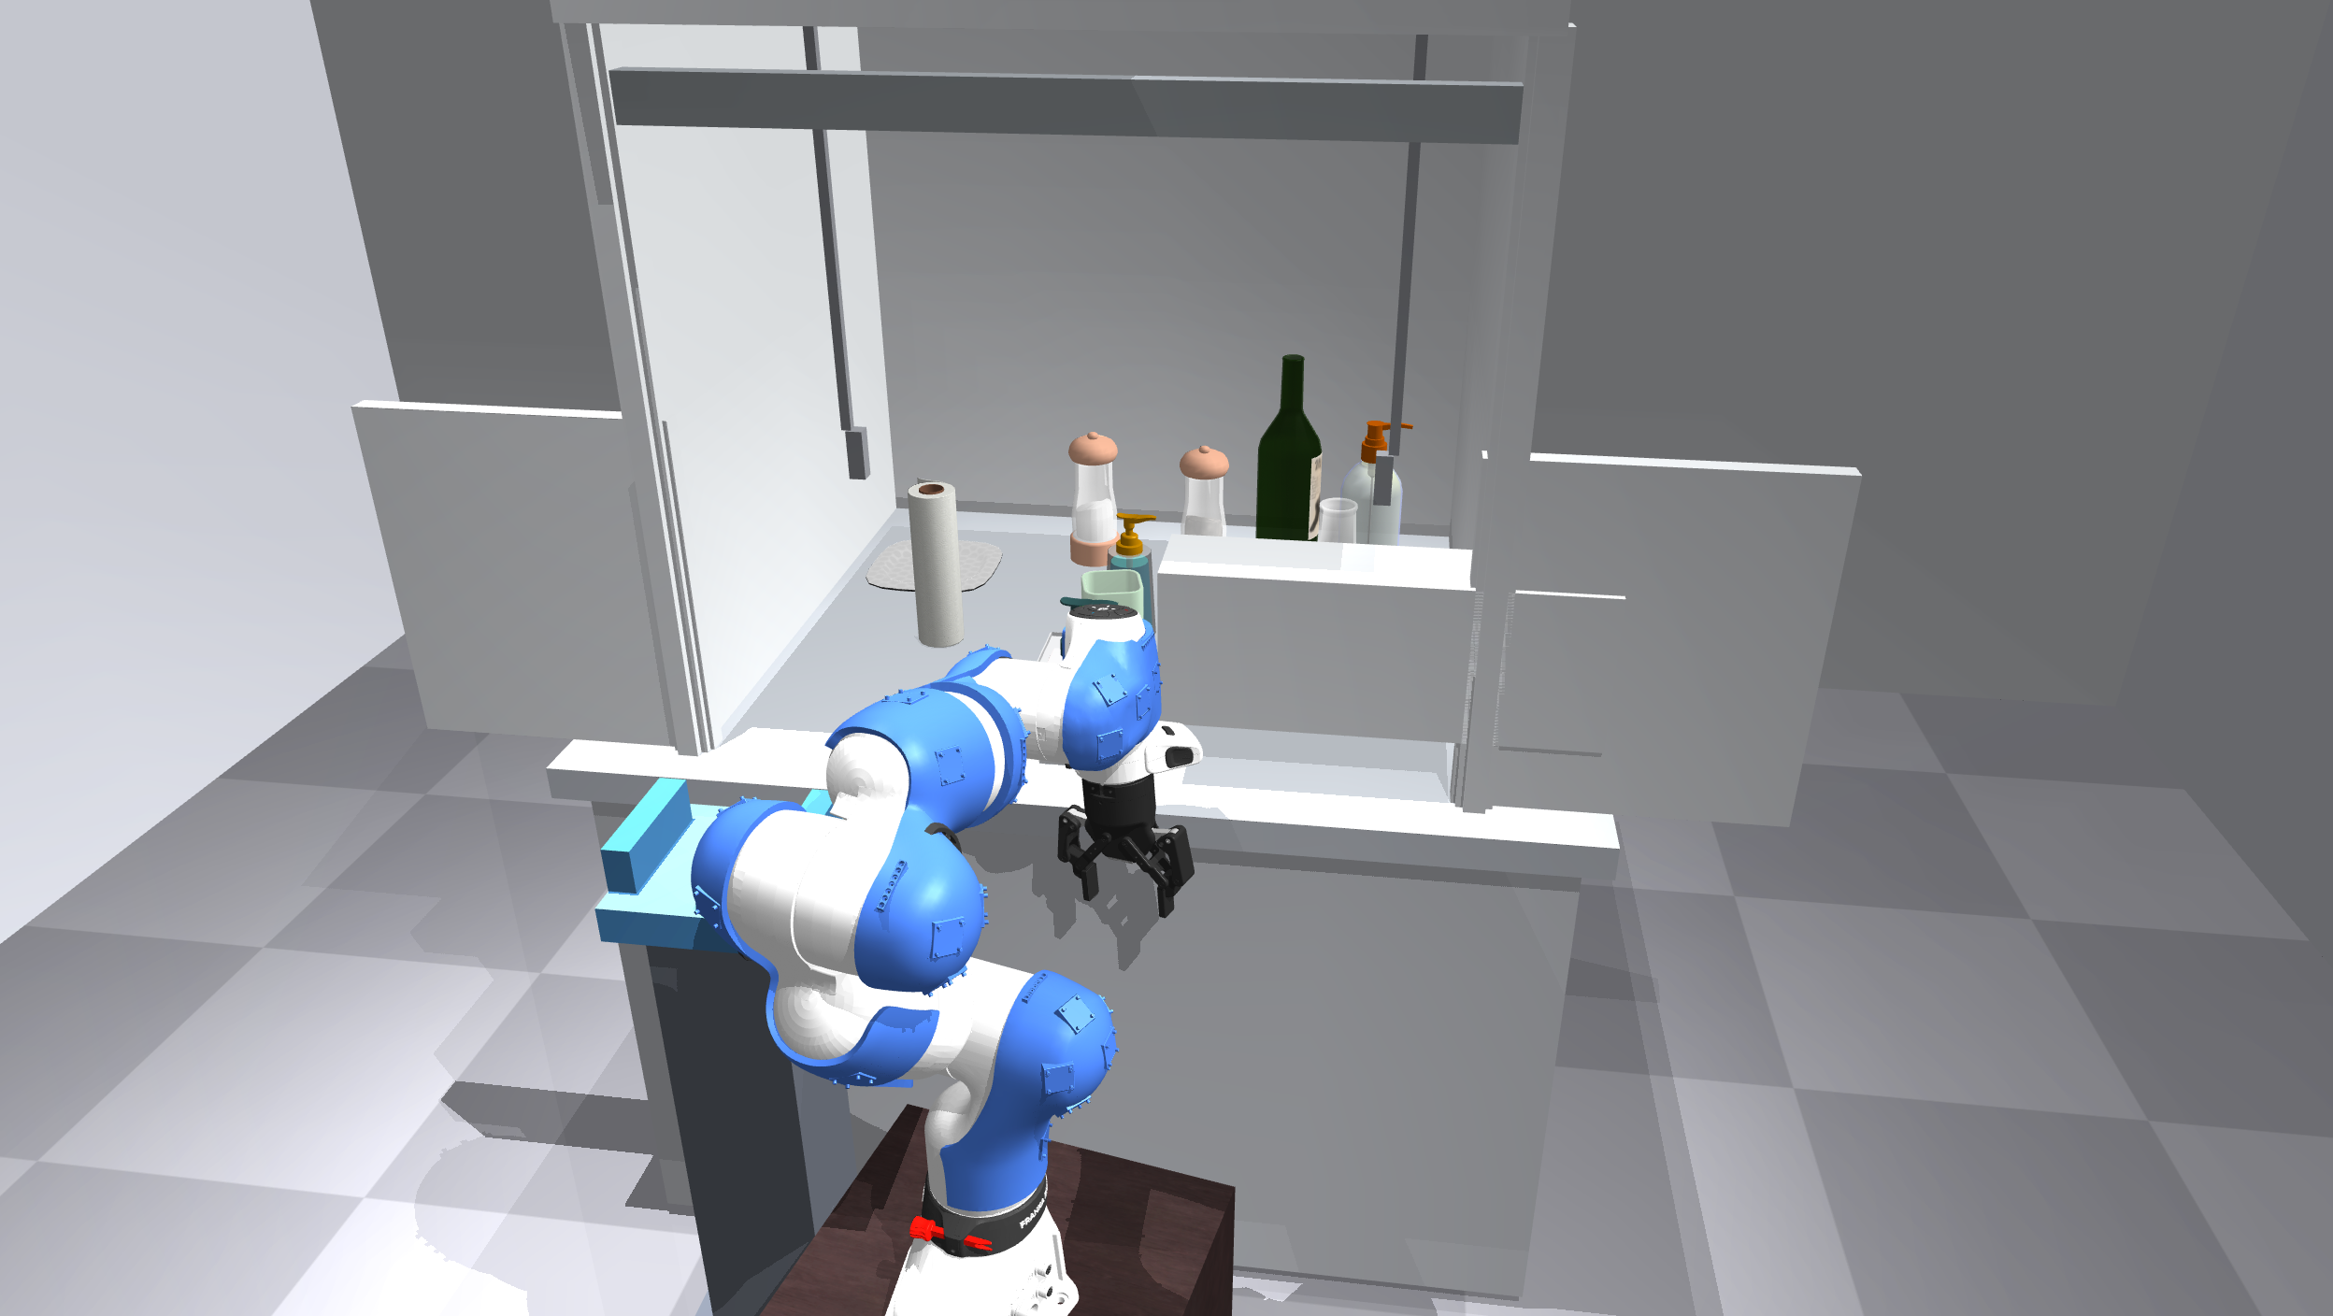
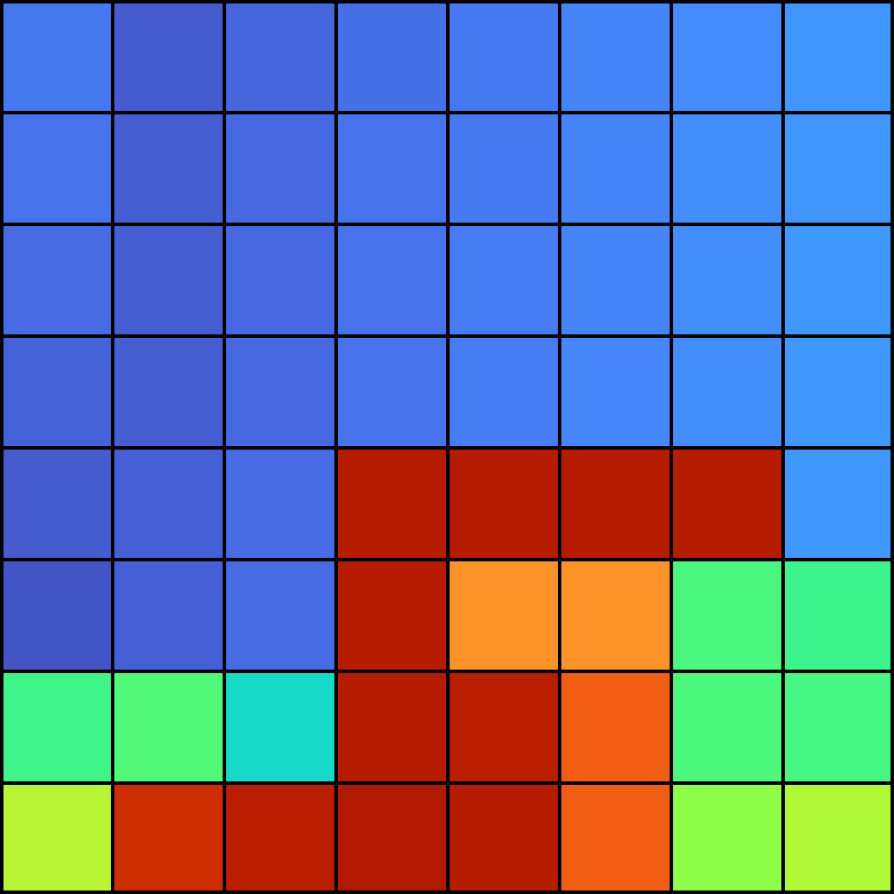
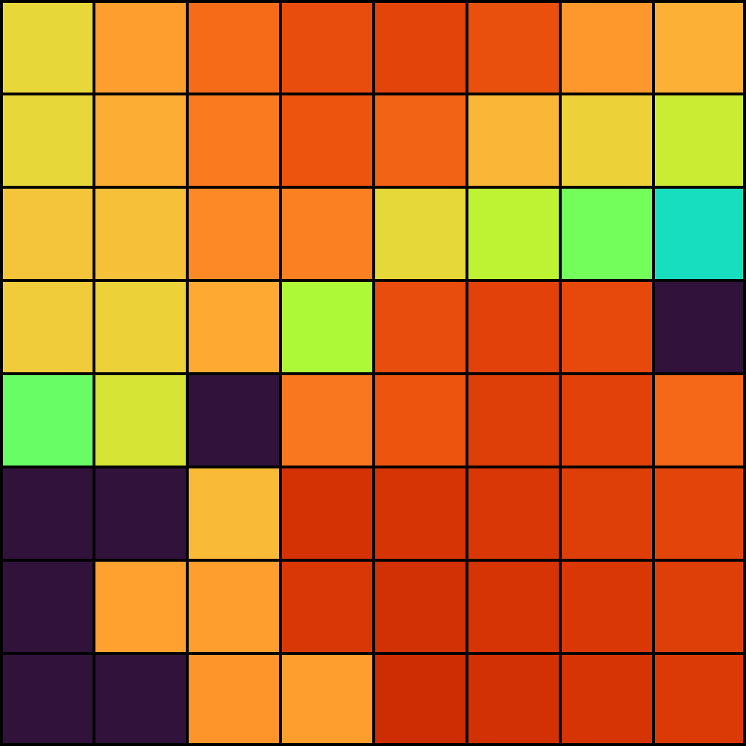
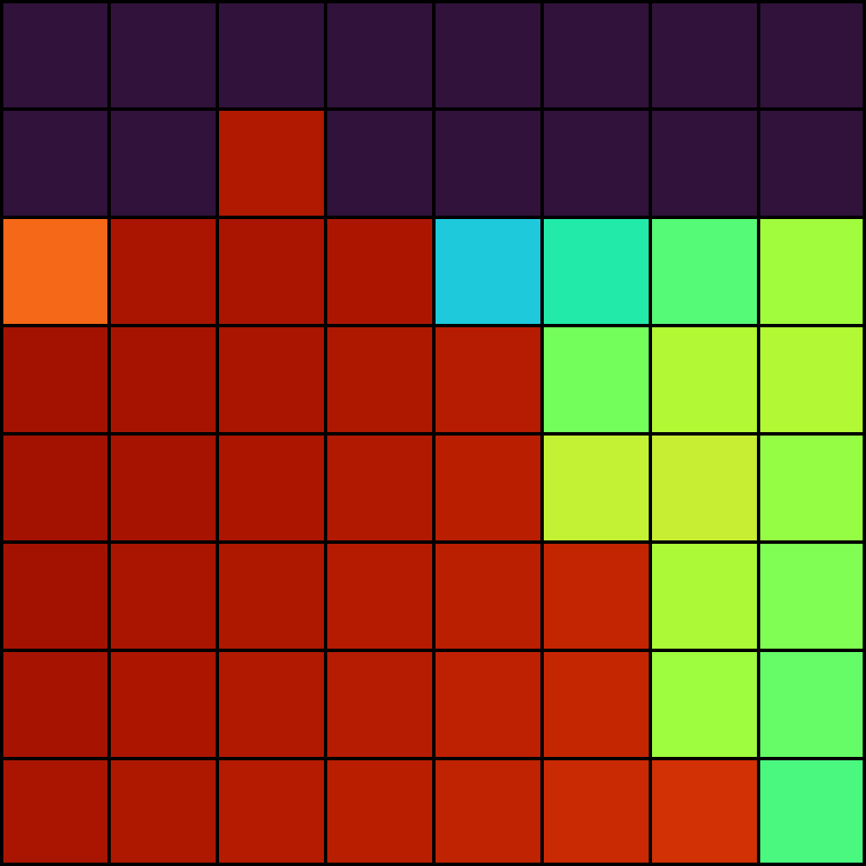
RGB observations
Visual encoder
Image tokens
Global visual context
PACT
Action chunk
Whole-body proximity
Multimodal transformer
Arm + gripper commands
Temporal encoder
Sensor tokens
Shared across sensors
One per sensor
Execute, then query again
40 sensors × 8 × 8 ranges
Joint state
Arm + gripper
Live RGB and proximity at each policy query

Slide 2
50 queries
RGB camera(s)
ResNet-18
Image tokens
Learned action positions
240 × 320 per view
Shared visual backbone
512-d + image positions
ACT encoder
ACT decoder
4 layers · 512-d
7 layers
Range history
Shared encoder
40 readouts
Projection
8 × 40 × 8 × 8
CNN + temporal transformer
128-d CLS per sensor
512-d + sensor identity
Closeness: 5–200 mm
Repeat each of 8 frames ×4
Initialize shared encoder
Joint state
Action chunk
z = 0
50 × 8 commands
9-d → 512-d token
Latent token at inference
Geometry pretraining
XYZ · validity · depth · future
Inference path shown. History sampling and camera selection depend on the run.

