Slide 1
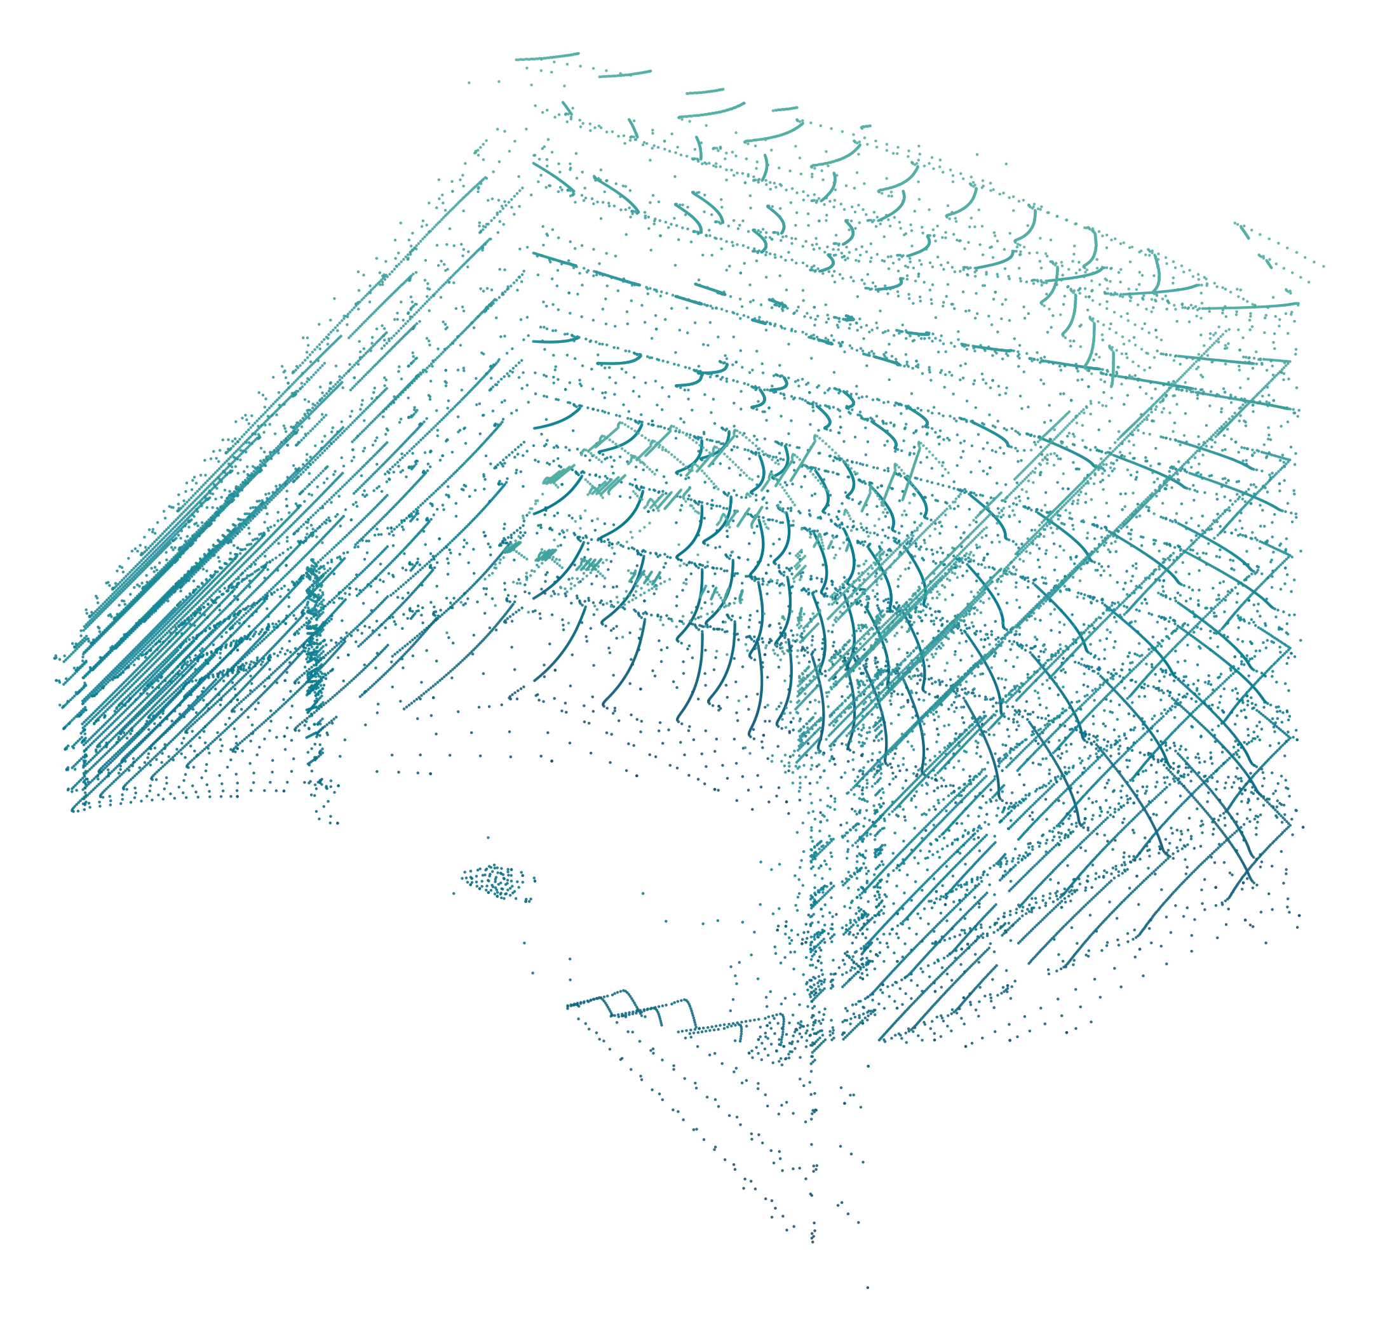
Notes:
Sensor-only reconstruction from six link-6 proximity sensors. Each snapshot contains six raw 8×8 depth arrays (384 measured samples). Accumulating the latest reading at each of 106 recorded approach steps, transformed using the stored sensor poses, reveals observed parts of the fume-hood surfaces and protruding obstacle. No RGB, depth from external/wrist cameras, scene meshes, fitted surfaces or interpolated points contribute to this reconstruction. The cloud is partial: unobserved surfaces remain empty.
Plate: link6_hood_scan. Snapshot: 384 individually editable points in six sensor groups. Dense scans: transparent PNG, with SVG and full 3D PLY alongside. See manifest.json for provenance and limitations.

Slide 2
Notes:
Sensor-only reconstruction from six link-6 proximity sensors. Each snapshot contains six raw 8×8 depth arrays (384 measured samples). Accumulating the latest reading at each of 106 recorded approach steps, transformed using the stored sensor poses, reveals observed parts of the fume-hood surfaces and protruding obstacle. No RGB, depth from external/wrist cameras, scene meshes, fitted surfaces or interpolated points contribute to this reconstruction. The cloud is partial: unobserved surfaces remain empty.
Plate: link6_snapshot_384. Snapshot: 384 individually editable points in six sensor groups. Dense scans: transparent PNG, with SVG and full 3D PLY alongside. See manifest.json for provenance and limitations.

Slide 3
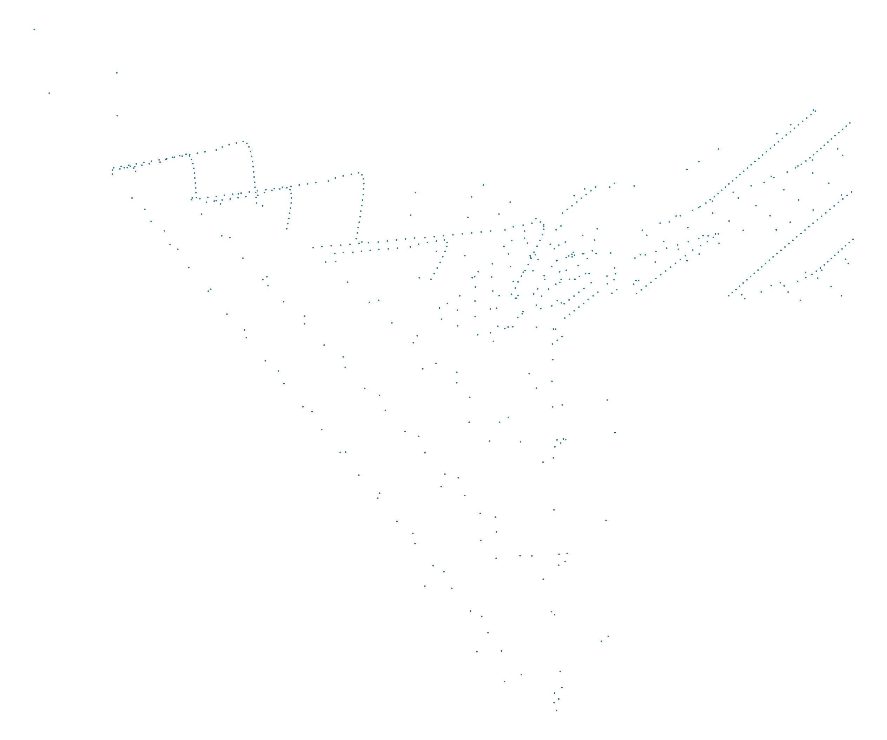
Notes:
Sensor-only reconstruction from six link-6 proximity sensors. Each snapshot contains six raw 8×8 depth arrays (384 measured samples). Accumulating the latest reading at each of 106 recorded approach steps, transformed using the stored sensor poses, reveals observed parts of the fume-hood surfaces and protruding obstacle. No RGB, depth from external/wrist cameras, scene meshes, fitted surfaces or interpolated points contribute to this reconstruction. The cloud is partial: unobserved surfaces remain empty.
Plate: link6_obstacle_detail. Snapshot: 384 individually editable points in six sensor groups. Dense scans: transparent PNG, with SVG and full 3D PLY alongside. See manifest.json for provenance and limitations.

