Slide 1
2023 1학기 FR 프로젝트
Portfolio Optimization
35기: 류제현 박민규 황인준
36기: 이대원 장은경 전호연
PPT: 류제현

Slide 2
Contents
Ⅰ. Project Description
Ⅱ. Data
Ⅲ. Code
Ⅳ. Personal Achievement

Slide 3
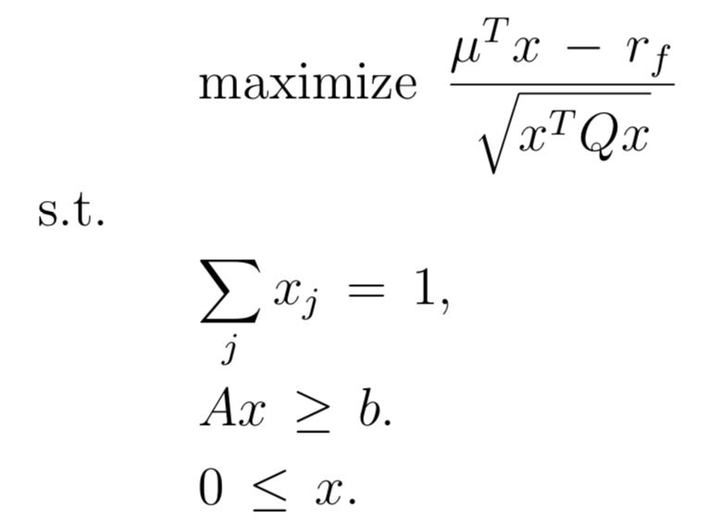
Ⅰ. Project Description : Blueprint
∙ 포트폴리오 최적화 (Portfolio Optimization)
자산 배분(Asset Allocation) / Long-Only Portfolio
1. Define Object Function
2. Estimate Expected Return and Covariance Matrix
3. Find Weight Vector that Maximize the Object Function
Target: Maximize Sharpe Ratio
∙ 최적화 방법 (Optimization Method) : How to Find Optimal Solution?
1. SLSQP
2. Deep Learning

Slide 4
Ⅰ. Project Description : Algorithm
∙ SLSQP
∙ Optimization Under Constraint and Bounds / Approximate Using a Second Order Equation
∙ Assets Universe : S&P500 / ETF
∙ Sharpe Ratio Maximization / Variance Minimization
∙ Deep Learning
∙ LSTM: Long Short Term Memory
∙ Assets Universe : ETF
∙ Sharpe Ratio Maximization

Slide 5
Ⅰ. Project Description : Novel Approach
∙ Shrinkage Estimated Covariance Matrix
Estimation Issues Arise
∙ The Length of Time Series < The Number of Asset
∙ J. Bun, J. P. Bouchaud, and M. Potters (2017)
“The errors in the covariance matrix estimates further propagate to portfolio optimization problems, leading to poor out-of-sample performance of portfolios optimized using noisy estimates”
∙ Prevent Overfitting
∙ Regularization of Neural Networks
∙ Robustness Test

Slide 6
Ⅱ. Data
Vender
∙ Daily Security Price: The Center for Research in Security Prices
∙ Daily S&P500 Constitute: The Center for Research in Security Prices
Preprocessing
∙ Prevention of Survivorship Bias: Using Daily S&P500 Constitute Data
∙ Using Adjusted Close Price: To Deal with Merger and Acquisition, Stock Split

Slide 7
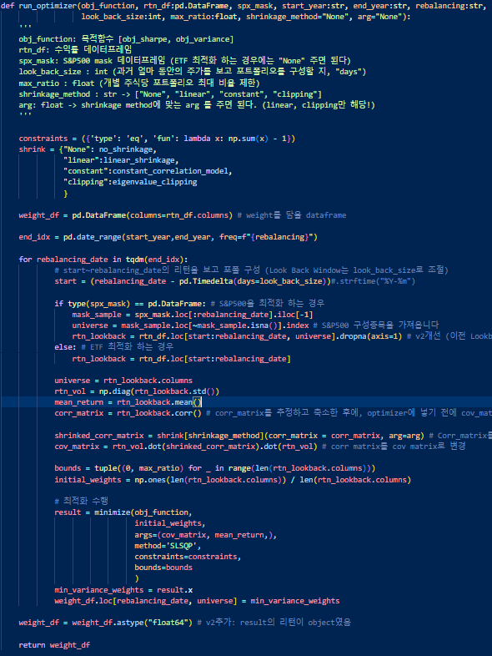
Ⅲ. CODE : Optimizer.py
Optimizer.py
Shrinkage_Method.py
Back_Testing.py
∙ Estimates Expected Return and Covariance Matrix
∙ Returns Weight Vector that Maximize the Object Function

Slide 8
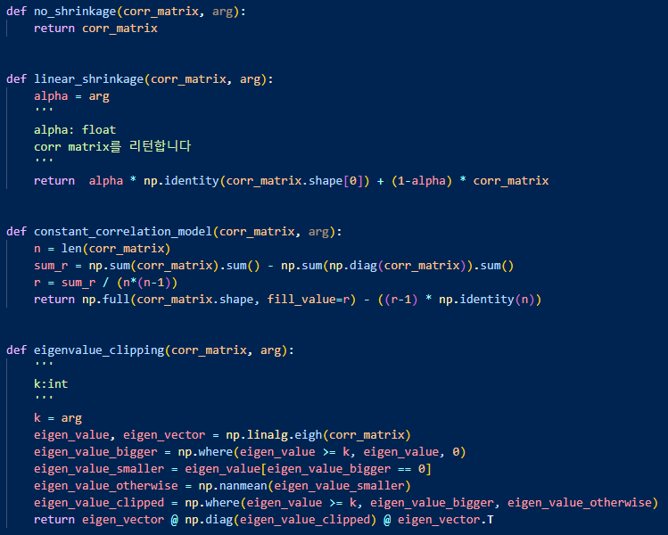

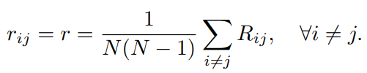
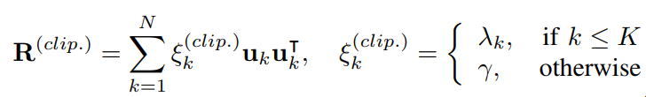
Ⅲ. CODE : Shrinkage_Method.py
Optimizer.py
Shrinkage_Method.py
Back_Testing.py
∙ Basic Linear Shrinkage
∙ Constant Correlation Model
∙ Eigen Value Clipping

Slide 9
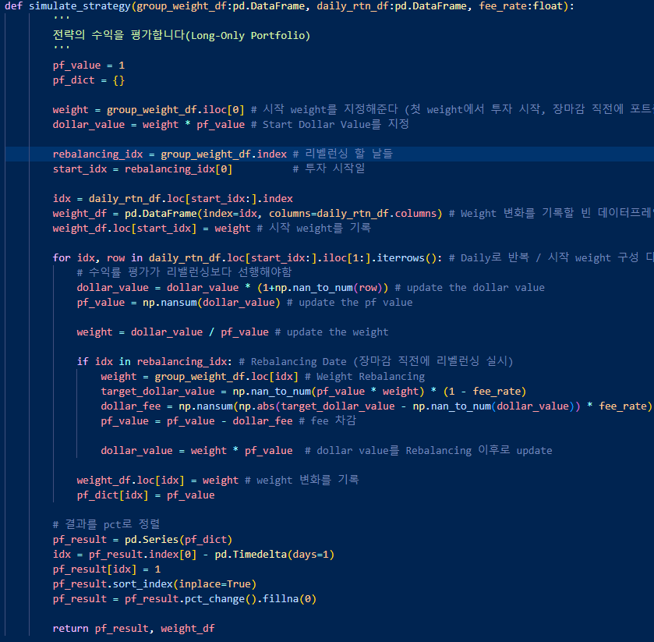
Ⅲ. CODE : Back_Testing.py
Optimizer.py
Shrinkage_Method.py
Back_Testing.py
∙ Most Important: Avoid Forward Looking Bias
∙ Back-Testing Should Operate Like a Market Simulator
∙ Consider Transaction Fees

Slide 10
Ⅳ. Personal Achievement
∙ 100% Object Oriented Programming (OOP)
∙ Ray : Python Multi Processing Library
∙ More Accurate Back-Testing

Slide 11
Thank you

