Slide 1
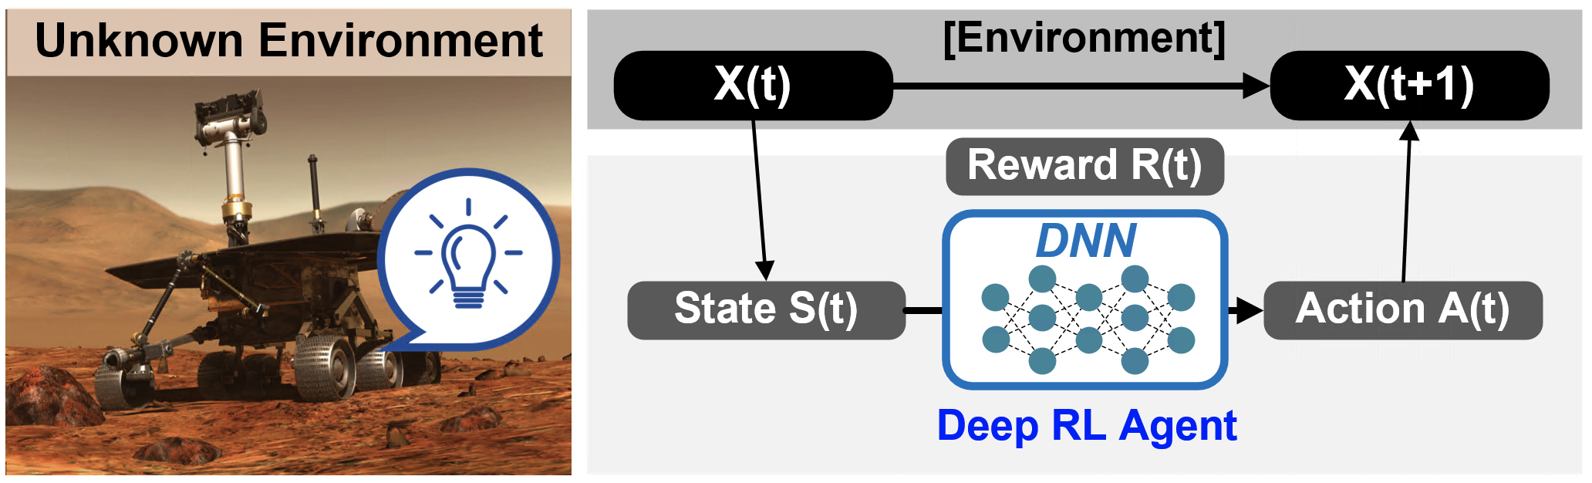
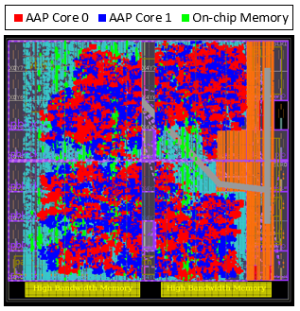
Deep Reinforcement Learning Network and Implementation of FIXAR FPGA-based Accelerator

Slide 2
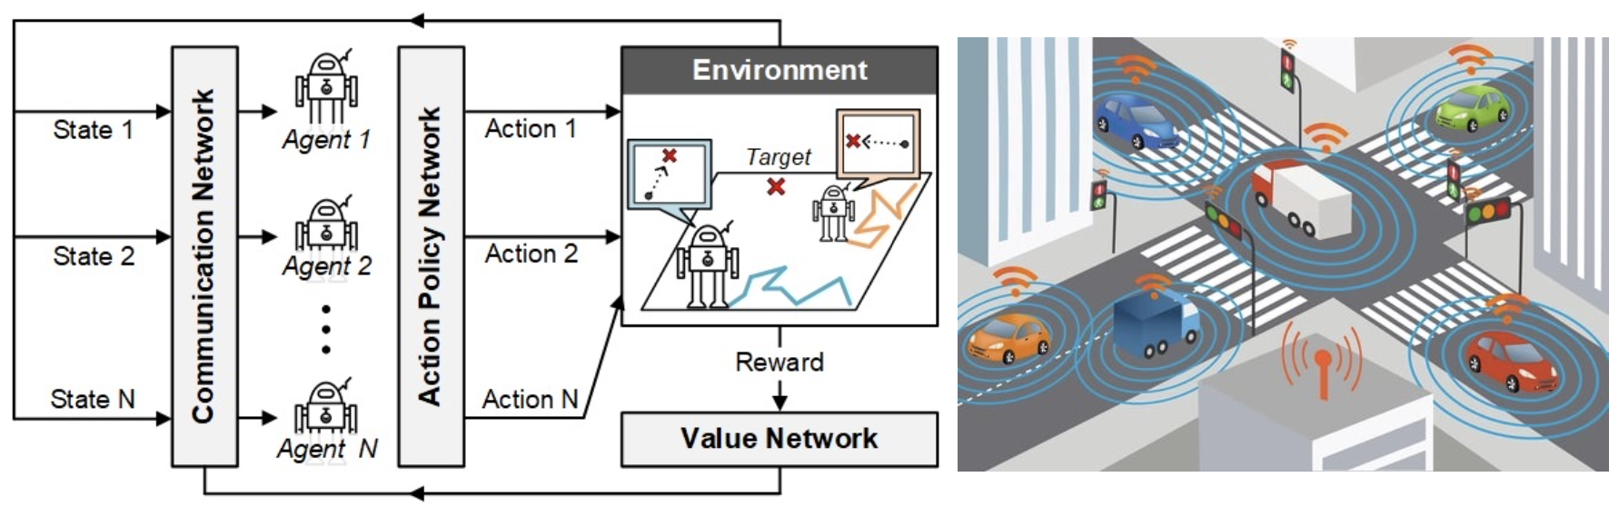
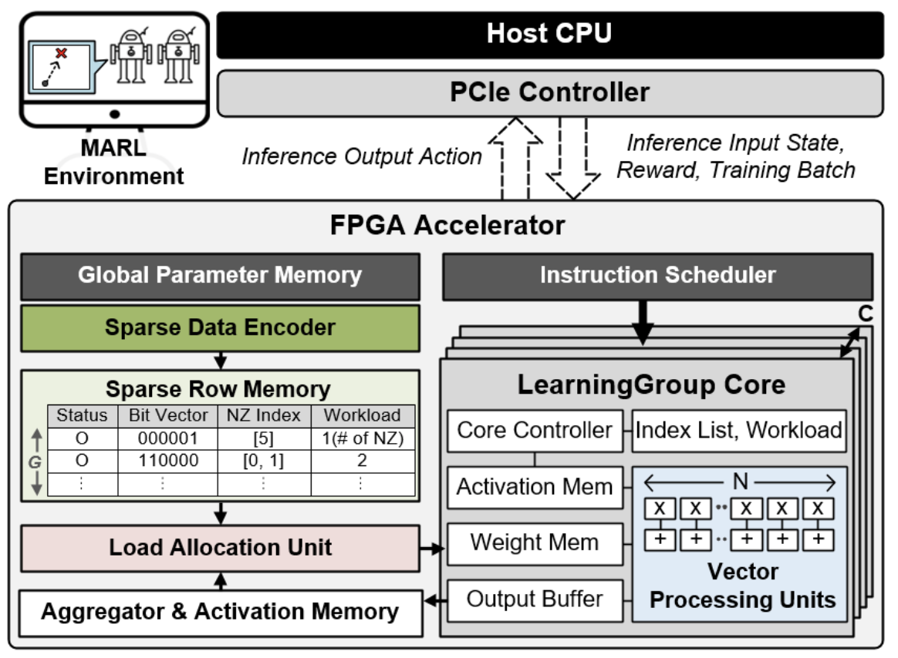
Multi-Agent DRL Application and Overall Architecture of LearningGroup Accelerator

