Slide 1
Blazing Pizzas
danroth27
log out
Get pizza
My orders
Your order
Pizza name
Hand-stretched gourmet cheesy meaty pizza.
Pizza name
Hand-stretched gourmet cheesy meaty pizza.
14” Mighty Meaty
+ double cheese
+ steel gift box
£14.45
Garlic sculpture
£3.00
X
Add >
Add >
X
Pizza name
Hand-stretched gourmet cheesy meaty pizza.
Pizza name
Hand-stretched gourmet cheesy meaty pizza.
Add >
Add >
Pizza name
Hand-stretched gourmet cheesy meaty pizza.
Pizza name
Hand-stretched gourmet cheesy meaty pizza.
£28.95
Buy >
Add >
Add >

Slide 2
Blazing Pizzas
danroth27
log out
Get pizza
My orders
X
Basic cheese and tomato
It’s plain, it’s dull, so why not add some sweet toppings?
Size:
9”
12”
17”
£11.95
Extra toppings:
(select)
+ Venison meatballs (£2.50) - remove
+ Served on silver platter (£149.00) - remove
+ Lobster on top (£64.50) - remove
Cancel
Price: £227.95
Order >

Slide 3
Blazing Pizzas
danroth27
log out
Get pizza
My orders
Order placed Thu 17th January at 6:48pm
Total: £34.90
Status: In preparation
View >
Order placed Wed 16th January at 2:23am
Total: £15.25
Status: Delivered
View >

Slide 4
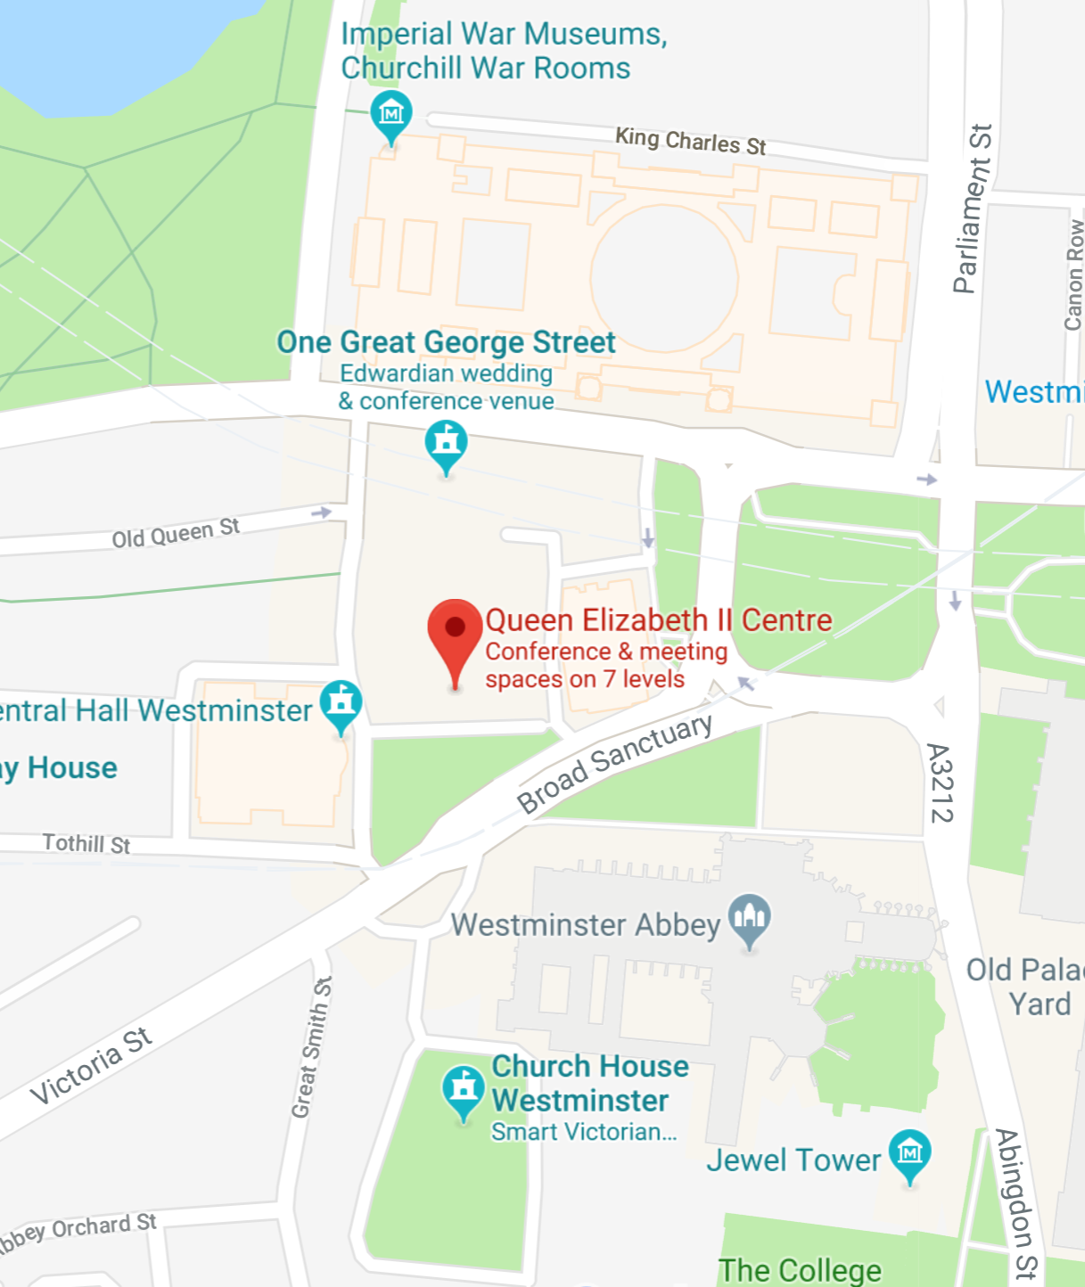
Blazing Pizzas
danroth27
log out
Get pizza
My orders
Order placed Thu 17th January at 6:48pm
Status: Out for delivery
14” Mighty Meaty
+ double cheese
+ steel gift box
£14.45
Garlic sculpture
£3.00

Slide 5
Backend APIs, if we skip delivery address/payment
List pizzas available
Returns [{ pizzaId, name, description, [{ size, price }], imageUrl? }]
List toppings available
Returns [{ toppingId, name, price }]
Submit order
Takes [{ pizzaId, size, [toppingId] }, userAuthToken?]
List orders
Takes { userAuthToken? }
Returns [{ orderId, date, totalPrice, status }]
Get order details
Takes { orderId, userAuthToken? }
Returns { [{ pizzaId, size, price, [toppingId] }], status, { lat, long } }

