Slide 1
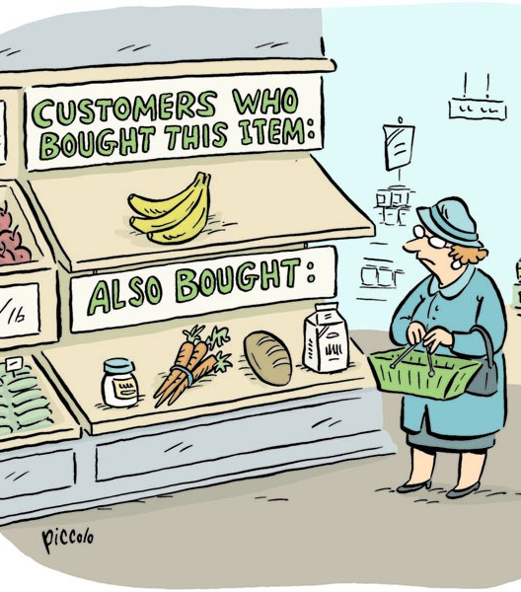
Collaborative Filtering
Collaborative filtering filters information by using the recommendations of other people. It is based on the idea that people who agreed in their evaluation of certain items in the past are likely to agree again in the future.
Uses Include:
Product recommendation
News content recommendation
Movie/TV recommendation
Social Network recommendation
Methods explored in this analysis include SVD Matrix Factorization and k-Nearest Neighbors.

Slide 2
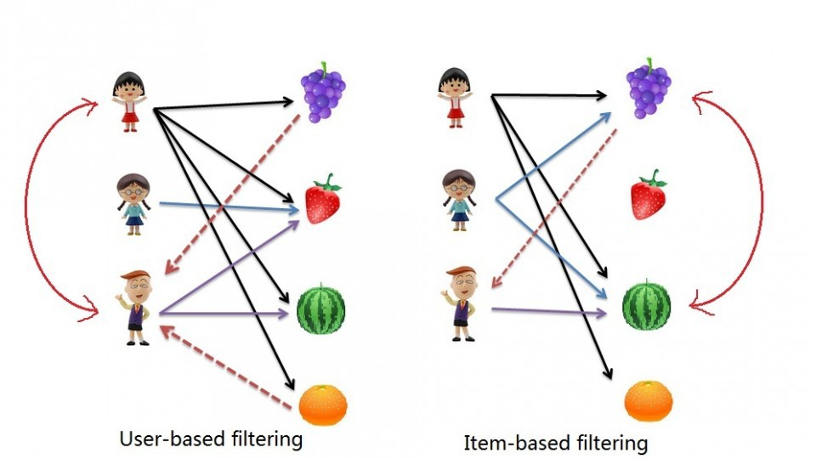
There are 2 types of Collaborative Filtering, user based and item based. Both work in a similar way but with a slightly different focus.
Both scenarios use a similarity matrix.
For user-user collaborative filtering, the user-similarity matrix measures the similarity between any two pairs of users.
Likewise, the item-similarity matrix measures the similarity between any two pairs of items.
For this analysis I will focus on the Item based approach.

Slide 3
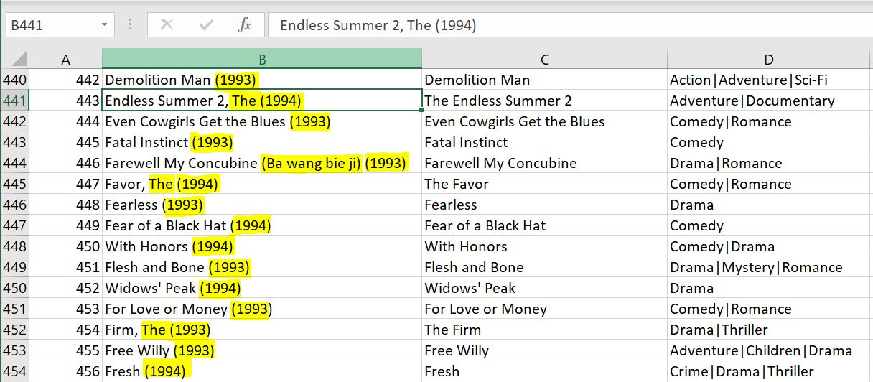
Data Cleansing & Exploration
Excel formulas were used to cleanse the movie title column to improve the quality of movie title queries in the Python code.
About the Data
The data used for this analysis came from grouplens.org
movies.csv (58,000 movies with genre and date information)
ratings.csv (Over 20M ratings from 28K users)

Slide 4
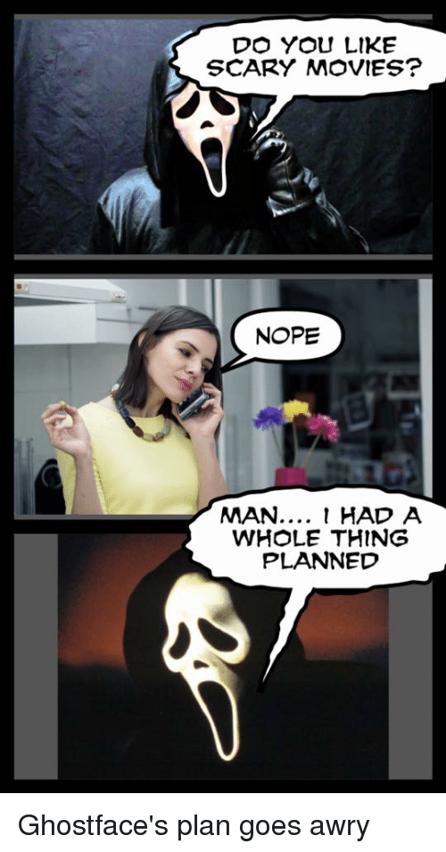
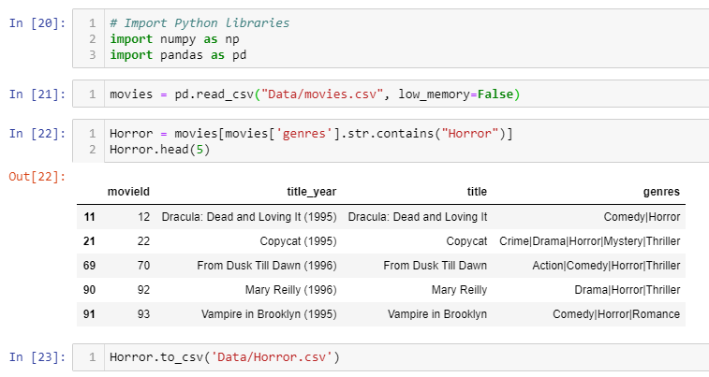
Data Cleansing & Exploration
Dealing With Data Size
In order to test and explore the different Collaborative Filtering methods, I limited my movie data size by breaking it out into genre. I then saved the data to separate CSV files so that I could easily switch between genres.
For the purpose of this demonstration I will focus on the Horror genre.
k-Nearest Neighbors

Slide 5
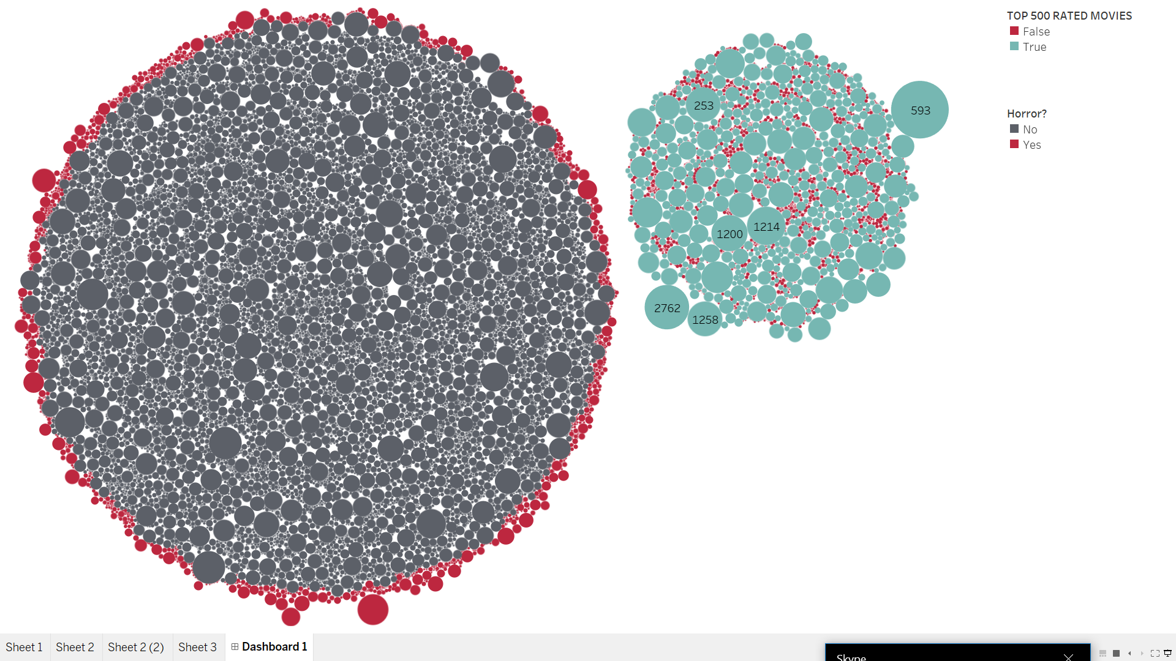
Data Cleansing & Exploration
ALL MOVIES
HORROR MOVIES

Slide 6
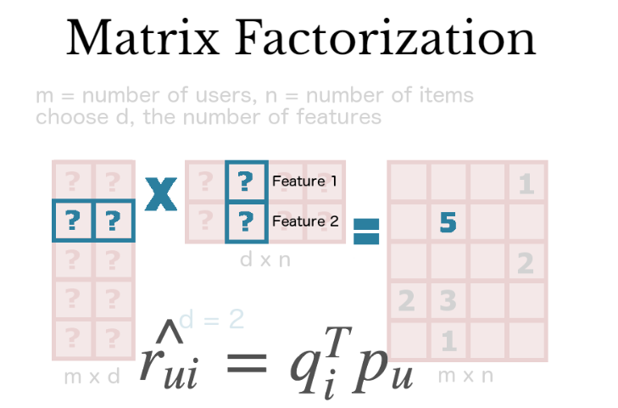
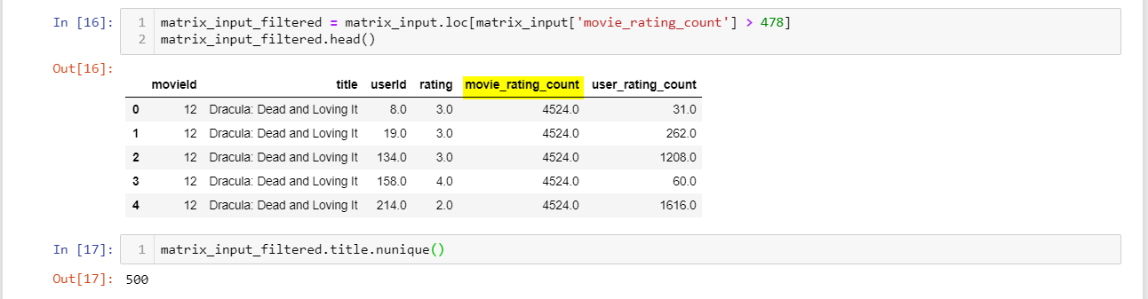
SVD Matrix Factorization
The first Collaborative Filtering method that I tested was SVD (singular value decomposition) Matrix Factorization. Matrix Factorization works by decomposing a user-item interaction matrix into the product of two lower dimensionality rectangular matrices.
To begin the process of testing this model, I decided to concentrate on the top 500 rated movies in a specific genre.

Slide 7
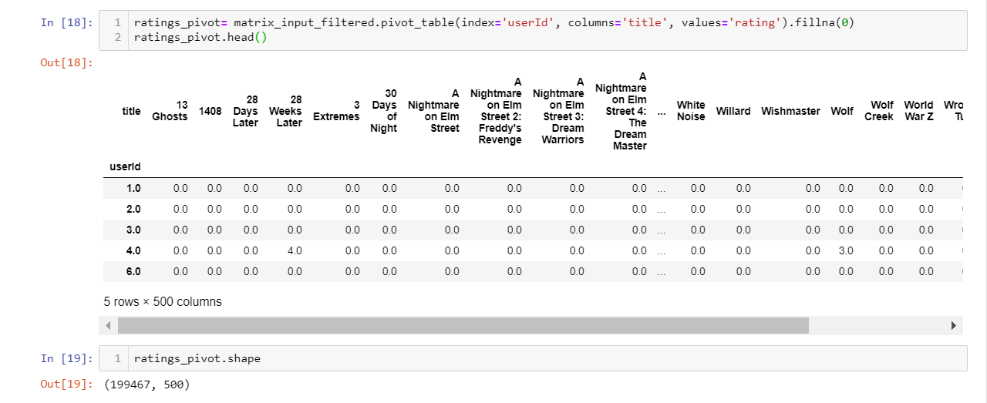
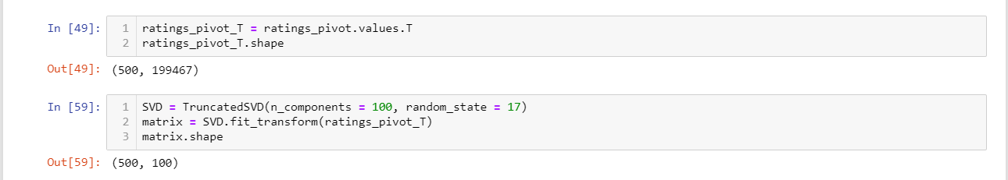
SVD Matrix Factorization
A matrix is created using the pivot_table function, with user Id as the index and movie title as columns. The matrix is transposed to flip the axis and TruncatedSVD is used to decompose it. The decomposed matrix is then fit into the model for dimensionality reduction

Slide 8
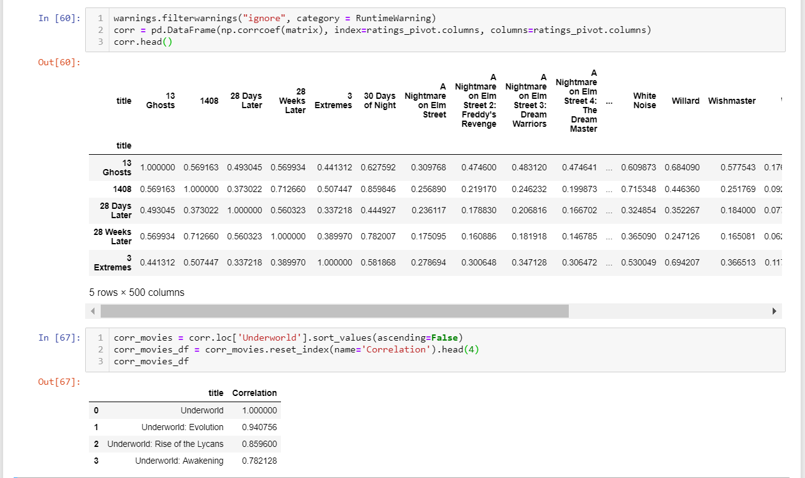
SVD Matrix Factorization
The Pearson’s R correlation coefficient is calculated for every movie pair and a final matrix is created to hold the data.
Test Run

Slide 9
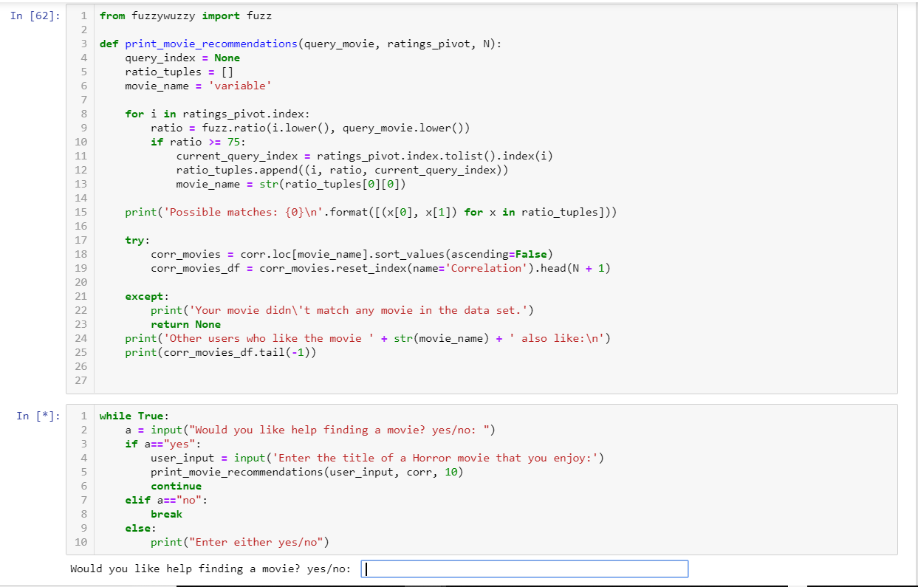
SVD Matrix Factorization
Fuzzywuzzy used for string matching when user inputs a movie title.
Pearson’s R Correlation is attempted based off results of fuzzy search.
Input loop added for better user experience.

Slide 10
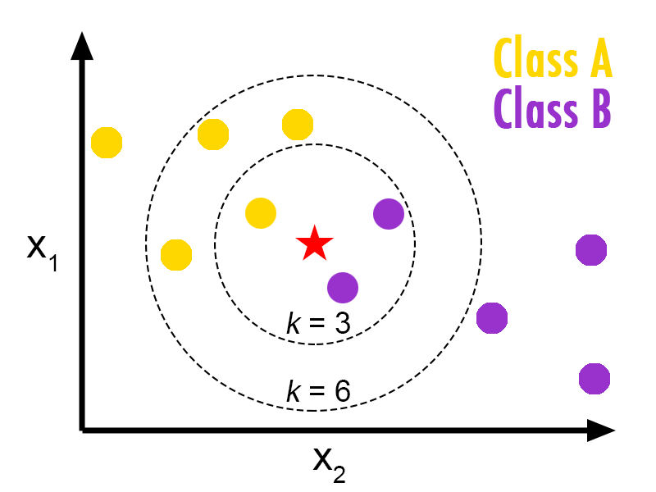
k-Nearest Neighbors
The second Colaborative filtering method I tried was k-Nearest Neighbors.
kNN is a machine learning algorithm used to find clusters of similar users based on common item (movie) ratings, and make predictions using the average rating of top-k nearest neighbors.
For comparison I have started with the same pandas data frame that was used in the SVD Matrix Factorization method.

Slide 11
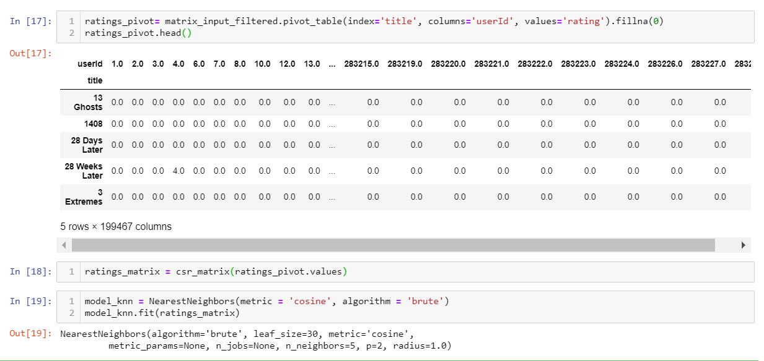
k-Nearest Neighbors
Implementing kNN
The filtered matrix input table is converted to a 2D matrix, and missing values are filled with 0 so that the distances between rating vectors can be calculated. the values(ratings) of the matrix data frame are then transformed into a scipy sparse matrix for more efficient calculations
Finding the Nearest Neighbors
The algorithm used to compute the nearest neighbors is called “brute”. “metric=cosine” is specified so that the algorithm will calculate the cosine similarity between rating vectors. Finally the model is fit with the ratings_matrix.

Slide 12
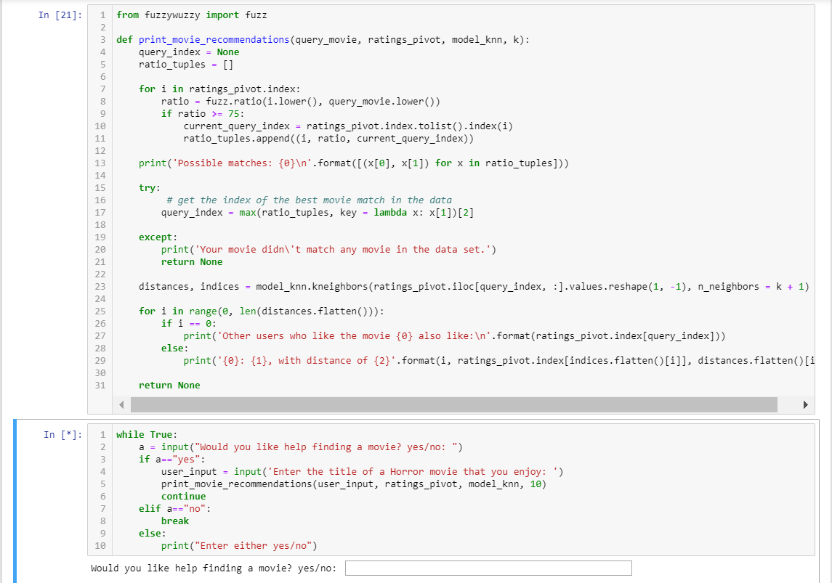
k-Nearest Neighbors
Fuzzywuzzy used for string matching when user inputs a movie title.
kNN Calculation attempted
Input loop added for better user experience.

Slide 13
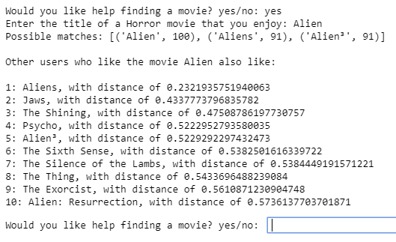
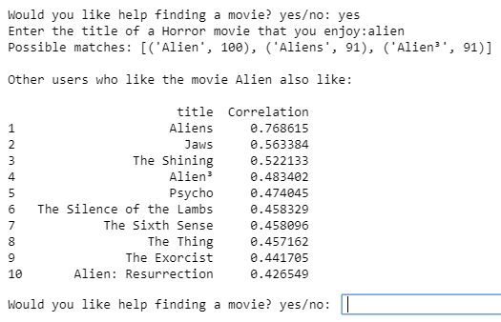
Compare Methods
k-Nearest Neighbors
The smaller the distance number, the closer the relation of items (movies) are.
SVD Matrix Factorization
The closer to 1 the correlation number is, the closer the relation of items (movies) are.

Slide 14
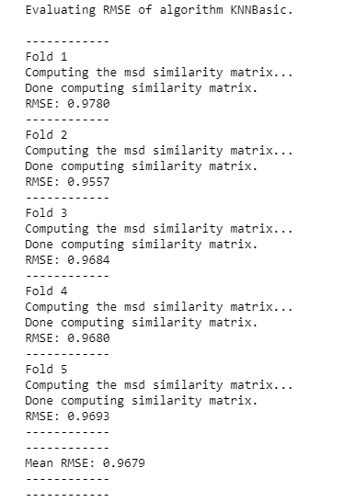
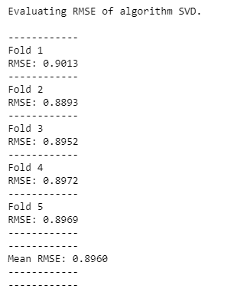
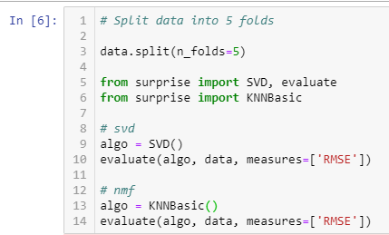
Compare Methods
Root Mean Square Error (RMSE) is the standard deviation of the residuals (prediction errors). Residuals are a measure of how far from the regression line data points are; RMSE is a measure of how spread out these residuals are. In other words, it tells you how concentrated the data is around the line of best fit.
k-Nearest Neighbors
Mean RSME : 0.9679
SVD Matrix Factorization
Mean RSME : 0.8960

Slide 15

Collaborative Filtering:
The Conclusion
Future Exploration:
The scope of this project covered the exploration of creating a collaborative Filtering movie recommendation system, using a small subset of data. I would like to take this idea and apply what I have learned to the entire movie and ratings dataset. In order to do this I would leverage PySpark for parallel computation.
I would also like to look in to the different Deep Learning approaches that exist for collaborative filtering models as well as hybrid models.
Key Takeaways:
Intuitive recommendations can be made using the 2 simple python methods reviewed in this presentation.
kNN and SVD Matrix Factorization methods produce similar results which is a good sign that the models are working as expected.
Recommendation systems implemented in most real world scenarios would require a big data approach.
There are many more ways to achieve Collaborative filtering besides what I have discussed here. I have barely scratched the surface.
Collaborative filtering is used EVERYWHERE!

