Slide 1


IN2009B
Improvement of an Organization’s Value Chain
Summer 2026
Emmanuel Gómez

Slide 2


| Agenda
Intro
M4-M5
Syllabus

Slide 3

| Intro
José Emmanuel Gómez Rocha
PhDc Engineering Sciences
Optimization
Production planning
Location
Routing
Machine Learning

Slide 4


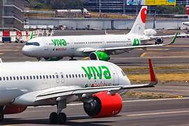
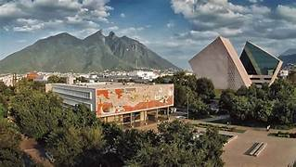
| Intro

Slide 5
| Main goal IN2009B
Understand modern supply chains
Solve supply chain and logistics problems.
Apply the knowledge with the trainer partner aka “socio formador”.

Slide 6
| Syllabus
Every Friday the hw is evaluated:
You can send whenever you want your hw, just remember that the 4th Friday of the course is the due date.
Every Friday your hw grades will be updated according to your progress.
There are not penalties for late deliveries (with exception as the bullet number 1)

Slide 7
| Hw requirements
You must share a google drive folder with me:
LastName(s)_Name(s)_A00…, example: GomezRocha_JoseEmmanuel_A0123456789.
Notebooks are saved with the number of the activity (1, 2,…, N)
Share the drive folder to my email: emmanuel.gr@tec.mx

Slide 8


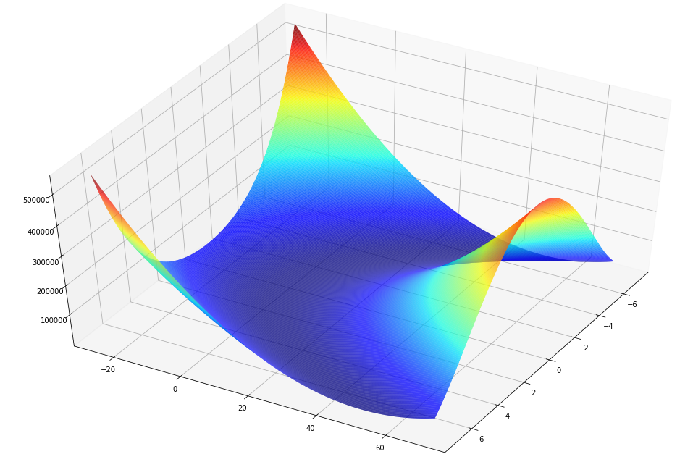
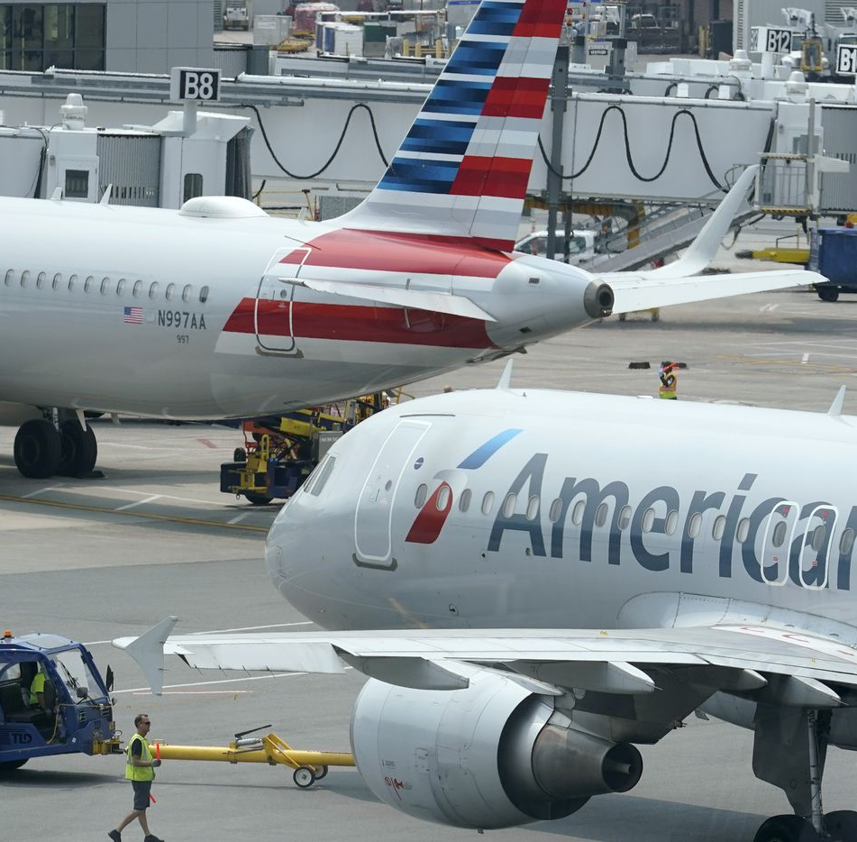
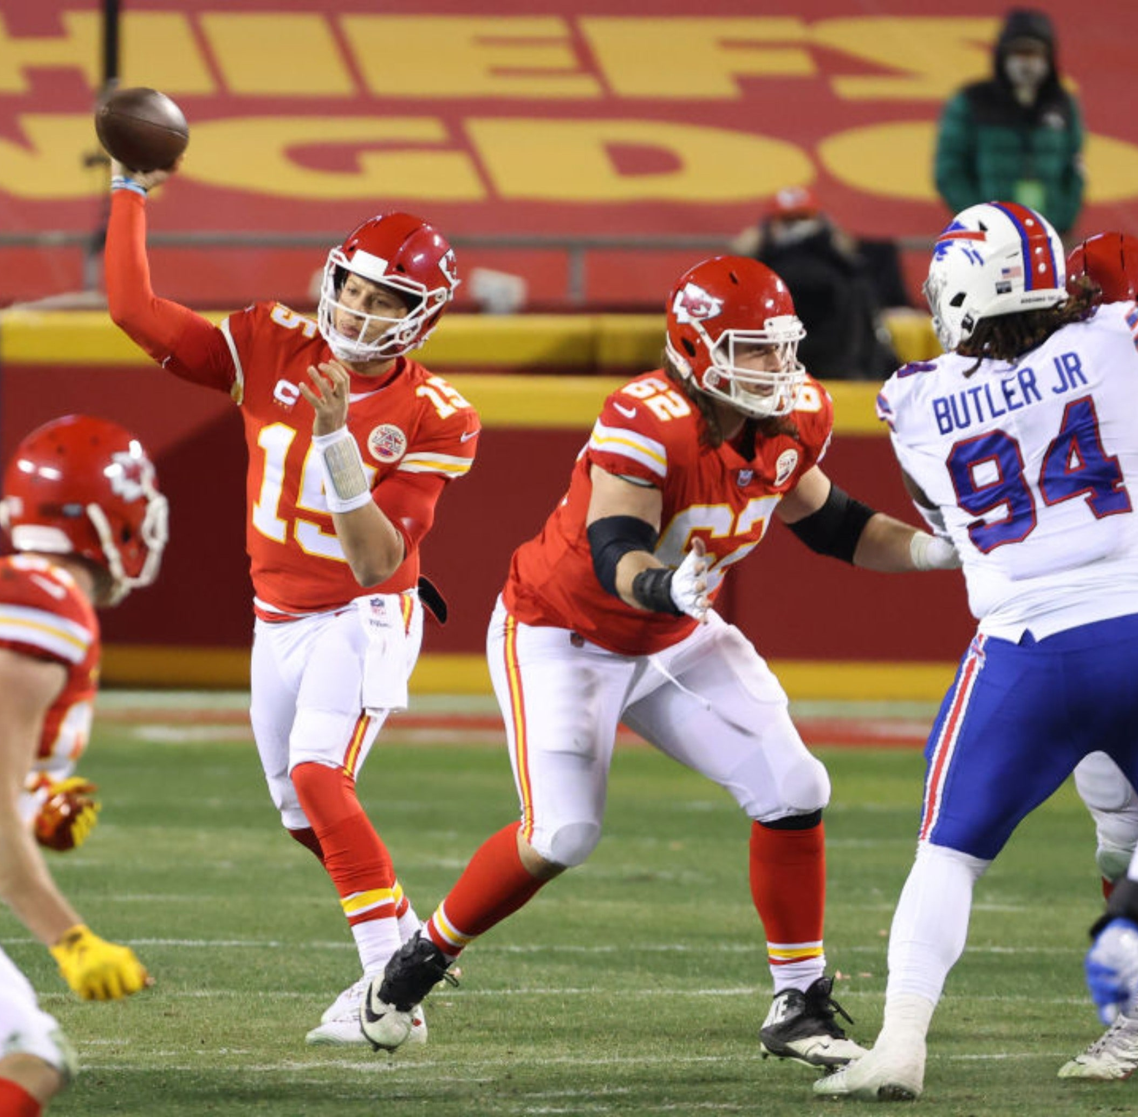
| Operations Research
What do Apple, Starbucks, American Airlines, and the NFL have in common?
The use of mathematical optimization.

Slide 9
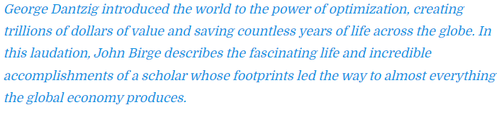
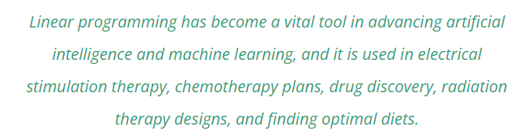
| Operations Research today’s impact
Phd. John Birge, (George Bernard Dantzig: The Pioneer of Linear Optimization, Management and Business Review, 2021)

Slide 10
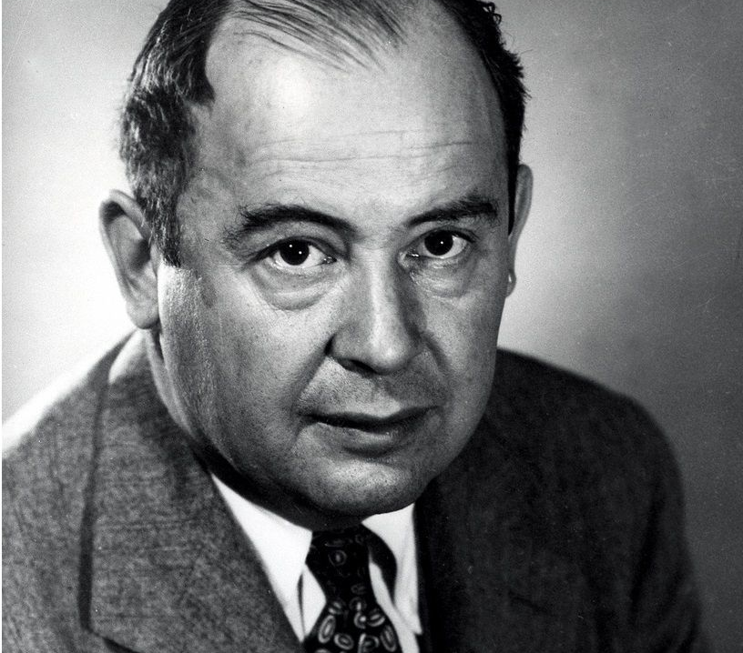
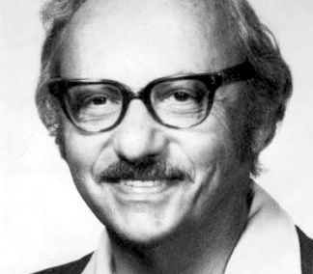
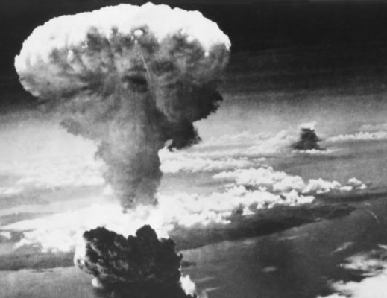
| Operations Research: the origin
Mathematical programming, statistics, simulation: the big secret during the 2nd WW.

Slide 11


| Operations Research: beyond industry, manufacturing and logistics…
https://www.youtube.com/watch?v=5dYE5vy6sMY
https://www.youtube.com/watch?v=oYcRp_8VHjE

Slide 12
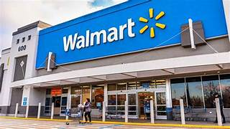
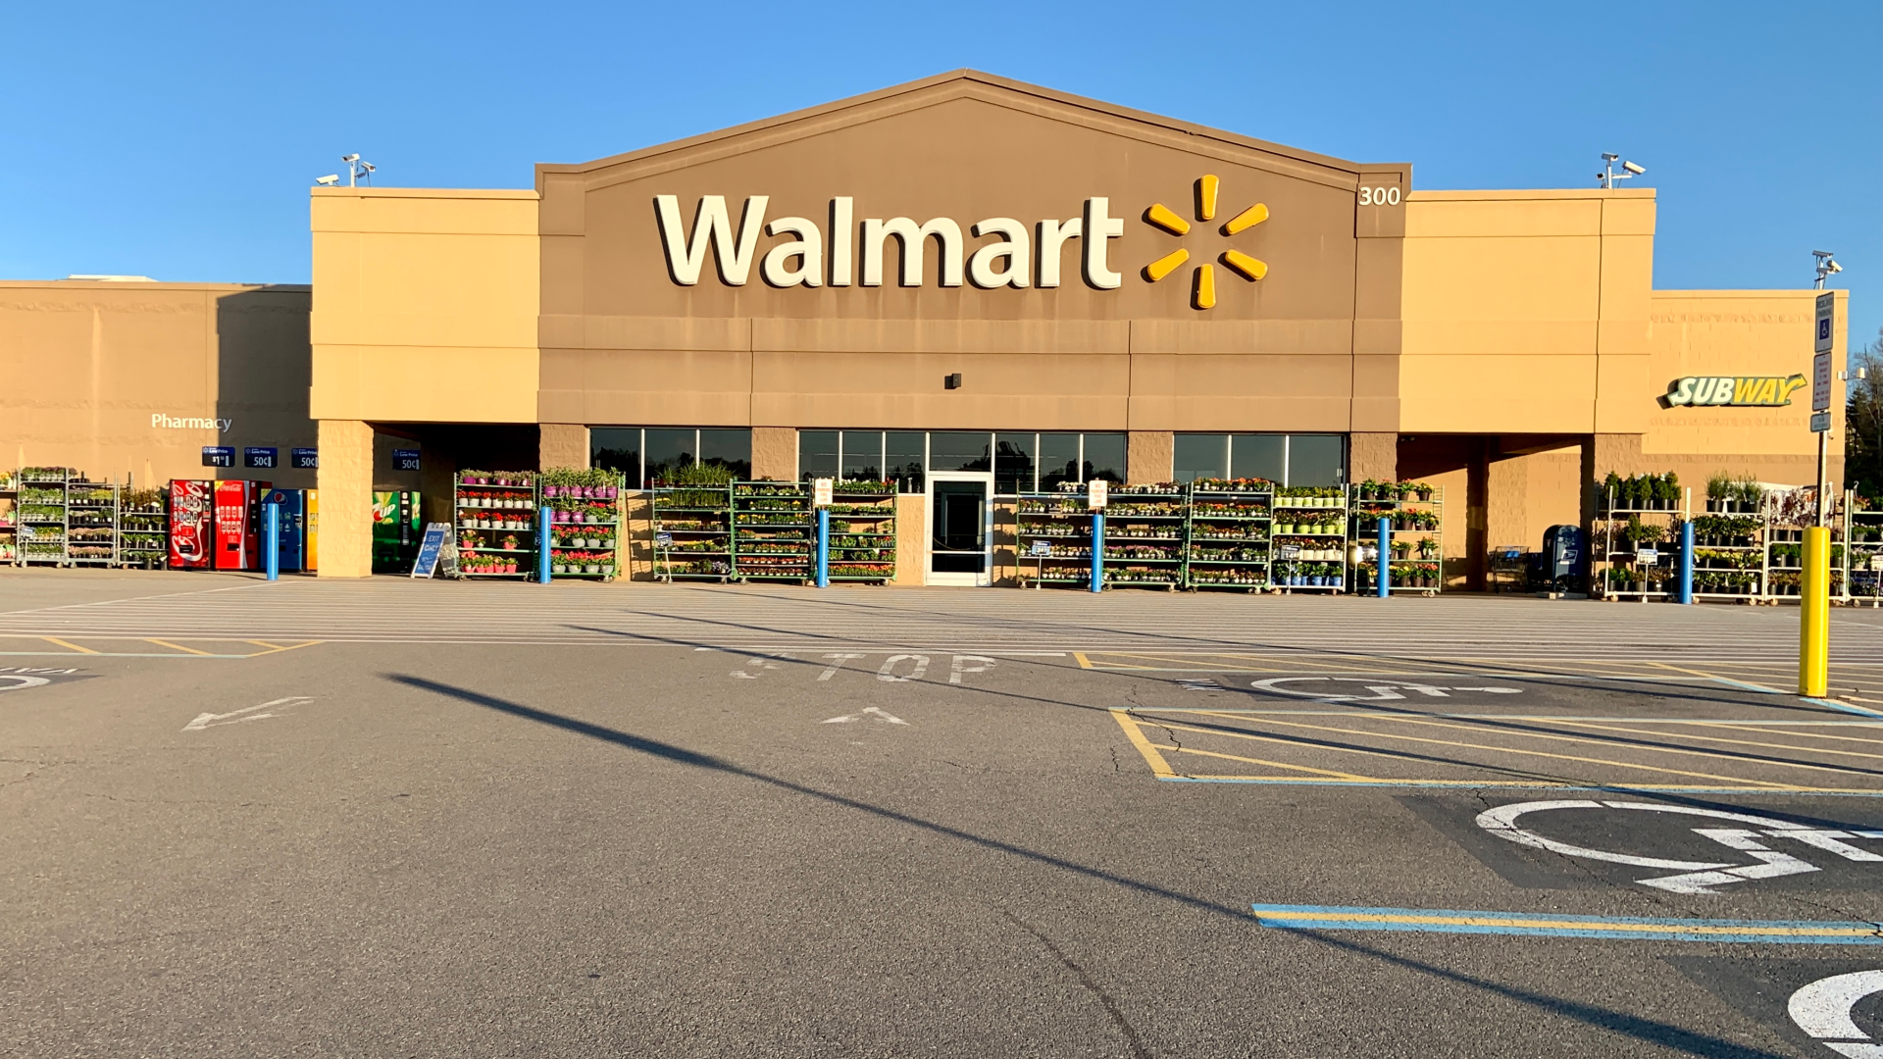
| Operations Research: return to the main course
https://www.youtube.com/watch?v=MGNvEZZ3qPw

