Slide 1
CMPS454 – NLP
Arabic Diacritization
Presented By:
Name | ID
Ali Mohamed Hashish | 1190223
Amr Ahmed Abdelzaher | 1190074
John Maurice | 1190403
Joseph Ameer Aziz | 1190052

Slide 2
Project Flow
Cleaning and preprocessing the data.
Extracting features for our model.
Training the model and predicting diacritics.
Calculating accuracy and DER.

Slide 3
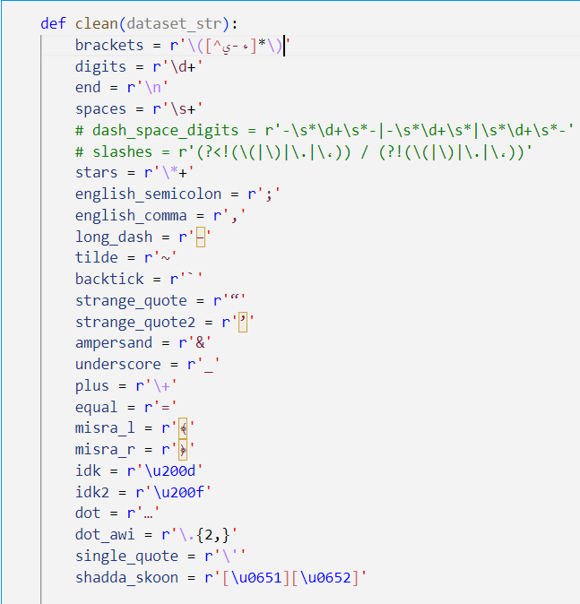
Cleaning
Removing some characters that do not contribute as much to the meaning of the sentence, and would not help in diacritization.

Slide 4
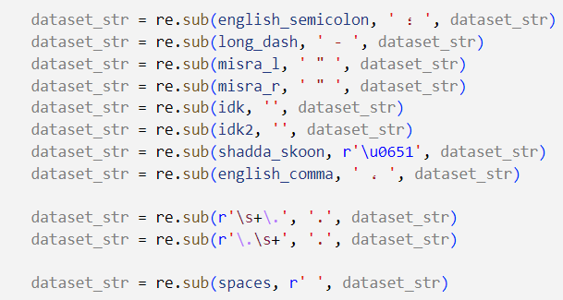
Cleaning
Replacing some characters to unify the format. Like using Arabic commas instead of English ones.

Slide 5
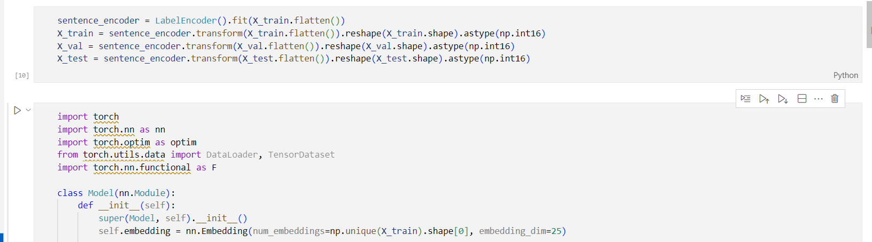
Feature Extraction – Label Encoder & Embeddings
Label encoder converts characters from 0 to unique_character - 1

Slide 6
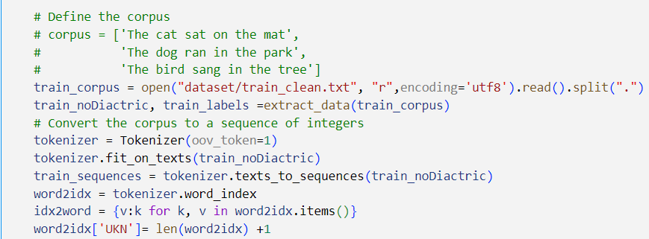
Feature Extraction – CBOW
We use tokenizer while accounting for OOV tokens. We train the neural network on a fake task, producing some word embeddings.

Slide 7
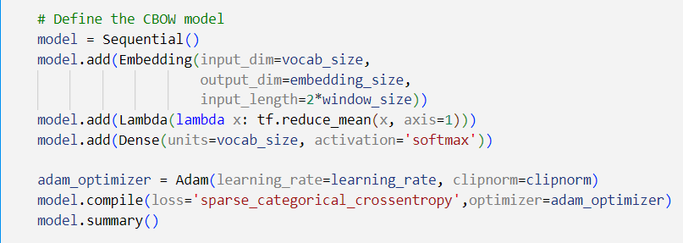
Feature Extraction – CBOW
The output of our encoder is passed to the CBOW model.
Notes:
We also experimented a bit with SG, but didn’t produce great results.

Slide 8
Model
We experimented with a few models:
  Model obtained from the Shakkala paper.
  First modification to Shakkala.
  Second modification to Shakkala.
  Third modification to Shakkala.
  CBHG.

Slide 9
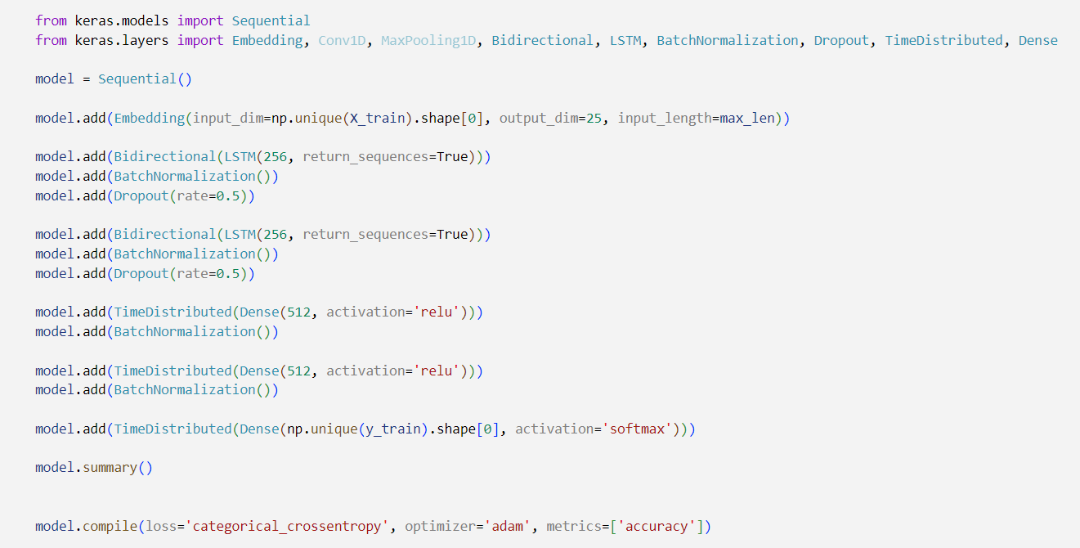
Shakkala Paper Model
DER: 2.6%

Slide 10
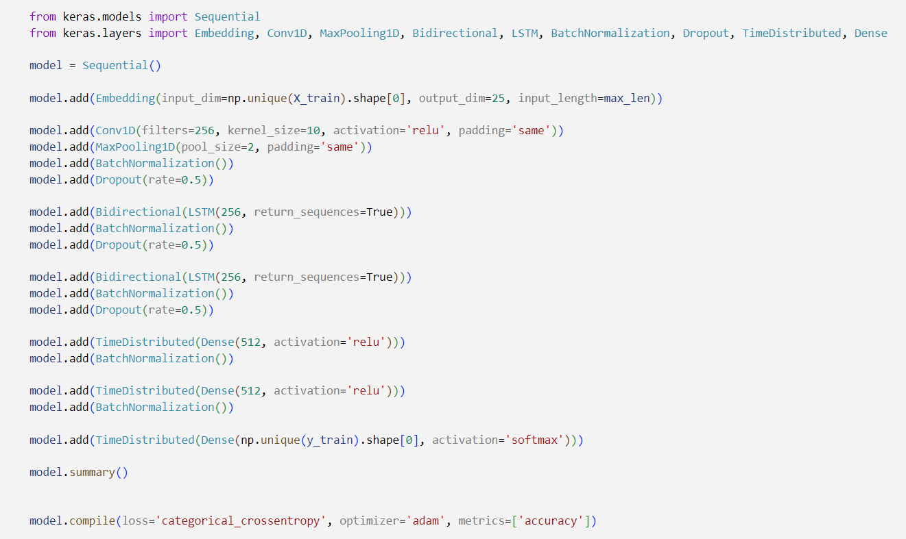
First Modification to Shakkala
Using Conv1D to improve performance.

Slide 11
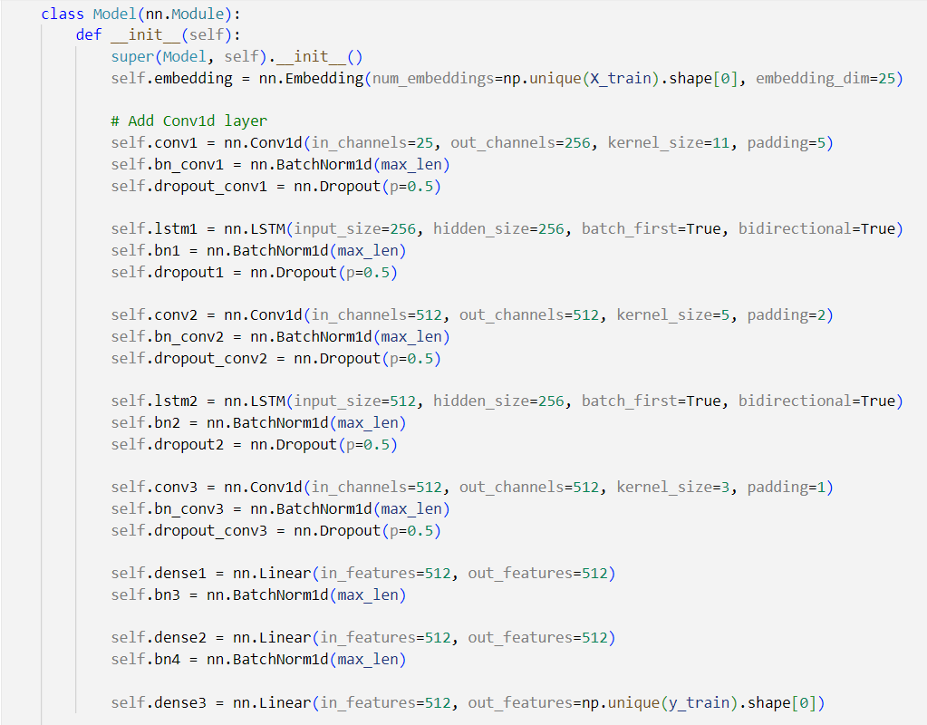
Second Modification to Shakkala
DER: 2.24%
Added more convolution layers
Submitted model (conv_1000)

Slide 12
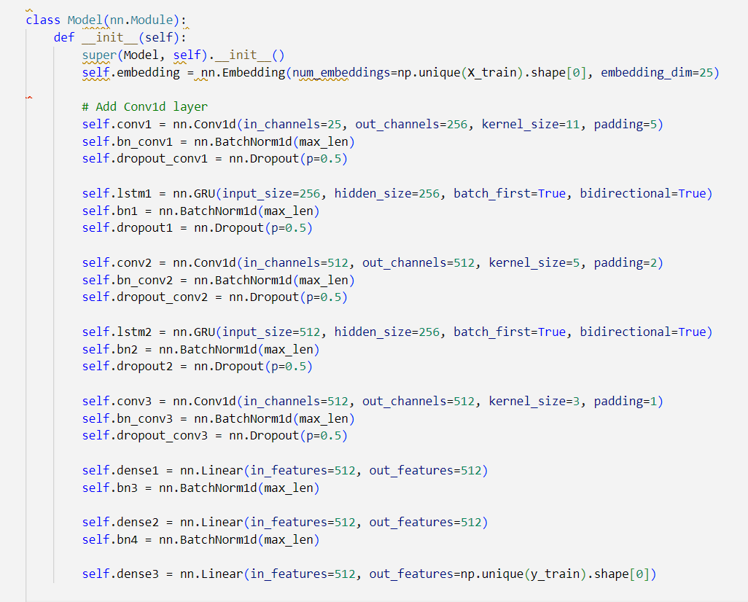
Third Modification to Shakkala
Replaced LSTMs with GRUs.
Did not lead to desired results.

Slide 13
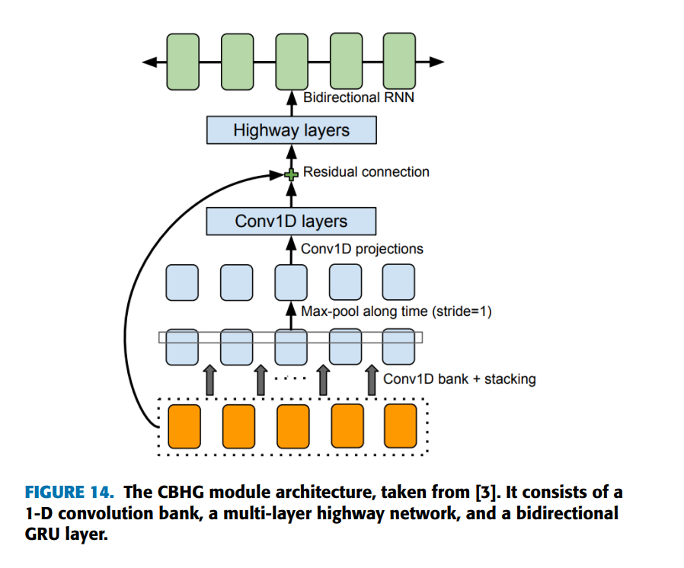
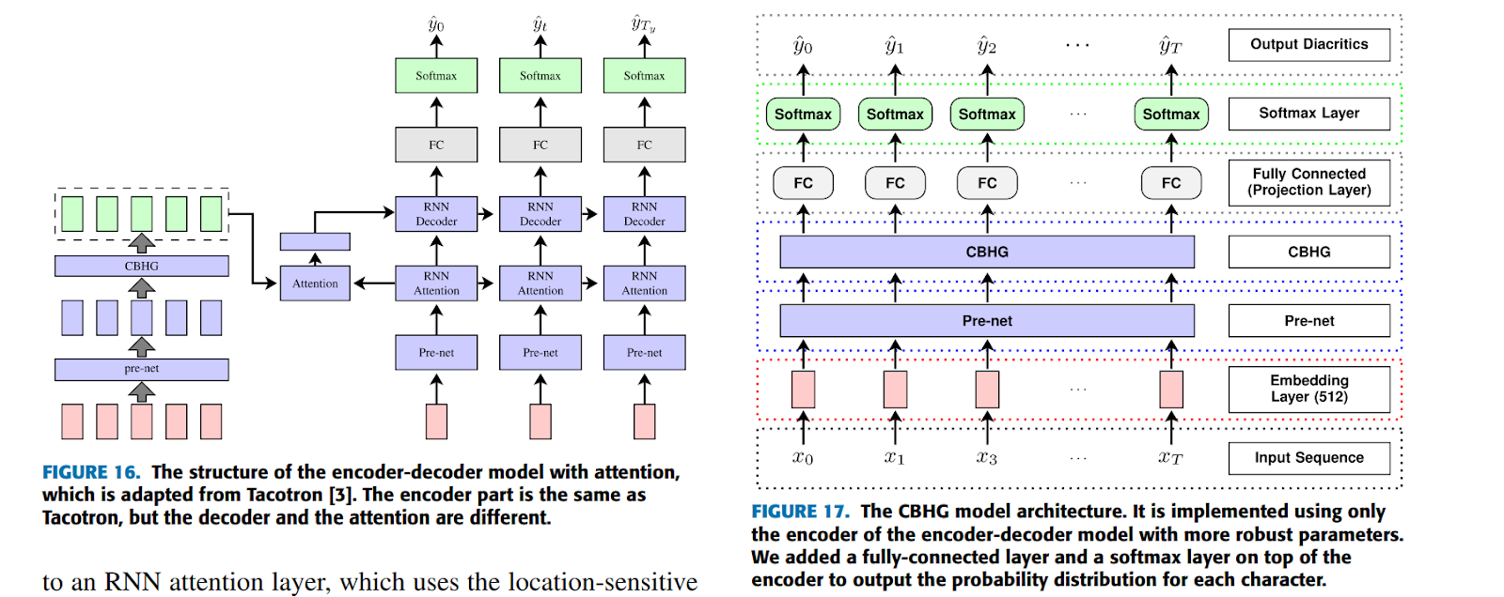
CBHG
DER: 2.9%

