Slide 1

LOGISTIC REGRESSION
S-LAB TALK SERIES
NATIONAL INSTITUTE OF SCIENCE AND EDUCATIONAL RESEARCH
PRESENTED BY PINKI PRADHAN

Slide 2
OUTLINE
INTRODUCTION
ASSUMPTIONS
MATHEMATICAL INTERPRETATIONS
SIGMOID FUNCTION
OPTIMISATION
MULTICLASS CLASSIFICATION

Slide 3
INTRODUCTION
Logistic regression is a predictive analysis.
Used for Classification
Used in a situation when a researcher is interested to predict the occurrence of any happenings.
The objective of Logistic regression is to find the best fitting model to describe the relationship between the dichotomous characteristics of interest and a set of independent variables.

Slide 4
ASSUMPTIONS
Data should be linearly separable or almost linear separable
Logistic regression does not assume a linear relationship between dependent and independent variable.
The dependent variable must be dichotomy(2 categories).
The independent variable need not be interval, nor normally distributed , nor of equal variance with each group.

Slide 5
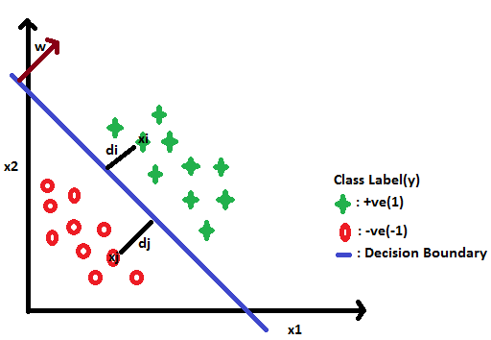
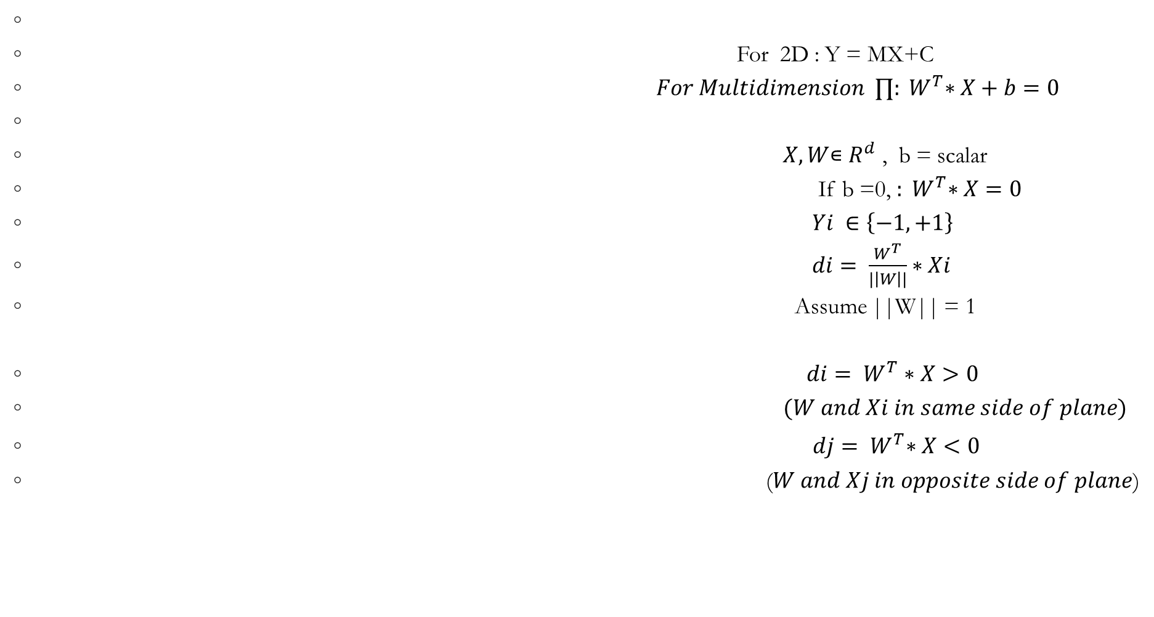
For 2D : Y = MX+C
$For Multidimension ∏{: W}^{T}∗X+b=0$
$X,W$∊ $R^{d}$ , b = scalar
If b =0, ${: W}^{T}∗X=0$
$Yi ∈\left\{−1,+1\right\}$
$di= \frac{W^{T}}{|\left|W\right||}∗Xi$
Assume ||W|| = 1
${di= W}^{T}∗X>0$
$(W and Xi in same side of plane)$
${ dj= W}^{T}∗X<0$
($W and Xj in opposite side of plane$)

Slide 6
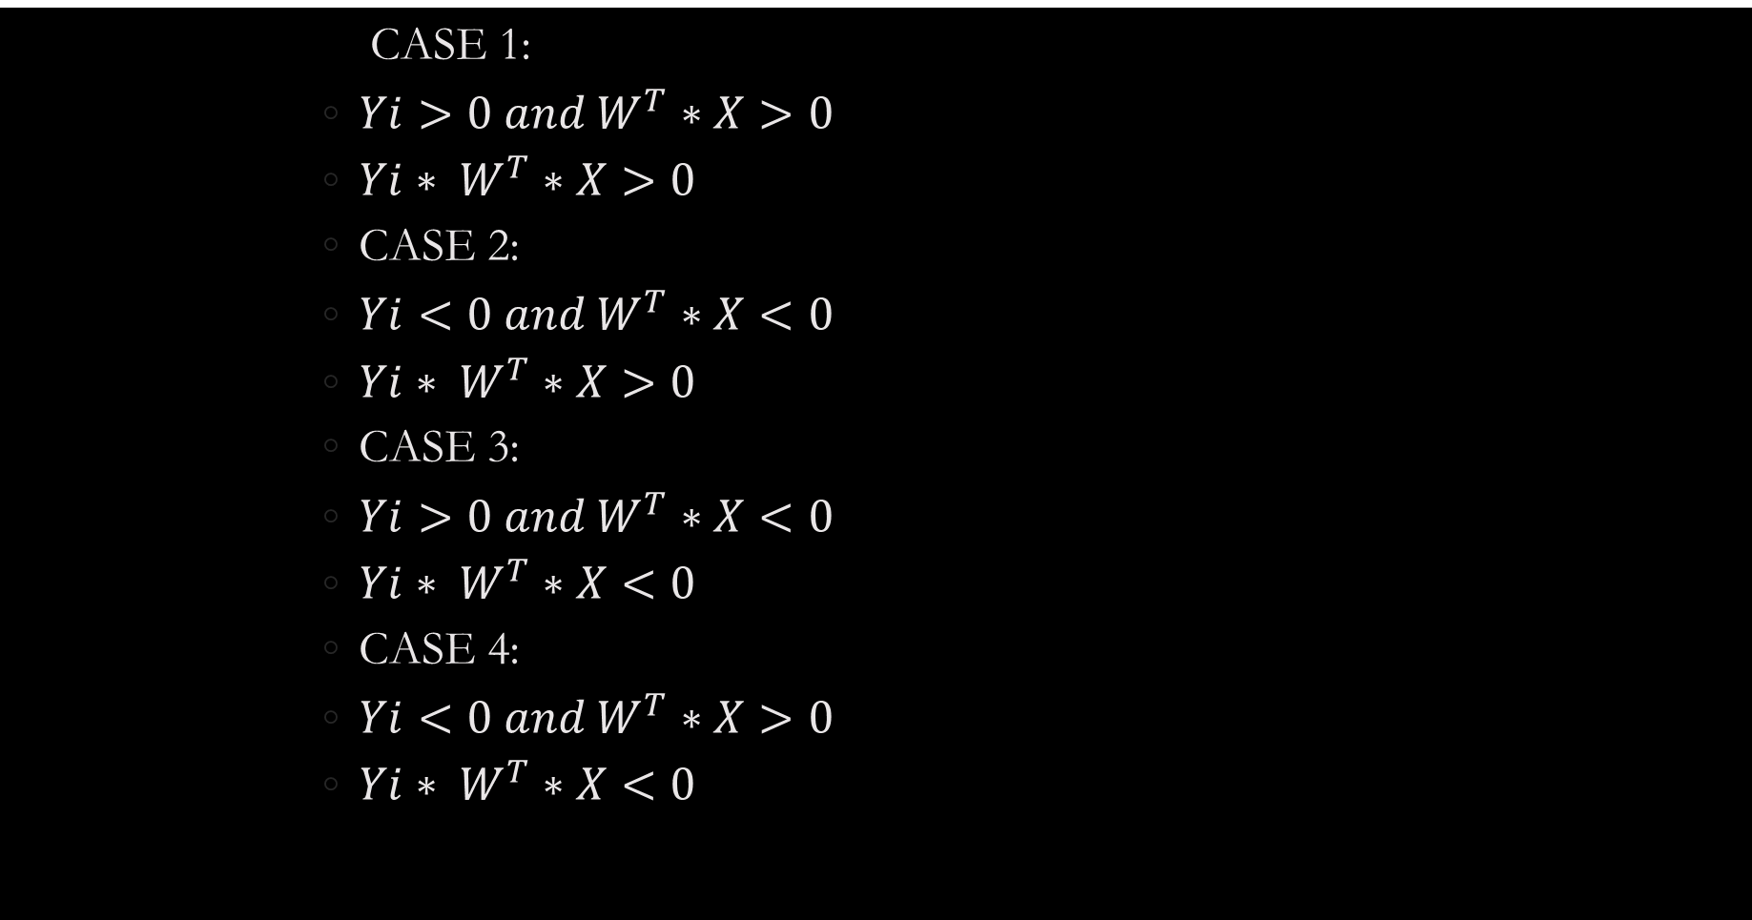
                CASE 1:
              ${Yi>0 and W}^{T}∗X>0$
              ${Yi∗ W}^{T}∗X>0$
              CASE 2:
              ${Yi<0 and W}^{T}∗X<0$
              ${Yi∗ W}^{T}∗X>0$
              CASE 3:
              ${Yi>0 and W}^{T}∗X<0$
              ${Yi∗ W}^{T}∗X<0$
              CASE 4:
              ${Yi<0 and W}^{T}∗X>0$
              ${Yi∗ W}^{T}∗X<0$

Slide 7
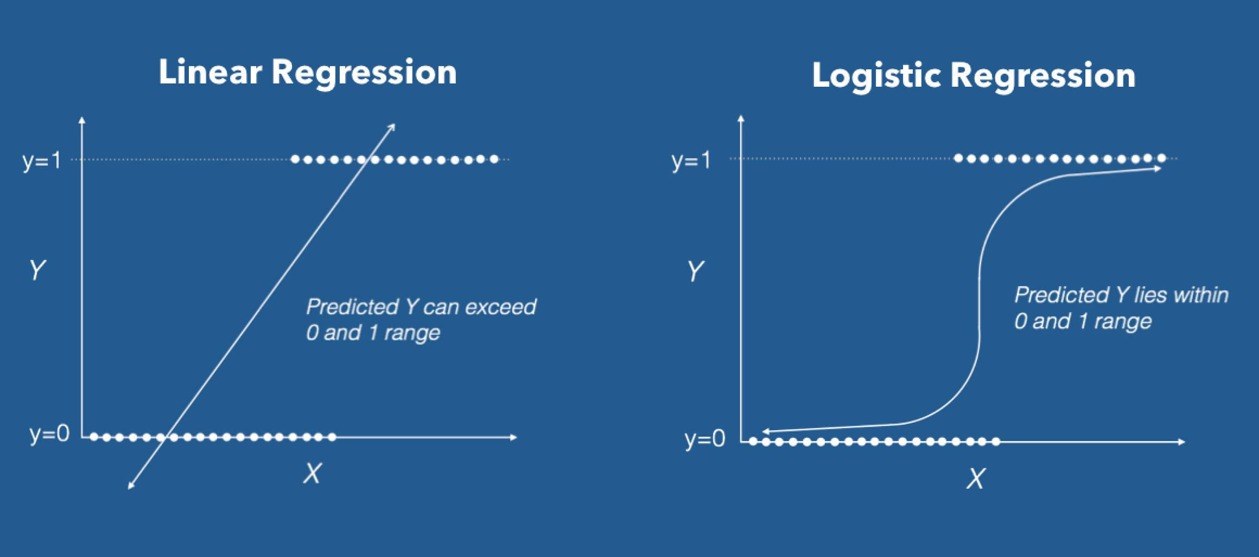

Slide 8
SIGMOID FUNCTION
It is a mathematical function having a characteristic that can take any real value and map it to between 0 to 1 shaped like the letter “S”. The sigmoid function also called a logistic function.
Y = 1 / 1+e ^{-z}
So, if the value of z goes to positive infinity then the predicted value of y will become 1 and if it goes to negative infinity then the predicted value of y will become 0. And if the outcome of the sigmoid function is more than 0.5 then we classify that label as class 1 or positive class and if it is less than 0.5 then we can classify it to negative class or label as class 0.

Slide 9
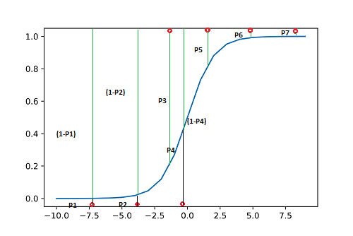
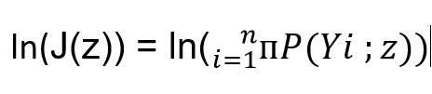


(1-P1)*(1-P2)P3*(1-P4)*P5*P6*P7
J(z) = P(Y ; z) = P(Y, Y2 … Yn ; z)
1

Slide 10
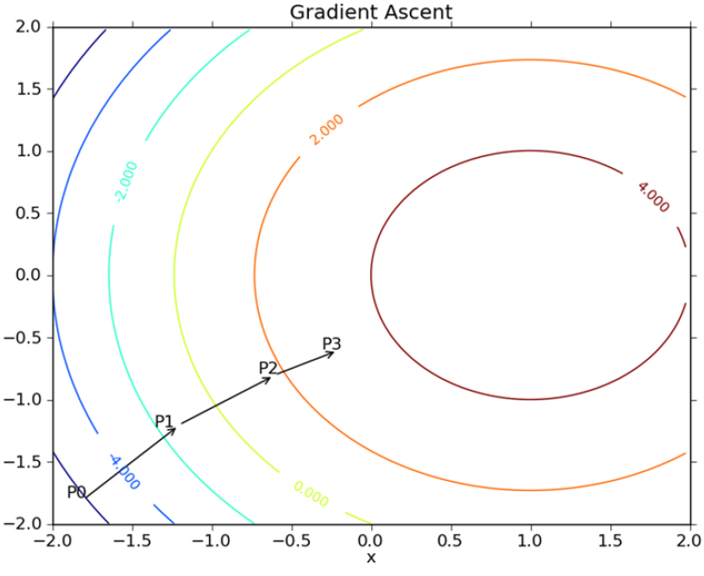
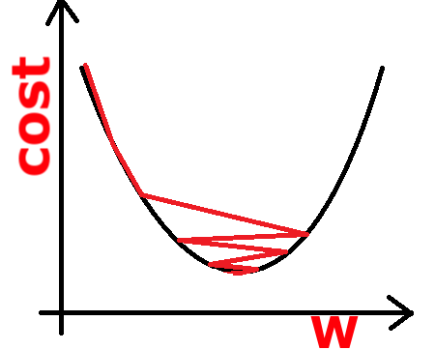
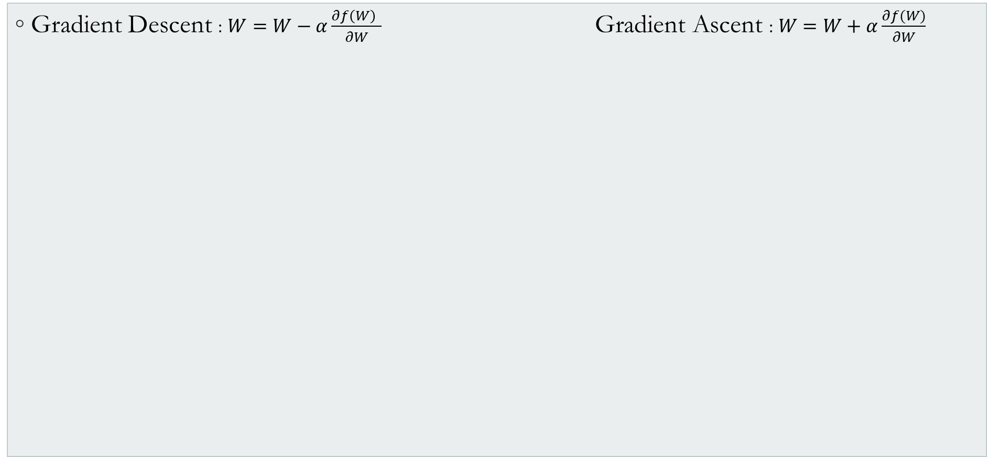
OPTIMISATION
Gradient Descent : $W=W−α\frac{∂f\left(W\right) }{∂W} \text{Gradient} \text{A}\text{scent} \text{: }W=W+α\frac{∂f(W)}{∂W}$

Slide 11
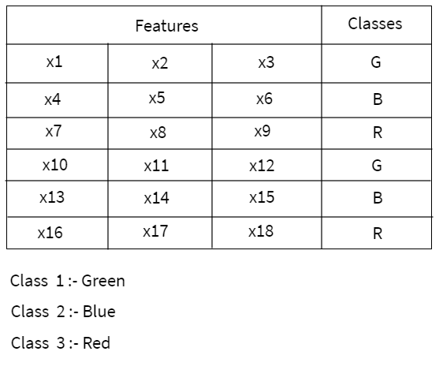
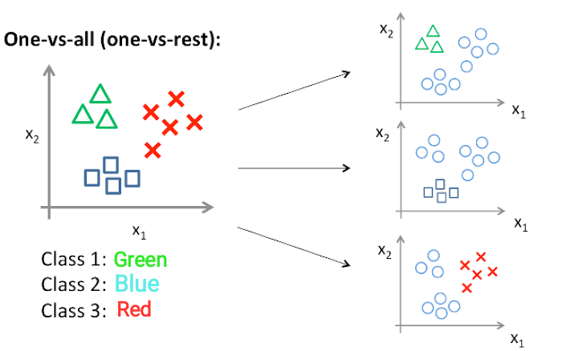
MULTICLASS CLASSIFICATION PROBLEM :
ONE VS ALL / ONE VS REST

Slide 12
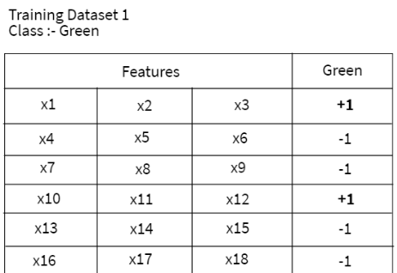
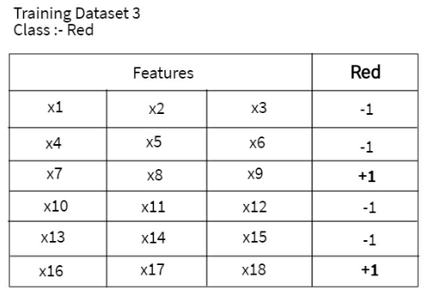
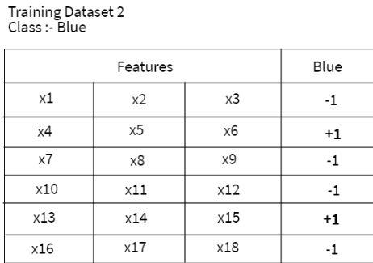

Slide 13
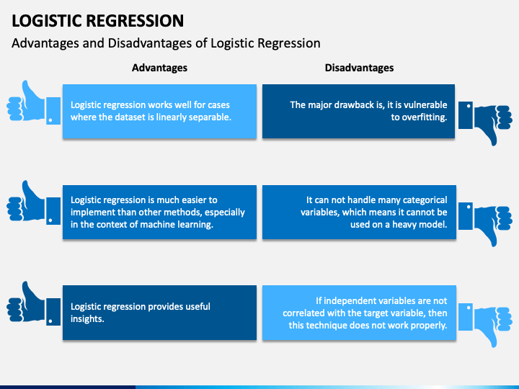
ADVANTAGES AND DISADANTAGES

