Slide 1
Java GUI Calculator
By: Abdul Mateen Khilji (033-19-0008)

Slide 2
GRAPHICAL USER-INTERFACE (GUI)
GUI typically stands for Graphical User-Interface (UI). It implies a framework in which, certain graphics exist, or to be more precise, come into being after the execution of a certain program.
The UI, which displays everything to the user at the front-end, executes the programs consecutively in the back-end. In short, the UI only displays which is ordered by the programmer.
The way we interact with our computers daily, is also user-interface. Nonetheless, the UIs vary depending upon the programmer how he wants it to be and, in the back-end, the necessary block of programs will be taking places as per their instructions.

Slide 3
GUI IN JAVA
UI in Java is carried out to perform some certain actions and display the results to the user. For the convenience of the user, the UI is made in such a way that the user can understand each and everything that what’s going on!
To create the applications, the GUI in Java was introduced. In our daily life, we come across many applications in computers and almost all of them are created using Java and many other languages.

Slide 4
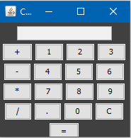
CALCULATOR GUI
I have found a simple yet neat and clan GUI for Calculator in Java that computes basic mathematical expressions, i.e., addition, subtraction and so on.
The program executes multiple libraries to provide the user with its own UI. It contains text-field, frame-work library and some clickable buttons library.
Notes:
Source Code: https://www.geeksforgeeks.org/java-swing-simple-calculator/

Slide 5
LIBRARIES USED
The program makes use of frame-work library, text-field library along with clickable buttons library to make the UI interactive for the user.
Frame-work library creates a specified frame (Say suppose: 200x200) and in it are provided the rest of the information / stuff that might be useful for the user.
Text-Field library makes an empty input in which, the input from the user can be taken or the output can be shown (If it’s readable).
ActionListener library takes notice of the buttons that were pressed / clicked and returns to the specific program with that information. In our case, the buttons will be provided and will be taken care of in the back-end.

Slide 6
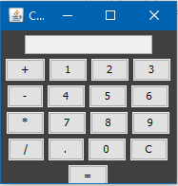
LIBRARIES USED
Framework
Text / Input
Clickable buttons

Slide 7
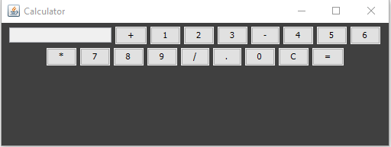
GUI RESPONSIVENESS
The GUI is made responsive such that however the user wants to interact with the application, its UI will always be convenient for the user.
However, in our case, it’s not that much responsive because if we manually increase the size of the output window (Framework), the window will spread, and our UI will look ugly. Since it’s an advanced topic, so, it’s not covered in this project.

Slide 8
CALCULATOR MODIFIED CODE
The source code, the modified version, of the whole program is provided here.
https://github.com/JealousGx/oop-simple-calculator
The preceding link contains this presentation, the output and, the code itself.
The source code, the first copy, of the whole program is also provided here.
https://www.geeksforgeeks.org/java-swing-simple-calculator/
The is where I got the code from and then modified it myself as per my convenience.

