Slide 1
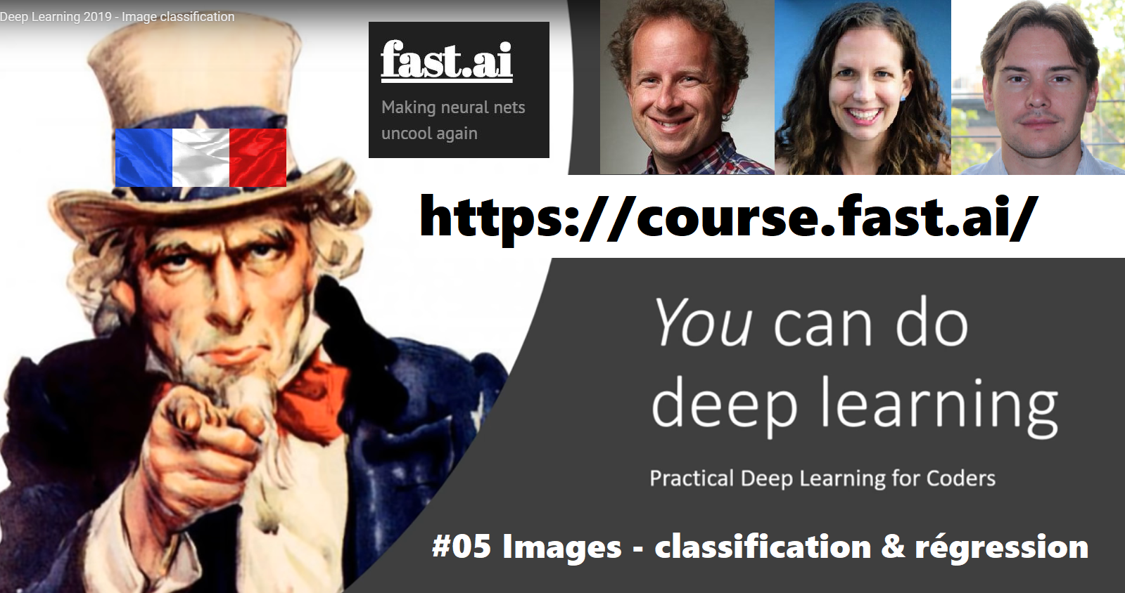

Slide 2

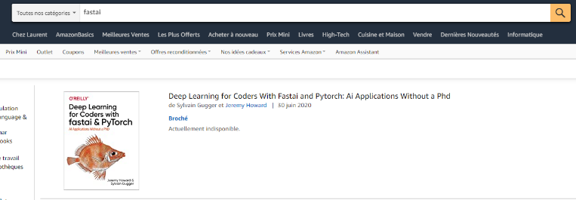
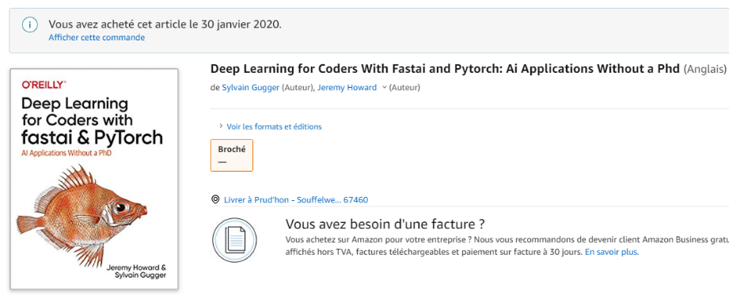
Ces vidéos sont réalisées sur le plan du livre de
Jeremy Howard et
Sylvain Gugger.
Achetez le livre dès qu’il sera disponible svp pour soutenir les auteurs !
The code in the notebooks and python .py files is covered by the GPL v3 license.
The remainder (including all markdown cells in the notebooks and other prose) is not licensed for any redistribution or change of format or medium, other than making copies of the notebooks or forking this repo for your own private use. No commercial or broadcast use is allowed.
We are making these materials freely available to help you learn deep learning, so please respect our copyright and these restrictions.
https://github.com/fastai/fastbook

Slide 3
Comment préparer les données ?
DataBlock

