Slide 1
REMOTE DESKTOP
SERVICES
Windows Server Administration — Lab Research Project
Presented by: Matheos Touma
Windows Server 2016 • VirtualBox Lab • RDP Protocol

Slide 2
What is Remote Desktop Services?
Remote Desktop Services (RDS) is a Microsoft Windows Server role that allows users to remotely access desktops, applications, and data from any device over a network.
🖥️
🌐
👥
Remote Access
Network Based
Multi-User
Access a full Windows desktop or specific applications from any location or device.
Works over LAN, WAN, or internet using the RDP (Remote Desktop Protocol) on port 3389.
Multiple users can connect simultaneously to the same Windows Server session.

Slide 3
RDS Architecture & How It Works
💻
🌐
NETWORK
LAN / Internet
🖥️
RDP
Port 3389
Encrypted
Tunnel
CLIENT
RD SERVER
Any Device
Windows / Mac / Mobile
Windows Server 2016
RD Session Host
How it works: The client sends keyboard/mouse input to the server over the network. The server processes everything and sends back only the screen image. All applications and data remain on the server — never on the client device.

Slide 4
RDS Role Services
🖥️
RD Session Host
🔑
RD Licensing
The core component. Hosts the desktop sessions and applications that remote users connect to.
Manages Client Access Licenses (CALs) required for users to connect to RDS legally.
🌐
RD Gateway
🔗
RD Web Access
Allows secure RDP connections over the internet through HTTPS without a VPN.
Provides a web portal where users access RemoteApp programs and desktops via a browser.
⚖️
RD Connection Broker
💾
RD Virtualization Host
Load-balances user connections across multiple RD Session Host servers for high availability.
Hosts virtual machine-based desktops using Hyper-V for VDI (Virtual Desktop Infrastructure).

Slide 5
Benefits of RDS
Why organizations choose Remote Desktop Services
💰
Cost Savings
🔒
Enhanced Security
🏠
Remote Work
Thin clients are cheaper than full PCs. Software licenses are centralized.
Data never leaves the server. Full control over user access and permissions.
Employees work from anywhere — home, travel, or any office worldwide.
⚙️
Easy Management
📈
Scalability
🔄
Disaster Recovery
IT manages one server instead of hundreds of individual workstations.
Easily add users or resources without upgrading every endpoint device.
Data is centralized, making backups and recovery fast and reliable.

Slide 6
RDS Security Considerations
🔐
Network Level Authentication (NLA):
Requires users to authenticate before a full RDP session is established, protecting against unauthorized access.
🔒
SSL/TLS Encryption:
All data between client and server is encrypted. In our lab, a self-signed certificate was used (normal for testing).
🧱
Windows Firewall Rules:
Port 3389 must be explicitly opened. We ran netsh commands to allow RDP traffic through the firewall.
👤
User Permissions:
Only users in the 'Remote Desktop Users' group can connect. We created a dedicated rdpuser account.
🔑
RD Licensing (CALs):
Production environments require Client Access Licenses. Our lab uses the 120-day grace period.
🌐
RD Gateway for Internet:
For connections over the internet, RD Gateway tunnels RDP through HTTPS port 443 for added security.

Slide 7
Lab Demo — Environment Setup
Lab Environment
Connection Flow
Hypervisor:
Oracle VirtualBox
Install RDS Role via Server Manager
Server OS:
Windows Server 2016 Standard
Configure RD Session Host
Server Name:
Touma
Create rdpuser account
Server IP:
192.168.1.16
Open Firewall Port 3389
Client OS:
Windows 11 (Host PC)
Run mstsc on client PC
Protocol:
RDP — Port 3389
Enter Server IP & credentials
RDS Role:
RD Session Host + Licensing
Accept SSL Certificate
Test User:
rdpuser (custom account)
✅ Connected via RDP!

Slide 8
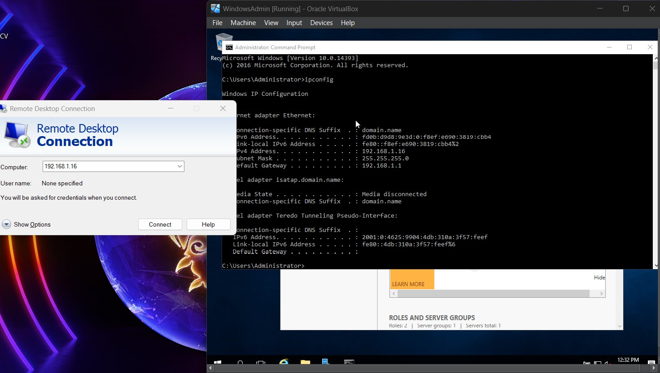
Lab Demo — Step 1: Initiating the RDP Connection
mstsc (Remote Desktop Connection) opened on host PC → Server IP 192.168.1.16 entered → VM ipconfig shown in background confirming matching IP

Slide 9
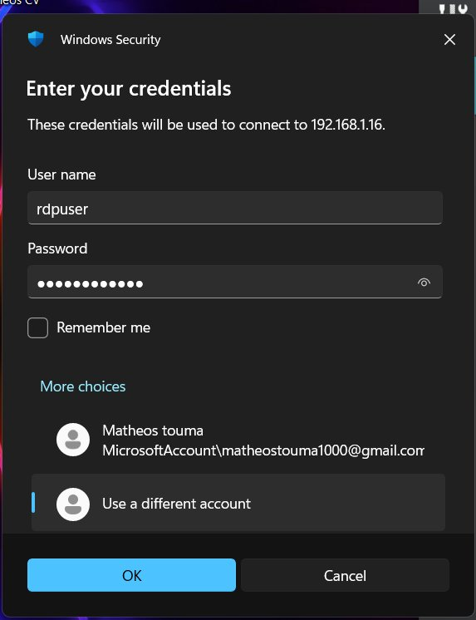
Lab Demo — Step 2: Entering Credentials
Windows Security prompt → rdpuser account entered → connecting to 192.168.1.16 (the Windows Server 2016 VM)

Slide 10
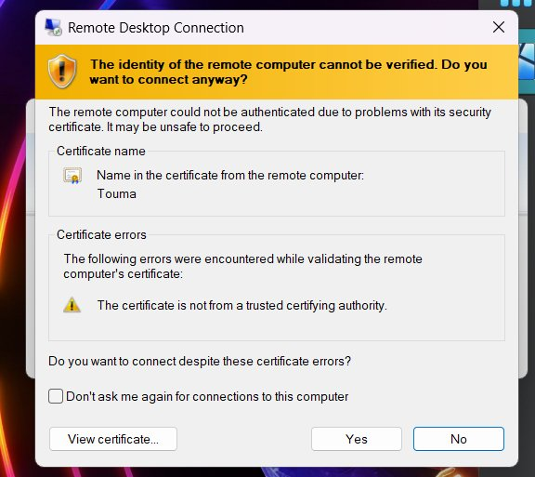
Lab Demo — Step 3: SSL Certificate Warning
⚠️ This is normal in a lab environment. The server uses a self-signed SSL certificate (not from a trusted CA). In production, organizations use trusted certificates from providers like DigiCert or Let's Encrypt. We clicked 'Yes' to proceed.
Certificate name: Touma (server name) — The identity warning confirms the RDP handshake is working correctly

Slide 11
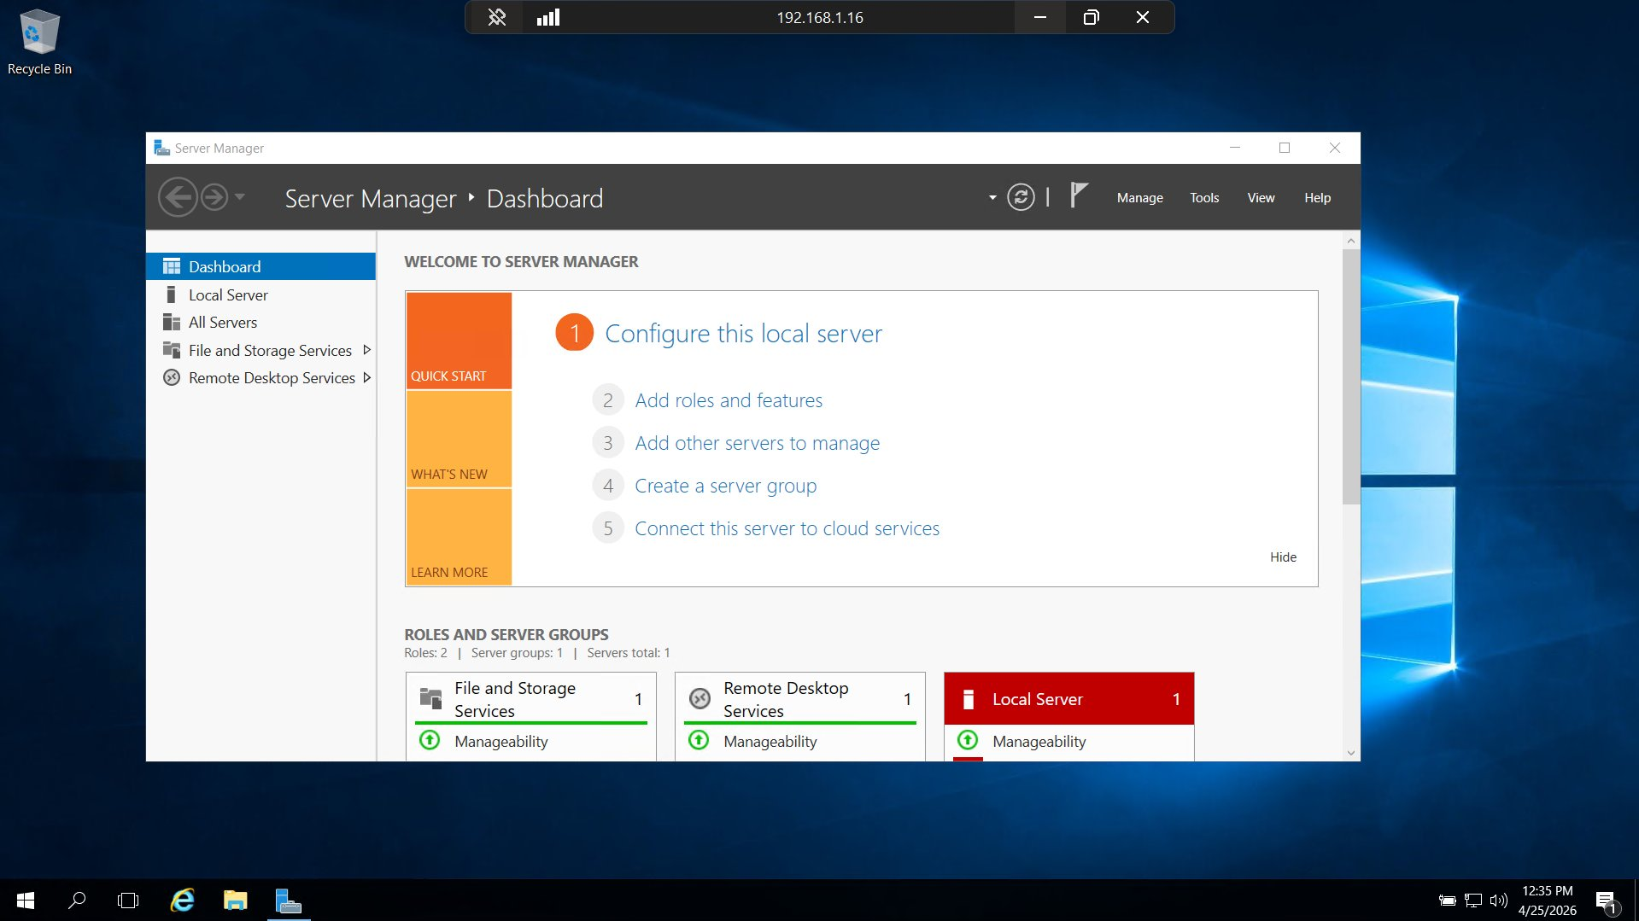
✅ Lab Demo — Successfully Connected via RDP!
Full RDP session established → Windows Server 2016 desktop visible → Server Manager shows Remote Desktop Services role installed → IP 192.168.1.16 confirmed in title bar

Slide 12
Real World Use Cases
🏢
Corporate Remote Work
🛠️
IT Support & Administration
Employees connect to their office workstations from home using RDP, accessing all company resources securely.
Administrators remotely troubleshoot and manage servers and workstations without physical access.
🏥
Healthcare
🎓
Education
Medical staff access patient records and hospital systems from any terminal within the facility.
Students access lab software and resources remotely without needing expensive hardware.
💻
Virtual Desktop Infrastructure
☁️
Cloud Computing
Companies deploy virtual desktops to replace physical PCs, reducing hardware costs significantly.
Azure Virtual Desktop uses RDS technology to deliver Windows desktops from Microsoft's cloud.

Slide 13
Conclusion
▶ RDS is a powerful Windows Server role enabling centralized remote access
▶ Key components include RD Session Host, Licensing, Gateway, and Web Access
▶ Successfully installed and configured RDS on Windows Server 2016 in a lab
▶ Demonstrated live RDP connection from host PC to VM using rdpuser account
▶ RDS is widely used in enterprise environments for remote work and IT management
▶ Production deployments add RD Gateway, trusted certificates, and proper CALs
Thank you! — Questions Welcome

