Slide 1
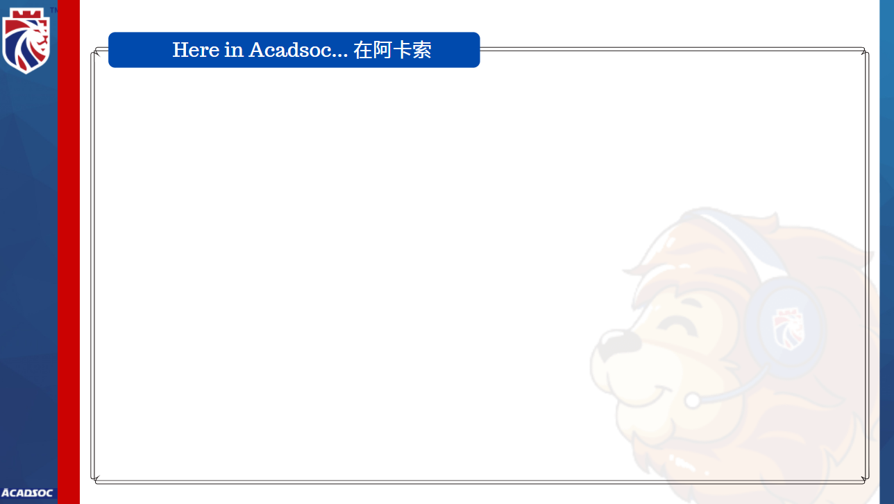

Welcome to Acadsoc
Congratulations!
You finished the class.
恭喜你完成了这节课。

Slide 2
Strengths 优点
You can communicate with me in simple sentences. 你可以和我进行简单的交流。
You can easily make sentences with new words. 你可以轻易地用新单词造句。
For example, you made a sentence with the word SLEEP, I have to sleep before 12 o’clock.
例如用sleep这个单词说I have to sleep before 12 o’clock。

Slide 3
Areas for Improvement 需要提高的地方
However, you still have challenges in the following words/sentences.
不过，我发现下面这些单词/句子对你来说还是有一点挑战性哦~
So, please repeat after me:
所以，请跟我再读/复习一下吧：
#1.__________________________ #2.______________________________
#3.__________________________
Good Job! Great! 你做得很好！

