Slide 1
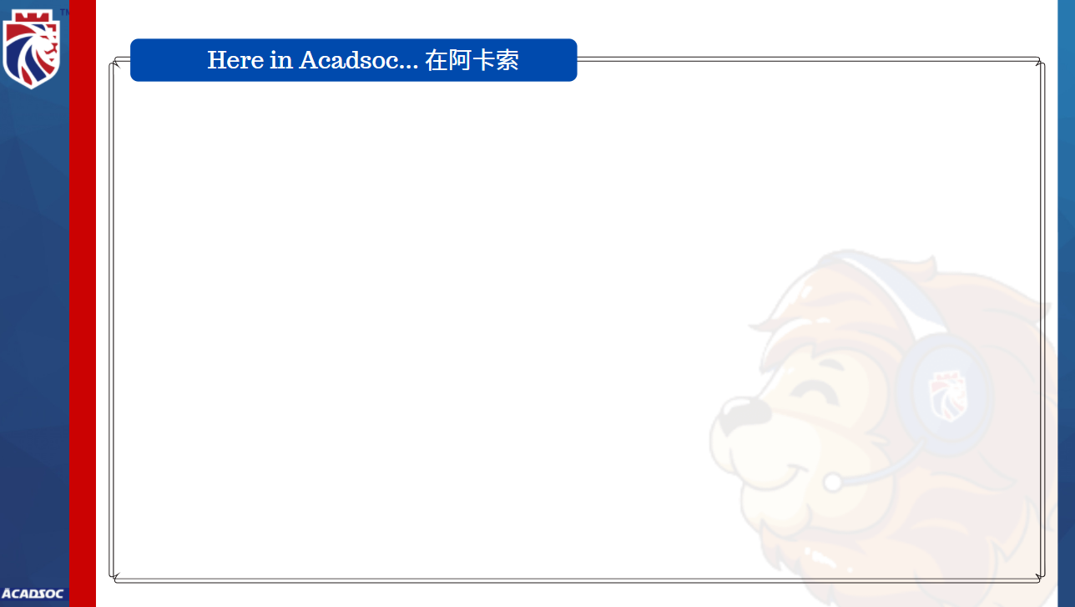

Welcome to Acadsoc
Congratulations!
You finished your first class in Acadsoc.
恭喜你完成了在阿卡索的第一节课。

Slide 2
Strengths 优点
You can communicate with me in simple sentences. 你可以和我进行简单的交流。
You can easily make sentences with new words. 你可以轻易地用新单词造句。
For example, you made a sentence with the word SLEEP, I have to sleep before 12 o’clock.
例如用sleep这个单词说I have to sleep before 12 o’clock。

Slide 3
Areas for Improvement 需要提高的地方
However, you still have challenges in the following words/sentences.
不过，我发现下面这些单词/句子对你来说还是有一点挑战性哦~
So, please repeat after me:
所以，请跟我再读/复习一下吧：
#1.__________________________ #2.______________________________
#3.__________________________
Good Job! Great! 你做得很好！

Slide 4

Suggestions 建议
1. Learn with our tutors to practice your oral English every day.
与我们的外教老师一起每天练习口语。
2. Read new words loudly according to the electronic dictionary app.
根据单词软件的发音，大声朗读自己新学的单词。
3. Create an English environment and watch English TV series, like Friend to learn authentic English expressions.
给自己营造一个英语环境，经常看美剧去学习地道的口语表达，例如《老友记》。

Slide 5
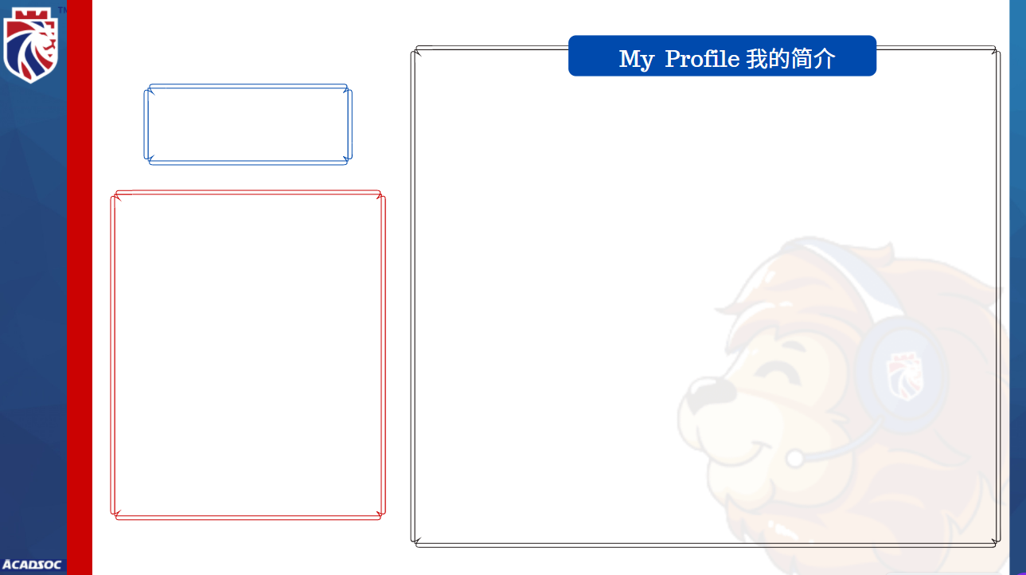

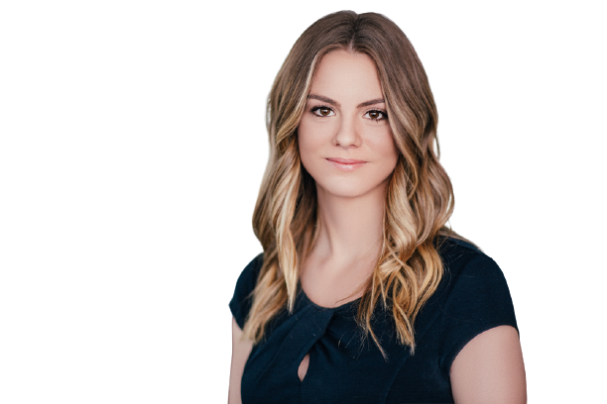
Name and TUID
My certificate:
TESOL
全球公认的ESL英语教师专业资格证
Strength in this textbook
Interactive exercises and extended teaching
擅长互动练习和拓展教学
Specialize in:
Oral English, Vocabulary, Knowledge Extension
擅长教授词汇,语法,知识拓展

