Slide 1
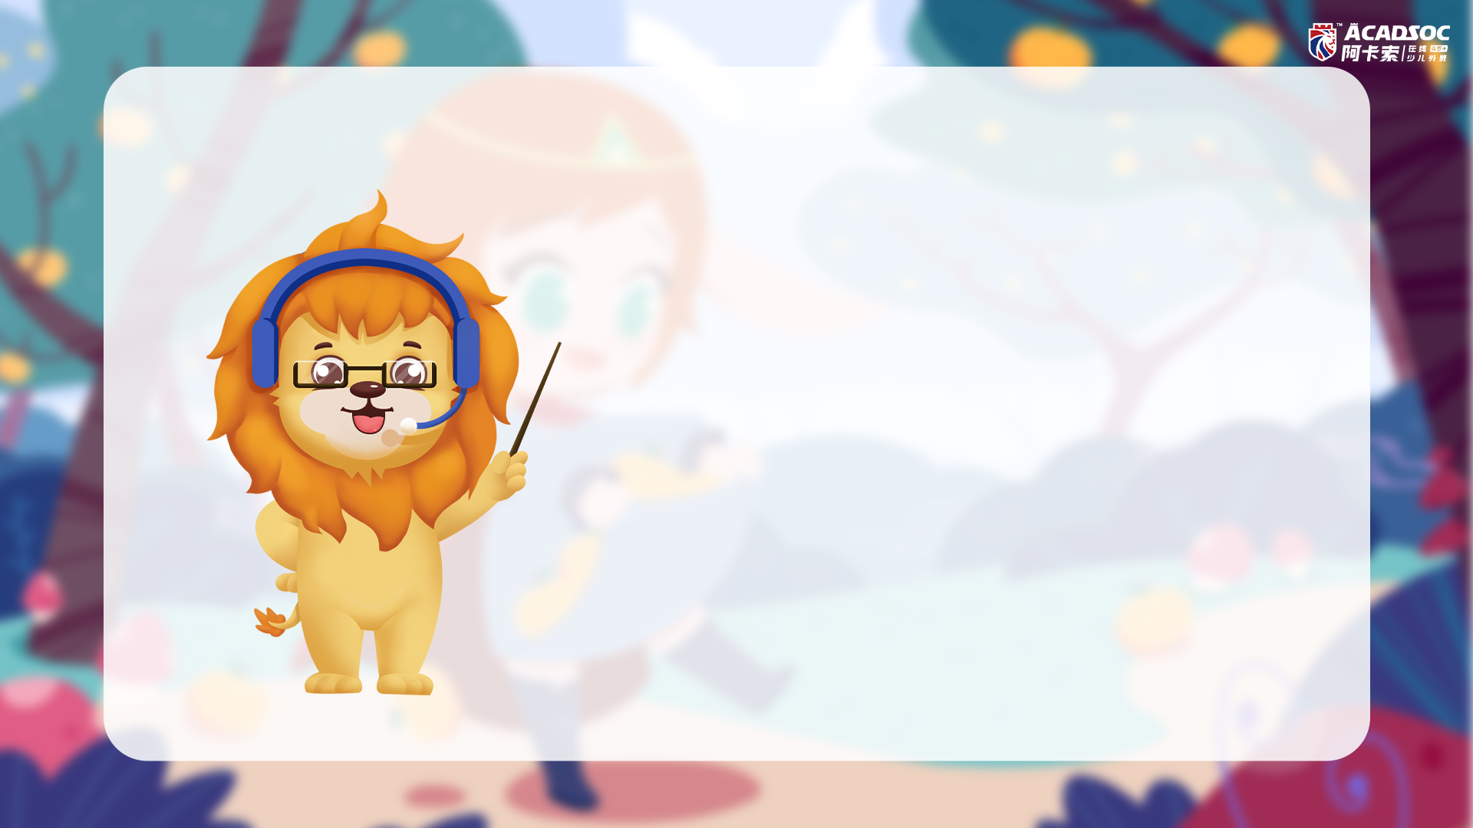
The class will start soon.
课程很快就会开始~
Things to do before class
上课前要做的事情
Things to do during the class 上课中要做的事情
1. Check your microphone and camera settings, make sure that both are working well.
检查麦克风和摄像头的设置，确保两者正常工作
1. Don’t be shy to speak! 不要害羞，大声说英语吧！
2. Relax and enjoy the class! 请放松并享受学习的快乐！
2. Please make sure that you have a good internet connection.
请确保您拥有良好的网络连接。
3. Just ask if you have
questions.
如果您有问题请大胆提出

