Slide 1







Health and Wellness Program
Enhancing Well-being and Productivity

Slide 2





What is a Health and Wellness Program?
Definition:
A structured initiative designed to promote physical, mental, and emotional well-being among employees or participants.
Objectives:
Improve overall health
Reduce stress and burnout
Components:
Enhance productivity
and job satisfaction
Physical fitness, mental health support, nutrition, and lifestyle management.

Slide 3


Benefits of Health and Wellness Programs
Physical Health:
Mental Health:
Reduces risk of chronic diseases (e.g., heart disease, diabetes)
Promotes healthy weight and physical fitness
Reduces stress and anxiety
Improves mood and mental clarity
Workplace Benefits:
Increased employee engagement
Reduced absenteeism and healthcare costs

Slide 4


Components of a Successful Program
Fitness Programs
Mental Health Support
On-site gym, fitness classes, or subsidized gym memberships
Counseling services, stress management workshops, and mindfulness programs
Nutrition
Lifestyle Management
Healthy eating workshops, access to nutritious snacks, or meal plans
Work-life balance initiatives, flexible work hours, and ergonomic workspaces

Slide 5



Assessment
Creating a Health and Wellness Plan
Conduct needs assessment surveys to understand participants' health needs and interests
Goal Setting
Set clear, achievable goals for health and wellness outcomes
Program Design
Develop a structured plan with specific activities and resources
Implementation
Launch the program and ensure access to all participants

Slide 6

Encouraging Participation
Communication
Incentives
Engagement
Create a supportive community through group activities and social events
Use newsletters, emails, and meetings to promote the program
Offer rewards or recognition for participation and achievement

Slide 7



Measuring Success
Track participation rates, health improvements, and employee feedback
Key Metrics
Collect feedback from participants to assess program impact and areas for improvement
Surveys and Feedback
Measure changes in health indicators such as reduced sick days and lower healthcare costs
Health Outcomes:

Slide 8
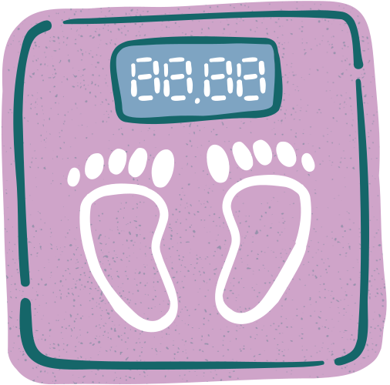


Challenges and Solutions
Challenges
Low participation rates, limited resources or budget and resistance to change
Solutions
Tailor programs to address specific needs, utilize cost-effective resources and partnerships and foster a culture that values health and wellness

Slide 9



Summary
Health and wellness programs enhance physical and mental well-being, support productivity, and reduce healthcare costs. Key to success includes a comprehensive program design, encouraging participation, and regular evaluation.

Slide 10


Thank You

