Slide 1
TOOLBOX TALK
AUTOMOTIVE SAFETY SYSTEMS
Technology that prevents accidents and protects lives
Notes:
- Welcome. This talk covers the safety systems built into modern vehicles – before, during and after a crash.
- Key message for today: technology helps, but the driver is still the most important safety system.
- Ask: who drove to work or to site today? Keep that journey in mind.

Slide 2




The Biggest Risk Is on the Road
WHY IT MATTERS
A surprising fact for everyone who drives for work
What this means for us
4 in 10
Driving is a high-risk task
Plan every journey like any other critical job
GUESS FIRST
on-the-job deaths in oil & gas extraction come from highway vehicle crashes – the leading cause
What is the No.1 cause of on-the-job deaths in oil & gas extraction?
Car safety systems help
Only if they work – and you use them
Source: US OSHA, Oil and Gas Extraction – Hazards (BLS Census of Fatal Occupational Injuries)
You are the key safety system
Alert, belted, phone away, right speed
Notes:
- Ask the question on the card and take 2–3 guesses before clicking. Most people guess falls, fires or dropped objects.
- Reveal: highway vehicle crashes are the leading cause – about 4 in 10 deaths (US OSHA, citing BLS CFOI). NIOSH data for other years shows lower shares (about 18–29%), but vehicles still rank first.
- Link: that is why vehicle safety systems – and how we drive – matter so much in our industry.
- Source: osha.gov/oil-and-gas-extraction/hazards

Slide 3



Four Layers That Protect You
THE BASIC IDEA
Before, during and after a crash
BEFORE A CRASH
DURING
AFTER
PREVENT
WARN & ASSIST
PROTECT
RESPOND
Active safety
ADAS
Passive safety
Post-crash
Helps you keep control and avoid the crash
Sensors watch the road, warn, and may brake or steer
Protects the people inside when a crash happens
Calls for help and reduces further hazards
e.g. Braking, stability, grip
e.g. Cameras, radar
e.g. Belts, airbags, body structure
e.g. eCall, fuel or high-voltage cut-off
If one layer fails, the next one is there. But the driver is still the most important safety system.
Notes:
- Four layers: PREVENT (active safety), WARN & ASSIST (ADAS), PROTECT (passive safety), RESPOND (post-crash).
- Each click reveals the next layer – walk left to right along the crash timeline.
- Stress: the layers back each other up, but none of them replaces an alert, belted driver.

Slide 4
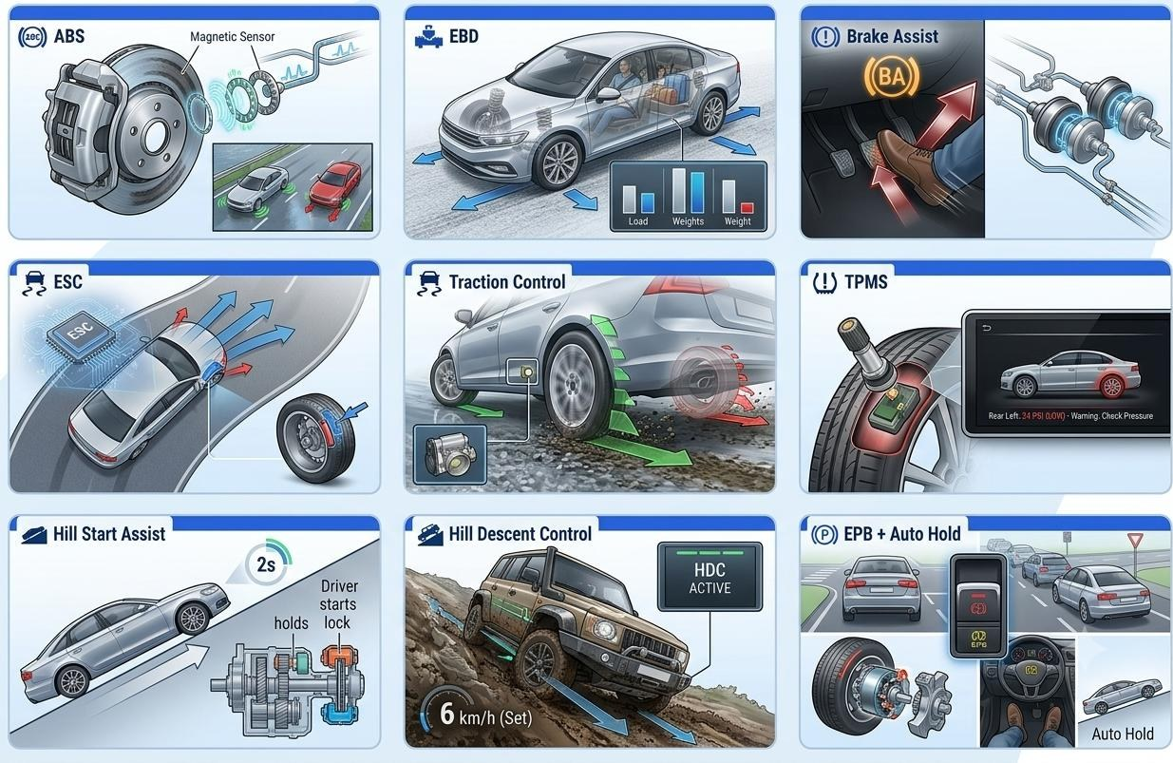
Keeping Control: Brakes, Grip and Stability
ACTIVE SAFETY
Helps you stop, steer and keep grip
BRAKING
ABS Stops wheels locking under hard braking
EBD Shares brake force to suit the load
Brake Assist Adds full force in a panic stop
STABILITY & GRIP
ESC Brakes single wheels to stop a skid
Traction control Stops wheelspin when pulling away
TPMS Warns of an under-inflated tyre
SLOPES & STOPS
Hill Start Assist Stops roll-back on a slope
Hill Descent Control Holds a slow speed downhill
EPB + Auto Hold Electric handbrake; holds you at stops
Notes:
- Active safety helps you STOP, STEER and keep GRIP – it works before a crash.
- ABS lets you keep steering while braking hard: press firmly and hold – don't pump the pedal on an ABS car.
- TPMS is only a warning: still check tyres visually and set the correct pressure before a journey.
- Ask: which of these warning lights have you seen on your own dashboard?

Slide 5
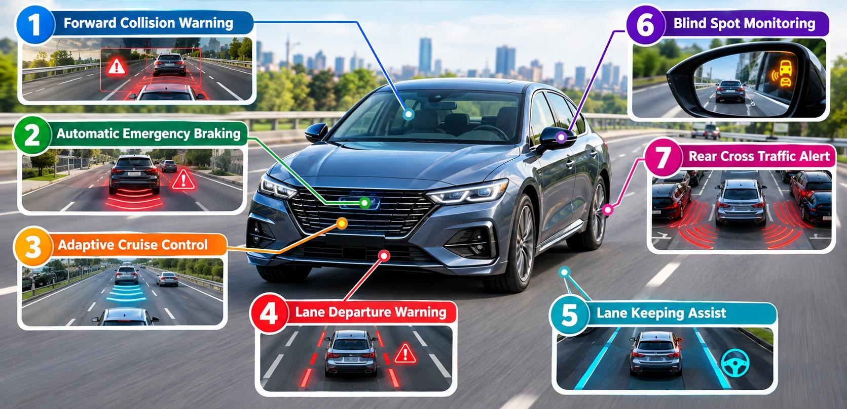





Is Your Car Watching the Road?
ADAS
Driver assistance: warn first, then help brake or steer
Forward Collision Warning
Beeps when you close in too fast
1
Automatic Emergency Braking
Brakes by itself if a crash is imminent
2
Adaptive Cruise Control
Keeps a set speed and a set gap
3
Lane Departure Warning
Alerts you if you drift over the lines
4
Lane Keeping Assist
Gently steers you back into the lane
5
Blind Spot Monitoring
Light in the mirror when a car is alongside
6
ADAS assists – it does not drive for you. Keep cameras and sensors clean; dirt, rain or glare can stop them working.
Rear Cross Traffic Alert
Warns of traffic crossing as you reverse
7
Notes:
- Numbers 1–7 in the list match the numbers in the picture; each click reveals the next system.
- Pattern: most systems WARN first (beep, light, vibration); some then ACT (brake or steer).
- Recommendation (added, not in the original deck): systems have limits – bad weather, dirty sensors and faded lane lines reduce performance. Check the vehicle handbook.
- Ask: what do you do when the car warns you? (Act on it – brake, check mirrors, correct your position.)

Slide 6
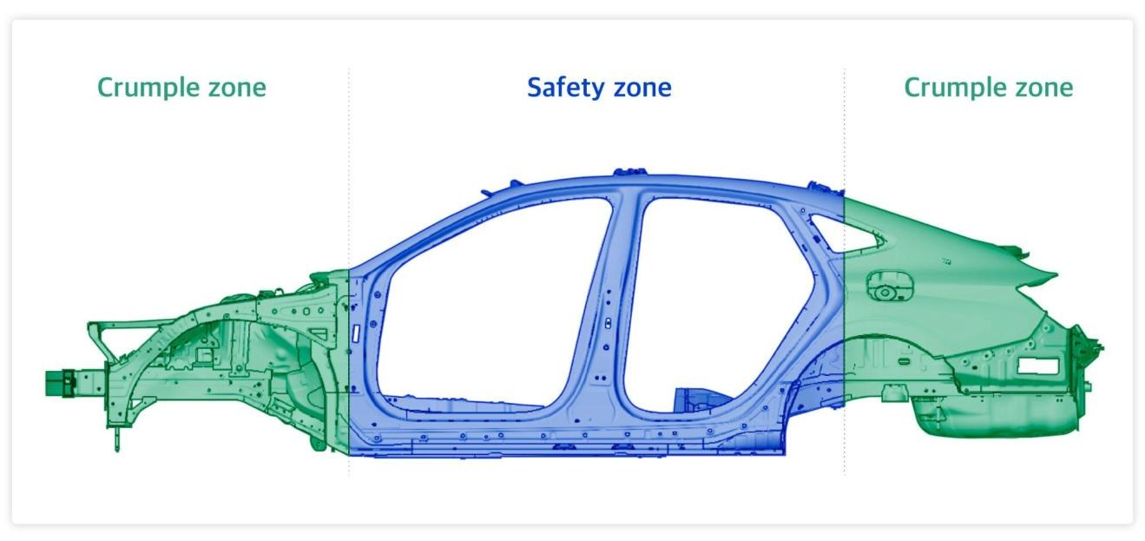





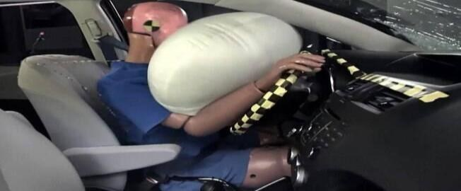
What Protects You in a Crash?
PASSIVE SAFETY
Soft ends, a strong middle, and restraints that work together
Airbags (front, side, curtain)
Cushion you in certain crashes
Seatbelts
Hold you in place and spread the forces
Pretensioners
Pull the belt tight as the crash begins
Load limiters
Let the belt give a little to protect the chest
Crumple zones + safety cell
Built into the body of every modern car
Crumple zones absorb crash energy; the safety cell keeps space around you
Airbags work WITH seatbelts,
not instead of them. Hold the wheel at 9 and 3.
45%
Seatbelts cut the risk of death for front-seat car occupants by 45% (60% in light trucks)
Source: US NHTSA
Notes:
- Car body: soft ends (crumple zones) absorb energy; the strong middle (safety cell) keeps space around you.
- Restraints work as a team: pretensioner tightens the belt, load limiter eases chest load, airbag cushions.
- An airbag without a belt can injure: sit upright, belt low over the hips, hands at 9 and 3 (from the original deck).
- Fact: NHTSA – lap/shoulder belts reduce fatal-injury risk by 45% for front-seat car occupants and 60% in light trucks (crashstats.nhtsa.dot.gov).

Slide 7
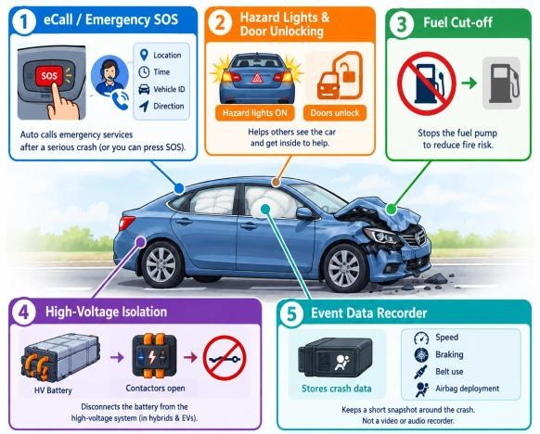





What Happens After a Crash?
POST-CRASH SAFETY
Calling for help and reducing further hazards
What happens to an EV's high-voltage system after a serious crash?
eCall / SOS
Hazards & unlock
Fuel cut-off
HV isolation
EDR
Can call emergency services and send the location
May switch on hazards and unlock doors
Can stop fuel delivery after certain crashes
Helps disconnect an EV's high voltage
Event Data Recorder: stores selected crash data
ANSWER HV isolation helps disconnect the battery from the high-voltage system. Still treat a damaged EV or hybrid as live: keep clear of orange cables and tell the emergency services it is an EV.
Features vary by vehicle – check the handbook
Notes:
- Ask the EV question and take answers first. Click through the five systems, then reveal the answer.
- Answer (original deck): HV isolation helps disconnect the battery from the high-voltage system.
- Added recommendation – confirm with your HSE team: isolation may not make the vehicle fully safe; a damaged battery can stay energised or reignite later. Never touch orange HV cables.
- EDR is not a video or audio recorder – it keeps a short snapshot (speed, braking, belt use, airbag deployment).

Slide 8
Before, During and After a Crash
THE CRASH SEQUENCE
What the car does at each stage – where fitted
BEFORE Seconds before
DURING Milliseconds
AFTER Minutes after
FCW warns the driver
Crumple zones absorb energy
eCall / SOS calls for help
Brake Assist / AEB add braking
Pretensioners tighten belts
Hazards on, doors unlock
ABS & ESC keep you steering
Airbags inflate, then vent
Fuel or high voltage cut off; data recorded
The car reacts in milliseconds. Your part starts before: stay alert, keep your distance, buckle up.
Notes:
- One timeline for the whole talk: BEFORE (seconds), DURING (milliseconds), AFTER (minutes).
- 'Where fitted' – not every vehicle has every system. Know what YOUR vehicle has.
- Bottom line (added summary): the driver's actions before and during the journey matter most.

Slide 9
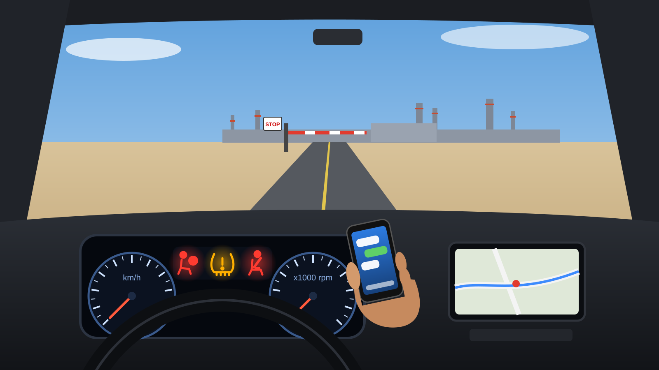
Can You Identify the Hazard?
INTERACTIVE
You are about to drive off site. Spot 4 hazards before you move.
Hazard 1 ?
1
Airbag warning light ON
RISK Airbags may not work in a crash
DO Don't drive – report the defect
Hazard 2 ?
2
Tyre pressure (TPMS) warning
RISK Less grip, longer stopping, blow-out
1
2
3
DO Check and inflate tyres before leaving
4
Hazard 3 ?
3
Seatbelt not fastened
RISK Airbags can't protect an unbelted driver
DO Buckle up – every seat, every trip
Hazard 4 ?
4
Phone in hand
Discuss in pairs for 1 minute – then reveal one hazard per click
RISK Eyes and mind off the road
DO Phone away before moving off
Notes:
- Show the scene, ask the question, allow 1 minute. Each click reveals one hazard: hazard, then risk, then control.
- 1 Airbag/SRS light ON: system fault – airbags may not deploy. Do not use the vehicle; report it under your vehicle defect procedure. 2 TPMS light: under-inflated tyre – less grip, longer stopping, risk of tyre failure. Check and inflate to the placard pressure.
- 3 Seatbelt warning light: driver unbelted – buckle up, all occupants. 4 Phone in hand: distraction – put it away or stop safely before using it.
- Mandatory where your company has adopted the IOGP Life-Saving Rules: always wear a seatbelt; do not use phones or operate devices while driving; follow journey management.

Slide 10
KEY TAKEAWAY
Safety Technology Helps.
Safe Driving Saves Lives.
Thank you. Drive safely today. Questions?
Notes:
- Close on one message: technology helps, but safe driving saves lives.
- Recap: check warning lights and tyres, belt up, phone away, stay alert.
- Invite questions; remind the team how to report vehicle defects locally.

