Slide 1
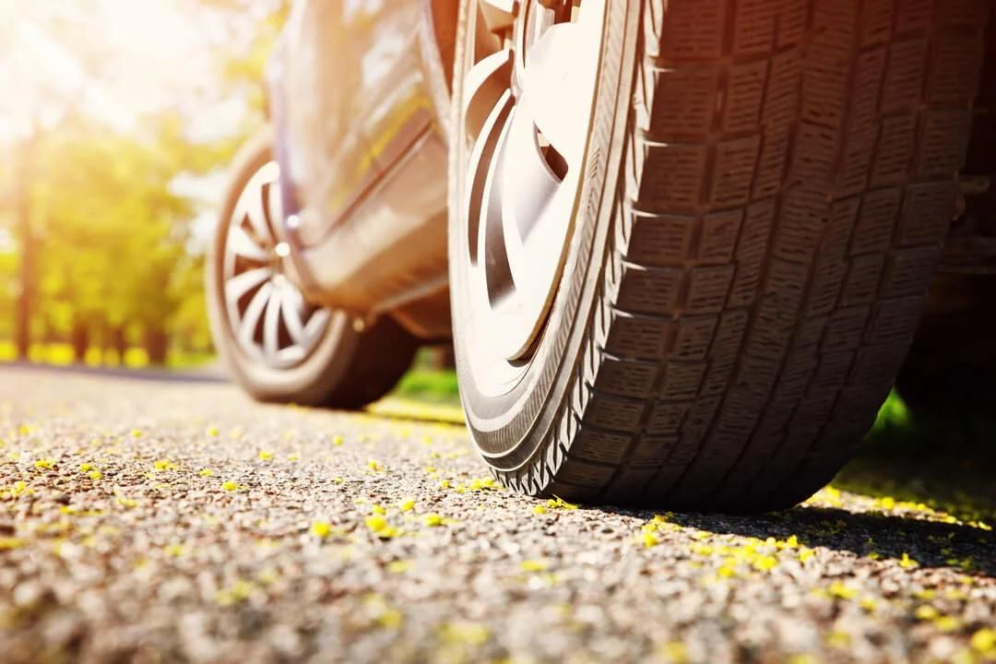
TOOLBOX TALK · BEGINNER TRAINING
Automotive Safety Systems
How cars help prevent crashes, protect people and call for help
With verified examples from India and global markets · October 2026
Notes:
TIMING: about 30 seconds
WHAT TO SAY:
Good morning, everyone. Quick question before we start: how many safety systems do you think are working in your car right now? Let one or two people guess.
EXPLAIN SIMPLY:
Most people say two or three – seatbelts and airbags. In reality a modern car can have twenty or more. In the next few minutes we'll see what they do, how they work, where their limits are, and how they appear on real cars in India and around the world.
REAL-WORLD EXAMPLE:
Škoda says its Kylaq compact SUV for India comes with 25 active and passive safety features as standard (press release, 6 November 2024).
TRANSITION:
Let's start with why this matters.
SOURCES:
• Škoda Storyboard – The all-new Škoda Kylaq (press release, 6 Nov 2024): https://www.skoda-storyboard.com/en/press-releases/the-all-new-skoda-kylaq-a-new-era-for-skoda-in-indias-popular-sub-4-metre-suv-segment/

Slide 2
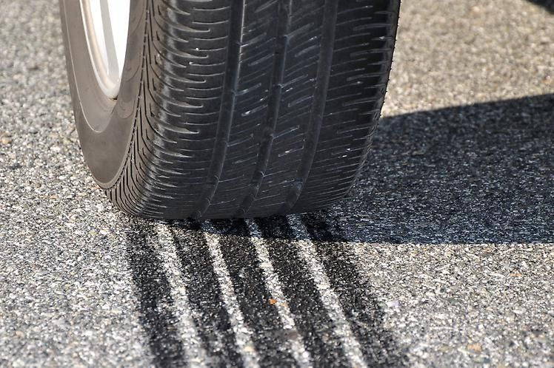




Two Seconds on a Wet Road
WHY THIS MATTERS
Traffic ahead stops suddenly. What helps you now?
?
How many safety systems are working in your car right now?
Most people guess two or three
Seatbelts and airbags
Modern cars often have 20 or more
Braking, stability, sensors, airbags, emergency call
Each one buys time or reduces force
Seconds before a crash, milliseconds during it
None of them beats physics
Speed, distance and attention still decide the outcome
Skid marks: a tyre that is sliding instead of rolling
Notes:
TIMING: about 40 seconds
WHAT TO SAY:
Picture this: you're on a wet road and the traffic ahead stops suddenly. You have about two seconds. What decides whether you stop in time?
EXPLAIN SIMPLY:
Skid marks like these show a tyre that has stopped rolling and is sliding. A sliding tyre can't steer. Many safety systems exist to stop exactly this from happening – and if a crash still happens, other systems protect the people inside and call for help afterwards.
ASK THE AUDIENCE:
Show of hands: who knows whether their own car has stability control (ESC)?
EXPECTED ANSWER:
Usually only a few hands. That's fine – by the end of this session you'll know how to check.
CLICKS:
Click 1–4 reveal the four points on the right.
TRANSITION:
To make sense of all these systems, we group them into four layers.

Slide 3




Four Layers That Protect You
THE BASIC IDEA
Before, during and after a crash
BEFORE A CRASH
DURING
AFTER
PREVENT
WARN & ASSIST
PROTECT
RESPOND
Active safety
ADAS
Passive safety
Post-crash
Helps you keep control and avoid the crash
Driver assistance: sensors watch the road, warn, may brake or steer
Protects the people inside when a crash happens
Calls for help and reduces further hazards
e.g. Braking, stability, grip
e.g. Cameras, radar
e.g. Belts, airbags, body structure
e.g. eCall, fuel or high-voltage cut-off
If one layer fails, the next one is there. But the driver is still the most important safety system.
Notes:
TIMING: about 40 seconds
WHAT TO SAY:
Vehicle safety works in four layers – a bit like the layers of protection we use on site.
EXPLAIN SIMPLY:
Active safety helps you keep control so the crash never happens: braking, stability, grip. ADAS – Advanced Driver Assistance Systems – uses cameras and radar to watch the road, warn you, and sometimes brake or steer. Passive safety protects people during a crash: seatbelts, airbags and the car's structure. Post-crash safety helps afterwards: calling for help and cutting fuel or high-voltage power. The coloured tag on each of the next slides tells you which layer we're in.
REAL-WORLD EXAMPLE:
India: ABS has been compulsory on every car on sale since April 2019, and a driver airbag, seatbelt reminders and a speed-warning system were mandated from July 2019 (Autocar India).
ASK THE AUDIENCE:
Which two layers work before a crash happens?
EXPECTED ANSWER:
Active safety and ADAS.
CLICKS:
Click 1–4 reveal each layer; click 5 shows the key message.
TRANSITION:
So how does a safety system actually work? Almost all of them follow the same three steps.
SOURCES:
• Autocar India (cited in original deck) – ABS compulsory on all cars on sale in India from April 2019: https://www.autocarindia.com/car-news/new-cars-and-bikes-to-get-more-safety-tech-this-year-411018

Slide 4

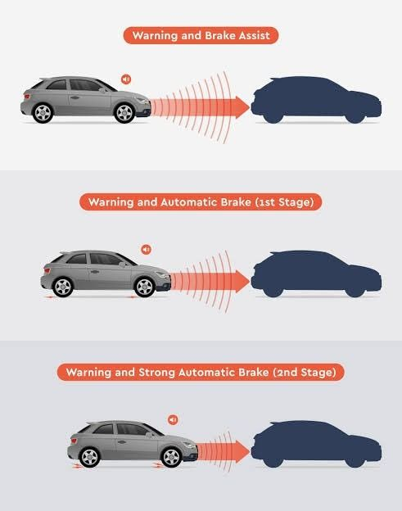


Sense → Decide → Act
HOW IT WORKS
Almost every safety system follows the same three steps
1 SENSE Sensors measure what is happening
Wheel-speed sensors, steering angle, camera, radar, crash sensors
Example: Automatic Emergency Braking
Sense: camera and radar see a stopped car
Decide: a crash is likely
Act: warn → light brake → strong brake
2 DECIDE A control unit compares it with what should happen
Hundreds of times a second – far faster than a person
3 ACT The car responds
Warning beep, brake one wheel, cut engine power, steer, fire an airbag
These systems assist the driver. They do not replace your attention.
Notes:
TIMING: about 45 seconds
WHAT TO SAY:
Here's the secret: almost every system we'll talk about today works in three steps – sense, decide, act.
EXPLAIN SIMPLY:
SENSE: sensors measure what's happening – wheel speed, steering angle, the road ahead through a camera or radar, or a sudden deceleration in a crash. DECIDE: a small computer (control unit) compares that with what should be happening, many times a second. ACT: the car responds – a warning, braking a single wheel, reducing engine power, a steering nudge, or firing an airbag.
REAL-WORLD EXAMPLE:
Automatic Emergency Braking (right): the camera and radar see a stopped vehicle ahead, the computer decides a crash is likely, then it warns you first, brakes lightly, and finally brakes hard if you still haven't reacted. Volvo made its City Safety auto-brake standard on the XC60 in 2008 (Volvo press release, cited in the original deck).
ASK THE AUDIENCE:
What could stop a camera from seeing properly?
EXPECTED ANSWER:
Heavy rain, fog, mud or dirt on the windscreen, sun glare, faded road markings.
CLICKS:
Clicks 1–3 wipe in Sense, Decide, Act; click 4 shows the AEB example.
TRANSITION:
Let's look at the key features in each layer, starting with active safety.

Slide 5
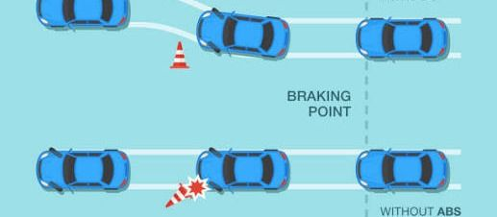
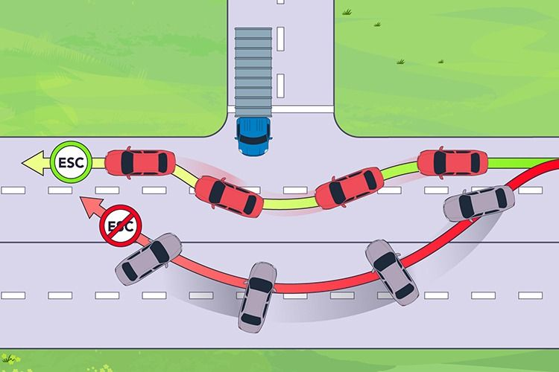
Keeping Control: Brakes, Grip and Stability
ACTIVE SAFETY
Helps you stop, steer and keep grip
ABS
EBD
Brake Assist
Stops wheels locking under hard braking
Shares brake force to suit the load
Adds full force in a panic stop
ESC
Traction control
TPMS
ABS: wheels keep turning, so you can still steer
Brakes single wheels to stop a skid
Stops wheelspin when pulling away
Warns of an under-inflated tyre
Hill Start Assist
Hill Descent Control
EPB + Auto Hold
Stops roll-back on a slope
Holds a slow speed downhill
Electric handbrake; holds you at stops
ESC: green path with ESC; red path without, the car can spin
Notes:
TIMING: about 60 seconds
WHAT TO SAY:
Active safety helps you keep control. Nine features – let's take them a row at a time.
EXPLAIN SIMPLY:
Row 1 – braking. ABS (anti-lock brakes): wheel-speed sensors spot a wheel about to lock and rapidly release and reapply brake pressure. Locked wheels slide and can't steer; rotating wheels can. Tip: press firmly and hold – don't pump; the buzzing pedal is normal. EBD (electronic brake-force distribution) adjusts front/rear pressure to suit the load. Brake Assist spots a fast, panicky press and boosts pressure, because most people don't press hard enough in an emergency.
Row 2 – grip and stability. ESC (electronic stability control) compares where you steer with where the car is going; if it starts to slide it brakes individual wheels and can cut power (the diagram: green path with ESC, red without). Traction control stops wheelspin when pulling away on wet paint, mud or gravel. TPMS warns when a tyre is significantly under-inflated – it doesn't replace monthly checks with a gauge.
Row 3 – everyday helpers. Hill Start Assist holds the brakes briefly so you don't roll back. Hill Descent Control holds a slow, steady speed down steep slopes. An electric parking brake with Auto Hold keeps the car still at traffic lights after you lift off the brake.
REAL-WORLD EXAMPLE:
Maruti Suzuki says the new Swift has ABS with EBD, Brake Assist, ESP and Hill Hold as standard (May 2024). Hyundai lists ESC, TPMS and Hill-start Assist across the Creta line-up in India. Names differ: ESC = ESP = VSA = VSM.
ASK THE AUDIENCE:
In an emergency, should you pump the brakes in a car with ABS?
EXPECTED ANSWER:
No. Press firmly, hold it, and steer around the hazard if it's safe. And remember: ESC only works within the tyres' grip – it doesn't let you corner faster.
CLICKS:
Clicks 1–3 reveal the three rows.
TRANSITION:
Next: systems that watch the road for you.
SOURCES:
• Maruti Suzuki – Launch of the Epic New Swift (May 2024): https://www.marutisuzuki.com/corporate/media/press-releases/2024/may/ms-launches-epic-new-swift-with-all-new-z-series-engine
• Hyundai Motor India – CRETA safety page: https://www.hyundai.com/in/en/find-a-car/creta/safety

Slide 6
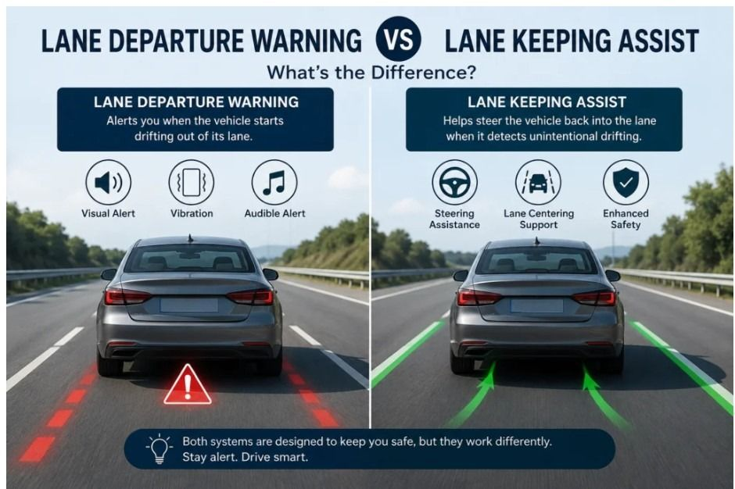







Is Your Car Watching the Road?
ADAS
Driver assistance: warn first, then help brake or steer
Forward Collision Warning Beeps when you close in too fast
Automatic Emergency Braking Brakes by itself if a crash is imminent
Adaptive Cruise Control Keeps a set speed and a set gap
Lane Departure Warning Alerts you if you drift over the lines
Lane Keeping Assist Gently steers you back into the lane
Lane Departure Warning alerts you; Lane Keeping Assist also steers you back
Blind Spot Monitoring Light in the mirror when a car is alongside
?
Does blind-spot monitoring replace the shoulder check?
Rear Cross Traffic Alert Warns of traffic crossing as you reverse
Notes:
TIMING: about 60 seconds
WHAT TO SAY:
ADAS stands for Advanced Driver Assistance Systems. They use a camera (usually behind the windscreen), radar (often behind the grille badge) and short-range sensors in the bumpers.
EXPLAIN SIMPLY:
Click 1 – the forward group. Forward Collision Warning measures the gap and closing speed and warns you; on its own it does not brake. Automatic Emergency Braking can brake by itself if you don't react enough. Adaptive Cruise Control holds a set speed and a set gap, slowing behind traffic. Click 2 – the lane group. Lane Departure Warning beeps or vibrates the wheel if you drift over the lines without indicating; Lane Keeping Assist goes further and gently steers you back. Both need visible markings and your hands on the wheel. Click 3 – the side and rear group. Blind Spot Monitoring lights up in the mirror when a vehicle is alongside; Rear Cross Traffic Alert warns of cars crossing behind you as you reverse out of a parking bay.
REAL-WORLD EXAMPLE:
Tesla says Forward Collision Warning, Automatic Emergency Braking and Lane Departure Avoidance are standard on every Model Y. In India, ADAS is usually limited to top variants – for example the Hyundai Creta King and the Mahindra XEV 9e Pack Three.
ASK THE AUDIENCE:
Use the slide question: does blind-spot monitoring replace the shoulder check?
EXPECTED ANSWER:
No. It adds awareness, but motorcycles and fast-approaching vehicles can be missed. Mirrors plus shoulder check, every time. And with adaptive cruise on, the driver is still responsible for braking.
CLICKS:
Clicks 1–3 reveal the forward, lane and side/rear groups.
TRANSITION:
Now, if a crash does happen – what protects the people inside?
SOURCES:
• Tesla – Model Y page (FCW, AEB, Lane Departure Avoidance standard): https://www.tesla.com/modely
• Hyundai Motor India – Hyundai CRETA 2026 advanced features & specs guide (blog): https://www.hyundai.com/in/en/blog/hyundai-creta-advance-features-specs-guide
• Mahindra – Top-variant prices of BE 6 & XEV 9e (Pack Three features): https://auto.mahindra.com/press-release/mahindra-democratises-premium-ev-technology-announces-top-variant-prices-of-be-6-and-xev-9e.html

Slide 7
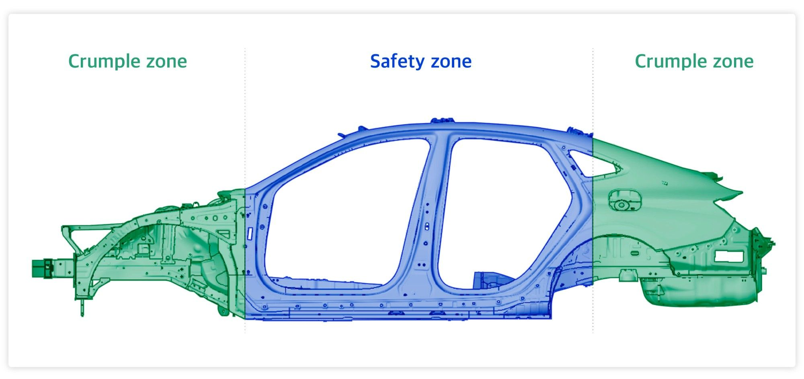




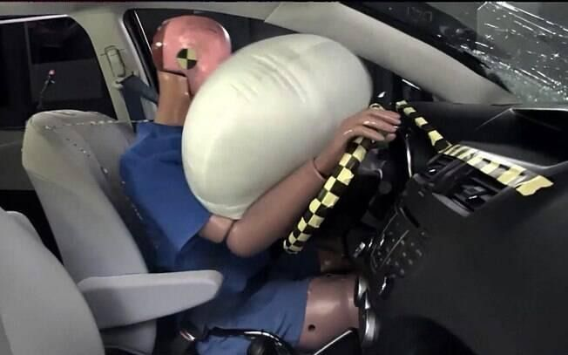


What Protects You in a Crash?
PASSIVE SAFETY
Soft ends, a strong middle, and restraints that work together
Airbags (front, side, curtain)
Cushion you in certain crashes
Seatbelts
Hold you in place and spread the forces
Pretensioners
Pull the belt tight as the crash begins
Load limiters
Let the belt give a little to protect the chest
Crumple zones absorb crash energy; the safety cell keeps space around you
ISOFIX anchors
Click-in mounting for child seats
Airbags work WITH seatbelts, not instead of them. Hold the wheel at 9 and 3.
Crumple zones + safety cell
Built into the body of every modern car
Notes:
TIMING: about 50 seconds
WHAT TO SAY:
Ask: why is it good that the front of a car crumples? Answer: crumpling absorbs crash energy and slows the deceleration, so less force reaches the people inside.
EXPLAIN SIMPLY:
The diagram shows the idea: soft crumple zones at the front and back, a strong safety cell in the middle to keep space around you. Then the restraints. Seatbelts hold you in the right position and spread forces across the strong parts of the body. Pretensioners pull the belt tight in the first moments of a crash. Load limiters let a little belt out in a controlled way so the force on the chest isn't too high. Airbags inflate in milliseconds and then vent to cushion you – they're supplemental restraints, so without a belt you can hit the bag, or the car, out of position. ISOFIX anchors make it easier to fit a compatible child seat correctly.
REAL-WORLD EXAMPLE:
Mercedes-Benz engineer Béla Barényi patented the crumple-zone and rigid-cabin idea in 1952; it went into series production on the 1959 W 111. Maruti Suzuki lists six airbags, belt pretensioners, force (load) limiters and ISOFIX on the Swift ZXi+. Practical tip: hold the wheel at 9 and 3 and keep your chest about 25 cm from the wheel centre.
ASK THE AUDIENCE:
Why don't airbags replace seatbelts?
EXPECTED ANSWER:
Airbags are supplemental. The belt keeps you in position; without it you can be thrown into the bag or the car, especially in side impacts and rollovers.
CLICKS:
Clicks 1–6 reveal the protection features one by one.
TRANSITION:
So what actually happens, second by second, in a crash?
SOURCES:
• Maruti Suzuki – Swift variant feature listing (CNG / variants page): https://marutisuzuki.com/cng/swift
• Mercedes-Benz (via Automotive World, cited in original deck): https://www.automotiveworld.com/news-releases/75-years-protection-occupants-road-users-mercedes-benz-innovation-tradition/

Slide 8
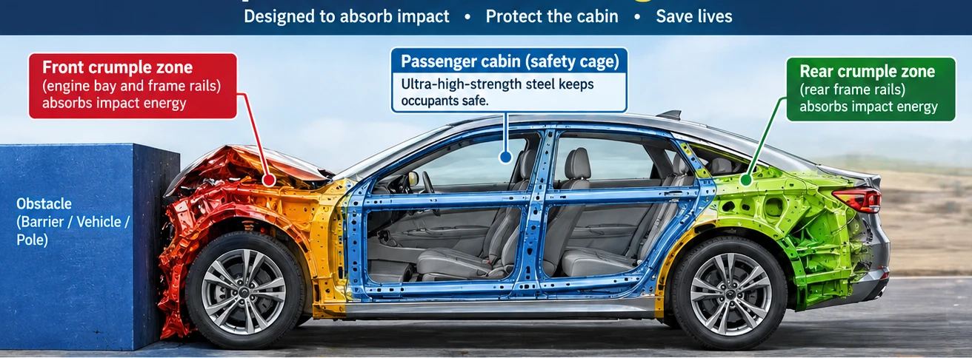
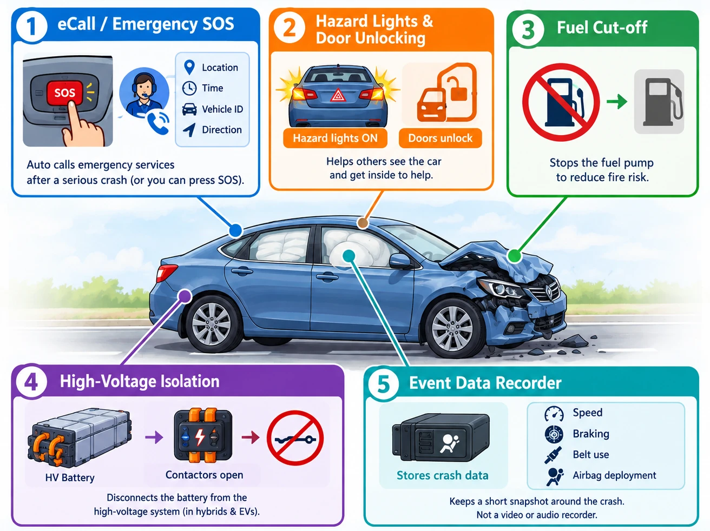
Before, During and After a Crash
THE CRASH SEQUENCE
What the car does at each stage – where fitted
BEFORE Seconds before
DURING Milliseconds
AFTER Minutes after
FCW warns the driver
Brake Assist / AEB add braking
ABS & ESC keep you steering
Crumple zones absorb energy
Pretensioners tighten belts
Airbags inflate, then vent
eCall / SOS calls for help
Hazards on, doors unlock
Fuel or high voltage cut off; data recorded
EV crash rule: treat orange cables and the battery as live. Never touch them.
Illustrative images; not a specific vehicle. Features vary by vehicle, variant and market.
Notes:
TIMING: about 60 seconds
WHAT TO SAY:
Let's put all four layers on a timeline: before, during and after a crash.
EXPLAIN SIMPLY:
BEFORE (seconds): Forward Collision Warning alerts you; you brake; Brake Assist and – if you don't do enough – Automatic Emergency Braking add braking; ABS and ESC keep the car steerable. DURING (milliseconds): the crumple zone folds in a planned way while the cabin keeps its shape (left image); crash sensors fire the belt pretensioners and the airbags, and the load limiters let the belt give slightly. AFTER (minutes): on cars that have them, eCall or SOS calls emergency services with your location; the hazard lights come on and doors unlock to help rescuers; fuel delivery or the EV's high-voltage system is cut off; and an Event Data Recorder keeps a short snapshot of speed, braking, belt use and airbag deployment. It is not a video or audio recorder.
REAL-WORLD EXAMPLE:
In the EU, eCall is required on new car models approved after 31 March 2018, and Event Data Recorders on all new cars registered from 7 July 2024. Tesla's 2025 Model Y Emergency Response Guide says airbag deployment is designed to deactivate high voltage outside the battery – but the battery itself stays charged.
ASK THE AUDIENCE:
You arrive first at an EV crash. What must you not touch?
EXPECTED ANSWER:
Orange high-voltage cables and the battery pack. Call emergency services and keep clear.
CLICKS:
Clicks 1–3 wipe in Before, During and After; the crash image appears with During and the post-crash image with After.
TRANSITION:
That's the theory. Now let's see which of these features real cars actually have.
SOURCES:
• European Union – Your Europe (cited in original deck) – eCall in new car models approved after 31 March 2018: https://europa.eu/youreurope/citizens/travel/security-and-emergencies/emergency-assistance-vehicles-ecall/index_en.htm
• EUR-Lex – Regulation (EU) 2019/2144 consolidated text (07.07.2024): https://eur-lex.europa.eu/eli/reg/2019/2144/2024-07-07/eng
• Tesla (cited in original deck) – 2025 Model Y Emergency Response Guide: https://digitalassets.tesla.com/tesla-contents/image/upload/2025-Model-Y-Emergency-Response-Guide.pdf

Slide 9
Real Cars, Exact Variants
REAL VEHICLES
Selected features confirmed in official manufacturer sources
Market | Vehicle | Exact variant · year | Selected verified safety features | Verified
India | Hyundai Creta | King (automatic) · 2026 | AEB, adaptive cruise, lane keeping, ESC, TPMS, EPB + Auto Hold, 6 airbags | 12/24
India | Mahindra XEV 9e | Pack Three · 2025–26 · EV | AEB, lane centring, blind spot & rear cross-traffic alert, ESP, 7 airbags | 10/24
India | Maruti Suzuki Swift | ZXi+ · 2024– | ABS + EBD, Brake Assist, ESP, Hill Hold, 6 airbags, pretensioners, load limiters | 9/24
USA | Hyundai IONIQ 5 N | MY2026 · EV | Adaptive cruise, lane keeping, blind-spot & rear cross-traffic avoidance, SOS/auto-collision call | 13/24
USA | Tesla Model Y | Premium · MY2026 · EV | FCW, AEB, lane departure avoidance and adaptive cruise (TACC) on every Model Y | 6/24
UK | Dacia Sandero | Essential (entry) · 2025–26 | AEB, lane departure warning + lane keeping, eCall, ESC, 6 airbags – even on the base trim | 11/24
Same model name ≠ same safety kit. Always check the brochure for your exact variant.
Sources: hyundai.com/in · mahindraelectricsuv.com · marutisuzuki.com · hyundainews.com · tesla.com · press.dacia.co.uk (full list in notes and research report)
Notes:
TIMING: about 60 seconds
WHAT TO SAY:
Here are six real cars – three sold in India, three abroad – each with its exact variant and model year.
EXPLAIN SIMPLY:
The last column shows how many of our 24 checklist features we could confirm for that exact variant from the manufacturer's own documents. Point out the pattern: in India the advanced driver-assistance features (AEB, adaptive cruise, lane keeping, blind-spot alert) are found on the top variants such as the Creta King and the XEV 9e Pack Three, while the Swift ZXi+ focuses on strong basics. In Europe and the UK, even an entry-level car like the Dacia Sandero Essential has AEB, lane keeping and eCall, because the EU safety rules made them compulsory and Dacia fitted the same kit to its UK cars.
REAL-WORLD EXAMPLE:
Hyundai notes that smart cruise control on the Creta comes only with automatic gearboxes – so a manual Creta King would not have it. That is exactly why the variant matters.
ASK THE AUDIENCE:
If two people both drive a 'Hyundai Creta', do they have the same safety features?
EXPECTED ANSWER:
Not necessarily. Equipment varies by variant, gearbox and model year. Check the brochure or the variant page for your exact car.
CLICKS:
Click 1 shows the key message.
TRANSITION:
Why do cars in different markets differ so much? Mostly because of the rules.
SOURCES:
• Creta King: Hyundai Motor India – CRETA brochure (Knight / King): https://www.hyundai.com/content/dam/hyundai/in/en/data/brochure/creta-brochureknight.pdf ; Hyundai Motor India – Hyundai CRETA 2026 advanced features & specs guide (blog): https://www.hyundai.com/in/en/blog/hyundai-creta-advance-features-specs-guide
• XEV 9e Pack Three: Mahindra Electric SUV – XEV 9e brochure R1 (28 Apr 2026): https://www.mahindraelectricsuv.com/on/demandware.static/-/Library-Sites-eSUVSharedLibrary/default/MXV9/XEV9e_BROCHURE_R1_20260428.pdf ; Mahindra – Top-variant prices of BE 6 & XEV 9e (Pack Three features): https://auto.mahindra.com/press-release/mahindra-democratises-premium-ev-technology-announces-top-variant-prices-of-be-6-and-xev-9e.html
• Swift ZXi+: Maruti Suzuki – Swift variant feature listing (CNG / variants page): https://marutisuzuki.com/cng/swift ; Maruti Suzuki – Launch of the Epic New Swift (May 2024): https://www.marutisuzuki.com/corporate/media/press-releases/2024/may/ms-launches-epic-new-swift-with-all-new-z-series-engine
• IONIQ 5 N: Hyundai Motor America – 2026 IONIQ 5 N Specs and Features (22 Jul 2025): https://www.hyundainews.com/assets/documents/original/68164-2026IONIQ5NSpecsFeatures20250722A.pdf ; Hyundai Motor America – Hyundai launches Bluelink+ (ACN and SOS included): https://www.hyundainews.com/releases/3761?lang=en_US
• Model Y: Tesla – Model Y page (FCW, AEB, Lane Departure Avoidance standard): https://www.tesla.com/modely ; Tesla – Model Y Owner's Manual – Traffic-Aware Cruise Control (all Tesla vehicles): https://www.tesla.com/ownersmanual/modely/en_us/GUID-101D1BF5-52D2-469A-A57D-E7230BBEE94B.html
• Sandero Essential: Dacia UK – Dacia says yes to extra equipment and no to extra cost (GSR2 kit standard from Essential): https://www.press.dacia.co.uk/releases/440 ; Dacia UK – Sandero and Sandero Stepway press kit (May 2023): https://www.press.dacia.co.uk/assets/documents/original/4592-DaciaSanderoandSanderoStepwayPressKitMay2023.pdf

Slide 10



Why Safety Kit Differs by Market
INDIA VS GLOBAL
Rules set the minimum; manufacturers decide the rest
INDIA
EUROPEAN UNION
UNITED STATES
ABS compulsory on all cars on sale since April 2019
Bharat NCAP voluntary star ratings since October 2023
6 airbags now standard on many models (e.g. Swift, Alto K10)
ADAS mostly on top variants (e.g. Creta King, XEV 9e Pack Three)
eCall on new models approved after 31 March 2018
From 7 July 2024 all new cars need AEB, emergency lane keeping, EDR, TPMS and more
UK example: Dacia fitted the same kit to the Sandero Essential
ESC & TPMS required by federal safety standards (FMVSS 126, 138)
AEB rule finalised 2024; compliance from Sept 2029 (FMVSS 127)
Example: Tesla fits FCW, AEB and lane departure avoidance on every Model Y
A crash-test star rating is not a feature list. Five stars do not mean every system is fitted.
Notes:
TIMING: about 60 seconds
WHAT TO SAY:
Why does a basic European car have automatic braking when many Indian cars don't? Mostly because of the rules in each market.
EXPLAIN SIMPLY:
INDIA: ABS has been compulsory on all cars on sale since April 2019. Bharat NCAP, launched on 22 August 2023 and testing from 1 October 2023, gives voluntary crash-test star ratings. Six airbags have become standard on many models – Hyundai announced it across its range in October 2023, and Maruti Suzuki's ARENA range including the Alto K10 from May 2025. ADAS is still mostly on top variants. EUROPEAN UNION: eCall is required on new models approved after 31 March 2018. Under the General Safety Regulation, from 7 July 2024 every new car registered must have AEB, emergency lane keeping, an Event Data Recorder, intelligent speed assistance, driver drowsiness warning, TPMS and ESC, among others. The UK is outside the EU, but Dacia says it fitted the same equipment to the Sandero from the entry Essential trim. UNITED STATES: federal standards require ESC (FMVSS 126) and TPMS (FMVSS 138). NHTSA finalised an AEB standard (FMVSS 127) in 2024 with compliance from 1 September 2029; the rule has since been subject to reconsideration, so check its current status.
REAL-WORLD EXAMPLE:
Mahindra's XEV 9e and BE 6 achieved 5-star Bharat NCAP ratings – but that rating does not tell you which ADAS features a given variant has. Bharat NCAP tests the base variant.
ASK THE AUDIENCE:
Does a 5-star crash-test rating mean the car has automatic emergency braking?
EXPECTED ANSWER:
No. The rating reflects test performance; check the equipment list for your variant.
CLICKS:
Clicks 1–3 reveal India, EU and USA; click 4 shows the key message.
TRANSITION:
So how complete is the safety kit on real cars? Let's measure it.
SOURCES:
• Autocar India (cited in original deck) – ABS compulsory on all cars on sale in India from April 2019: https://www.autocarindia.com/car-news/new-cars-and-bikes-to-get-more-safety-tech-this-year-411018
• PIB, Government of India – Bharat NCAP launched 22 Aug 2023; testing from 1 Oct 2023: https://www.pib.gov.in/PressReleaseIframePage.aspx?PRID=1951030&reg=3&lang=2
• Bharat NCAP – Programme website (voluntary star rating): https://www.bncap.in/
• Maruti Suzuki – ARENA offers 6 airbags as standard (May 2025): https://www.marutisuzuki.com/corporate/media/press-releases/2025/may/maruti-suzuki-arena-enhances-safety-by-offering-6-airbags-as-standard
• Autocar Pro (cited in original deck) – Hyundai six airbags standard: https://www.autocarpro.in/news/hyundai-india-announces-six-airbags-as-standard-for-all-models-117076
• European Union – Your Europe (cited in original deck) – eCall in new car models approved after 31 March 2018: https://europa.eu/youreurope/citizens/travel/security-and-emergencies/emergency-assistance-vehicles-ecall/index_en.htm
• EUR-Lex – Regulation (EU) 2019/2144 consolidated text (07.07.2024): https://eur-lex.europa.eu/eli/reg/2019/2144/2024-07-07/eng
• European Commission – Mandatory driver assistance systems apply to all new vehicles from 7 July 2024: https://single-market-economy.ec.europa.eu/news/mandatory-drivers-assistance-systems-expected-help-save-over-25000-lives-2038-2024-07-05_en
• Dacia UK – Dacia says yes to extra equipment and no to extra cost (GSR2 kit standard from Essential): https://www.press.dacia.co.uk/releases/440
• NHTSA – FMVSS No. 126 Electronic Stability Control Systems: https://www.nhtsa.gov/document/electronic-stability-control-systems-fmvss-no-126
• NHTSA – FMVSS No. 138 Tire Pressure Monitoring Systems: https://www.nhtsa.gov/sites/nhtsa.gov/files/fmvss/tirepressure-fmvss-138.pdf
• NHTSA – FMVSS No. 127 Automatic Emergency Braking final rule (compliance from 1 Sept 2029): https://www.nhtsa.gov/press-releases/nhtsa-fmvss-127-automatic-emergency-braking-reduce-crashes
• Tesla – Vehicle safety and security features (support): https://www.tesla.com/support/vehicle-safety-security-features
• Mahindra – BE 6 and XEV 9e create history with 5-star Bharat NCAP rating: https://auto.mahindra.com/press-release/xev-nine-e-and-be-six-create-history.html

Slide 11
How Complete Is the Safety Kit?
FEATURE COVERAGE
Verified features out of a fixed 24-feature checklist
100%
No vehicle could be confirmed with all 24
75–99%
None verified
50–74%
IONIQ 5 N 13/24 (54.2%) · Creta King 12/24 (50.0%)
25–49%
Sandero 45.8% · XEV 9e 41.7% · Swift 37.5% · Model Y 25.0%
Low verified ≠ unsafe. It means we could not prove the feature for that exact variant from official documents. Unproven features are not counted.
Coverage = verified features ÷ 24 × 100. Below 25%: Kylaq Prestige+ 20.8%, XC90 Core 20.8%, Alto K10 16.7%. Research date 13 Oct 2026; see research report.
Notes:
TIMING: about 75 seconds
WHAT TO SAY:
How complete is the safety kit on real cars? We built a fixed checklist of the 24 features covered in this session and checked nine exact variants against it.
EXPLAIN SIMPLY:
Method: Feature coverage = verified features present ÷ 24 × 100. Every vehicle is scored against the same 24 features. A feature only counts as present (blue bar) if an official manufacturer document confirms it for that exact variant, or a law in that market requires it on every new car. The amber bar adds features that the manufacturer documents for the model in general – in an owner's manual or brochure – but that we could not tie to this exact variant. Results: no vehicle could be confirmed to include every feature in the checklist, and none reached the 75% band on verified evidence. 50% band: Hyundai IONIQ 5 N (US, MY2026) 13/24 = 54.2%; Hyundai Creta King automatic (India) 12/24 = 50.0%. 25% band: Dacia Sandero Essential (UK) 11/24 = 45.8%; Mahindra XEV 9e Pack Three (India) 10/24 = 41.7%; Maruti Suzuki Swift ZXi+ (India) 9/24 = 37.5%; Tesla Model Y Premium (US) 6/24 = 25.0%. Below 25%: Škoda Kylaq Prestige+ 5/24 = 20.8%; Volvo XC90 T8 Core (UK) 5/24 = 20.8%; Maruti Suzuki Alto K10 4/24 = 16.7%.
REAL-WORLD EXAMPLE:
Important: the Volvo XC90 and Tesla Model Y score low on the blue bar mainly because their official pages and manuals don't tie every feature to a specific trim – post-crash features such as automatic door unlock and EDR are rarely stated anywhere. Their amber bars (45.8% and 58.3%) show the model-level evidence. Treat this as a measure of documented, verifiable equipment, not as a crash-safety ranking.
ASK THE AUDIENCE:
Why might a premium car score lower than a budget car on this chart?
EXPECTED ANSWER:
Because the score counts only what we could prove from official documents for that exact variant. A missing proof is not a missing feature – and that's a good habit for buyers too: ask for the variant brochure.
CLICKS:
Clicks 1–4 reveal the bands from 100% down; click 5 shows the caution.
TRANSITION:
Let's finish with a quick knowledge check.
SOURCES:
• Full per-vehicle evidence, source URLs and unresolved gaps: Automotive_Safety_Research_Report.docx and Vehicle_Feature_Coverage_Workbook.xlsx (delivered with this deck).

Slide 12


Quick Quiz and Key Takeaways
KNOWLEDGE CHECK
Answer out loud – then click to check
1. ABS is working and the pedal buzzes. Pump or hold?
2. Does ESC let you take a bend faster?
✓ Hold firmly and steer around the hazard.
✓ No. It only works within the tyres' grip.
3. Does blind-spot monitoring replace the shoulder check?
4. Same model name = same safety features?
✓ No. Mirrors and shoulder check, every time.
✓ No. Check the brochure for your exact variant.
Safe speed
Safe distance
Belt on, every trip
Tyres & brakes checked
Never rely on assists
Safety technology helps. Safe driving saves lives.
Notes:
TIMING: about 60 seconds
WHAT TO SAY:
Four quick questions. Ask each one, let people answer, then click to reveal.
EXPLAIN SIMPLY:
Q1: hold the pedal firmly – don't pump – and steer around the hazard. Q2: no – ESC helps only within the tyres' grip; speed and tyre condition still decide. Q3: no – blind-spot monitoring can miss motorcycles and fast-approaching vehicles. Q4: no – equipment varies by variant, gearbox and model year; check the brochure. Then the five habits: a safe speed for the conditions, a safe following distance (it gives you and AEB time to act), the seatbelt on every trip, tyres and brakes in good condition (check pressure monthly and tyre age from the DOT code), and never relying entirely on driver assistance.
ASK THE AUDIENCE:
Which of these five habits did you do on your way here today?
EXPECTED ANSWER:
Answers vary; reinforce the seatbelt as the non-negotiable one.
CLICKS:
Clicks 1–4 reveal the quiz answers; click 5 the habits; click 6 the final message.
TRANSITION:
Close: "Safety technology helps, but safe driving saves lives. Thank you – drive safely today." Take one or two questions if time allows.

