Slide 1
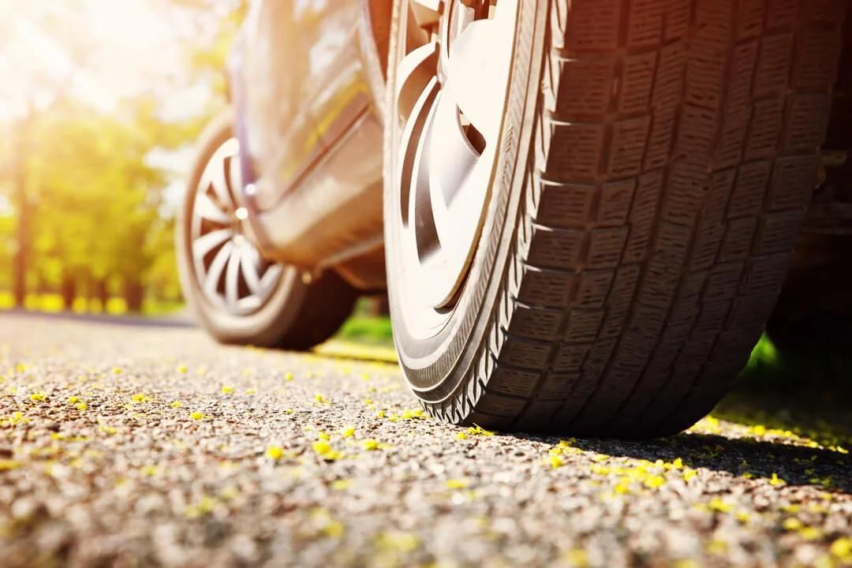
TOOLBOX TALK
AUTOMOTIVE SAFETY SYSTEMS
Technology that prevents accidents and protects lives
Your car is protecting you right now. Do you know how?
Notes:
• Open with a question: how many safety systems are working in your car right now? Take 2–3 guesses.
• Most people say two or three (belts, airbags) – the real answer is often 20 or more.
• Click: show the opening message. Promise: in a few minutes they'll know what the systems do and where their limits are.

Slide 2




More Safety Systems Than You Think
WHY IT MATTERS
25+
Four layers protect you:
PREVENT
WARN & ASSIST
Active safety
ADAS
safety features fitted as standard on one compact SUV sold in India
Keeps you in control
Sensors watch the road
Source: Škoda Auto press release, Kylaq launch, 6 Nov 2024
PROTECT
RESPOND
ABS is compulsory on every car on sale in India since April 2019.
Passive safety
Post-crash
Protects you in a crash
Calls for help after
Source: Autocar India
Notes:
• Škoda says the Kylaq has 25+ active and passive safety features as standard (press release, 6 Nov 2024).
• India also mandated a driver airbag, seatbelt reminders and a speed-warning system from July 2019 (Autocar India).
• Click 1–4: the four layers. Before a crash: Active + ADAS. During: Passive. After: Post-crash.
• Ask: which two layers work before a crash? (Active safety and ADAS.)

Slide 3









Stop Safely and Stay in Control
ACTIVE SAFETY
IN AN EMERGENCY STOP OR SKID
ABS
EBD
Brake Assist
ESC
Traction control
Stops wheels locking, so you can still steer
Shares braking force to suit the load
Adds full force in a panic stop
Brakes single wheels to stop a skid
Stops wheelspin when pulling away
EVERYDAY HELPERS
TPMS
Hill Start Assist
Hill Descent Control
EPB / Auto Hold
Warns of a badly under-inflated tyre
Holds the brakes so you don't roll back
Keeps a slow, steady speed downhill
Electric parking brake; holds you at stops
EMERGENCY STOP: press firmly and HOLD – don't pump. Steer around the hazard. ESC cannot create grip that isn't there.
Notes:
• ABS: wheel sensors stop a wheel locking – locked wheels slide and can't steer. Buzzing pedal is normal.
• ESC compares where you steer with where the car goes; TCS stops wheelspin on wet paint, mud or gravel.
• TPMS doesn't replace monthly checks with a gauge. Auto Hold: you're still responsible for securing a parked car.
• Ask: should you pump the brakes with ABS? (No – press firmly, hold, steer.)

Slide 4









Is Your Car Watching the Road?
ADAS
SENSE
Camera + radar scan the road
DETECT
Software spots vehicles, people, lane lines
WARN or ACT
Alerts you – may brake or steer
Forward Collision Warning
Auto Emergency Braking
Adaptive Cruise Control
Top row: AHEAD of you
Bottom row: BESIDE & BEHIND you
Beeps when you close in too fast
Brakes itself if a crash is imminent
Holds a set speed and gap
Lane Departure Warning
Lane Keeping Assist
Blind Spot Monitoring
Rear Cross Traffic Alert
Alerts you if you drift over lines
Gently steers you back
Lights up if a car is alongside
Warns of traffic as you reverse
ADAS ASSISTS – IT DOES NOT DRIVE. Blind-spot monitoring does NOT replace your shoulder check.
Notes:
• Camera behind the windscreen, radar behind the grille badge, ultrasonic sensors in the bumpers.
• FCW warns; AEB can brake by itself; with adaptive cruise on, the driver is still responsible for braking.
• Rain, fog, glare, dirty sensors and faded lines reduce performance. Blind-spot systems can miss motorcycles.
• Ask: what could stop a camera seeing properly? (Rain, fog, dirt, sun glare, faded markings.)

Slide 5
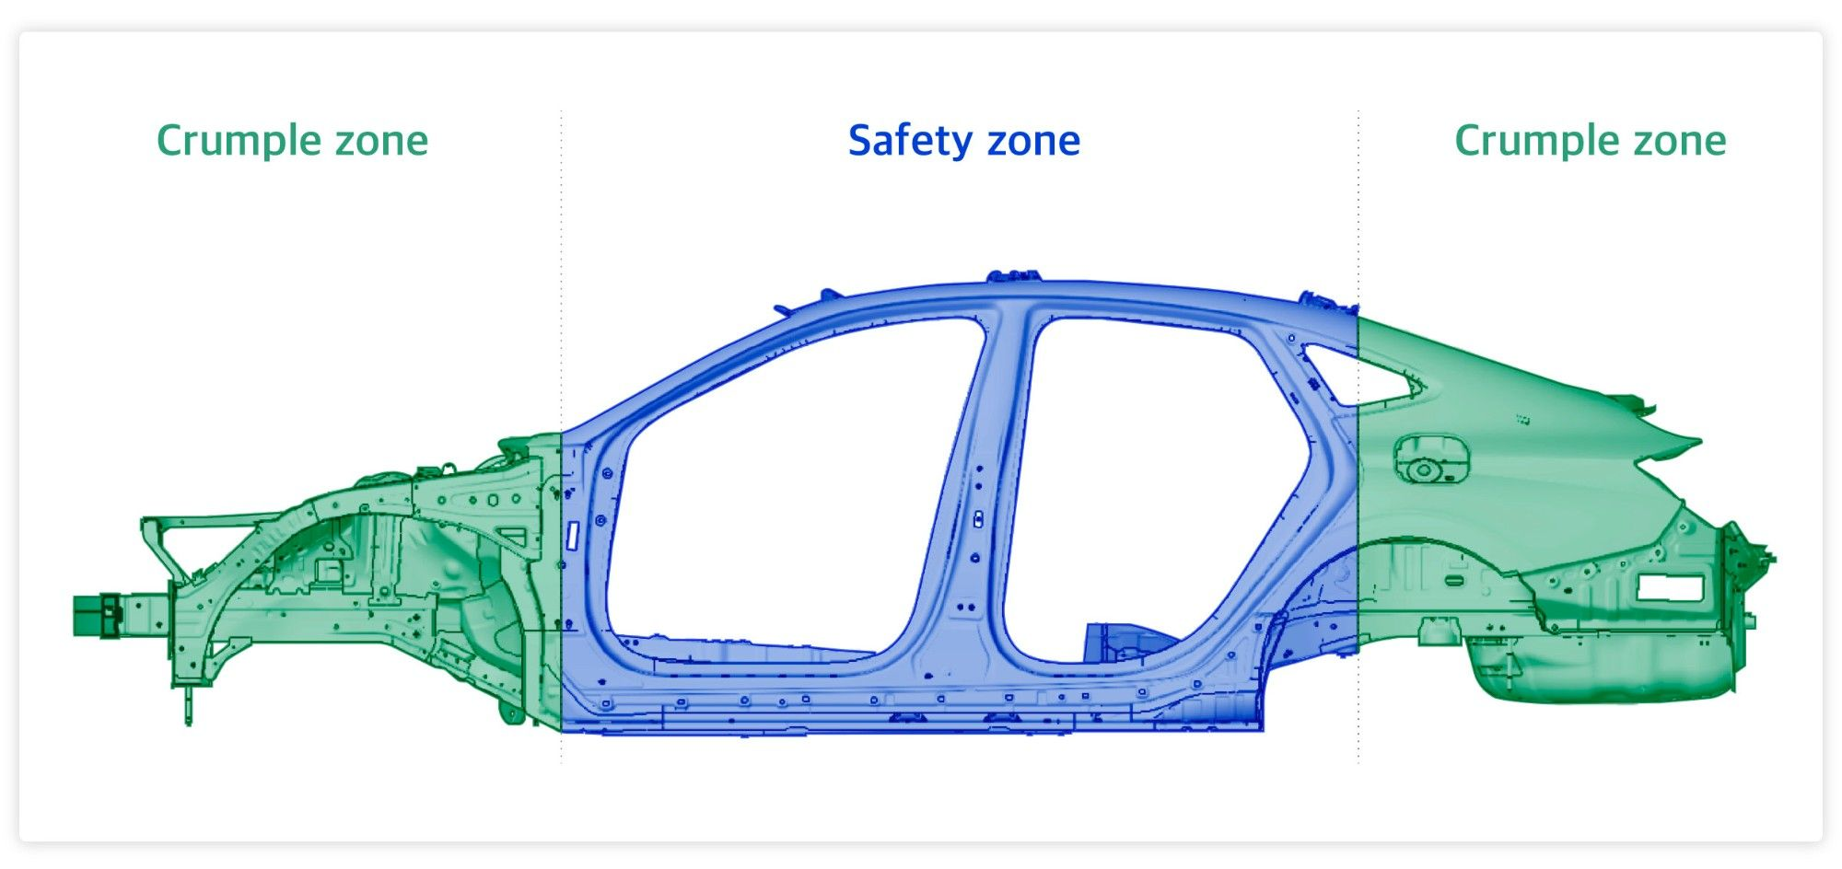







What Protects You During a Crash?
PASSIVE SAFETY
Seatbelts Hold you in place; spread the force
Pretensioners Pull the belt tight as a crash begins
Load limiters Let the belt give a little – protects the chest
Airbags Cushion you in certain crashes
Soft ends absorb crash energy. A strong safety cell keeps space around you.
ISOFIX
Click-in child-seat anchors
Head restraints
Set close behind your head – cuts whiplash
Pedestrian protection
Softer or pop-up bonnets on some cars
Airbags work WITH seatbelts – not instead of them. Belt on: every seat, every trip.
Notes:
• Crumple zones fold in a planned way; the safety cell (pillars, sills) keeps its shape – soft ends, strong middle.
• Airbags are supplemental: without a belt you can hit the bag – or the car – out of position.
• Belt over shoulder and hips, never behind your back. Head restraint top roughly level with the top of your head.
• Ask: why is it good that the front crumples? (It absorbs energy, so less force reaches people.)

Slide 6
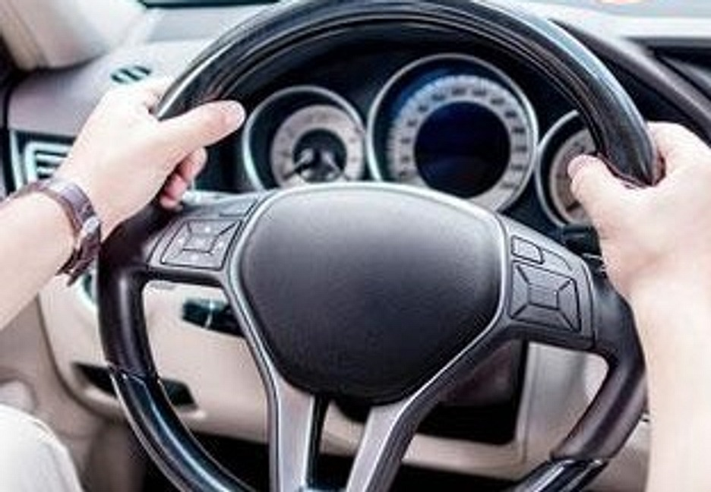

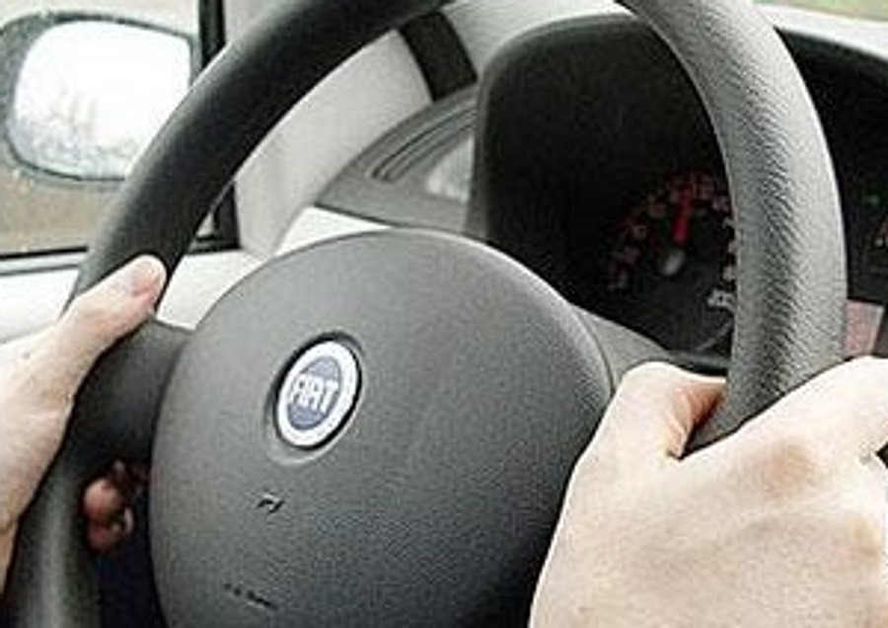
CAN YOU IDENTIFY THE HAZARD?
SPOT THE HAZARD
Look at the driver's hands. What could happen if the airbag fires?
HAZARD: hands high on the wheel.
The airbag inflates fast from the wheel centre – high hands can be thrown into your face.
SAFE: hold at 9 and 3, thumbs on the rim. Keep your chest about 25 cm from the wheel centre.
Photo: original training deck (illustrative)
Notes:
• Show the photo and let the group answer before clicking.
• Click 1: red circles on both hands. Click 2: the hazard. Click 3: the safe grip.
• Answer: hands at the top are in the airbag's path; it inflates in milliseconds from the wheel centre.
• Safe action: 9 and 3, thumbs on the rim, chest at least ~25 cm (10 in) from the wheel centre.

Slide 7





What Happens After a Crash?
POST-CRASH SAFETY
eCall / SOS
Hazards & unlock
Fuel cut-off
HV isolation
Event Data Recorder
Calls emergency services; sends location
May switch on hazards and unlock doors
Can stop fuel after certain crashes
Helps disconnect an EV's high voltage
Stores a short crash snapshot
EV CRASH RULE: treat every ORANGE cable and the battery as LIVE.
Never touch them. Call emergency services and keep clear.
Features vary by vehicle and market. The EDR records data such as speed, braking, belt use and airbag deployment – it is not a video or audio recorder.
Notes:
• EU: new car models approved after 31 March 2018 must have 112-based eCall (auto or button).
• EVs: many cut high voltage outside the battery when airbags fire – but the battery stays charged (Tesla 2025 Model Y ERG).
• EU GSR2: EDR on new cars from 7 July 2024; US 49 CFR Part 563 standardises EDR data where fitted.
• Ask: you arrive first at an EV crash – what must you not touch? (Orange cables and the battery pack.)

Slide 8


Technology Helps – Your Habits Decide
SAFE PRACTICES
Wet road, traffic stopped ahead:
1 FCW warns
2 YOU BRAKE
3 ABS lets you steer
4 AEB may step in
5 Belts & airbags
✗ UNSAFE
✓ SAFE
Drive too fast for the conditions
Keep a safe speed – every system works better slower
Tailgate
Keep a safe following distance – more in rain
Skip the belt on short trips
Seatbelt on, every seat, every journey
Ignore the TPMS light or old tyres
Check pressure monthly; read the tyre DOT code
Rely entirely on driver assistance
Eyes, mirrors and shoulder check come first
Tyre age: last 4 digits of the DOT code = week + year (2322 = week 23 of 2022). Only 3 digits = made before 2000: replace it.
Notes:
• Chain: which step depends entirely on you? Step 2 – your own reaction. Everything else only supports you.
• Not every car has all these systems, and none guarantees a crash is avoided.
• Clicks 6–10 reveal unsafe → safe pairs. TPMS light on: slow down, stop safely, check pressures.
• The DOT code may be only on the inner sidewall.

Slide 9
Quick Quiz
KNOWLEDGE CHECK
1. Emergency stop in a car with ABS – what do you do?
A Pump the brake pedal
B Press firmly, hold and steer
✓ B Press firmly, hold and steer
C Release the brake
2. Blind-spot monitoring is fitted. What about the shoulder check?
A Not needed any more
B Still do it – the system can miss things
✓ B Still do it – the system can miss things
C Only at night
3. First at an EV crash. What must you NEVER touch?
A The hazard-light switch
B Orange cables and the battery
✓ B Orange cables and the battery
C The SOS button
Notes:
• Read each question; take answers by show of hands, then click to reveal.
• Q1: B – press firmly, hold, steer. Pumping fights the ABS.
• Q2: B – blind-spot systems can miss motorcycles and fast-approaching vehicles.
• Q3: B – treat orange cables and the battery as live; call emergency services, keep clear.

Slide 10
KEY TAKEAWAY
SAFETY TECHNOLOGY HELPS.
SAFE DRIVING SAVES LIVES.
Thank you. Drive safely today. Questions?
Notes:
• Recap: active safety keeps control, ADAS watches the road, passive safety protects, post-crash calls for help.
• The driver is still the most important safety system in the car.
• Close: "Safety technology helps – safe driving saves lives." Take one or two questions.

